Slide 1
Progressive Alignment Method Using Genetic Algorithm for Multiple Sequence Alignment
Farhana Naznin, Ruhul Sarker, Daryl Essam
IEEE Transactions on Evolutionary Computation, 2012
Volume 16, Issue 5, pp. 615-631
Presenter: Tsung-Lin Lu
Date: July 6, 2021

Slide 2
Abstract (1/2)
In this paper, we have proposed a progressive alignment method using a genetic algorithm for multiple sequence alignment, named GAPAM. We have introduced two new mechanisms to generate an initial population: the first mechanism is to generate guide trees with randomly selected sequences and the second is shuffling the sequences inside such trees. Two different genetic operators have been implemented with GAPAM. To test the performance of our algorithm, we have compared it with existing well-known methods, such as PRRP, CLUSTALX, DIALIGN, HMMT, SB_PIMA, ML_PIMA, MULTALIGN, and PILEUP8, and also other methods, based on genetic algorithms (GA), such as SAGA, MSA-GA, and RBT-GA, by solving a number of benchmark datasets from BAliBase 2.0.

Slide 3
Abstract (2/2)
To make a fairer comparison with the GA based algorithms such as MSA-GA and RBT-GA, we have performed further experiments covering all the datasets reported by those two algorithms. The experimental results showed that GAPAM achieved better solutions than the others for most of the cases, and also revealed that the overall performance of the proposed method outperformed the other methods mentioned above.

Slide 4
Outline
Multiple sequence alignment (MSA)
Distance
Guide tree and MSA
GAPAM
Initialization：Random and shuffle
Child Generation：Crossover or mutation
Selection：Fitness calculation
Termination

Slide 5
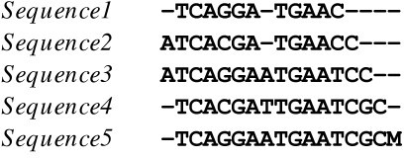
Multiple sequence alignment (MSA)
Match, mismatch, gap
Maximal matching
Progressive alignment method
It builds up a final MSA by combining pairwise alignments beginning with the most similar pair and progressing to the most distantly related pair.

Slide 6
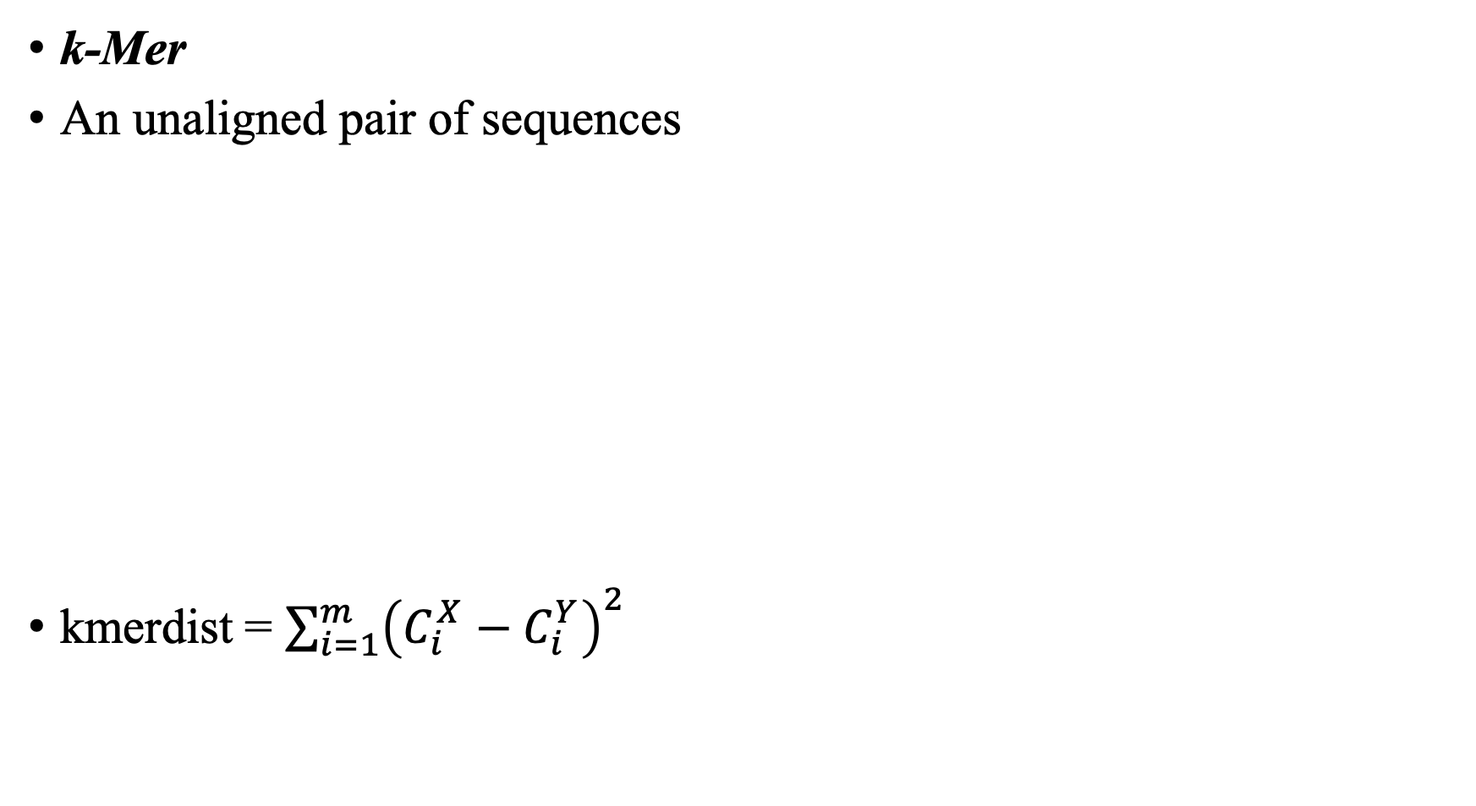
Distance The divergence of sequences (1/3)
k-Mer
An unaligned pair of sequences
kmerdist = $\sum_{i=1}^{m}{{\left(C_{i}^{X}−C_{i}^{Y}\right)}^{2}}$
X = ABCDEF | Y = CDBCDA
W_{X} ={ABC, BCD, CDE, DEF} | W_{Y} = {CDB, DBC, BCD, CDA}
W_{XY} ={ABC,BCD,CDE,DEF,CDB,DBC,CDA}
C^{X} = {1,1,1,1,0,0,0} | C^{Y} = {0,1,0,0,1,1,1}

Slide 7
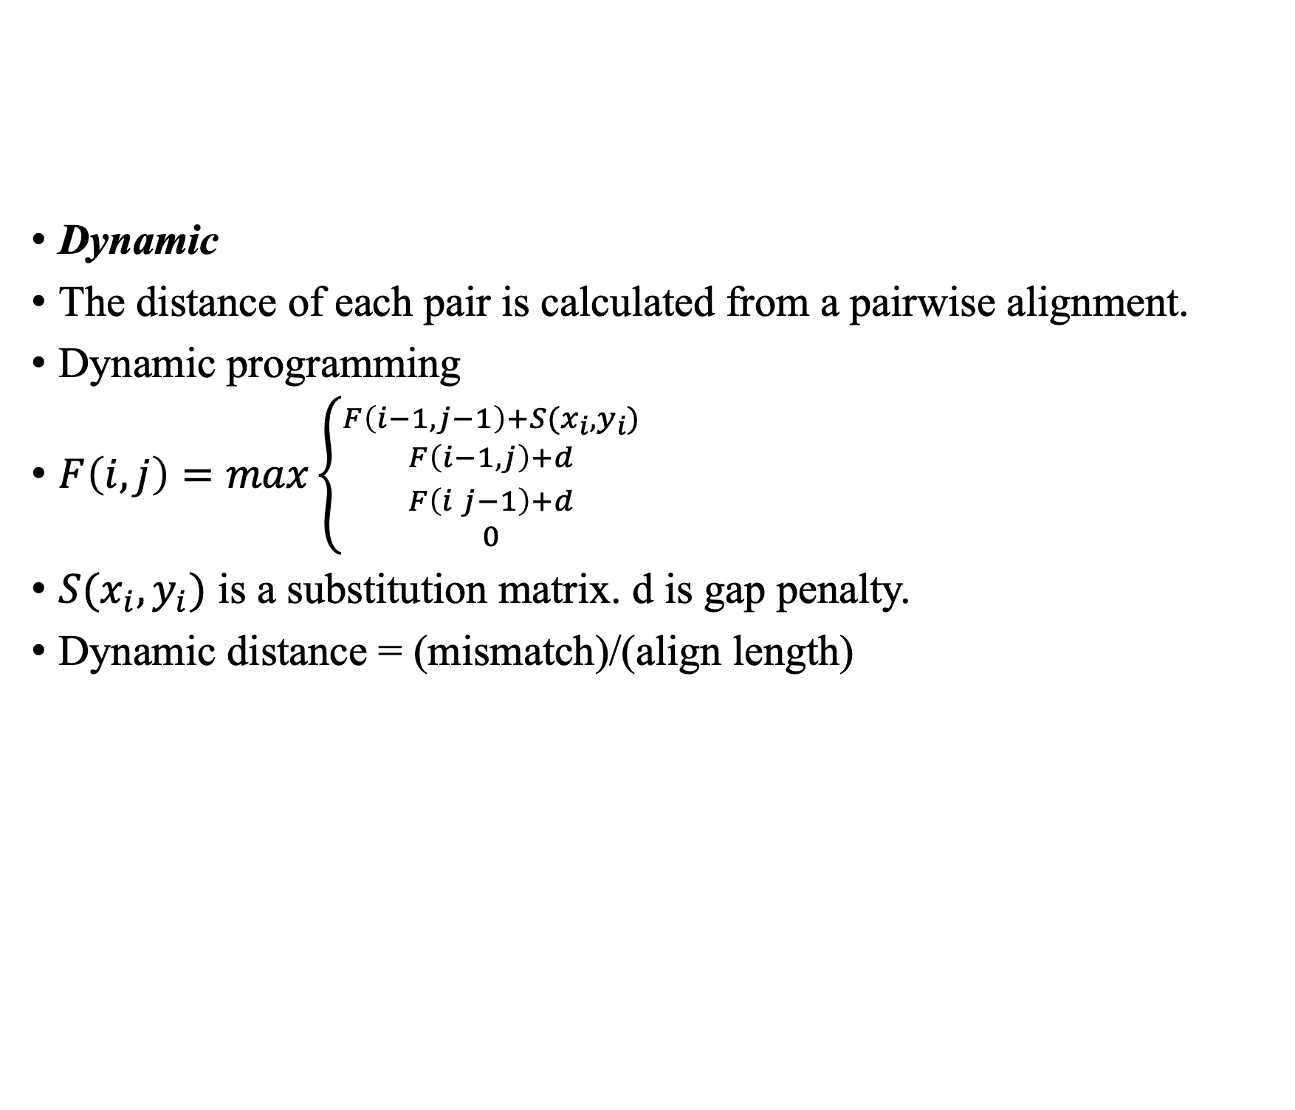
Distance The divergence of sequences (2/3)
Dynamic
The distance of each pair is calculated from a pairwise alignment.
Dynamic programming
$F\left(i,j\right)=max\left\{\begin{aligned}{F\left(i−1, j−1\right)+S(x_{i},y_{i}) \atop F\left(i−1, j\right)+d} \\ {F\left(i j−1\right)+d \atop 0}\end{aligned}\right.$
$S(x_{i},y_{i})$ is a substitution matrix. d is gap penalty.
Dynamic distance = (mismatch)/(align length)

Slide 8
Distance The divergence of sequences (3/3)
Kimura
The relationship between the observed amino acid substitutions and the actual (corrected) substitutions
Gap positions are ignored, and only exact matches contribute to the match score.
S = (exact_matches)/(positions_scored)
D=1−S
Distance = − ln(1 − D − 0.2 D²)

Slide 9
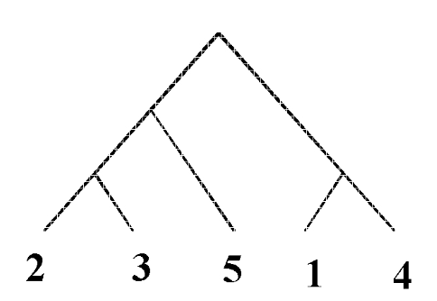
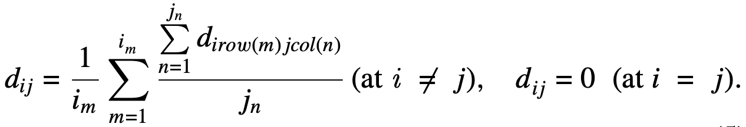
Guide tree and MSA (1/2)
UPGMA
Construct the guide tree from the distance table
Stage (i) Calculate the distances among all pairs.
Stage (ii) Prepare a distance matrix from Stage (i).
Stage(iii) Find a part of a guide tree by selecting the smallest distance pair from the distance matrix.

Slide 10
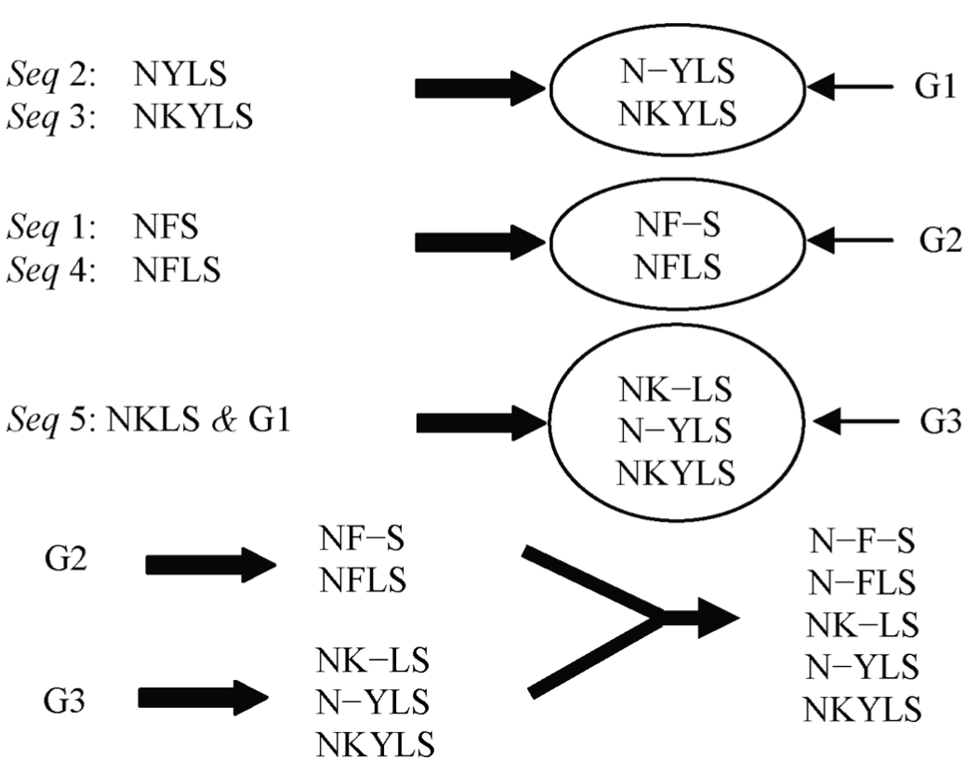
Guide tree and MSA (2/2)
Seq1: NFS
Seq2: NYLS
Seq3: NKYLS
Seq 4 : NFLS
Seq 5 : NKLS

Slide 11
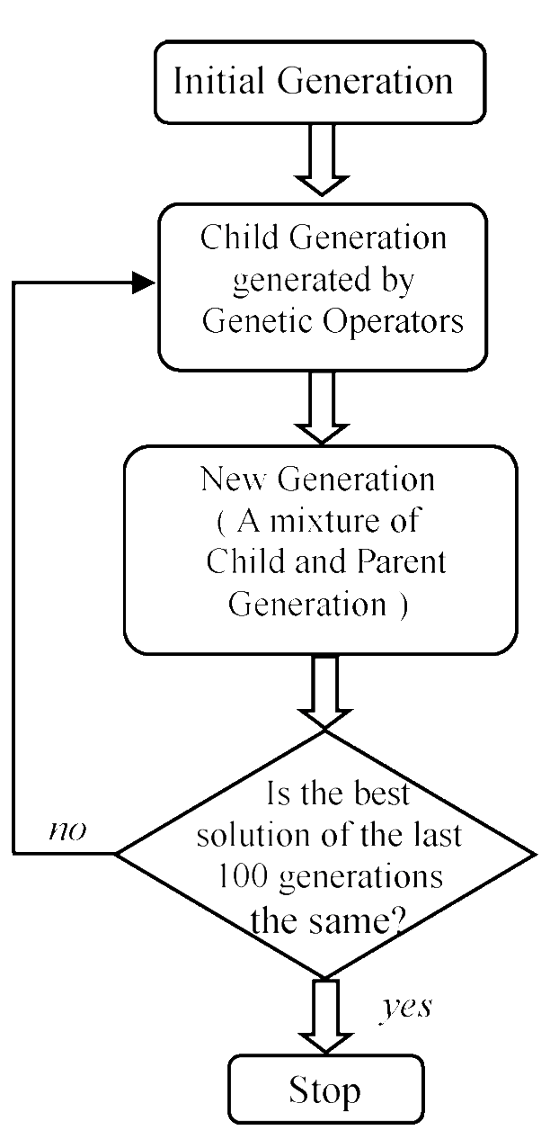
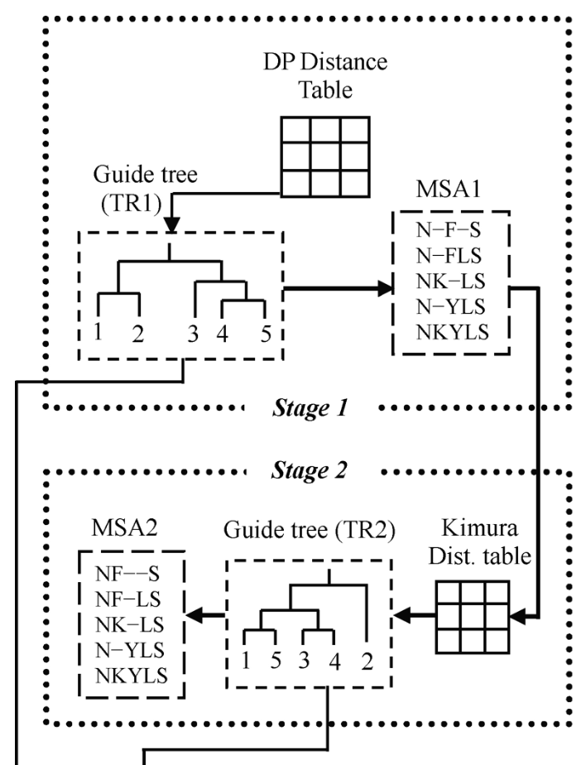
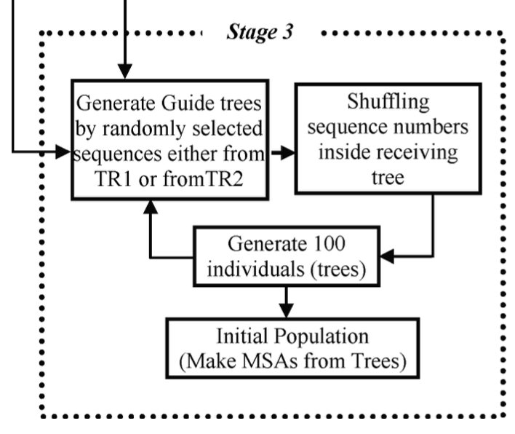
GAPAM Initialization

Slide 12
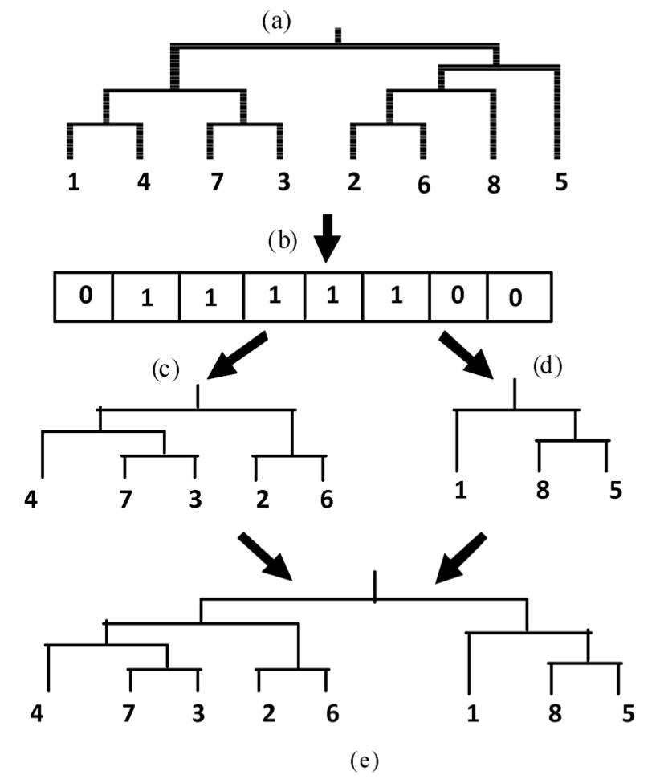
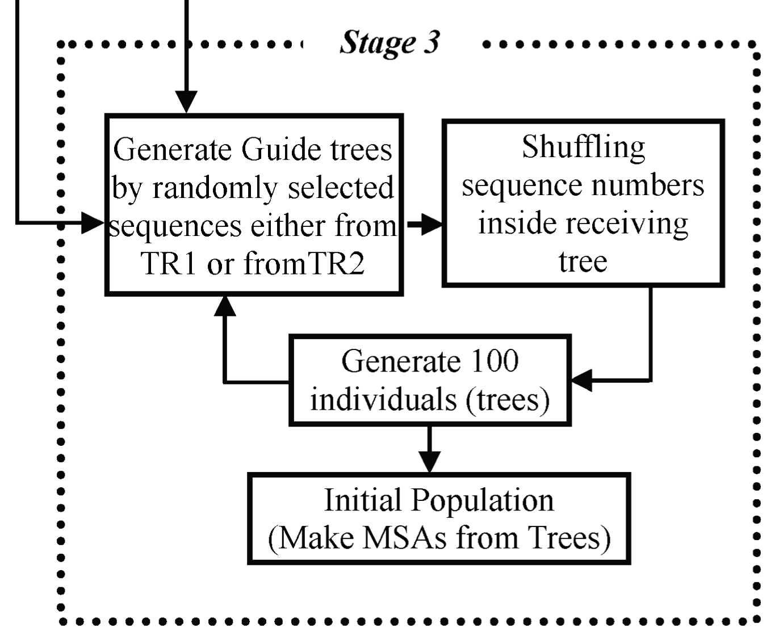
GAPAM Initialization：Mechanism 1 (random)

Slide 13
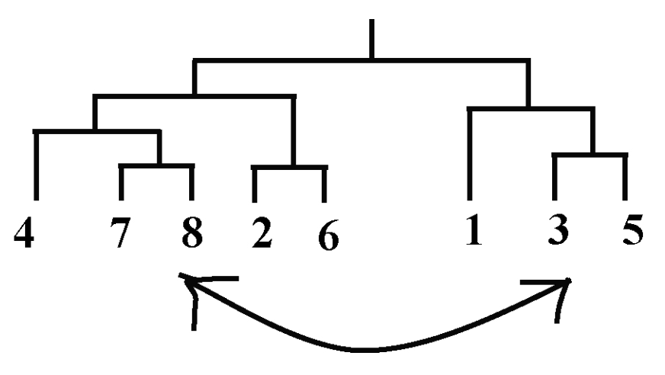
GAPAM Initialization：Mechanism 2 (shuffle)

Slide 14
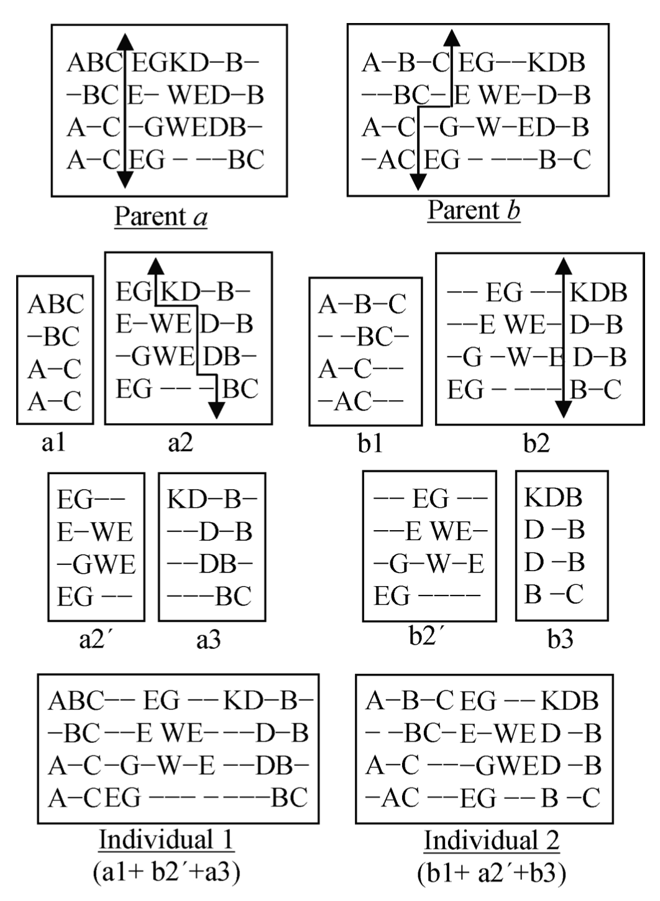
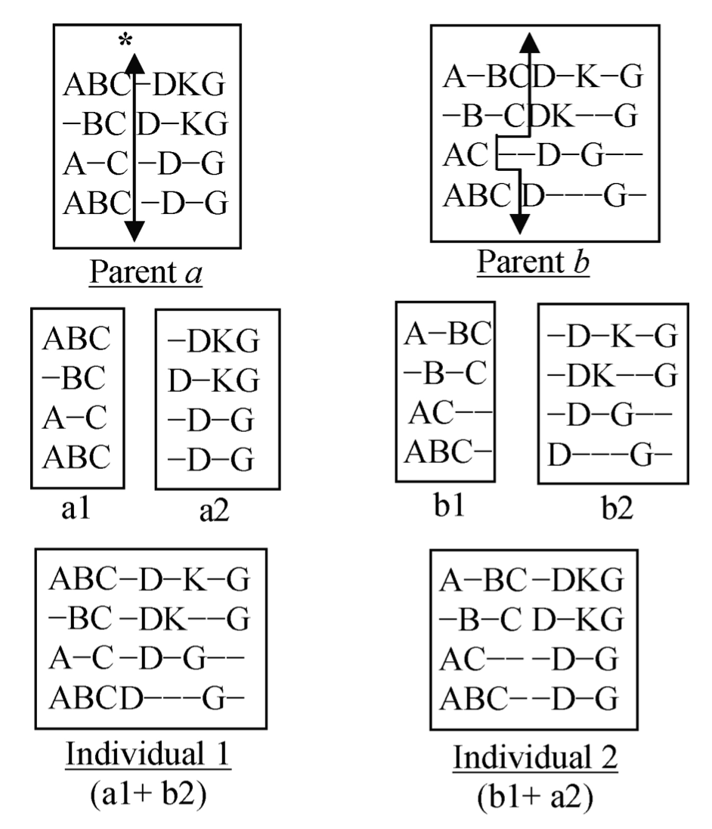
GAPAM Child Generation：Crossover
(1) Single point crossover
(2) Multiple point crossover

Slide 15
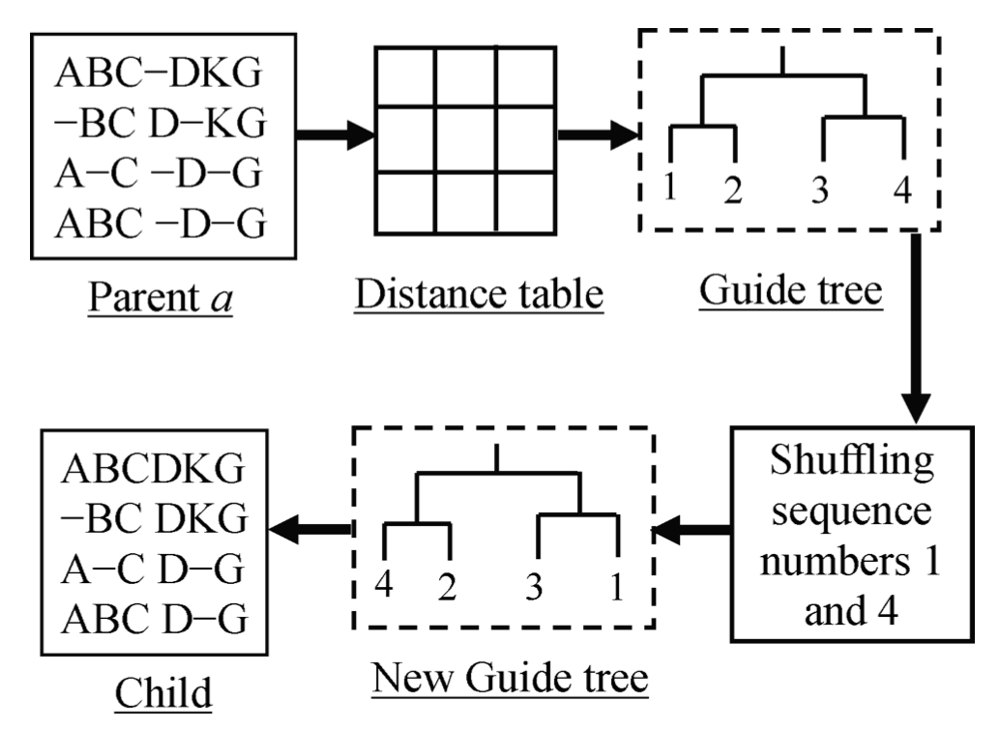
GAPAM Child Generation：Mutation
(3) Mutation

Slide 16
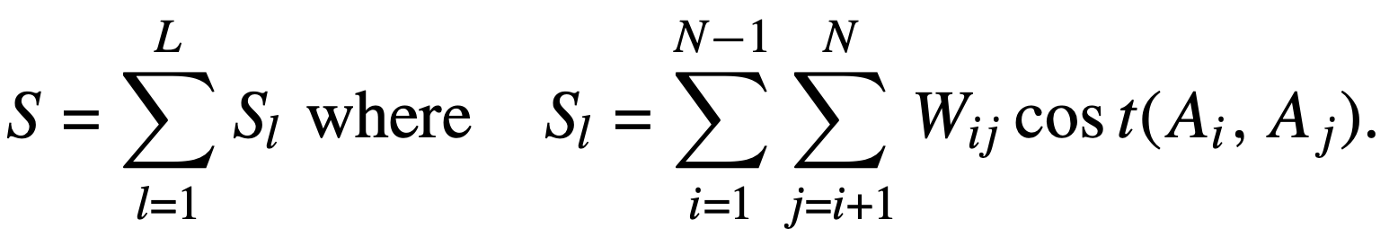
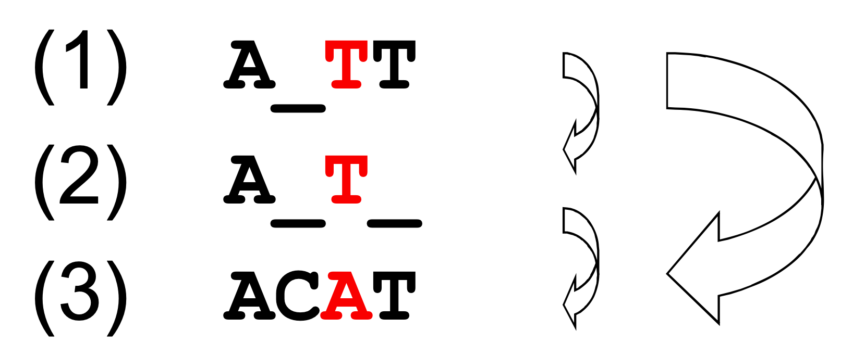

GAPAM Selection：Fitness calculation
Weighted sum of pair method (WSPM)
Select the best 50% of the parents and children
S is the cost of the MSA.
L is the length (columns)
N is the number of sequences
W is the weight
g is the cost of opening a gap
x is the cost of extending the gap
n is the length of the gap.

Slide 17
GAPAM Termination
Termination condition：The best solution remains the same in 100 consecutive generations.
The computational complexity of the GAPAM
O(N³ + L²)
O(N³)：Guide tree construction
O(L²)：Distance calculation
L is the length of the sequence
N is the number of sequences

Slide 18
Result (1/4)
Benchmark：BAliBase 2.0
Ref 1：small numbers of equidistant sequences
Ref 2：orphan or unrelated sequences
Ref 3：a pair of divergent subfamilies where the two groups are less than 25% identical
Ref 4：long terminal extensions
Rfe 5：large internal insertions and deletions
Baliscore：0.0 ~ 1.0
If the solution is identical with the corresponding manually created reference alignment then the score is 1.0.
Score matix：PAM or BLOSUM
Penalty and wieght：CLUSTAL W

Slide 19
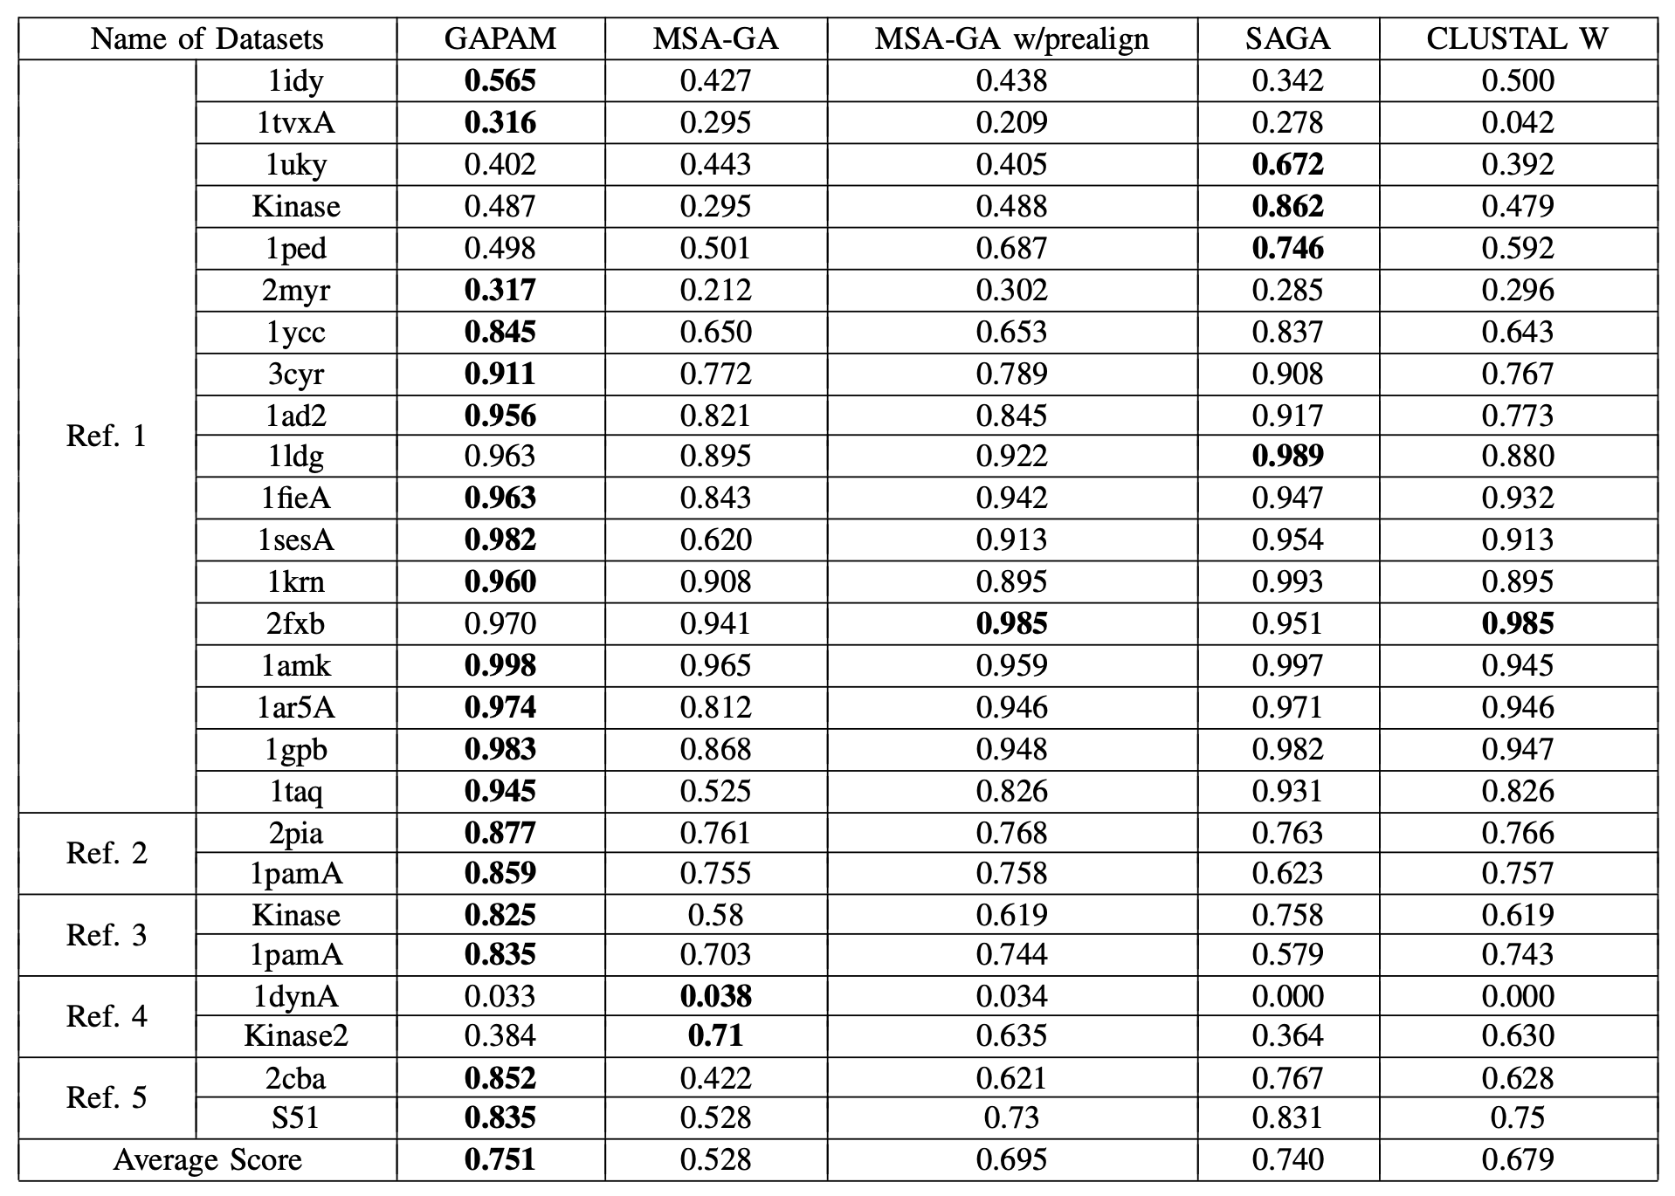

Slide 20
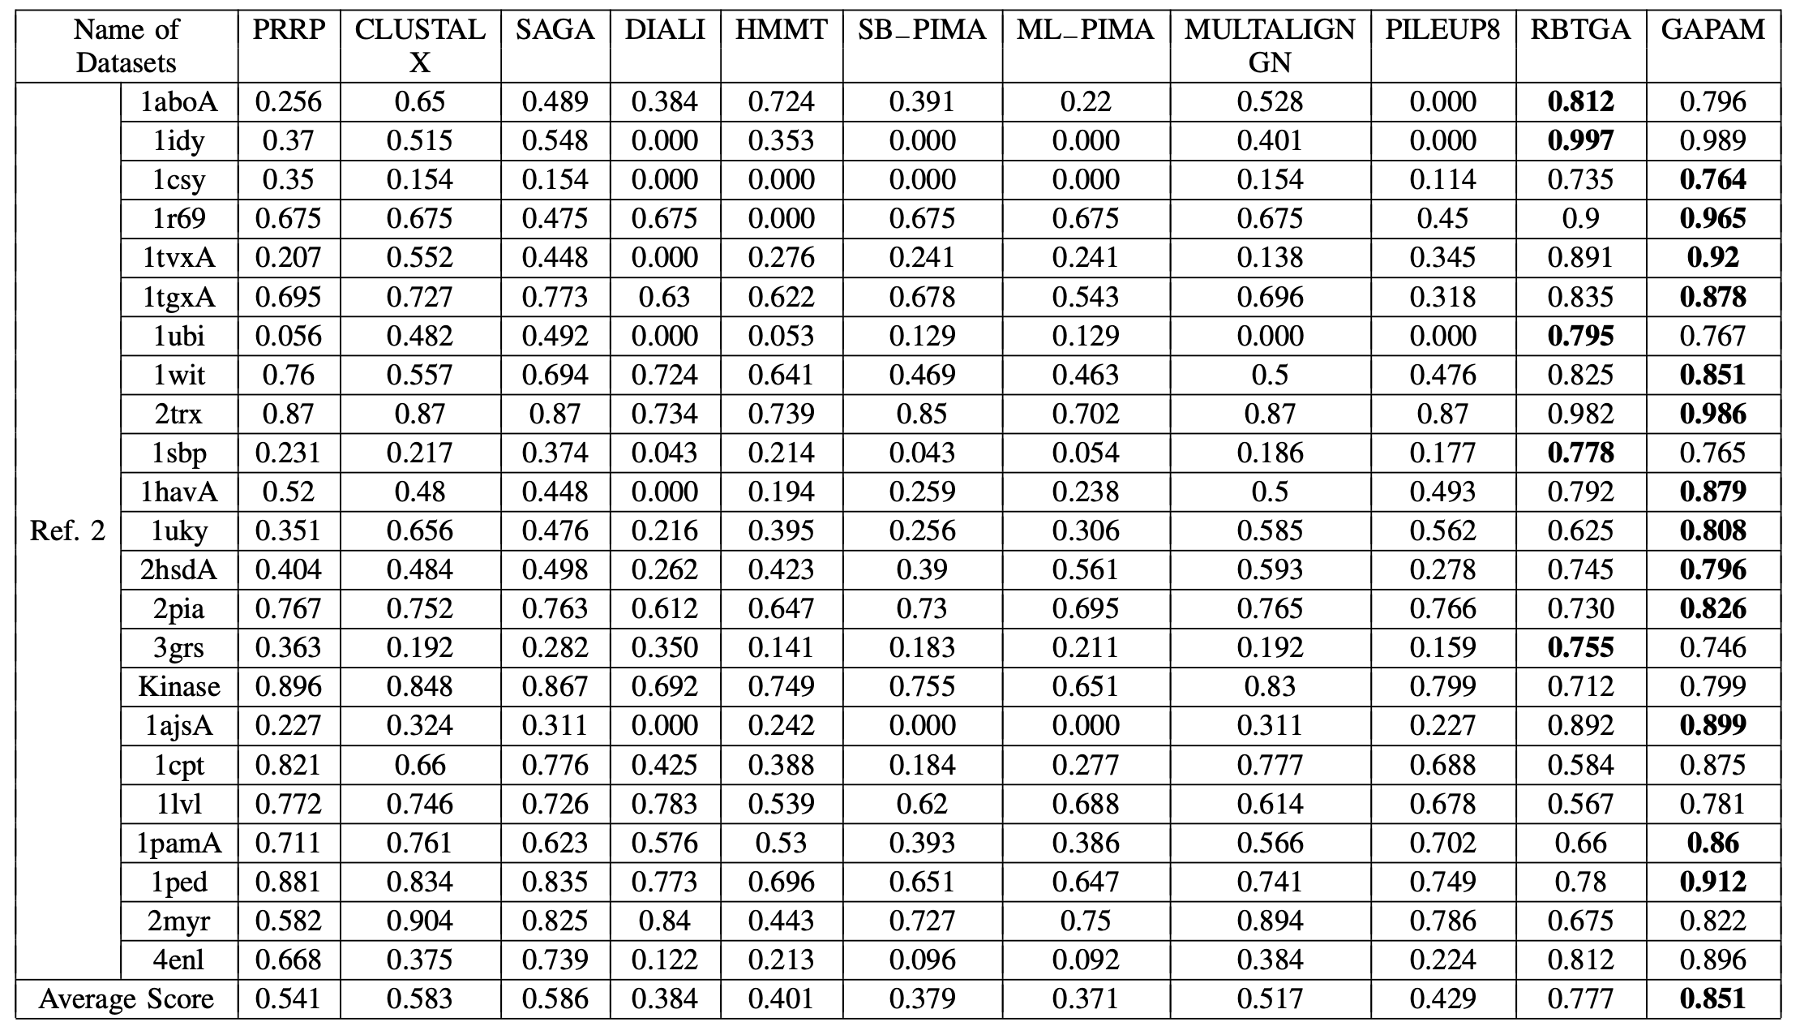

Slide 21
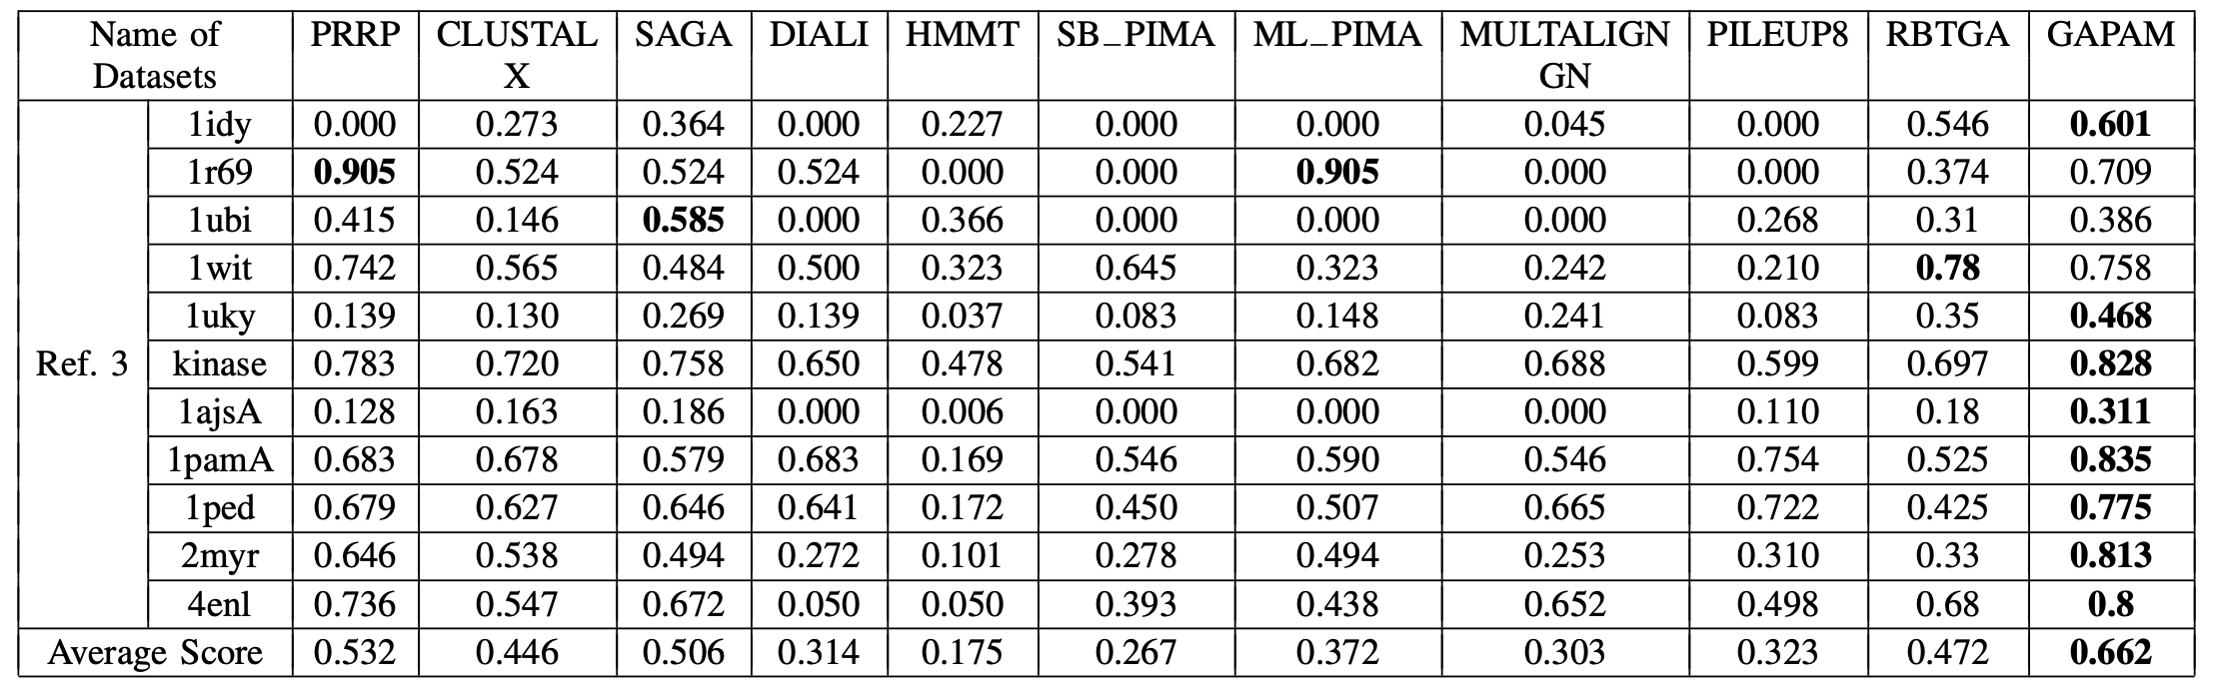
Result (4/4)

Slide 22
Thank you for listening

