Slide 1
Adaptive Score Normalization for Output Integration in Multiclassifier Systems
Giuseppe Pirlo and Donato Impedovo
IEEE Signal Processing Letters, Vol. 19, No. 12, December 2012
Presenter: Che-Jui Hsu(許哲睿)
Date: 2013/4/9

Slide 2
Abstract
This letter introduces a new score normalization technique – based on Dynamic Time Warping (DTW) – for output integration in multiclassifier systems. More precisely, DTW is used to match the score cumulative distribution of each individual classifier against a standard cumulative distribution. The warping function allows optimal alignment of the scores provided by the individual classifiers with the scores on the standard cumulative distribution. Furthermore, in order to adapt the normalization process to the behavior of the individual classifiers and to the decision fusion rule, a new class of fuzzy cumulative distributions is introduced and a genetic approach is used to select the optimal distribution to be used as standard cumulative distribution for score normalization. The experimental tests report better results for the fuzzy normalization technique than for those obtained with other approaches present in the literature.

Slide 3
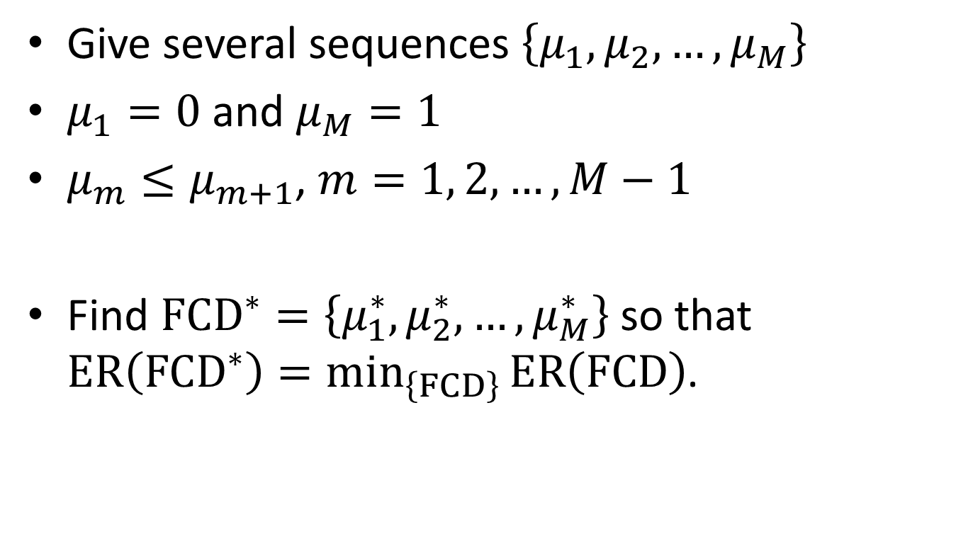
Fuzzy Cumulative Distributions (FCD)
Give several sequences $\left\{μ_{1},μ_{2}, …,μ_{M}\right\}$
$μ_{1}=0$ and $μ_{M}=1$
$μ_{m}≤μ_{m+1}$, $m=1, 2, …, M−1$
Find ${\text{FCD}}^{∗}=\left\{μ_{1}^{∗},μ_{2}^{∗}, …,μ_{M}^{∗}\right\}$ so that $\text{ER}\left({\text{FCD}}^{∗}\right)=\min_{\left\{FCD\right\}}{\text{ER}\left(\text{FCD}\right)}$.

Slide 4
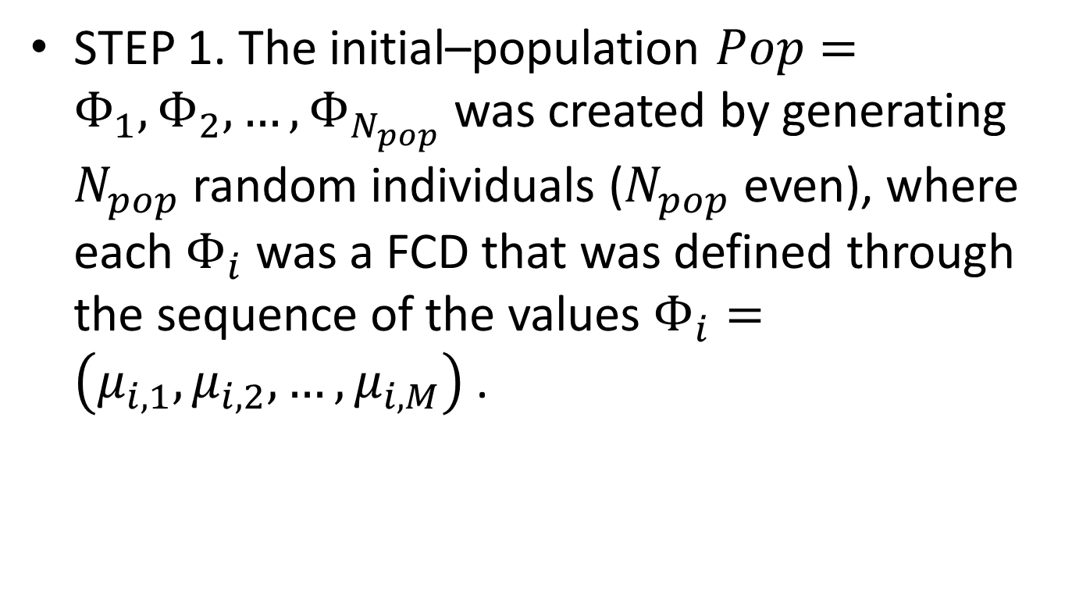
FCD Algorithm (1/6)
STEP 1. The initial–population $Pop=Φ_{1},Φ_{2}, …,Φ_{N_{pop}}$ was created by generating $N_{pop}$ random individuals ($N_{pop}$ even), where each $Φ_{i}$ was a FCD that was defined through the sequence of the values $Φ_{i}=\left(μ_{i,1},μ_{i,2}, …,μ_{i,M}\right)$ .

Slide 5
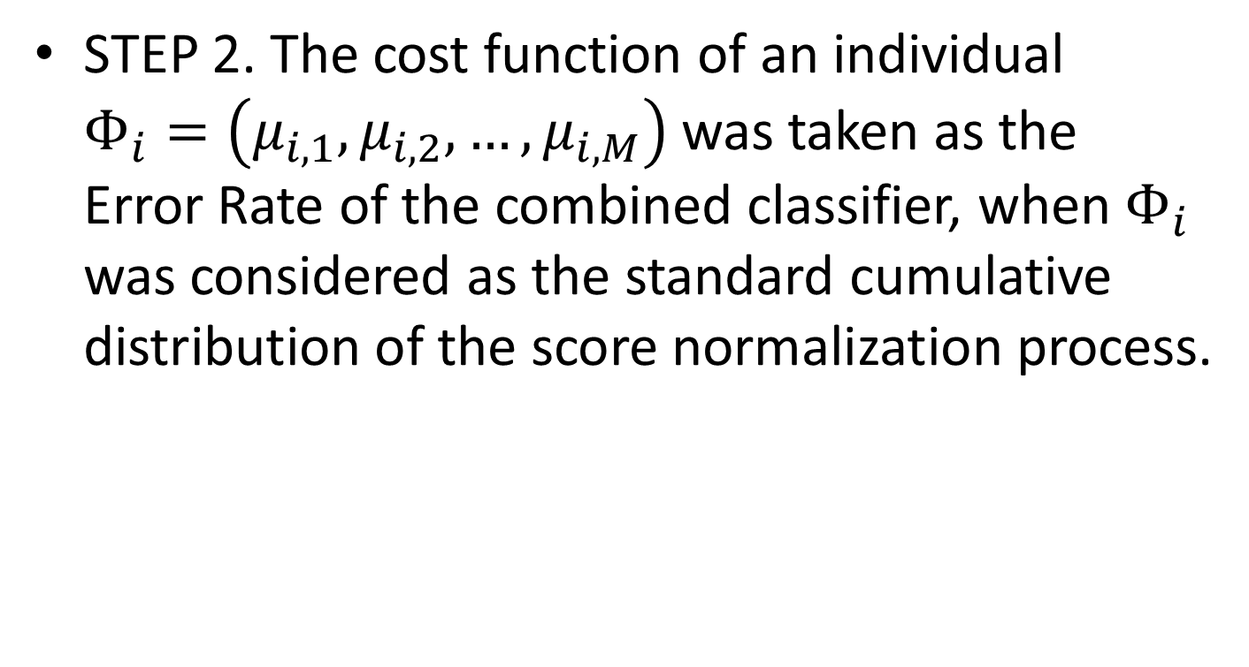
FCD Algorithm (2/6)
STEP 2. The cost function of an individual $Φ_{i}=\left(μ_{i,1},μ_{i,2}, …,μ_{i,M}\right)$ was taken as the Error Rate of the combined classifier, when $Φ_{i}$ was considered as the standard cumulative distribution of the score normalization process.

Slide 6
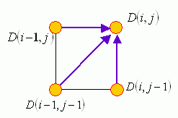

Dynamic Time Warping (DTW)
$D\left(i, j\right)=\min\left(D\left(i−1, j\right), D\left(i, j−1\right), D\left(i−1, j−1\right)\right)+dist\left(i, j\right)$
Ref: http://mirlab.org/jang/books/dcpr/dpDtw.asp?title=8-4%20Dynamic%20Time%20Warping&language=chinese

Slide 7
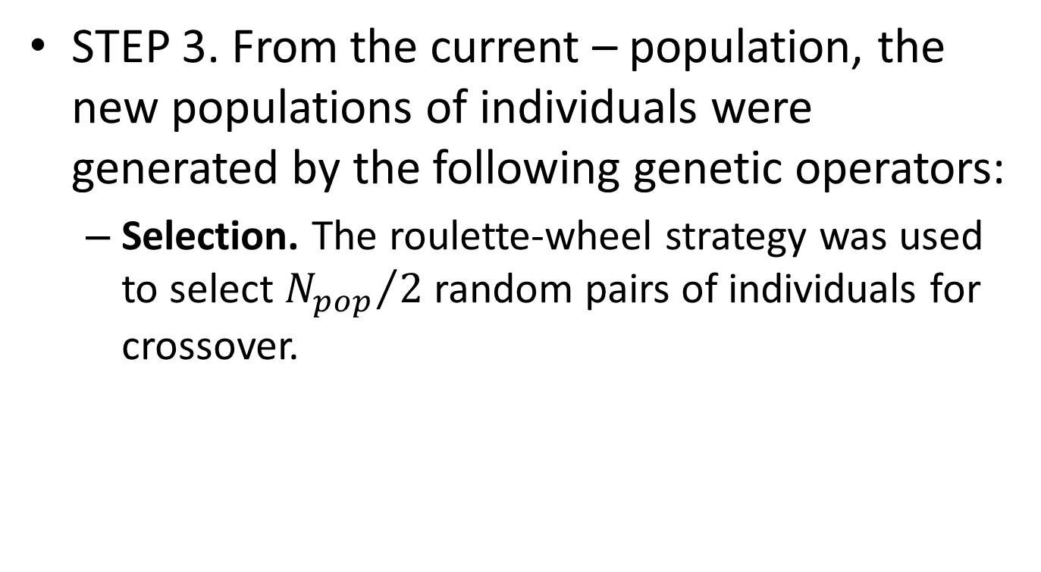
FCD Algorithm (3/6)
STEP 3. From the current – population, the new populations of individuals were generated by the following genetic operators:
Selection. The roulette-wheel strategy was used to select ${N_{pop}}/2$ random pairs of individuals for crossover.

Slide 8
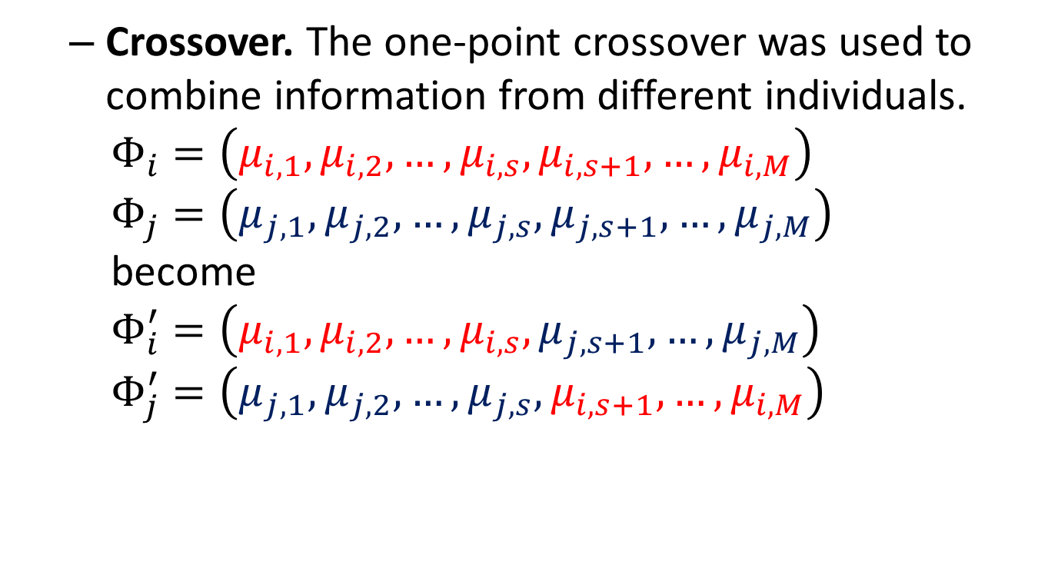
FCD Algorithm (4/6)
Crossover. The one-point crossover was used to combine information from different individuals. $Φ_{i}=\left(μ_{i,1},μ_{i,2}, …,μ_{i,s},μ_{i,s+1},…,μ_{i,M}\right)$ $Φ_{j}=\left(μ_{j,1},μ_{j,2}, …,μ_{j,s},μ_{j,s+1},…,μ_{j,M}\right)$ $\text{become}$ $Φ_{i}^{′}=\left(μ_{i,1},μ_{i,2}, …,μ_{i,s},μ_{j,s+1},…,μ_{j,M}\right)$ $Φ_{j}^{′}=\left(μ_{j,1},μ_{j,2}, …,μ_{j,s},μ_{i,s+1},…,μ_{i,M}\right)$

Slide 9
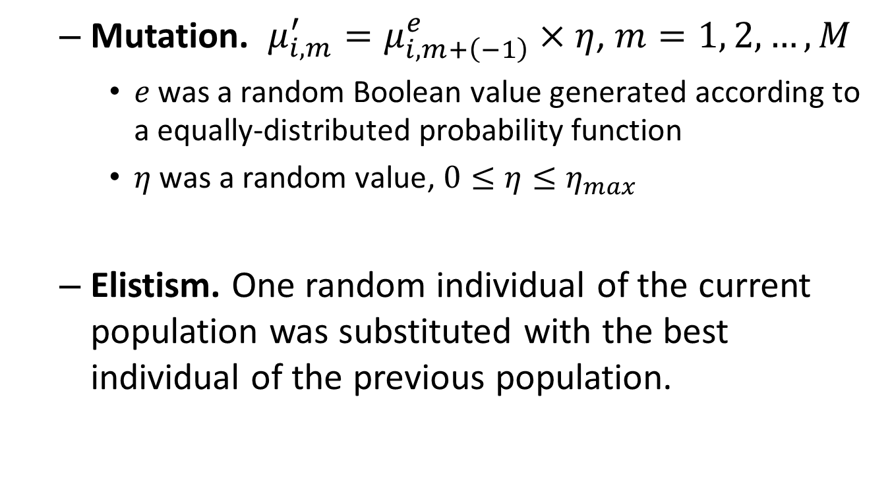
FCD Algorithm (5/6)
Mutation. $μ_{i,m}^{′}=μ_{i,m+\left(−1\right)}^{e}×η$, $m=1, 2, …, M$
$e \text{was} \text{a} \text{random} \text{Boolean} \text{value} \text{generated} \text{according} \text{to} \text{a} \text{equally}\text{−}\text{distributed} \text{probability} \text{function}$
$η \text{was} \text{a} \text{random} \text{value}$, $0≤η≤η_{max}$
Elistism. One random individual of the current population was substituted with the best individual of the previous population.

Slide 10
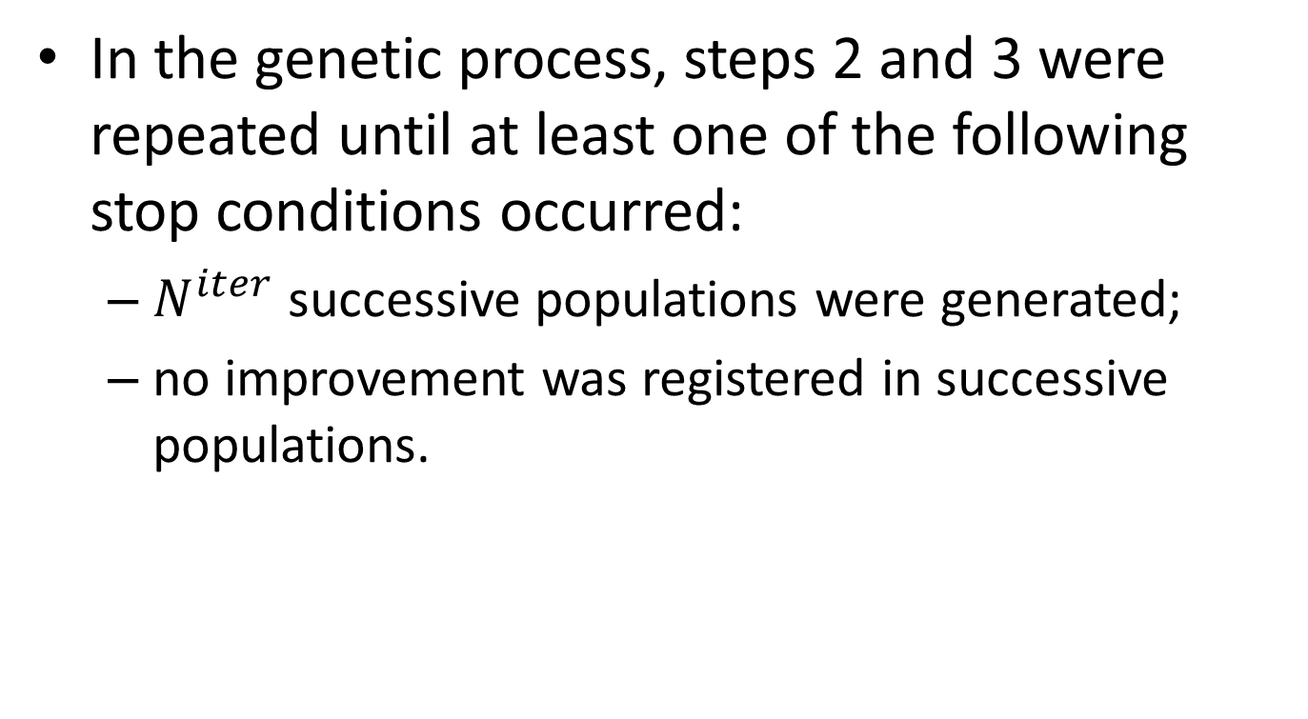
FCD Algorithm (6/6)
In the genetic process, steps 2 and 3 were repeated until at least one of the following stop conditions occurred:
$N^{iter}$ successive populations were generated;
no improvement was registered in successive populations.

Slide 11

Experiments
$M=50$, $N_{pop}=100$, $N^{iter}=50$, $μ_{mut_{prob}}=0.30$, $η_{max}=0.02$

