Slide 1
A genetic programming model to generate risk-adjusted technical trading rules in stock markets
Expert Systems with Applications 38 (2011) 8438–8445
Akbar Esfahanipour , Somayeh Mousavi
Presenter: Cheng-Han Lee
Date: 2013/4/9

Slide 2
Abstract
Technical trading rules can be generated from historical data for decision making in stock markets. Genetic programming (GP) as an artificial intelligence technique is a valuable method to automatically generate such technical trading rules. In this paper, GP has been applied for generating risk-adjusted trading rules on individual stocks. Among many risk measures in the literature, conditional Sharpe ratio has been selected for this study because it uses conditional value at risk (CVaR) as an optimal coherent risk measure. In our proposed GP model, binary trading rules have been also extended to more realistic rules which are called trinary rules using three signals of buy, sell and no trade. Additionally we have included transaction costs, dividend and splits in our GP model for calculating more accurate returns in the generated rules. Our proposed model has been applied for 10 Iranian companies listed in Tehran Stock Exchange (TSE). The numerical results showed that our extended GP model could generate profitable trading rules in comparison with buy and hold strategy especially in the case of risk adjusted basis.

Slide 3
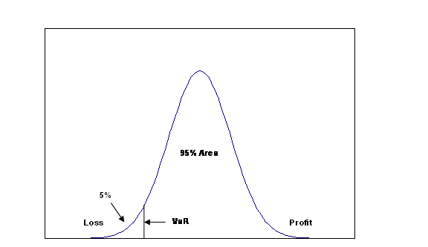
Risk
風險值(Value-at-Risk, VaR)：「在一段期間內，在既定的信心水準下，預期可能的最大損失之金額。」
條件風險(Conditional VaR, CVaR)：「在損失超過VaR情況下，對於損失的期望值」
共變異數法、
歷史模擬法、
蒙地卡羅模擬法

Slide 4
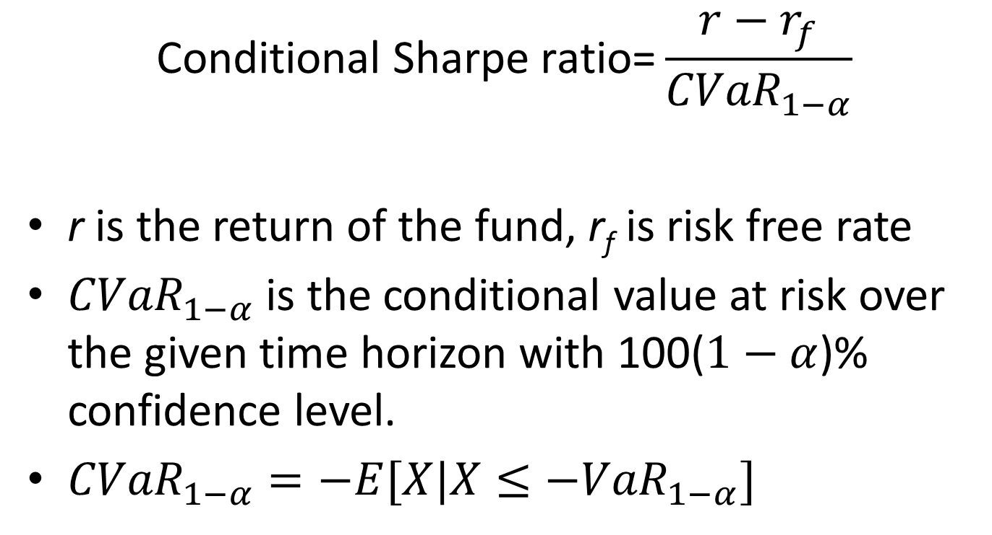

$$\text{Conditional} \text{Sharpe} \text{ratio}$$
$$\text{Conditional} \text{Sharpe} \text{ratio}\text{=}\frac{r−r_{f}}{{CVaR}_{1−α}}$$
r is the return of the fund, r_{f} is risk free rate
${CVaR}_{1−α}$ is the conditional value at risk over the given time horizon with 100($1−α$)% confidence level.
${CVaR}_{1−α}=−E[X|X≤−{VaR}_{1−α}]$

Slide 5
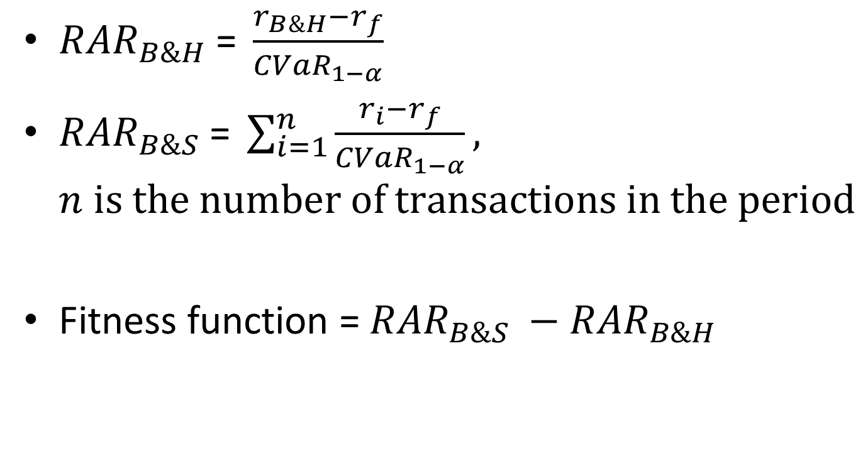
Fitness function of GP
${RAR}_{B\&H} \text{= }\frac{r_{B\&H}−r_{f}}{{CVaR}_{1−α}}$
${RAR}_{B\&S} \text{= }\sum_{i=1}^{n}{\frac{r_{i}−r_{f}}{{CVaR}_{1−α}}},$ $n is the number of transactions in the period$
Fitness function = ${RAR}_{B\&S} −{RAR}_{B\&H}$

Slide 6
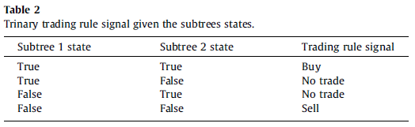
Trinary trading rule signal

Slide 7
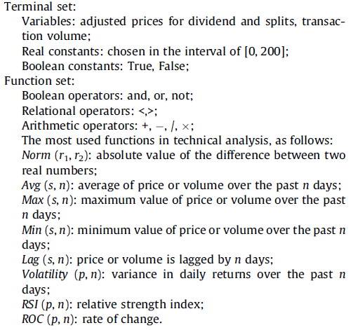

Slide 8
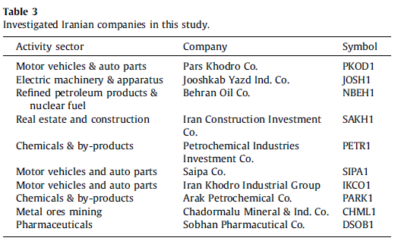
experiment
10 Iranian companies listed on Tehran Stock Exchange (TSE).
Training period: 22/8/2004–21/8/2007
Testing period: 22/8/2007–21/8/2008

Slide 9
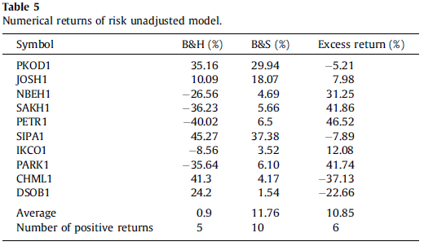
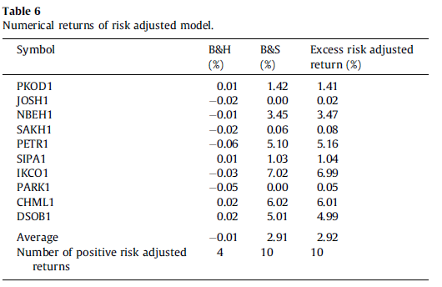

Slide 10
THE END

