Slide 1
Climate classifications: the value of unsupervised clustering Procedia Computer Science vol.9, pp. 897-906, 2012
Jakob Zscheischler^{a, b}, Miguel D. Mahechaª, Stefan Harmeling^{b} ª Max Planck Institute for Biogeochemistry, PO Box 100164, 07701 Jena, Germany
^{b} Max Planck Institute for Intelligent Systems, Spemannstr. 38, 72076 Tubingen, Germany
Presentor：Hsin-Chuan Yuan

Slide 2
Abstract
Classifying the land surface according to different climate zones is often a prerequisite for global diagnostic or predictive modelling studies. Classical classiﬁcations such as the prominent K̈oppen–Geiger (KG) approach rely on heuristic decision rules. Although these heuristics may transport some process understanding, such a discretization may appear “arbitrary” from a data oriented perspective. In this contribution we compare the precision of a KG classiﬁcation to an unsupervised classiﬁcation (k-means clustering). Generally speaking, we revisit the problem of “climate classiﬁcation” by investigating the inherent patterns in multiple data streams in a purely data driven way.

Slide 3
Abstract
One question is whether we can reproduce the KG boundaries by exploring different combinations of climate and remotely sensed vegetation variables. In this context we also investigate whether climate and vegetation variables build similar clusters. In terms of statistical performances, k-means clearly outperforms classical climate classiﬁcations. However, a subsequent stability analysis only reveals a meaningful number of clusters if both climate and vegetation data are considered in the analysis. This is a setback for the hope to explain vegetation by means of climate alone. Clearly, classiﬁcation schemes like K̈oppen-Geiger will play an important role in the future. However, future developments in this area need to be assessed based on data driven approaches.

Slide 4
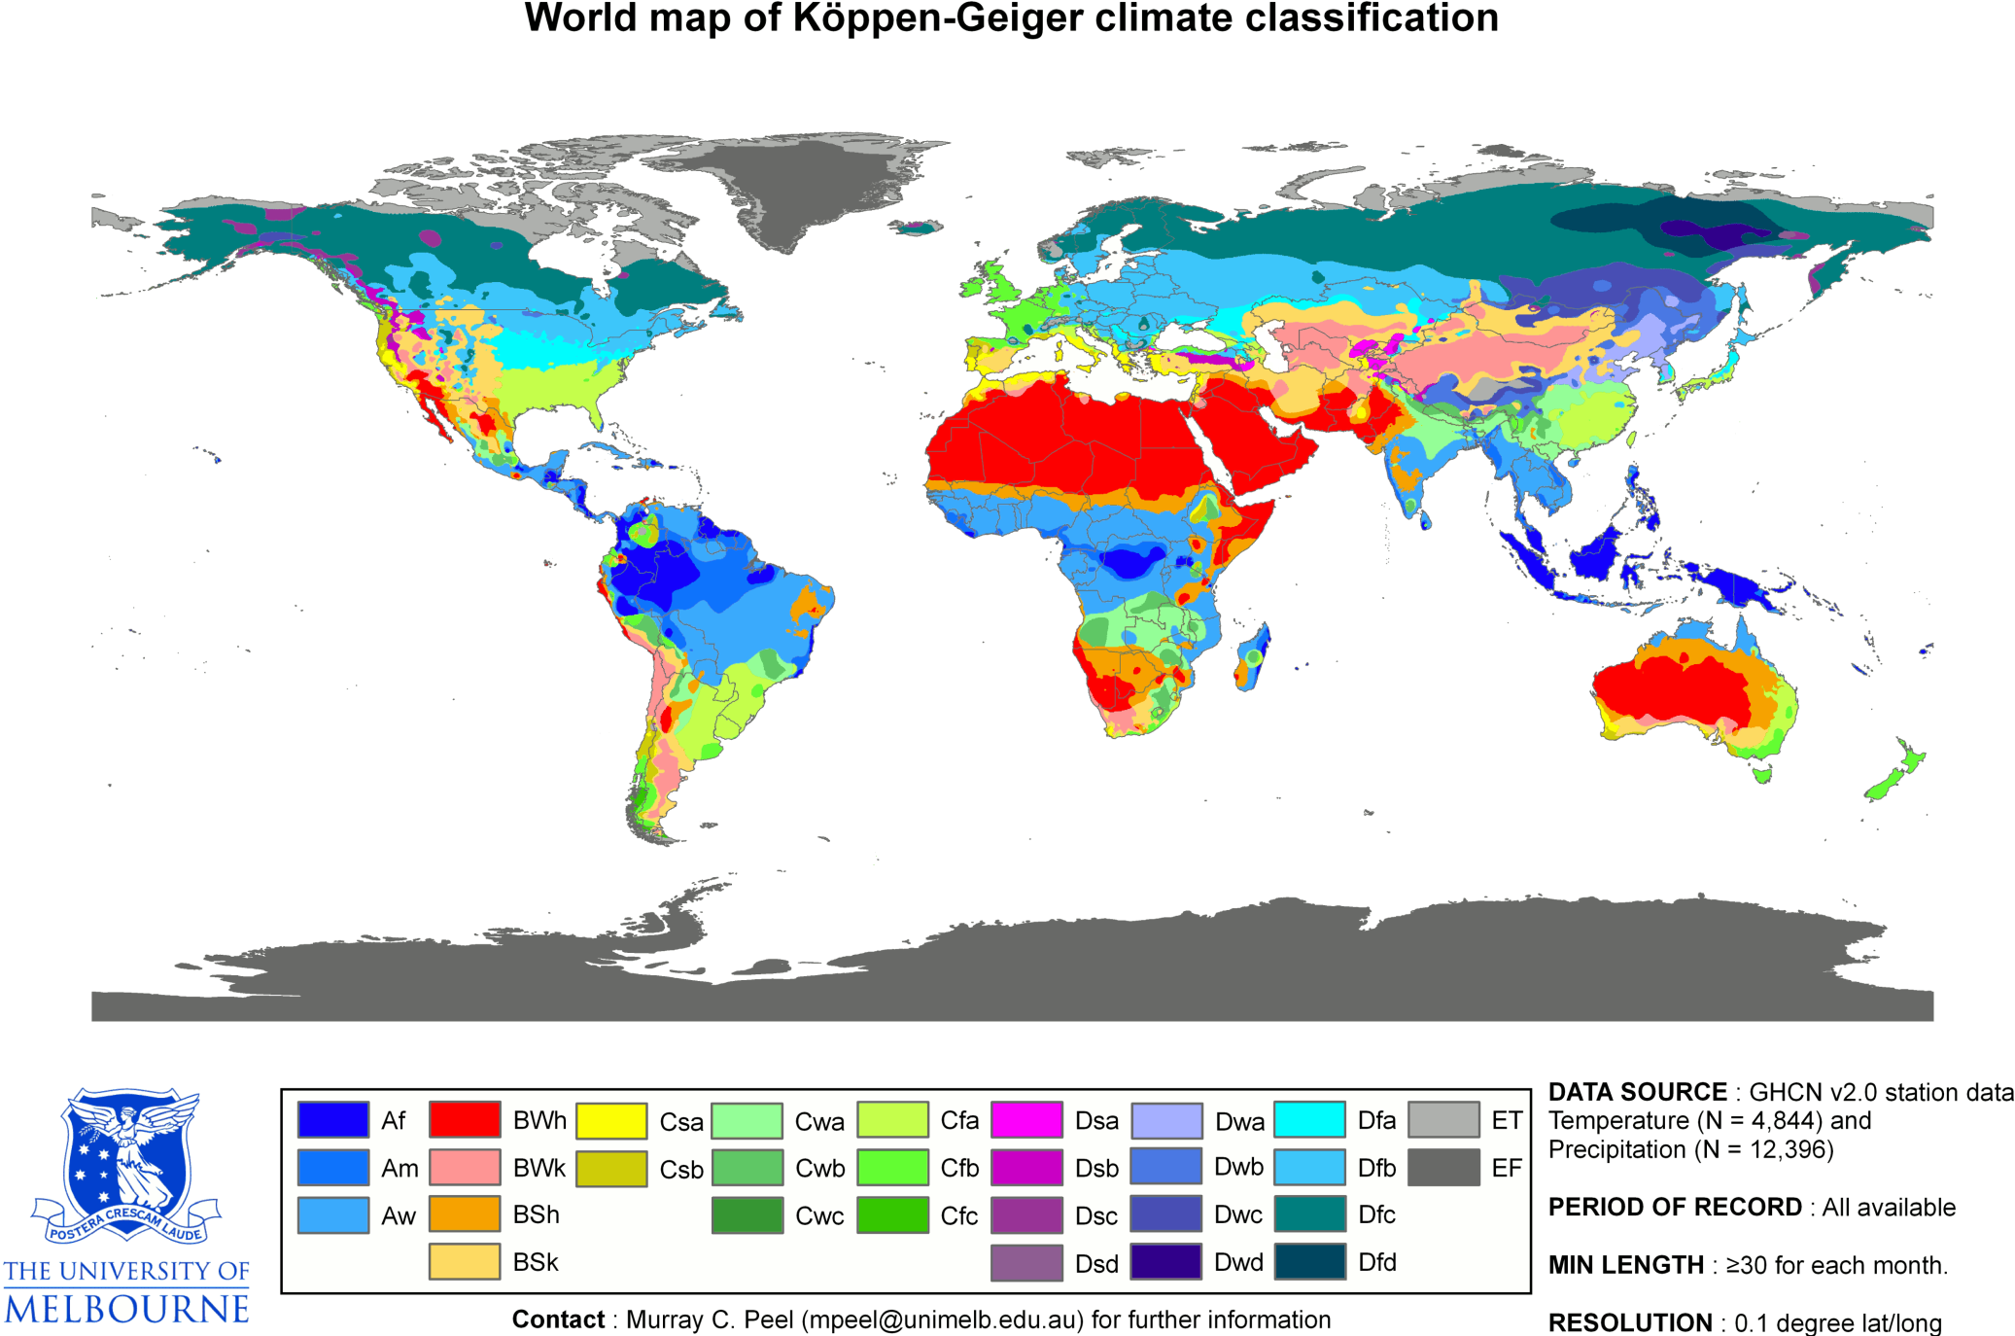
K̈oppen-Geiger climate classiﬁcation

Slide 5
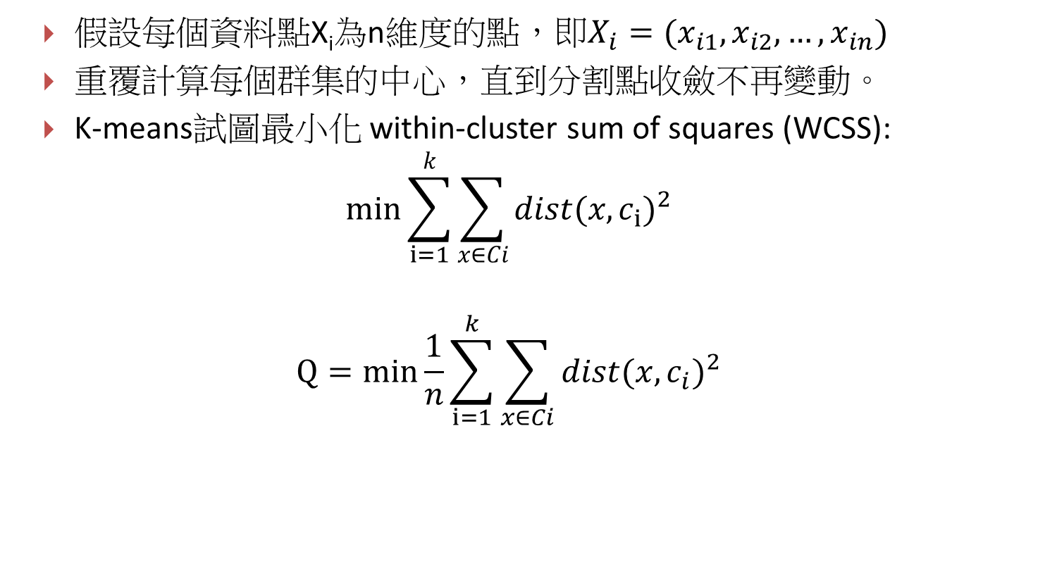
K-means
假設每個資料點X_{i}為n維度的點，即$X_{i}=(x_{i1},x_{i2},…,x_{in})$
重覆計算每個群集的中心，直到分割點收斂不再變動。
K-means試圖最小化 within-cluster sum of squares (WCSS):
$$min\sum_{i=1}^{k}{\sum_{x∈Ci}{{dist(x,c_{i})}^{2}} }$$
$$Q=min\frac{1}{n}\sum_{i=1}^{k}{\sum_{x∈Ci}{{dist(x,c_{i})}^{2}} }$$

Slide 6
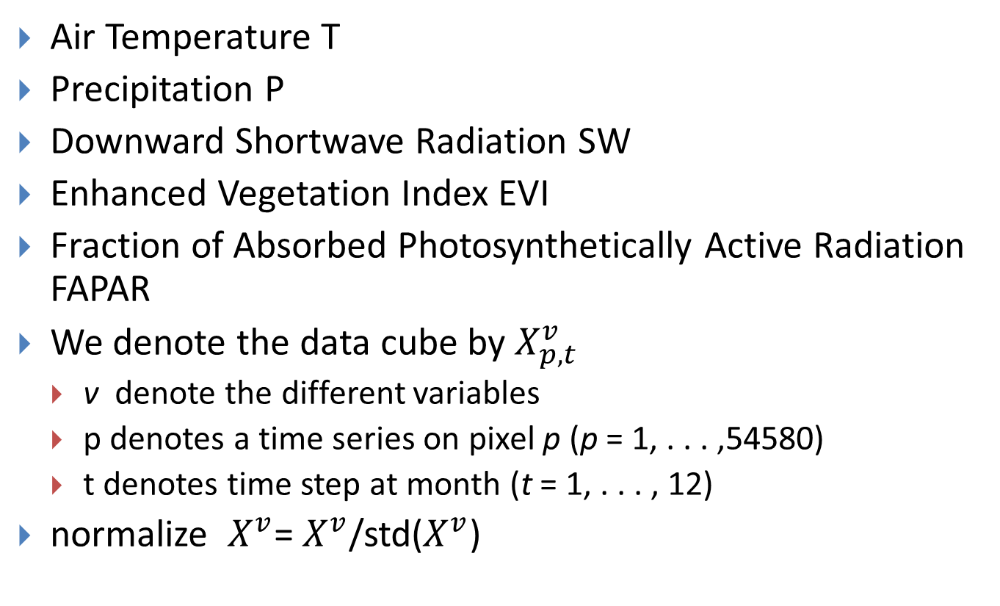
Data
Air Temperature T
Precipitation P
Downward Shortwave Radiation SW
Enhanced Vegetation Index EVI
Fraction of Absorbed Photosynthetically Active Radiation FAPAR
We denote the data cube by $X_{p,t}^{v}$
v denote the different variables
p denotes a time series on pixel p (p = 1, . . . ,54580)
t denotes time step at month (t = 1, . . . , 12)
normalize $X_{}^{v}$= $X_{}^{v}$/std($X_{}^{v}$)

Slide 7
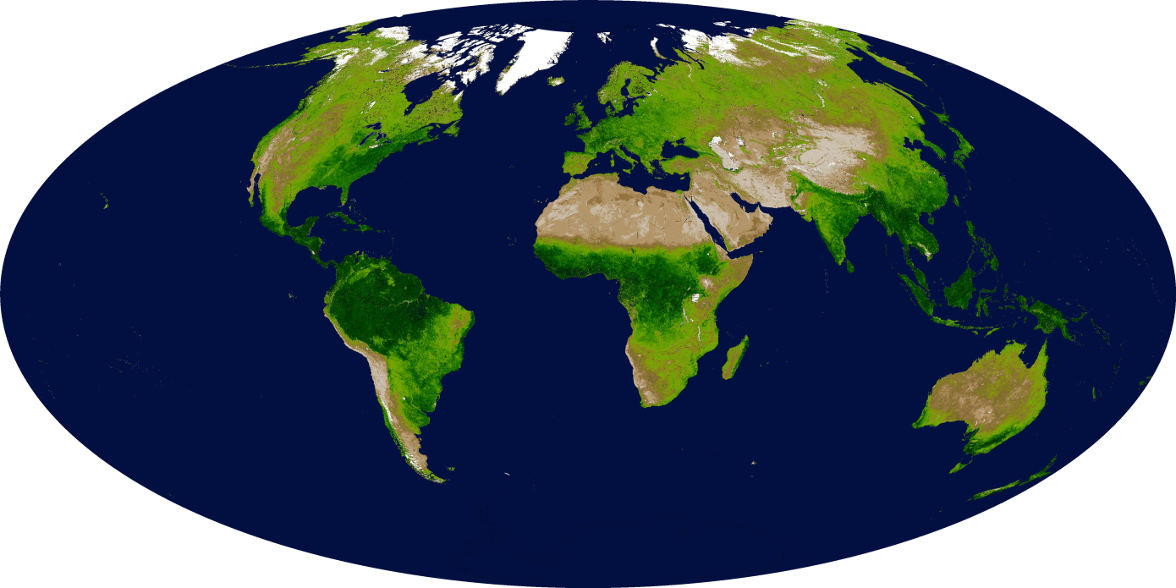
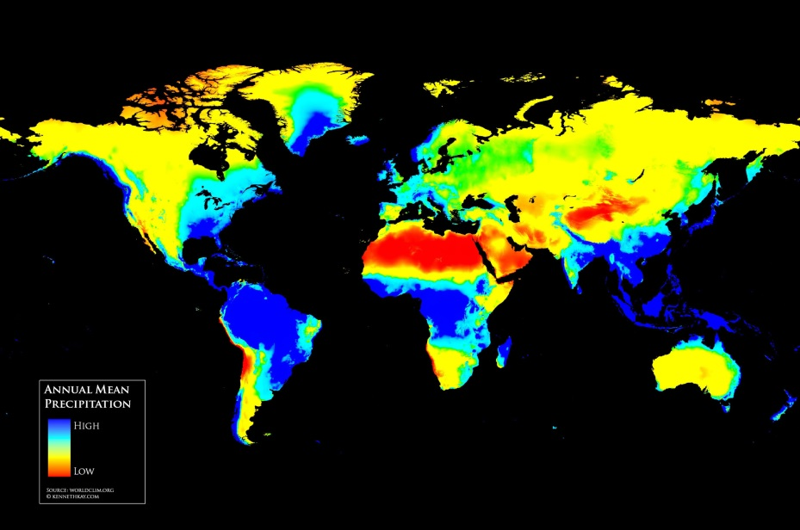
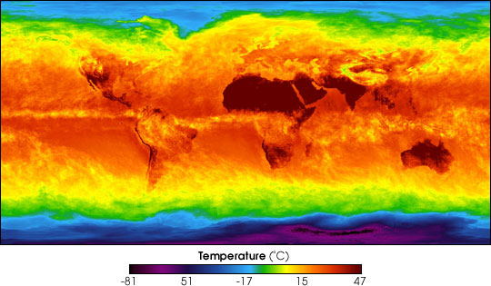
Data

Slide 8
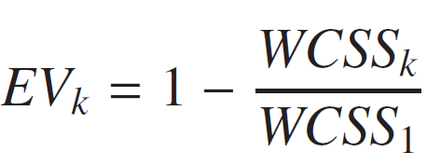
Explained predictand variance (EV)
Let WCSS_{k} be the within-cluster sum of squares of a clusterin.g with k clusters.
EV = 1 is perfect

Slide 9
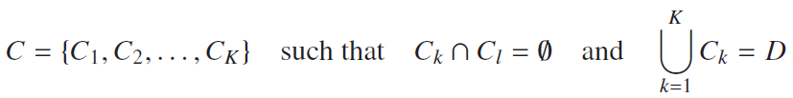



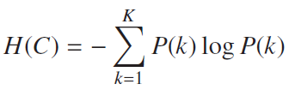
Variation of information (VI)
the number of points in the intersection of clusters Ck and Ck’ is
the probability that the chosen point is in cluster Ck is
the entropy of the random variable:

Slide 10

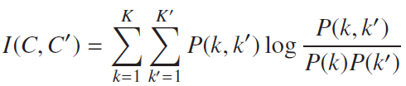

Variation of information (VI)
The joint probability:
The mutual information is
Then we can define VI to be the
0 implies identical

Slide 11
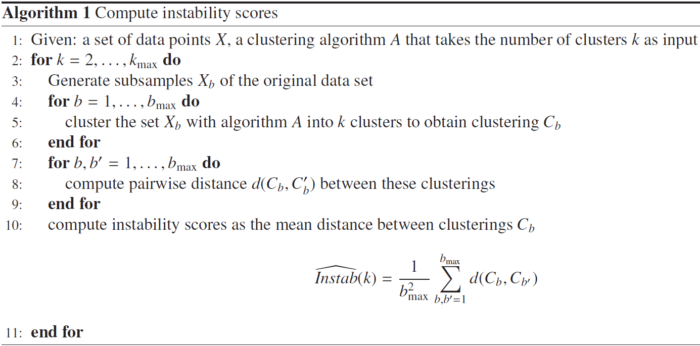
Instability of a clustering (Instab)
We define instability of a clustering by the expected difference between two clusterings C_{k}(S_{n}), C_{k}(S’_{n} ) on different data sets S_{n}, S’_{n} of the same size n, i.e.

Slide 12

Principal Component Analysis (PCA)
The singular value decomposition of X is X = WΣV^{T}
The principal components are given by

Slide 13
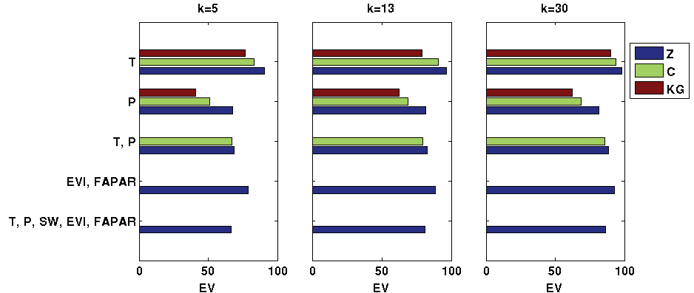
Results
Comparing the performance of k-means clustering via EV
Expected variance (EV) for different scenarios. KG=Koppen-Geiger, C=Cannon, Z=our analysis

Slide 14
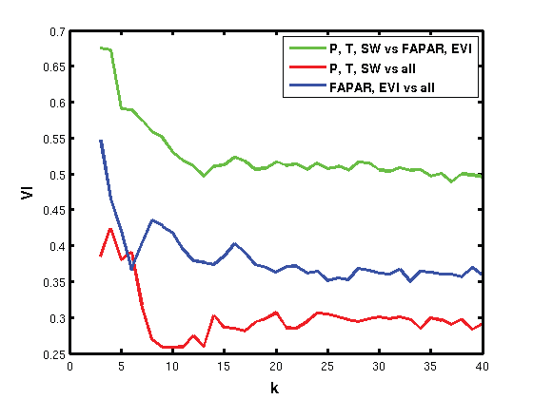
Results - Climate vs Vegetation

Slide 15
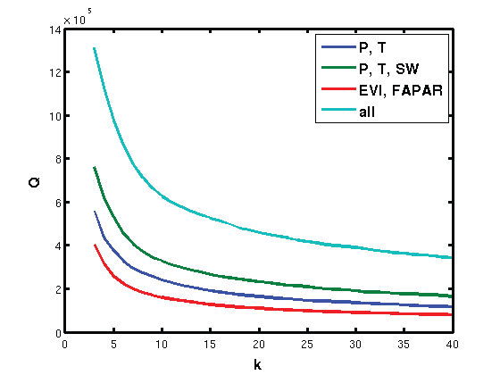
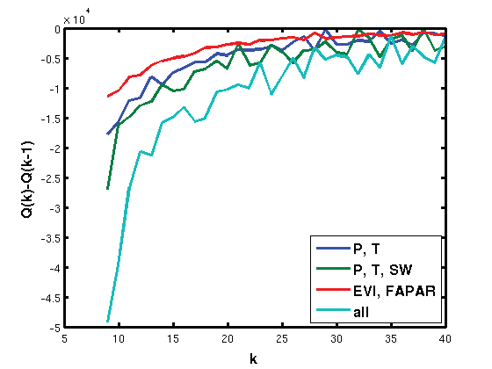
Finding the right k
Q for different number of clusters k and different variable subsets.
difference between Q(k) and Q(k − 1).

Slide 16
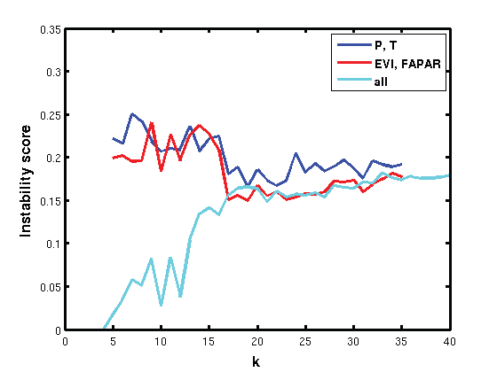
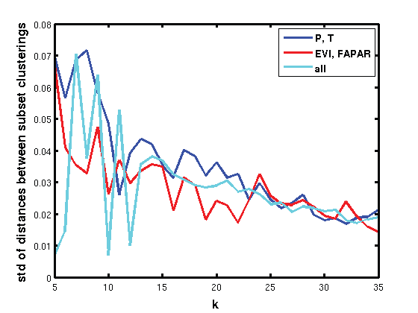
Finding the right k

Slide 17
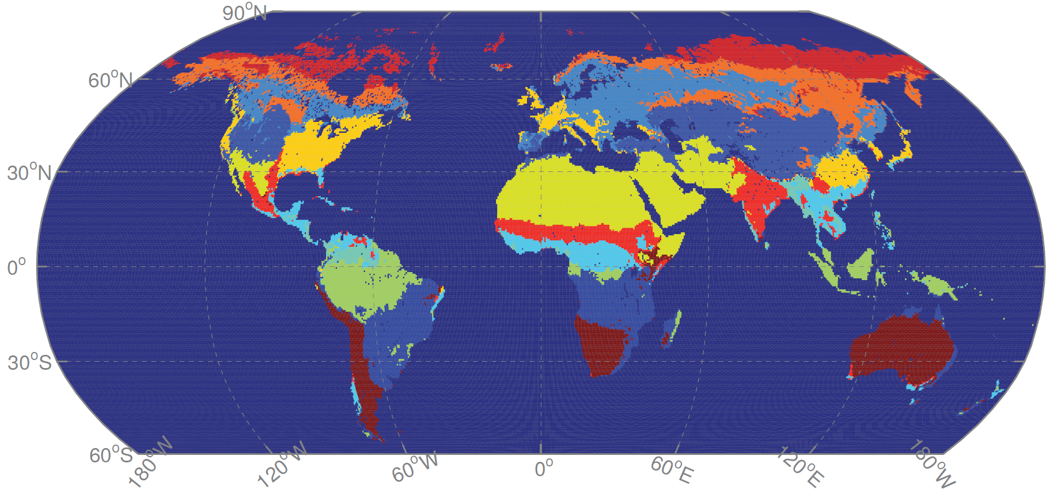
Results

Slide 18
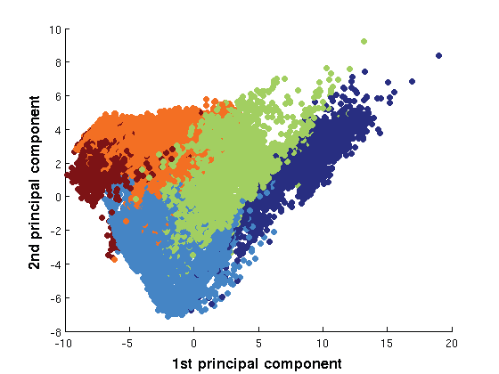
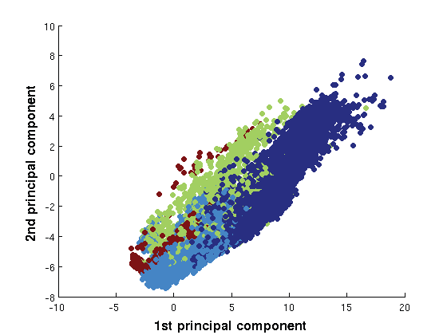
Results
Projection of the data from the northern (left) and southern (right) hemisphere onto the first two principalcomponents. Each point constitutes one pixel and is coloured according to the five main climates of the K¨oppen-Geiger classification.

Slide 19
Conclusions
We have shown that KG may not be optimal regarding this task and we tried to tackle it with an approach using unsupervised clustering.
the obtained clustering including climate and vegetation has rather diagnostic than predictive character.

