Slide 1
A Neural Network Primer
H. Abdi
Journal of Biological Systems, Vol. 2(3), pp. 247-283, (1994)
Presenter: Jen-Hui, Wang
Date: Dec. 28, 2006

Slide 2
Abstract
Neural networks are composed of basic units somewhat analogous to neurons. These units are linked to each other by connections whose strength is modifiable as a result of a learning process or algorithm. Each of these units integrates independently (in parallel) the information provided by its synapses in order to evaluate its state of activation. The unit response is then a linear or nonlinear function of its activation. Linear algebra concepts are used, in general, to analyze linear units, with eigenvectors and eigenvalues being the core concepts involved. This analysis makes clear the strong similarity between linear neural networks and the general linear model developed by statisticians. The linear models presented here are the perceptron, and the linear associator.

Slide 3
Abstract (cont.)
The behavior of nonlinear networks can be described within the framework of optimization and approximation techniques with dynamical systems (e.g., like those used to model spin glasses). One of the main notions used with nonlinear unit networks is the notion of attractor. When the task of the network is to associate a response with some specific input patterns, the most popular nonlinear technique consists of using hidden layers of neurons trained with back-propagation of error. The nonlinear models presented are the Hopfield network, the Boltzmann machine, the back-propagation network, and the radial basis function network.

Slide 4
The Perceptron
The perceptron can be considered as the first important implementation of artificial neural networks It was created in the fifties by Rosenblatt, the perceptron was designed to mimic or to model perceptual activities.
The main goal was to associate binary configurations patterns (i.e., patterns of [0,1] values) presented as inputs on a (artificial) retina with specific binary outputs

Slide 5
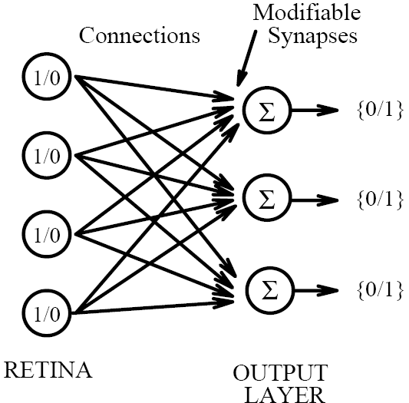
The Perceptron (cont.)
the perceptron is made of two layers: the input layer (i.e., the “retina” ) and the output layer (the “association layer”)
The activation of the cells of the input layer is transmitted to the cells of the output layer through connections (“synapses”) which can change the intensity of the signal

Slide 6
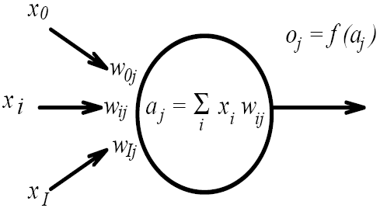
The Perceptron (cont.)
The output cell of a perceptron. The inputs are noted x_{i}, the synaptic weights are noted w_{i,j}, the total activation of the cell is noted a_{j}, its response or output, noted o_{j}

Slide 7
The Perceptron (cont.)
The cells of the output layer compute their state of activation as a function of the stimulation they receive through the synapses, and then give a (binary) response as a function of their state of activation.
The response is then obtained by thresholding the activation (i.e., the cell will be in the active state only if its activation level is larger than a given threshold)

Slide 8
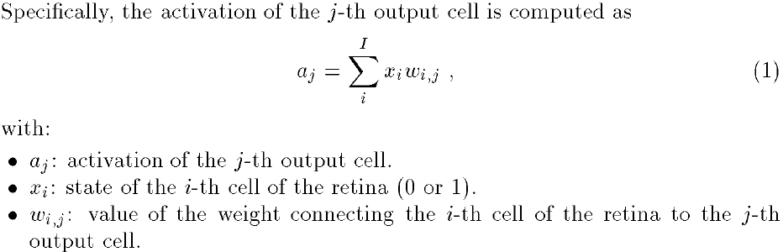
The Perceptron (cont.)

Slide 9


The Perceptron (cont.)
The output cells will then take either the active state (1) or the inactive state (0) if their level of activation is greater or less than their threshold noted θ_{j} (quite often θ_{j} is set to 0)
The threshold is modifiable by learning (like the weights). Actually, thresholding is often implemented by setting an input cell always active (the 0-th input cell) so that the weight w_{0,j} is equal to –θ_{j} (response bias)

Slide 10
Learning rule
The main problem for the perceptron is to learn how to adjust the synaptic weights in order to give the desired response for a given stimulus
The famous learning rule
  Widrow-Hoff learning rule, Delta rule
Widrow-Hoff learning rule
  This type of learning is referred to as supervised learning
  The output cells must be provided with the correct response so that they can compute an error signal
The output cells must know the state of the input cells, however, do not need to know the response of the other output cells

Slide 11

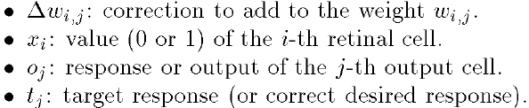

Widrow-Hoff learning rule
A cell will learn only if it makes a mistake (i.e., error signal is not zero)
The weights are adjusted and the learning procedure terminates as soon as the perceptron makes no error

Slide 12
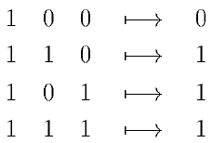
An example: learning the logical function OR
This perceptron is composed of three input cells two cells for the values of the argument of the logical function plus one cell (x₀) to implement threshold, and one output cell

Slide 13
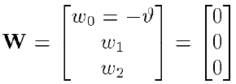

An example: learning the logical function OR
Supposing the synaptic weights are initialized to zero
The first randomly chosen association is [1,1,1]
The incorrect response of the perceptron is 0

Slide 14
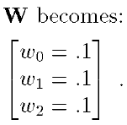
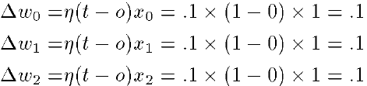
An example: learning the logical function OR
The error is the difference between the target value and the response of the output cell
Suppose that the learning constant η is set to the valueη= 0.1, and Widrow-Hoff learning rule is used

Slide 15

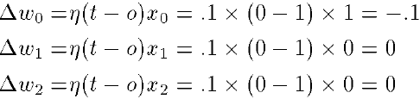
An example: learning the logical function OR
Suppose, now, that the first stimulus [1,0,0] is presented to the perceptron
The response of the output cell is 1, the correction to apply to the synaptic weights

Slide 16
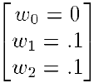
An example: learning the logical function OR
When the error correction rule is applied, W becomes:
With this set of weights, the perceptron is now able to give perfect answers for the OR problem

Slide 17
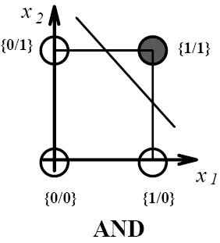
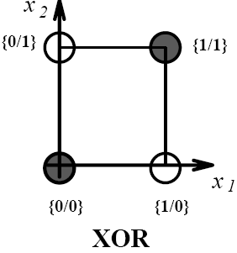
Evaluation of the perceptron
Because the activation of the output cell is a linear combination of the retinal input cells, the perceptron can learn only to discriminate linearly separable categories
If the categories are linearly separable, then if the learning constant η is small enough, convergence is guaranteed
Example of nonlinearly separable function: XOR

Slide 18
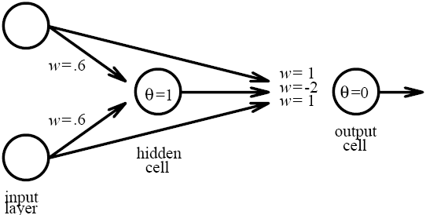

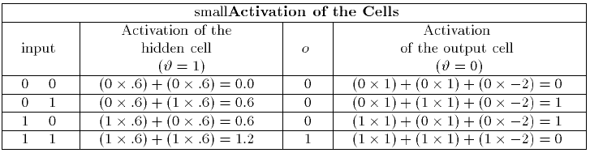
Evaluation of the perceptron
Several algorithms (the most popular of which is back propagation) make it possible for a perceptron with at least one hidden layer to implement the XOR logical function

Slide 19
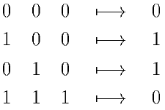
Evaluation of the perceptron
Another way of coping with a nonlinearly separable problem is to recode it in order to make it linearly separable
  For example, a third input cell is added and provided with the product of the two remaining cells
The following set of weights will then solve the XOR problem

Slide 20
Linear associators
They come in two forms
  Hetero-associator
  Auto-associators
The hetero-associators can be used to learn associations between input and output patterns
The auto-associator is a special case of the hetero-associator in which the association between an input pattern and itself is learned, it is used widely as a pattern recognition and pattern completion devices

Slide 21
Linear associators - Notation
f_{k}: Stimuli are represented by I × 1vector, k indicates the stimulus number, in general, input vectors are normalized so that f_{k}^{T}f_{k} = 1
g_{k}: The responses of the network are given by J × 1vector
F: The complete set of K stimuli is represented by a K × I matrix, in which the k-th row is f_{k}^{T}
G: The set of the K responses is represented by a K × J matrix, in which the k-th row is g_{k}^{T}
W: The J × I synaptic weight matrix
w_{i,j}: the weight corresponding to the connection between the i-th and the j-th output cell

Slide 22



Linear associators
The Hebbian learning rule in linear associators sets the change in the synaptic weights to be proportional to the product of the input and the output
If the proportionality constant is set to 1, the association between the k-th stimulus and the k-th response leads to the creation of the weight matrix.
The response of the associator is denoted , with just one association stored, it is easy to show that the associator estimates g_{k} perfectly

Slide 23


Linear associators
To implement several associations, the W_{k} matrices are summed in order to give W:
The estimation of the k-th response by the associator is obtained as:
In general, the quality of the associator estimation is evaluated by comparing and g_{k}
If the stimuli are pairwise orthogonal
  cos(f_{k}, f_{k’}) = 0 and = g_{k}, the responses perfectly
cross-talk

Slide 24
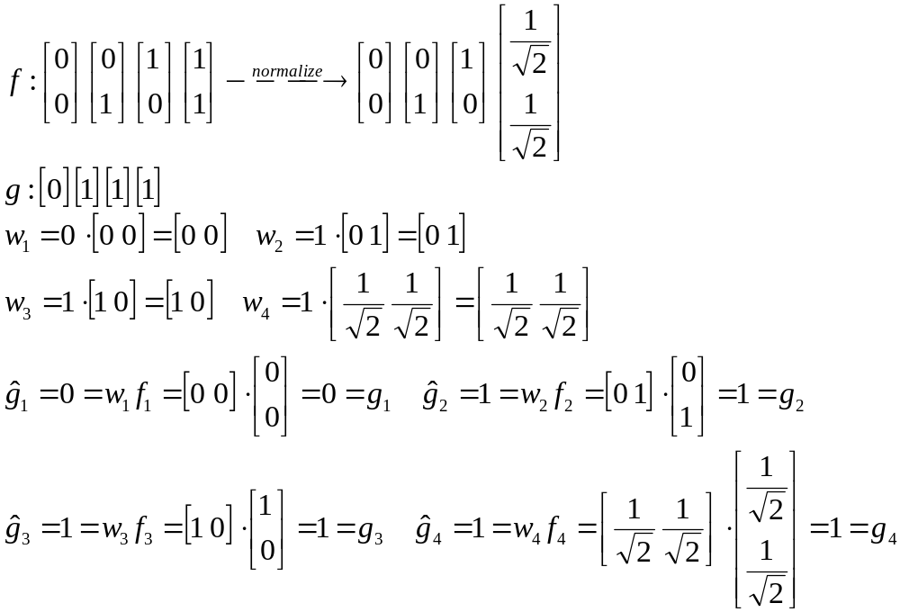
Example -- OR

Slide 25
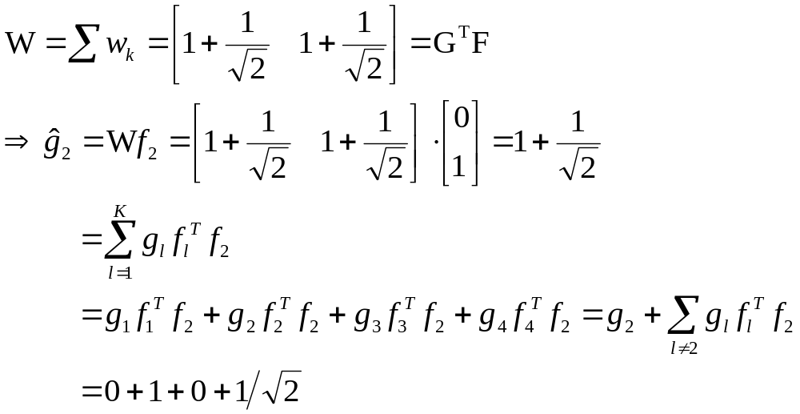
Example -- OR
crosstalk

Slide 26
linear auto-associator
It is a particular case of the linear-associator, the goal of this network is to associate a set of stimuli to itself (i.e., G is equal to F), The weight matrix W is now equal to F^{T}F
When the stimulus set is composed of non-orthogonal stimuli, the associator will fail to reconstruct perfectly the stimuli that were stored
Some new patterns will be perfectly reconstructed by the associator, creating in a way, the equivalent of a “false alarm” or “false recognition”, these patterns are defined by

Slide 27
Linear associators – back to the general case
In order to improve the performance of linear associators, several learning rules have been proposed, the most popular one is clearly the Widrow-Hoff learning rule
Widrow-Hoff learning rule is an iterative procedure correcting the error between the target response and the actual response of the network
In matrix notation, the Widrow-Hoff rule is:
W_{(t)} being the weight matrix at step t, ηbeing a (small) positive constant, and k being randomly chosen

Slide 28
Non-linear systems (auto-associator)
As with the perceptron, several nonlinear extensions of auto-associator have been developed. These models include the Hopfield net , Brain-State-in-a-Box
Acting as content-addressable memories, these nonlinear auto-associators try to find, among the patterns stored, the one closest to the stimulus

Slide 29


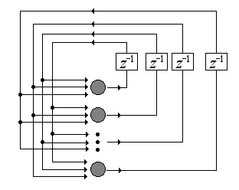

Hopfield Nets
It is an asynchronous nonlinear auto-associator
f_{k}: the k-th stimulus to be stored is represented by an I × 1 binary vector, taking values 0 or 1
: the set of thresholds for the I units is denoted
From the f_{k} vectors, new recoded vector denoted h_{k} :
  The 0 are replaced by -1
The weight matrix is obtained as

Slide 30
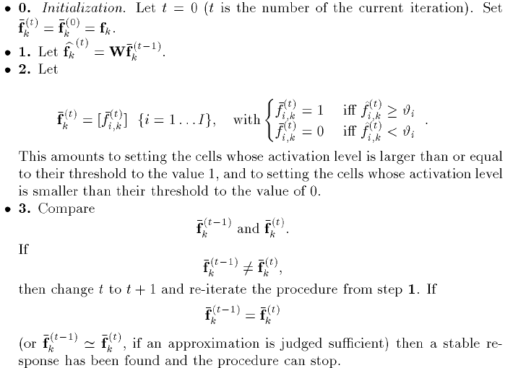
A stimulus is “recall” by presenting a “cue”, when f_{k} is used as a cue, recall from the memory is obtained through the following step

Slide 31
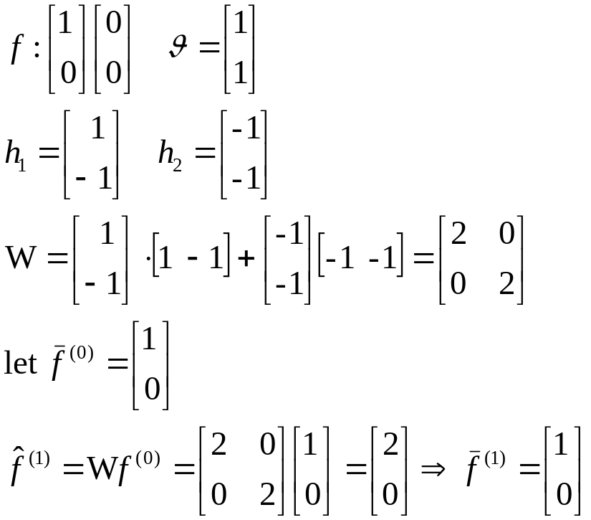
Example
Training patterns
Testing patterns

Slide 32
Hidden layer networks and back-propagation
An error back-propagation network is composed of at least three layers of cells: an input layer, one or more hidden layers, and an output layer
Back-propagation networks use supervised learning, the synaptic weights on these cells will be adjusted using the standard Widrow-Hoff learning rule for nonlinear units
The error is propagated backward through the same connections and synaptic weights to the cells of the hidden layer

Slide 33
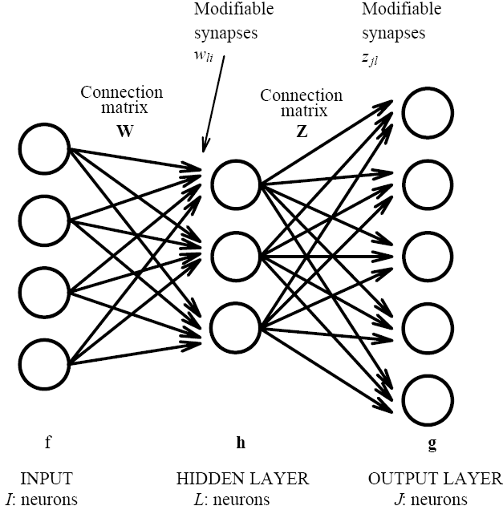
Notation
f_{k}: the I × 1 vector representing the k-th stimulus (the input layer is made of I cells)
h_{k}: the L × 1 vector representing the response of the hidden layer for the k-th stimulus (the hidden layer is made of L cells)
: the J × 1 vector representing the response of the output layer for the k-th stimulus (the output layer is made of J cell)
g_{k}: the J × 1 vector representing the target response of the output layer for the k-th stimulus
W: the L × I synaptic weight matrix of the connections between the I cells of the input layer and the L cells of the hidden layer
Z: the J × L matrix storing the weights of the connections between the hidden layer and the output layer

Slide 34
Hidden layer networks and back-propagation

Slide 35


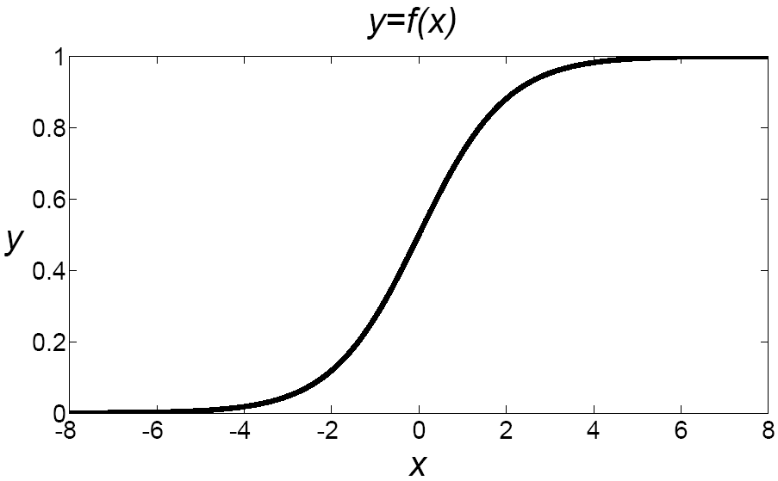

Hidden layer networks and back-propagation
In order to use error back-propagation, the response of a cell should be a nonlinear function of the cell activation.
The most widely used is the logistic function
The logistic function maps the activation into the continous interval [0, 1]
One reason for its popularity is the
ease of computing its derivative:

Slide 36


Hidden layer networks and back-propagation
The response of the hidden layer will be:
The response of the output layer will be: (assuming that the same nonlinear function)
Since back-propagation is a supervised learning technique, the output layer cells must be provided with the expected answer. Once the error signal at the output cells has been determined, the process of correcting the synaptic weights in order to minimize the error signal begins.

Slide 37
Hidden layer networks and back-propagation
For the cells of the output layer, the error for output cell j is
Using vector notation
The error signal, combines the cell error with its activation. Specifically, signal is weighted by the derivative of the output activation:
  denotes the Hadamar product

Slide 38
Hidden layer networks and back-propagation
The Widrow-Hoff learning rule corrects the matrix Z iteratively, at step (t+1), the weights stored in matrix Z become:
For the cells of the hidden layer, the error signal cannot be evaluated by direct comparison with target. The error signal is estimated as a function of the output error, of the synaptic weights, and of the response of the hidden layer cells
At step (t+1), the weights stored in matrix W become:

Slide 39
Gradient descent
The gradient descent method is a relatively well-known method of numerical analysis used to locate iteratively a minimum of a nonlinear derivable function
The gradient of a function is defined as the matrix of the (first) derivative of that function. Suppose that the parameters of a function are stored in a matrix denoted Z and that the function under consideration is (i.e., the problem is to find the matrix Z so that y reaches its minimum value)

Slide 40
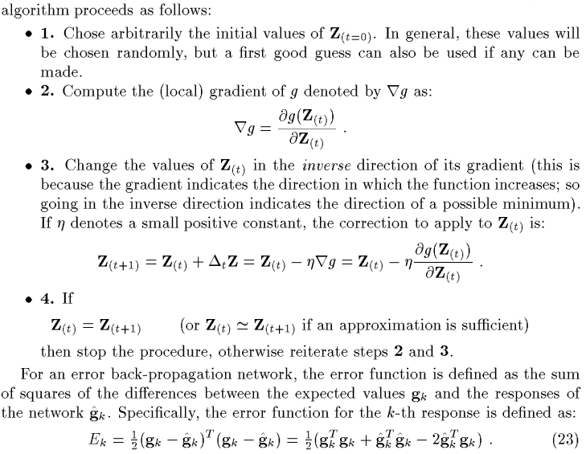

Slide 41
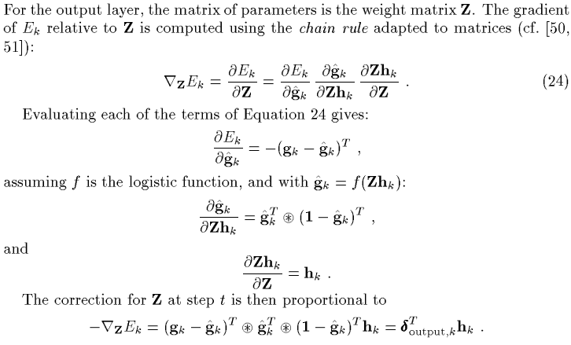
Gradient correction for the output layer

Slide 42
Evaluation of Back-propagation
Drawback
  The network needs to be provided with the correct answer (back-propagation is a supervised technique)
  Number of iterations needed for the network to converge
    That even for a simple problem like learning the XOR function, the number of iterations required for convergence can reach into the thousands, when a perceptron will solve it as a ternary relation in less than 10 iterations
  It is always difficult to determine, for a given problem, the best architecture in terms of number of hidden layers as well as number of cells per lyaer

Slide 43
Radial basis function network
These networks are used for finding an approximation of a nonlinear function as well as for finding interpolating values of a function defined only on a finite subset of real numbers
The essential idea is to implement a complex nonlinear mapping from the input pattern space to the output pattern space as a two-step process
  First step: simple nonlinear mapping from the input layer to the hidden layer
  Second step: a linear transformation from the hidden layer to the output layer
Learning occurs only at the level of the synapses between the hidden layer and the output layer. Because these connections are linear, learning can be very fast

Slide 44
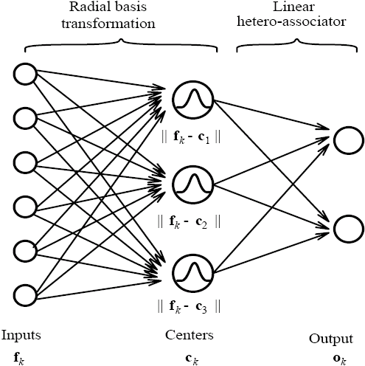
Radial basis function network
d_{l,k}
w_{j,l}
W
D

Slide 45
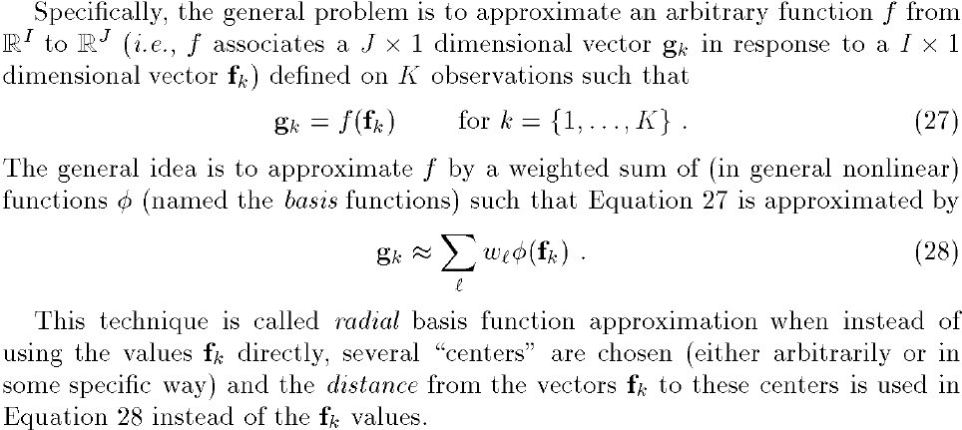
Radial basis function network

Slide 46

Radial basis function network
A center can be any I-dimensional vector (so that the distance between the centers and the f_{k} is always defined)
If a set of L centers c_{l} is chosen (with each center being an I dimensional vector), the equation is approximated as
The distance of the K observations to the L centers:
  C: a L × I matrix of the centers (c_{l}^{T} is the l-th row of C)
  d_{l,k}: Euclidean distance from observation k to center l

Slide 47

Radial basis function network
Then, the problem is to find a L × J matrix W
If the matrix is squared, and non-singular:
If is singular or rectangular, a least-squares approximation is given by
Several choices are possible for the Φ functions. One of the most popular choices is the Gaussian function

Slide 48
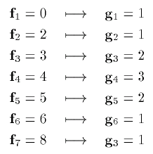
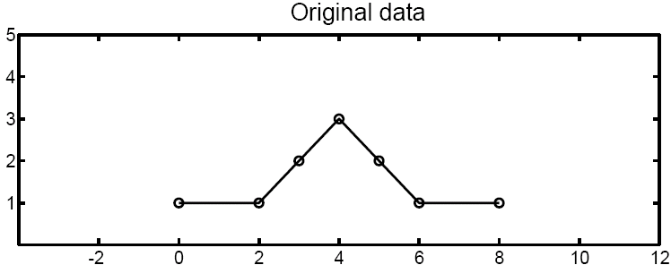
An example
Suppose that the function to be approximated associates the following one-dimensional (I=J=1) set of K=7 stimuli to their response:

Slide 49
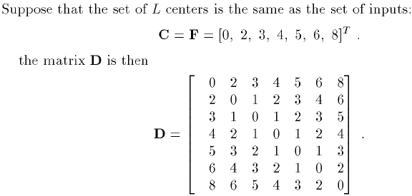
An example

Slide 50
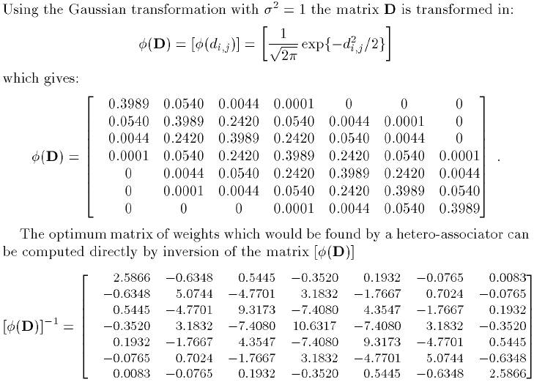

Slide 51
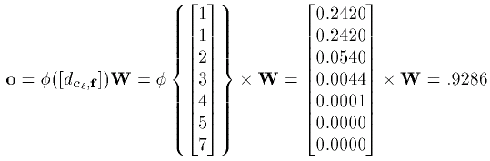
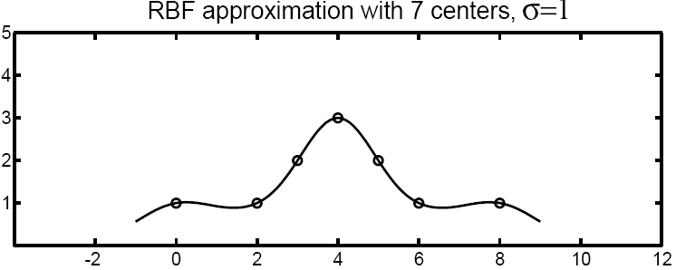

Slide 52
Radial basis function network
When a radial basis function network is used for approximating a function (i.e. when the set of centers is smaller than the set of training stimuli), the choice of values of σ becomes very important
The choice of the centers (as well as their number) is also important

Slide 53
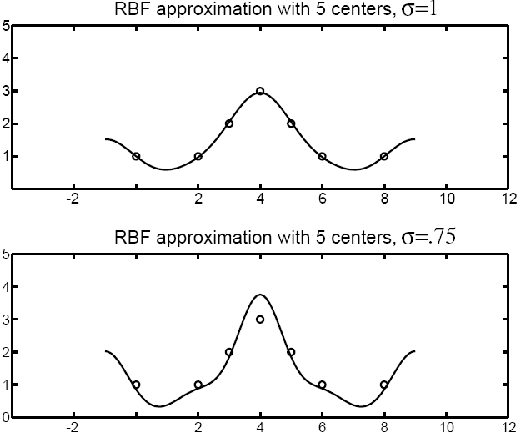

Slide 54
