Slide 1
Matching for Run-Length Encoded Strings
Apostolico, Landau and Skiena
Journal of Complexity, Vol. 15, pp. 4–16, 1999
Date: Feb. 1, 2007
Introducer: Hsing-Yen Ann

Slide 2
Problem Definition
Run-length coding compression
aaaaabbbccccdd ➔ a⁵b³c⁴d²
Given two compressed strings X and Y, to find the LCS without uncompressing X and Y.
X: length n, compressed length k
Y: length m, compressed length l
Bunke and Csirik proposed an O(ln + km) algorithm. (1995)
In this paper, an O(kl log(kl)) algorithm is proposed.

Slide 3
Two Kinds of Paths (1/3)
Dark blocks: matched blocks
Light blocks: mismatched blocks
Corner path: the path enters dark blocks only at the upper-left corner and exits only through the lower-right corner.
Forced path: the path traverses dark blocks by strictly diagonal moves and then jump to the next dark block horizontally (vertically).

Slide 4
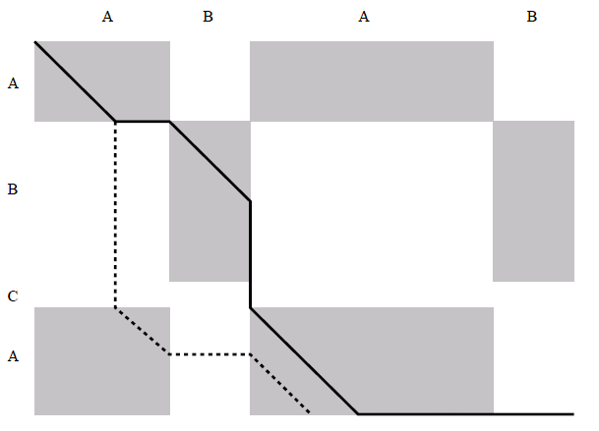
Two Kinds of Paths (2/3)

Slide 5

Two Kinds of Paths (3/3)
Given a start point (i, j), there may be many different Corner paths.
Given a start point (i, j), there is exactly one Forced path. (special case?!)
In a Forced path, all matches are in the same character.

Slide 6
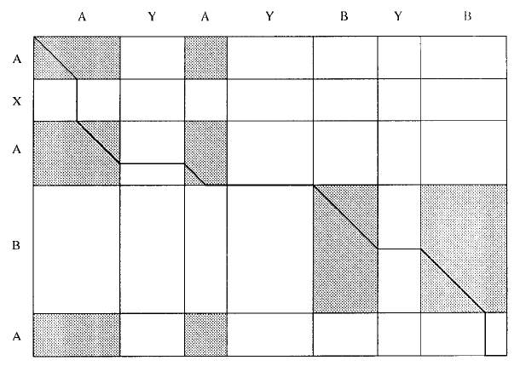
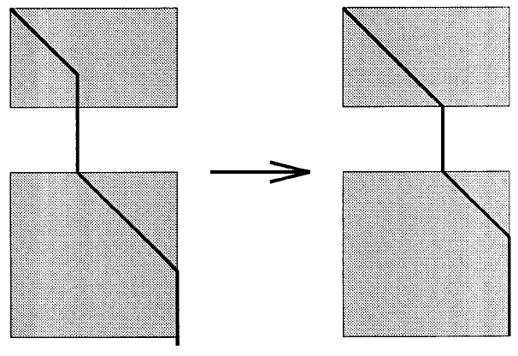
Examples for Lemma 1

Slide 7
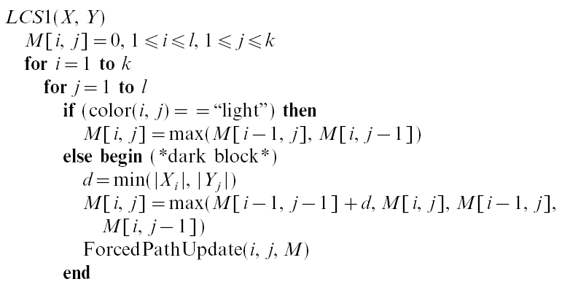
LCS – Initial Algorithm (1/2)
O(k+l)

Slide 8
LCS – Initial Algorithm (2/2)
ForcedPathUpdate(i, j):
Let (i, j) as a start point, update all nodes on this Forced path with the initial value v = M(i-1, j-1).
There are O(k+l) update for a Forced path.
There are O(kl) Forced paths.

Slide 9
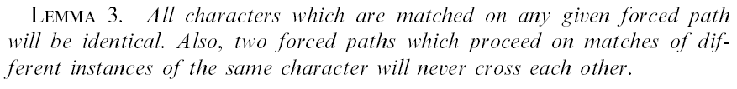
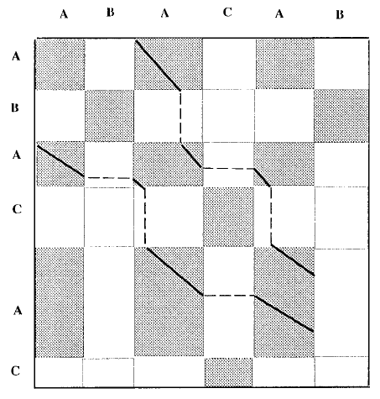
Lemma 3 – They Will Never Cross

Slide 10



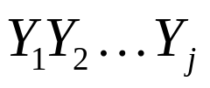

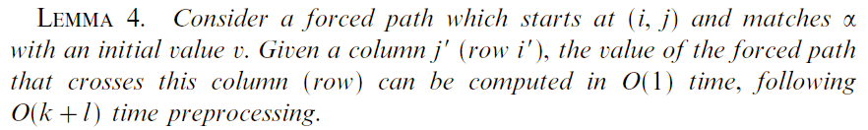
Tables LEFT and TOP
: count of α in
: count of α in
A forced path which start at (i, j) and matches α with initial value v. When it crosses column j’, its value will be .
Tables LEFT and TOP can be computed in O(k+l) time.

Slide 11

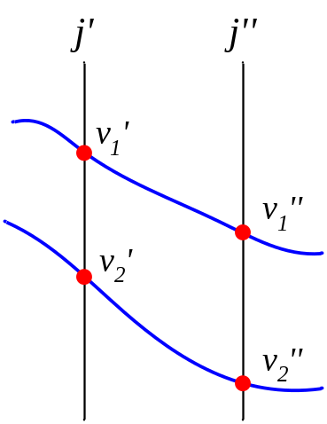
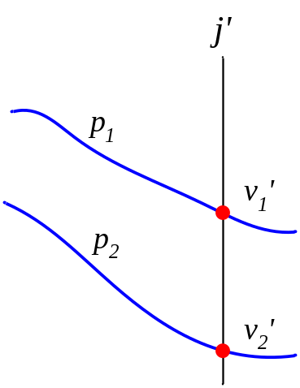
Lemma 5 – Some Forced Paths Can Be Deleted
If v₂ < v₁ then p₂ can be deleted from candidates.

Slide 12
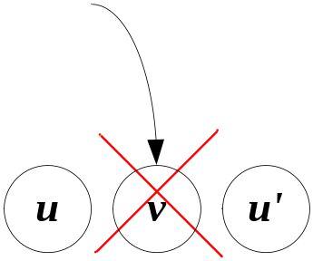
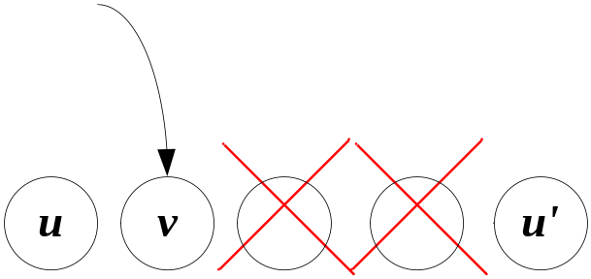
LCS – A Faster Algorithm (1/2)
Put all forced paths that matches α into two (sorted) balanced binary search trees, one for row and one for column.
A record of a forced path: (Rank, v, i, j)
For any two indexes i < j, Rank_{i} < Rank_{j} and v_{i} < v_{j}.
Maintain this property when adding a new forced path into the tree. (Adding by Ranks and deleting by values)

Slide 13
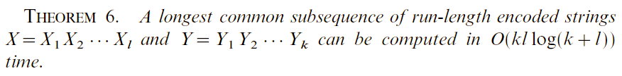
LCS – A Faster Algorithm (2/2)
When computing a dark block M[i, j] :
Step 1. Insert a new forced path according to its rank, and keep the paths sorted according to their value.
Step 2. Find the highest score (C) of the forced paths on column j, above row i.
Step 3. Find the highest score (R) of the forced paths on row i, left to column j.
Step 4. M[i, j] = max(M[i-1, j], M[i, j-1], C, R).

