Slide 1
Improved Greedy Algorithm for Protein Structure
Reconstruction
J Comput Chem 26: 506–513, 2005
Pierre Tuffery, Frederic Guyon, Philippe Derreumaux
Presenter: Jen-Hui, Wang
Date: Feb. 8, 2007

Slide 2
Abstract
This article concerns the development of an improved greedy algorithm for protein structure reconstruction. Our stochastic greedy algorithm, which attempts to locate the ground state of an approximate energy function, exploits the fact that protein structures consist of overlapping structural building blocks that are not independent. Application of this approach to a series of 16 proteins with 50–250 amino acids leads to predicted models deviating from the experimental structures by 0.5 Å RMSD using an RMSD-based energy function and within 1.5 to 4.8 Å RMSD using a Go-based energy function.

Slide 3
Abstract (cont.)
The Go-based results are significant because they illustrate the strength of combining structural fragments and stochastic greedy algorithms in capturing the native structures of proteins stabilized by long-range interactions separated by more than 30 amino acids. These results clearly open the door to less computationally demanding solutions to predict structures from sequences.

Slide 4
Introduction
Ab initio protein structure prediction from the optimization of a scoring function and without using any templates from the Protein Data Bank (PDB) is an important issue in biological science.
Recent work has taken advantage of the fact that the conformation of the overlapping short fragments along the sequence is not independent. Using a Hidden Markov Model (HMM), Camproux et al. learnt a structural alphabet (HMM-SA) consisting of 27 distinct prototype conformations (letters or Structural Building Blocks, SBB), they used the optimal series of SBBs describing each protein structure

Slide 5

Hidden Markov model
Short protein segments
  d₁(j), d₂(j), d₃(j)
    The distance between non-successive α-carbon
[d₁(j), d₂(j), d₃(j), d₄(j)] summarized in vector provide a unique representation of the conformation of each four-residue segment j

Slide 6
Hidden Markov model
給定輸入之觀察序列O=o₁o₂…o_{n} (o_{t} 表示在時間 t 所對應的觀測符號)。隱藏式馬可夫模型的目的就是要選出一個對應於觀測序列之最佳的狀態序列Q=q₁q₂…q_{n} (q_{t} 表示在時間 t 所對應的狀態)
State
S₃
S₃
S₃
S₃
S₃
S₂
S₂
S₂
S₂
S₂
S₁
S₁
S₁
S₁
S₁
1 2 3 T-1 T Time
o₁
o₂
o₃
o_{T-1}
o_{T}

Slide 7
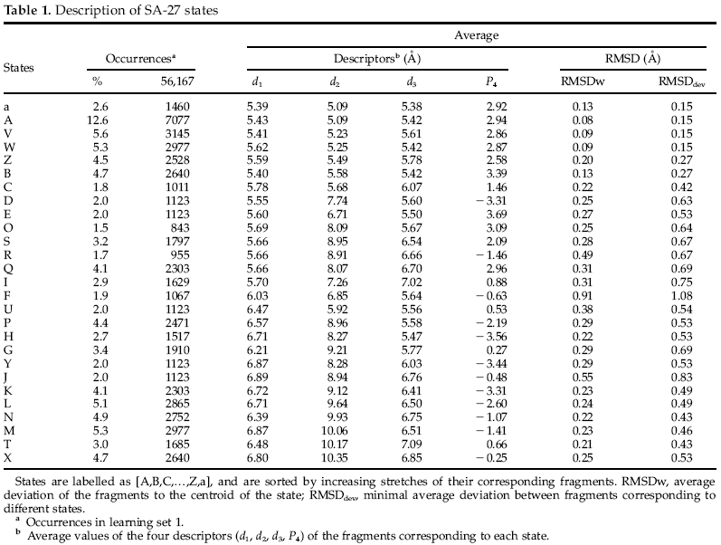

Slide 8
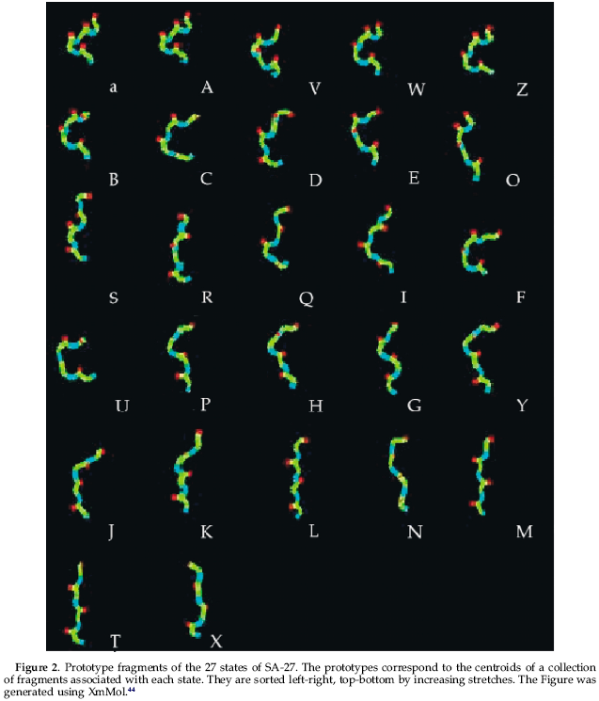

Slide 9
Materials and methods
Encoding Protein Structures into a Sequence of SBBs
  For each protein, we define a specific set of fragments by taking advantage of the possibility of typing its conformations as a series of SBBs, so as to mimic what could be expected as a result of prediction from the sequence
  HMM-SA describes the conformations of the overlapping fragments of four residue length of a protein structure. Thus, for a protein of length L+3 the resulting encoded structure is a trajectory of SBBs of length L

Slide 10
Materials and methods
Definition of the Fragments Associated with Each SBB
  Having encoded 1429 protein structures from PDB, we have extracted and identified for each SBB a set of representative fragments using a standard dynamic clustering procedure based on a minimal dissimilarity threshold (here a maximal RMSD from the centroid of the class)
  Using a threshold of 0.5 Å, it varies from 1 to 23, and results in a collection of 155 fragments for the 27 states, for an average of 4.6 prototypes per letter.

Slide 11
Materials and methods
Identification of the SBBs Describing the Local conformation at Each Position of the Structure
  It is possible to encode each protein structure as a series of letters of the alphabet using the Viterbi or the forward-backward algorithms
  The Viterbi algorithm identifies the best state sequence (optimal trajectory) among all the possible paths in {1, . . . , 27}^{L} by dynamic programming, taking into account the Markovian dependence between the consecutive states
  The forward-backward algorithm computes, for each position, the probability that the structure is represented by each of the 27 states

Slide 12
Materials and methods
  Here, we used the forward-backward approach to escape from the optimal description of the structure, and to introduce fuzziness in the local conformations. At each position of the structure, we have retained the letters of the alphabet associated with a probability higher than a threshold of 0.01
  This number of letters retained at each position depends on the local structure of the proteins. The corresponding profile of SBBs compatible with the structure will be referred to as a fuzzy trajectory
  During reconstruction, we thus consider at each position i all the fragments associated with each of the letters retained, that is, n_{i} fragments.

Slide 13
Materials and methods
Fragment Assembly
  Going from the N-terminus toward the C-terminus, the fragments are assembled by superimposing the first three alpha-carbons of the new fragment onto the last three of the previously built structure of length l. The superimposition is performed by a best fit technique. This results in a new structure of length l +1
  In order to define a reversible procedure allowing the exchange of one fragment by another, or to reverse the direction of the assembly, we memorize the best fit coordinates of all the alpha-carbons of the new fragment instead of only those of its fourth alpha-carbon, and we use these coordinates to generate the best fit coordinates of the next superimposed fragment at position i +1.

Slide 14
Materials and methods
Search Complexity
  Considering a protein of length L+3, of L fragments of four residue length, and given that each position i among L is associated with n_{i} possible fragments, the number of possible reconstructions for the whole protein is Π^{L} _{i=1} n_{i}.
  the complexity of the search (the average number of states per residue) is:

Slide 15
Materials and methods
Example
  One protein of 7 residue length, described by 4 letters or SBBs (e.g., AXPJ), if the number of representative fragments is 1, 2, 5, 4, respectively
    Complexity:
  Consider the fuzzy trajectory, now described by letter [A, B, a], [V, X], [P, Q, R], [J], the number of fragments [1, 1, 1], [3, 2], [5, 3, 6], [4]
    Complexity: ⁷√3*5*14*4

Slide 16
Materials and methods
Greedy Algorithm
  Greedy algorithms perform the incremental construction of the structure starting from the N-terminus and ending at the C-terminus. Clearly, the number of possible reconstructions for a protein of length L+3 is far too large to be explored exhaustively.
  The idea behind basic greedy algorithms , at each of the i positions, and after generating all the possible extensions of the structure, only a maximum of H conformations (heap size) among all the conformations generated are retained for the next step. This process is repeated until the C-terminal extremity is attained.
  The algorithm efficiency depends on the parameter H.
  Such a basic procedure does not warrant that the global optimum is reached

Slide 17
Materials and methods
Stochastic Greedy Algorithm
  Efficiency of such a search algorithm is firstly related to its ability to escape from local minima. To address this issue, we introduce some randomness in the selection of the H best conformations.
  Given a current number of Ci conformations at position i, we retain only the H_{b} energetically best conformations, and randomly select the remaining H-H_{b} conformations among the Ci-H_{b} conformations of lowest energy
  For example, if we consider all the letters of the alphabet at position i and use a heap size of 3000, this results in a number of 465,000 (3000*155) conformations. Let H_{b} be 1000, and this implies that we select the remaining 2000 conformations among the 464,000 other conformations.

Slide 18
Materials and methods
Iterated Greedy Algorithm
  One problem associated with an incremental construction of protein structure is that the selection of the conformations does not take into account the entire sequence. Clearly, we cannot ignore that long-range interactions may drive the algorithm in a different basin of the energy landscape. In order to address this issue, we introduce an iterated procedure on the whole greedy search.
  All iterations except the first one are performed on structural candidates describing the complete protein. In this process, going from N-terminus toward C-terminus, and having assembled a new fragment, we systematically reposition the C-terminus part of the structural candidate. This is possible because the assembly of the fragments is reversible
  Here, we do not attempt to optimize the number of iterations and use two iterations.

Slide 19
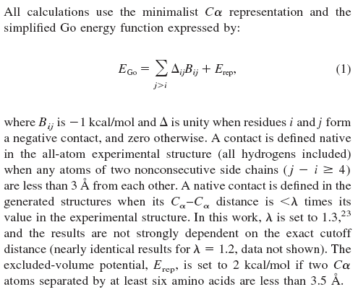
Materials and methods
Simplified Energy Function

Slide 20
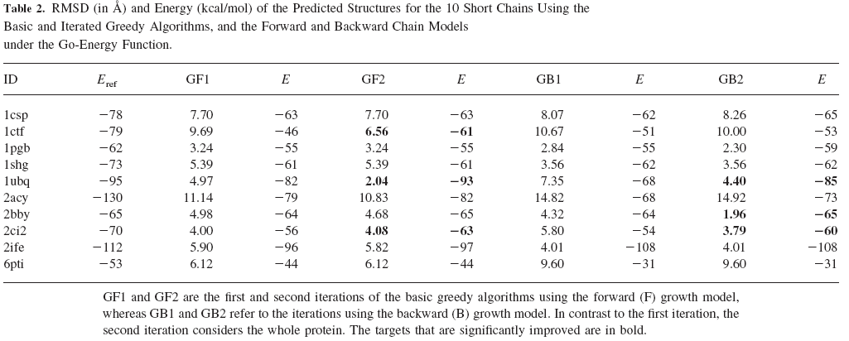
Results

Slide 21
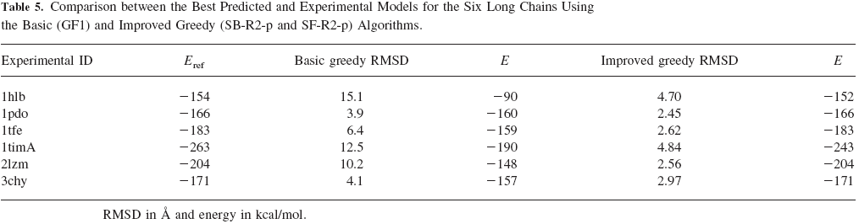
Results

