Slide 1
Time and Space Efficient Algorithms for Constrained Sequence Alignment
Z.S. Peng and H.F. Ting
CIAA 2004, LNCS 3317, pp. 237–246, 2005.
Presenter:De-Sheng Jhan
2015/01/13

Slide 2
Abstract
In this paper, we study the constrained sequence alignment problem, which is a generalization of the classical sequence alignment problem with the additional constraint that some characters in the alignment must be positioned at the same columns. The problem finds important applications in Bioinformatics. Our major result is an O(ln²)-time and O(ln)-space algorithm for constructing an optimal constrained alignment of two sequences where n is the length of the longer sequence and l is the length of the constraint. Our algorithm matches the best known time complexity and reduces the best known space complexity by a factor of n for solving the problem. We also apply our technique to design time and space efficient heuristic and approximation algorithm for aligning multiple sequences.

Slide 3
Sequence Alignment(SA)
S = ACDCBABCBDBA, S[1..m]
S’ = BACABBCDCADA, S’[1..n]
– | A | C | D | C | B | A | B | C | B | D | B | A
B | A | C | A | B | B | C | D | C | A | D | – | A

Slide 4
Constrained Sequence Alignment(CSA)
S = ACDCBABCBDBA, S[1..m]
S’ = BACABBCDCADA, S’[1..n]
P = BAD, P[1..l ]
A | C | D | C | B | A | B | C | – | B | – | – | D | B | – | A | – | –
– | – | – | – | B | A | – | C | A | B | B | C | D | – | C | A | D | A

Slide 5
Definitions
δ (a, b) : distance of any two characters
δ (-, -) = 0
δ_{opt}(S, S’, P) : the score of an optimal CSA

Slide 6
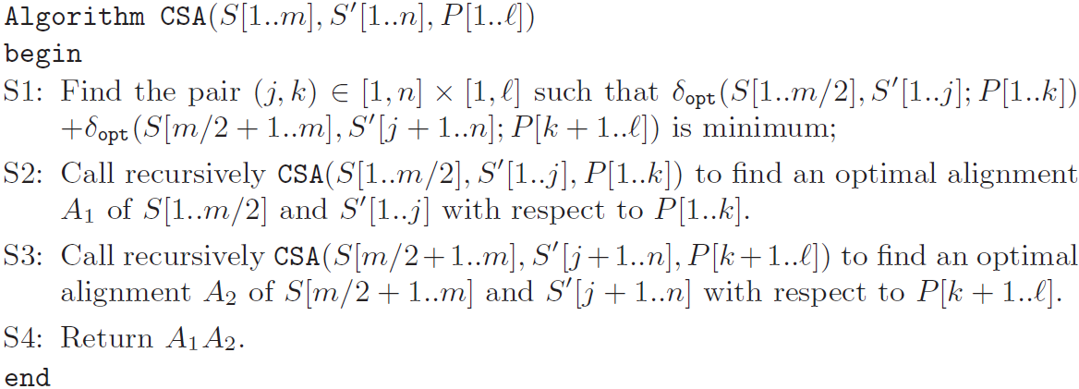
Recursive Algorithm

Slide 7
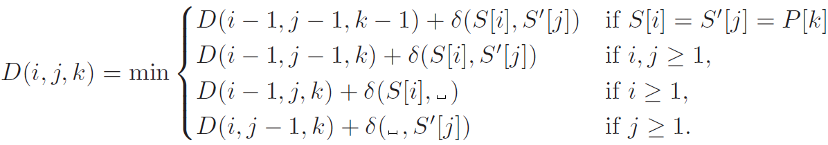
Chin et al.
D(i, j, k) = δ_{opt}(S[1..i], S’[1..j], P[1..k])

Slide 8
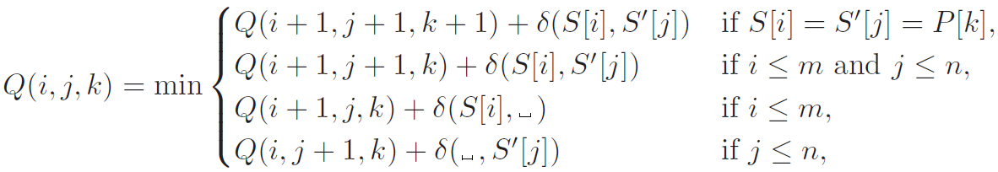
Formula
Q(i, j, k) = δ_{opt}(S[i..m], S’[j..n], P[k..l])

Slide 9
Step 1
D(i, j, k) = δ_{opt}(S[1..i], S’[1..j], P[1..k])
Q(i, j, k) = δ_{opt}(S[i..m], S’[j..n], P[k..l])
D(0, *, *), D(1, *, *),…, D(m/2, *, *) : O(lmn) time and O(ln) space
Q(m, *, *), Q(m-1, *, *), …, Q(m/2+1, *, *) : O(lmn) time and
O(ln) space

Slide 10
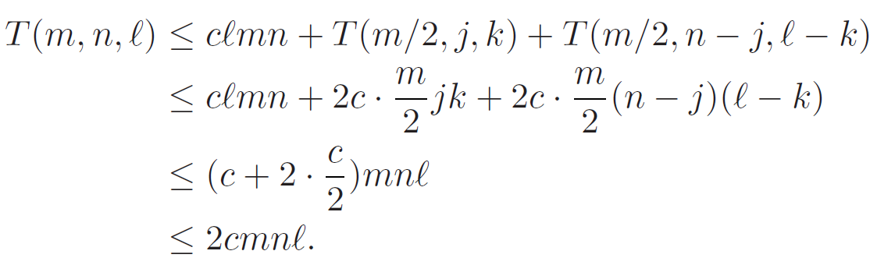
Algorithm CSA runs in O(lmn)

Slide 11
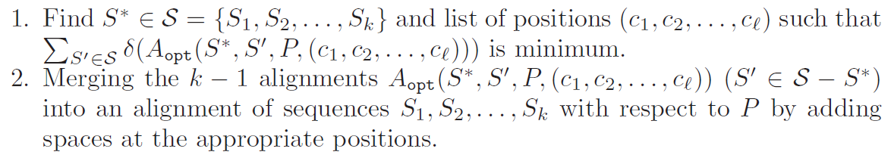
The center-star alignment approximation for CMSA
S = (S₁, S ₂,…, S _{k})

Slide 12
S₁:CCTGCTGCAG
S₂:GATGTGCCG
S₃:GATGTGCAG
S₄:CCGCTAGCAG
S₅:CCTGTAGG
P: GTG
 | S₁ | S₂ | S₃ | S₄ | S₅
S₁ | 0 | 4 | 3 | 2 | 4
S₂ | 4 | 0 | 1 | 6 | 5
S₃ | 3 | 1 | 0 | 5 | 5
S₄ | 2 | 6 | 5 | 0 | 4
S₅ | 4 | 5 | 5 | 4 | 0

Slide 13
P: GTG
S₁:CCTGCTGCAG
S₂:GATG–TGCCG
S₁:CCTGCTGCAG
S₃:GATG–TGCAG
S₁:CCTGCT–GCAG
S₄:CC–GCTAGCAG
S₁:CCTGCT–GCAG
S₅:CCTG–TAG––G
S1:CCTGCT–GCAG
S2:GATG–T–GCCG
S3:GATG–T–GCAG
S4:CC–GCTAGCAG
S5:CCTG–TAG––G

Slide 14
Reducing the Space Complexity
O(ln²) time and O(ln²) space
O(ln²) time and O(ln) space

Slide 15
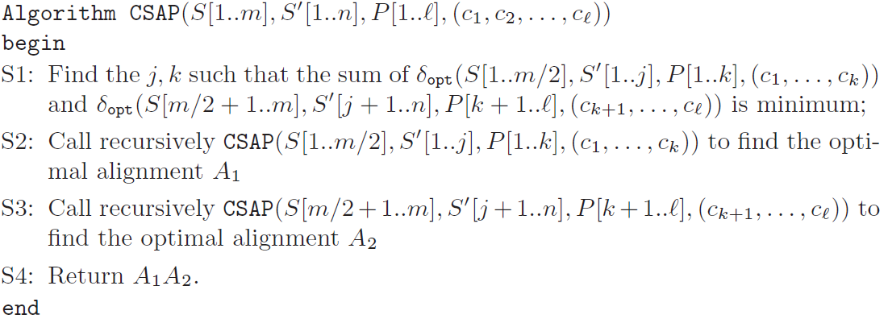
Algorithm CSAP

Slide 16
Reducing the Space Complexity
Space complexity of the Center-star algorithm from O(lk²n²) to O(lk²n).

Slide 17
Thanks for listening

