Slide 1
TANGLE: Two-Level Support Vector Regression Approach for Protein Backbone Torsion Angle Prediction from Primary Sequences
Jiangning Song, Hao Tan, Mingjun Wang,
Geoffrey I. Webb, Tatsuya Akutsu
PLoS One 2012 2;7(2):e30361. Epub 2012 Feb 2.
Presenter: Ding-Yao Huang
Date:2015/01/13

Slide 2
Abstract
Protein backbone torsion angles (Phi) and (Psi) involve two rotation angles rotating around the Ca-N bond (Phi) and the Ca-C bond (Psi). Due to the planarity of the linked rigid peptide bonds, these two angles can essentially determine the backbone geometry of proteins.
Accordingly, the accurate prediction of protein backbone torsion angle from sequence information can assist the prediction of protein structures. In this study, we develop a new approach called TANGLE (Torsion ANGLE predictor) to predict the protein backbone torsion angles from amino acid sequences.
TANGLE uses a two-level support vector regression approach to perform real-value torsion angle prediction using a variety of features derived from amino acid sequences, including the evolutionary profiles in the form of position-specific scoring matrices, predicted secondary structure, solvent accessibility and natively disordered region as well as other global sequence features.

Slide 3
Abstract
When evaluated based on a large benchmark dataset of 1,526 non-homologous proteins, the mean absolute errors (MAEs) of the Phi and Psi angle prediction are 27.8u and 44.6u, respectively, which are 1% and 3% respectively lower than that using one of the state-of-the-art prediction tools ANGLOR.
Moreover, the prediction of TANGLE is significantly better than a random predictor that was built on the amino acid-specific basis, with the p-value,1.46e-147 and 7.97e-150, respectively by the Wilcoxon signed rank test.
As a complementary approach to the current torsion angle prediction algorithms, TANGLE should prove useful in predicting protein structural properties and assisting protein fold recognition by applying the predicted torsion angles as useful restraints.
TANGLE is freely accessible at http://sunflower.kuicr.kyoto-u.ac.jp/,sjn/TANGLE/.

Slide 4
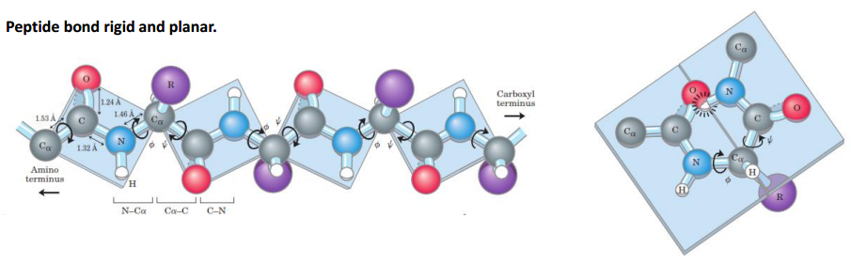
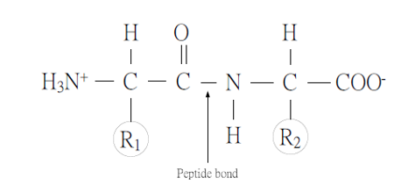
Introduction
Secondary structure
Psi
Omega
Phi

Slide 5

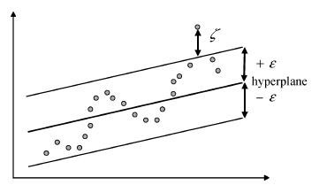
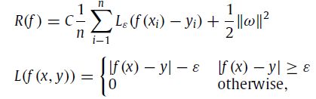

Introduction (Support Vector Regression)
x_{i} 是輸入向量，y_{i} 是實際目標值
是經驗誤差風險(empirical error risk)

Slide 6
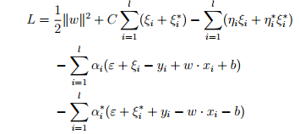
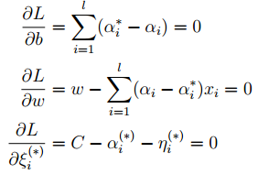

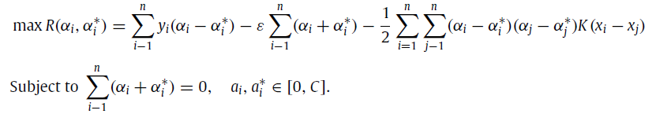
Introduction (Support Vector Regression)

Slide 7


Support Vector Regression (kernel function)
Support Vector (α_{i} − α_{i}∗ 不為零的 instances) 的個數有關
kernel function
linear: u'*v
polynomial: (gamma*u'*v + coef0)^degree
radial basis function: exp(-gamma*|u-v|^2)
sigmoid: tanh(gamma*u'*v + coef0)

Slide 8
Flow diagram of TANGLE
Protein sequence
PSI-BLAST
PSIPRED
SCRATCH
DISORDERED2
PSSM
Secondary
structure
Solvent
accessibility
Native
disorder
Sequence
length
Sequence
weight
First-stage SVR
Prediction
outputs
Second-stage SVR
Solvent accessibility
B factor
Prediction
results
Notes:
PSSM位置加權矩陣
Second structure
Solvent accessibility溶劑可接觸性
Native disorder 天然非穩定

Slide 9
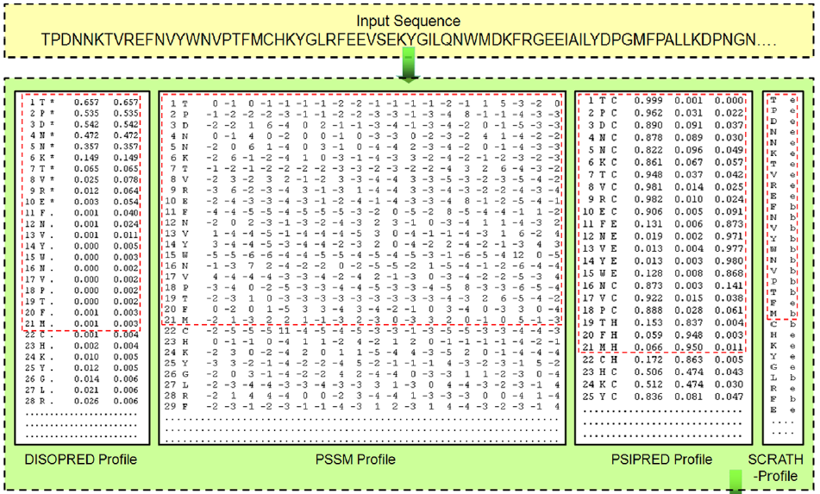
Sequence encoding schemes
20種胺基酸出現在第i個位置的可能得分
Notes:
20種胺基酸出現在第i個位置的可能得分

Slide 10
Sequence encoding schemes
預測結構穩定性
Notes:
穩定不穩定機率

Slide 11
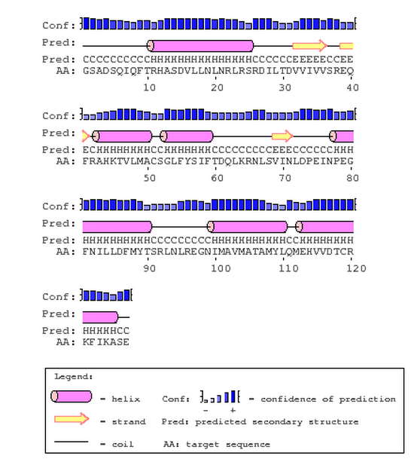
Sequence encoding schemes
helix
strand
coil
預測二級結構
溶劑可接觸性
Notes:
對於蛋白質預測的頻率

Slide 12
Sliding window

Slide 13
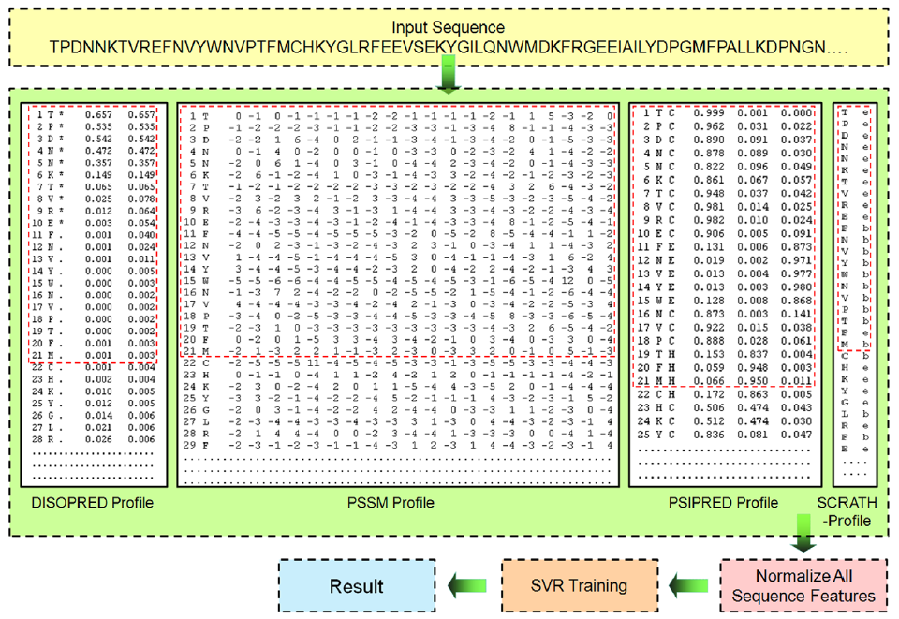

Slide 14
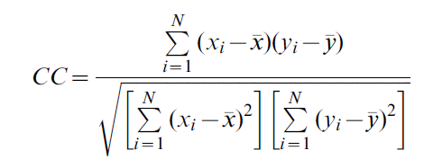
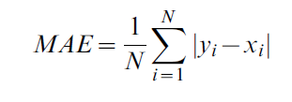
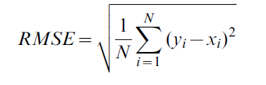
Performance Evaluation
X_{i} 是實際值
y_{i} 是預測值

Slide 15
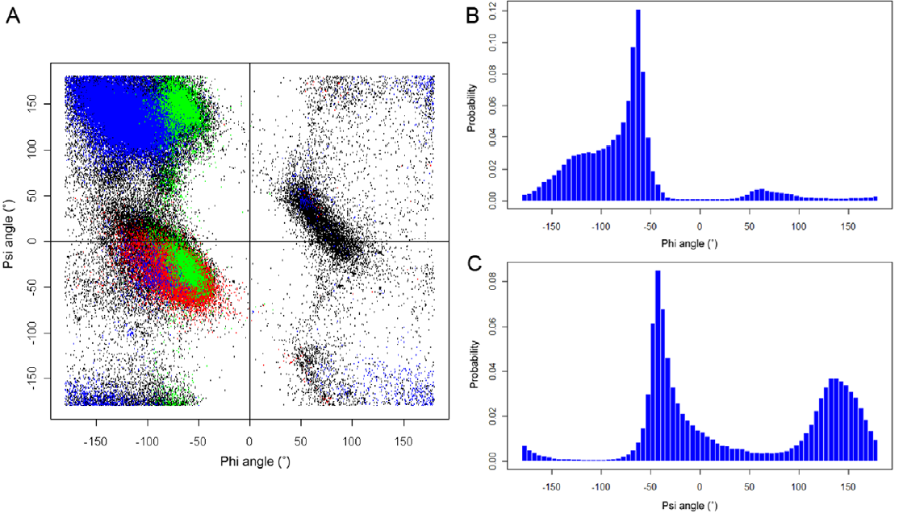
Results

Slide 16
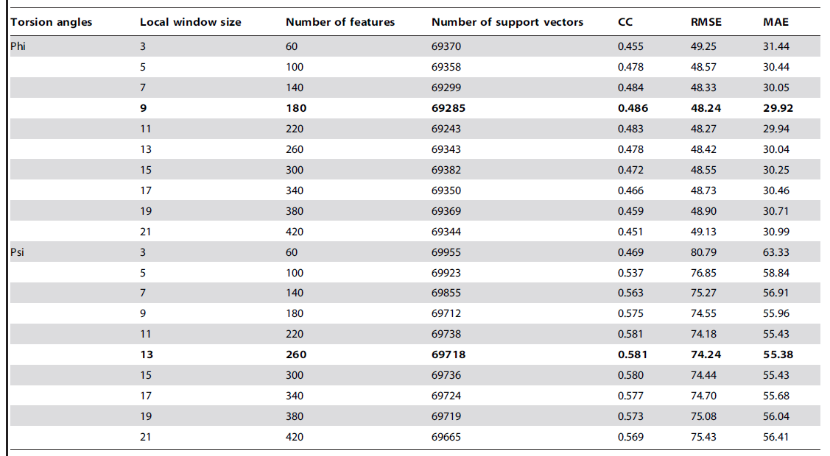
Effect of different local window size on the prediction performance

Slide 17
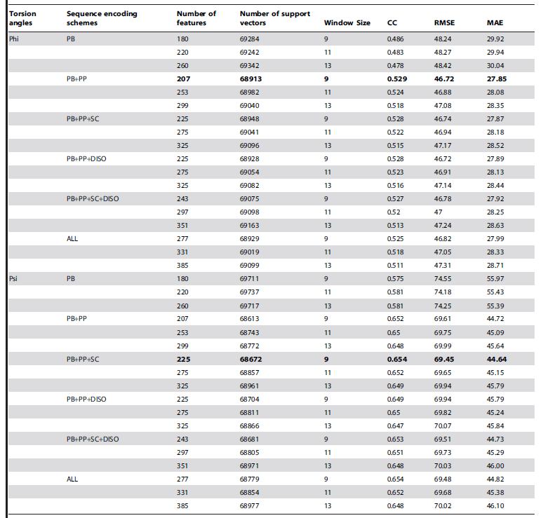
Effect of different sequence encoding schemes on the predictive performance

Slide 18
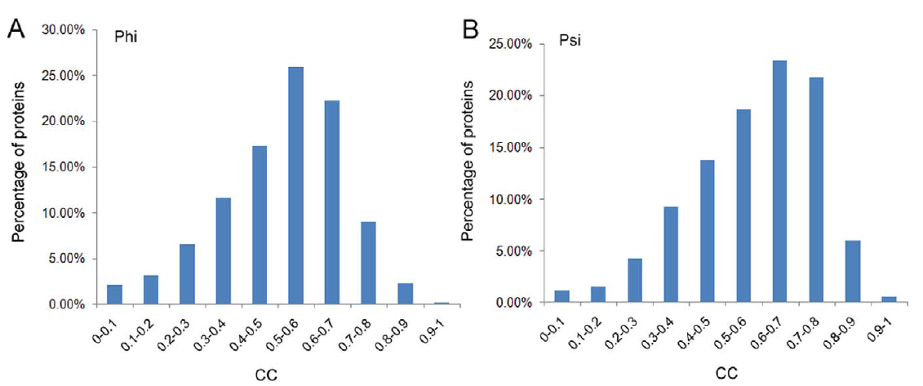
Correlation Coefficient

Slide 19
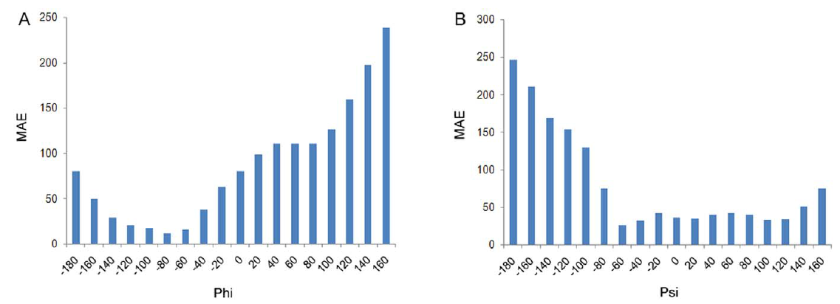
Mean Absolute Error

Slide 20
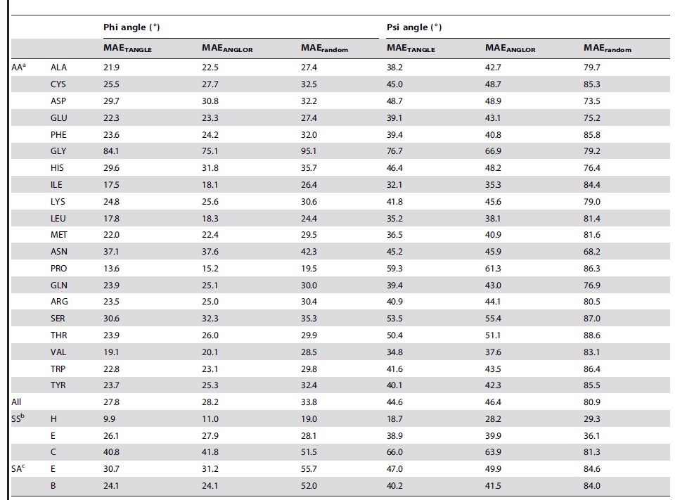

Slide 21
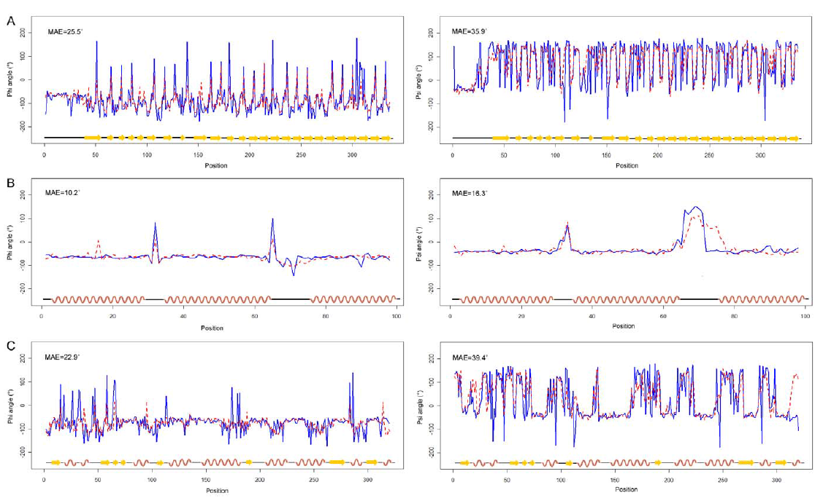

Slide 22
Conclusion
In this article, we have developed a new approach TANGLE to predict real-valued torsion angles from primary sequences by using a two-stage support vector regression approach. TANGLE used a variety of multiple sequence-derived features
Our work provides a complementary and useful approach towards the more accurate prediction of protein backbone torsion angles and complements the current torsion angle prediction algorithms
http://sunflower.kuicr.kyoto-u.ac.jp/~sjn/TANGLE/links.html

