Slide 1
Protein Backbone Reconstruction with Tool Preference Classification and Feature Selection
Student: Hsin-Chuan Yuan (袁信全)
Advisor: Prof. Chang-Biau Yang (楊昌彪)
Notes:
利用工具偏好分類與特徵選取之蛋白質骨幹重建

Slide 2
Introduction (1/4)
Protein Backbone Reconstruction Problem (PBRP)
Input: A protein sequence and its all Cα coordinates
Output: The coordinates of N, C and O atoms on the
backbone
Previous works:
SABBAC
BBQ (Backbone Building from Quadrilaterals)
Wang’s method
Chang’s method
PD2
Chen’s method
Wu’s method

Slide 3
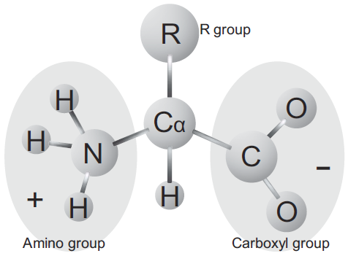
Introduction (2/4)
 | Amino Acid | Three-letter Abbreviation | One-letter Abbreviation
1 | Alanine | Ala | A
2 | Arginine | Arg | R
3 | Asparagine | Asn | N
4 | Aspartic Acid | Asp | D
5 | Cysteine | Cys | C
6 | Glutamic Acid | Glu | E
7 | Glutamine | Gln | Q
8 | Glycine | Gly | G
9 | Histidine | His | H
10 | Isoleucine | Ile | I
11 | Leucine | Leu | L
12 | Lysine | Lys | K
13 | Methionine | Met | M
14 | Phenylalanine | Phe | F
15 | Proline | Pro | P
16 | Serine | Ser | S
17 | Threonine | Thr | T
18 | Tryptophan | Trp | W
19 | Tyrosine | Tyr | Y
20 | Valine | Val | V
A protein is a consecutive chain of amino acids.
The fundamental structure of Alanine.

Slide 4
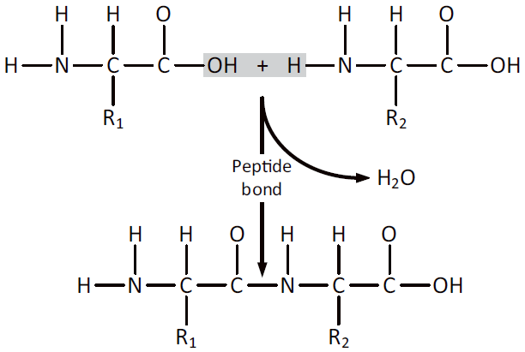
Introduction (3/4)
Peptide bond and backbone

Slide 5
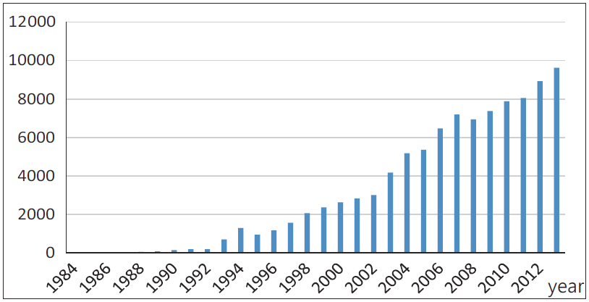
Introduction (4/4)
Critical assessment of protein structure prediction (CASP) is a world-wide experiments and contest for protein structure prediction.
Protein data bank (PDB) archive contains information about the 3D structures of proteins and nucleic acids.
The numbers of the protein structures deposited to PDB per year.

Slide 6
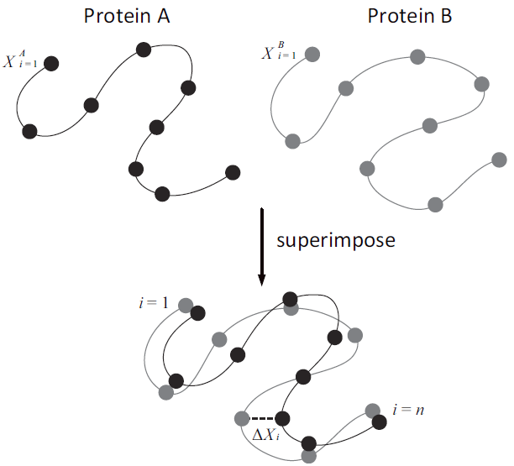
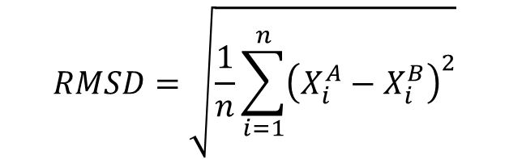
Root Mean Square Deviation (RMSD)
The RMSD is a measure of similarity between a predicted structure and a real one.
RMSD formula:
$$RMSD=\sqrt{\frac{1}{n}\sum_{i=1}^{n}{{\left(X_{i}^{A}−X_{i}^{B}\right)}^{2}}}$$

Slide 7
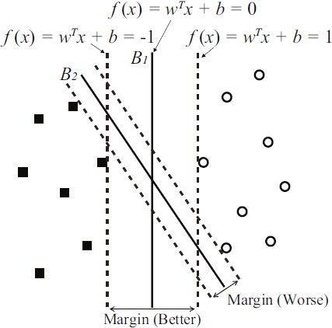
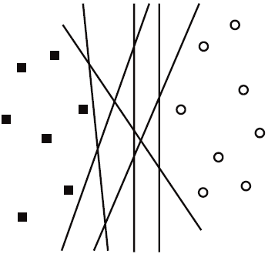
Support Vector Machine (SVM)
SVM is a supervised learning model which can be applied to classification or regression.

Slide 8
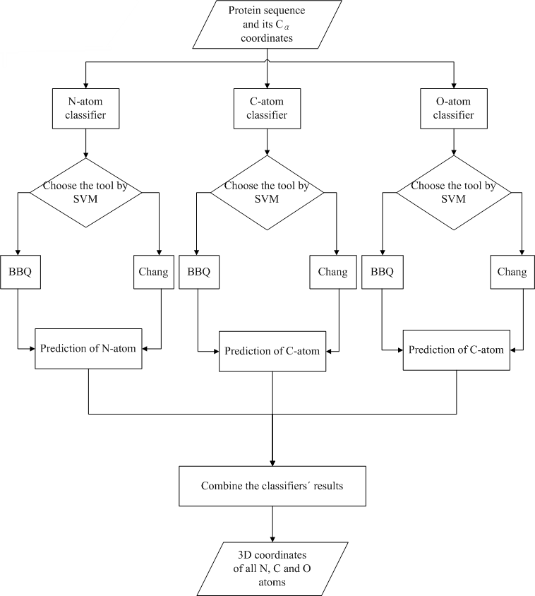
Previous Work (1/2)
Chen determines the tool to be used on N, C and O atoms of each protein.
The feature vector are derived from a coding rule which applied on the 9 common properties of amino acids of each protein.

Slide 9
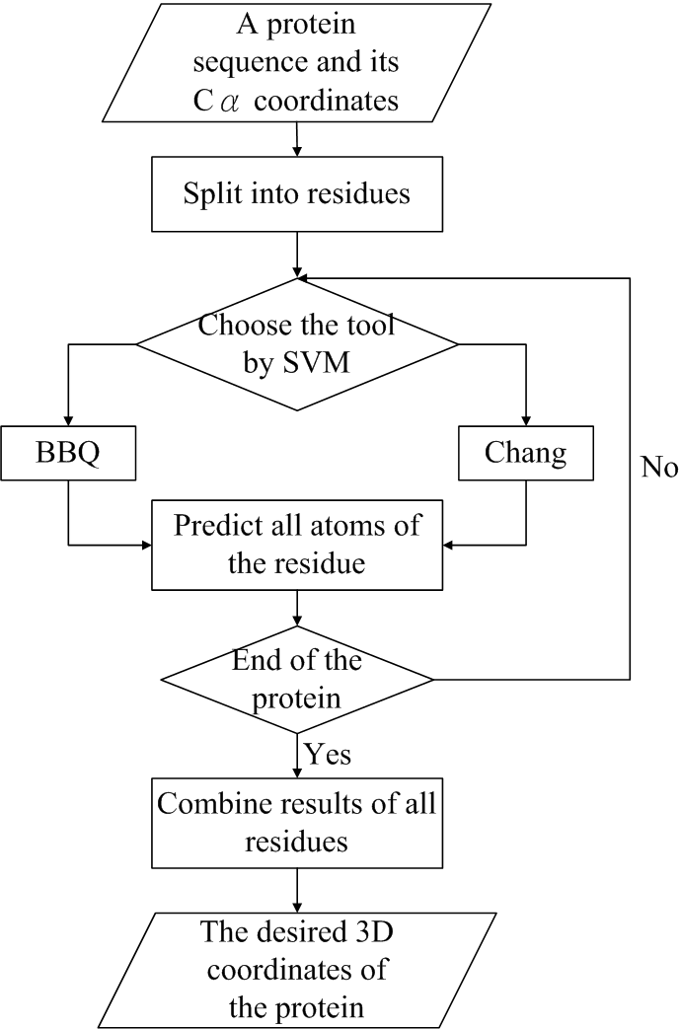
Previous Work (2/2)
Wu modified the Chen’s method.
The feature vector were derived from 13 common properties of amino acids of each protein and the properties of the adjacent amino acids.

Slide 10
Model Example
Models分別以胺基酸和原子作為擷取的依據，即20*3個models.
P₁ A:0.3, C:0.4, D:0.5, E:0.6…
E-C-D-E-C-D-D-C
Window size = 3
label | v1 | v2 | V3
0 | 0.4 | 0.5 | 0.6
1 | 0.4 | 0.5 | 0.5
0 | 0.5 | 0.5 | 0.4

Slide 11
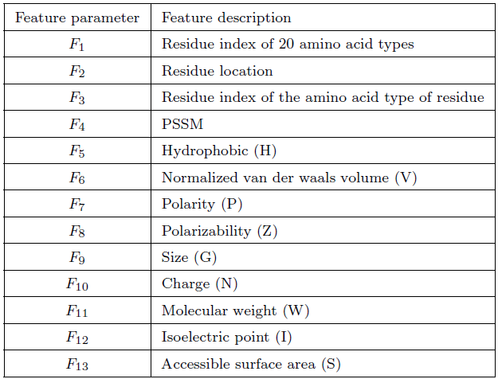
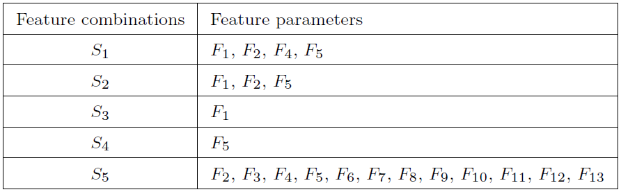
Previous Work (2/2)
Wu extracts the feature sets by 5 different combinations which are selected arbitrarily.

Slide 12
Our Method (1/5)
Our Method is based on Wu’s method which determines the tool to be used on prediction.
We aim to select significant features to obtain higher accuracy and increase the efficiency.
We further use 136 properties of amino acids (from AAindex ver.9.1) as the training features.
In order to balance the significance of each property of amino acids, we modified Wu’s method on the feature vectors by normalizing the properties.

Slide 13
AAindex example
Property A L R K N M D F C P Q S E T G W H Y I V
ANDN920101 4.35 4.17 4.38 4.36 4.75 4.52 4.76 4.66 4.65 4.44 4.37 4.5 4.29 4.35 3.97 4.7 4.63 4.6 3.95 3.95
ARGP820101 0.61 1.53 0.6 1.15 0.06 1.18 0.46 2.02 1.07 1.95 0 0.05 0.47 0.05 0.07 2.65 0.61 1.88 2.22 1.32
ARGP820102 1.18 3.23 0.2 0.06 0.23 2.67 0.05 1.96 1.89 0.76 0.72 0.97 0.11 0.84 0.49 0.77 0.31 0.39 1.45 1.08

Slide 14
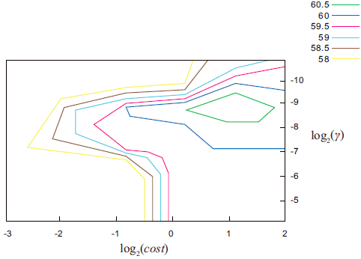
Our Method (2/5)
A grid-search technique was used to determine the best parameters, cost and γ. The two parameters were limit in 2⁻¹⁰ to 2⁻⁵ and 2⁻³ to 2², respectively.

Slide 15
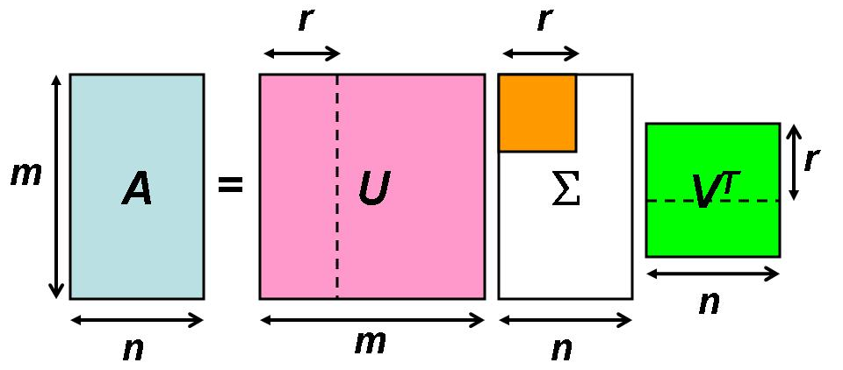
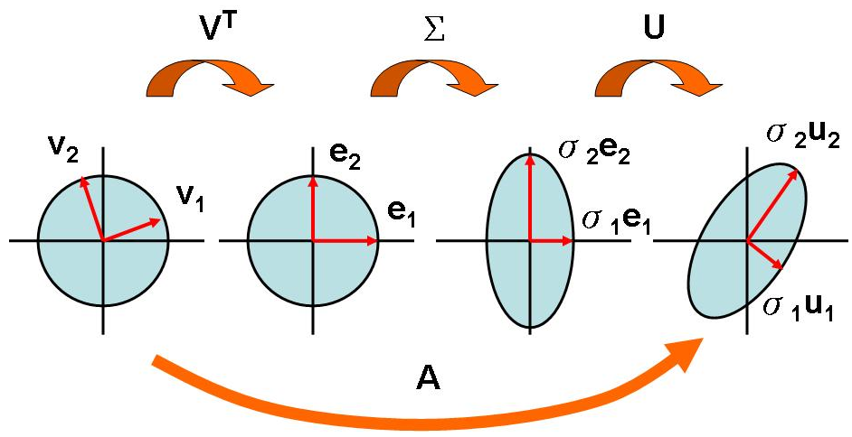
Our Method (3/5)
Singular value decomposition (SVD) is used in our method for dimensionality reduction.

Slide 16
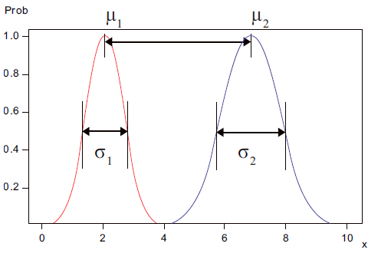
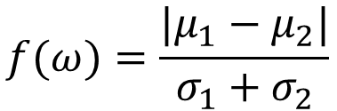
Our Method (4/5)
Fisher score measure each feature independently according to their scores under the Fisher criterion.
$$f(ω)=\frac{|μ_{1}−μ_{2}|}{σ_{1}+σ_{2}}$$

Slide 17
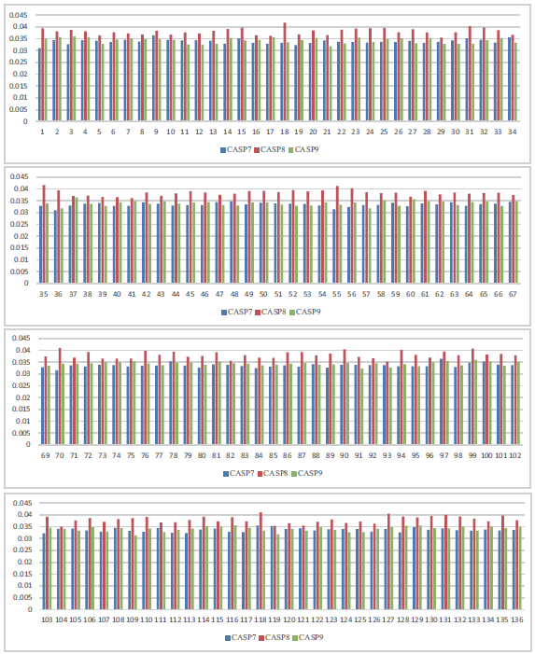
Experimental Results
The Fisher score of the 136 features for CASP7, CASP8 and CASP9.

Slide 18



Our Method (5/5)
Distance correlation is another method used to measure the statistical dependence between two vectors.
Not necessarily equal dimension.

Slide 19
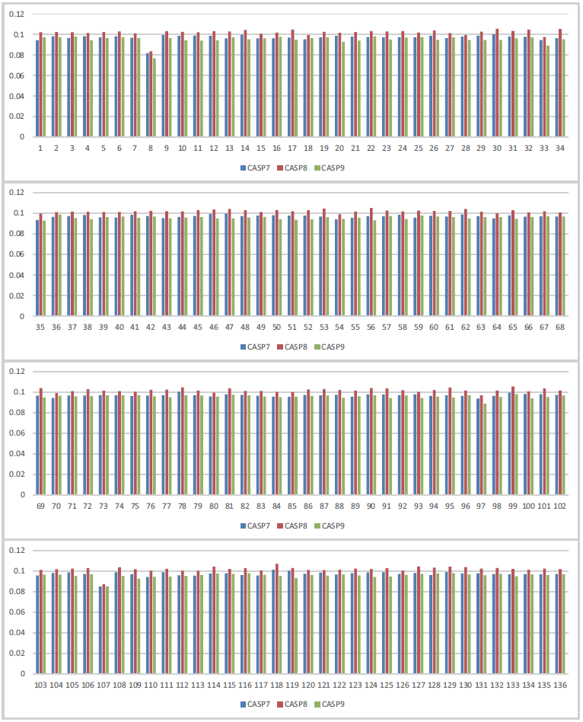
Experimental Results
The distance correlation of the 136 features in CASP7, CASP8 and CASP9.

Slide 20
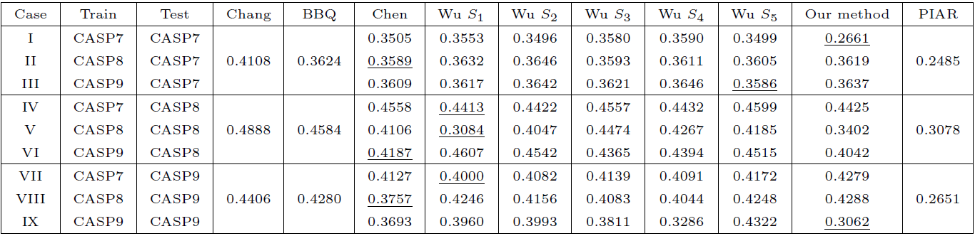
Experimental Results
We adopt Wu’s method with all of the 136 properties for predicting.

Slide 21
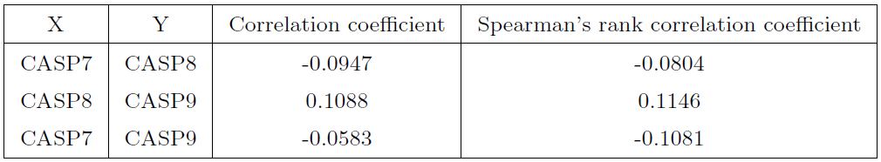
Experimental Results
The correlation coefficient and Spearman’s rank correlation coefficient between two Fisher scores in CASPs.

Slide 22
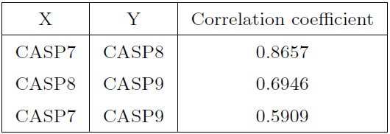
Experimental Results
The correlation coefficient between two results of distance correlation in CASPs.

Slide 23
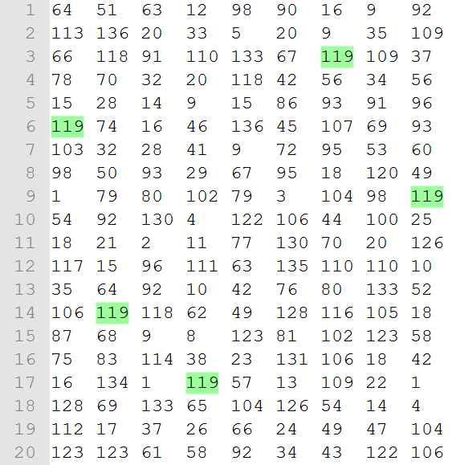
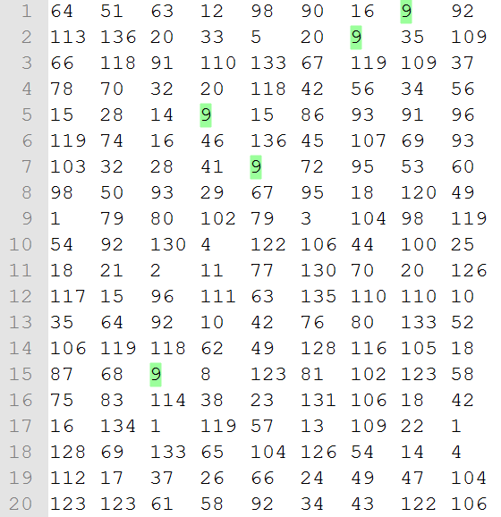
Single feature testing
訓練單一feature，觀察各feature所得出的RMSD結果
以排名選出較佳的features – Top 7 features
以case為單位做測試

Slide 24
Single feature testing
訓練單一feature，觀察各feature所得出的RMSD結果
以排名選出較佳的features – Top 7 features

Slide 25
Leave-one-protein-out
我們將目標放在自我預測， 即 CASP7 – CASP7 CASP8 – CASP8 CASP9 – CASP9 CASP10 – CASP10
在預測過程中，一次拿掉一條蛋白質資料做訓練，在將欲預測的蛋白質做測試。

Slide 26
Threshold Tuning
Leave-one-out | 7-7 | 8-8 | 9-9 | 10-10
No Thresh | 0.3584 | 0.4460 | 0.4254 | 0.3578
Thresh=0.05 | 0.3546 | 0.4442 | 0.4295 | 0.3573
Thresh=0.10 | 0.3447 | 0.4184 | 0.4226 | 0.3464
Thresh=0.20 | 0.3345 | 0.4235 | 0.4154 | 0.3437
Top 7 features
BBQ – PD2
Threshold = 0.05~0.20
針對不同的原子設定合適的Threshold
對於不同的Threshold組合，我們最後得到原子N, C門檻設為0.1，門檻設為0.15，得到較好的結果如下。
PD2 | 0.3335 | 0.4042 | 0.4096 | 0.3386
Atom O Thresh=0.15 Atom N,C Thresh=0.10 | 0.3420 | 0.4032 | 0.4089 | 0.3368
PD2
PD2
PD2
PD2

Slide 27
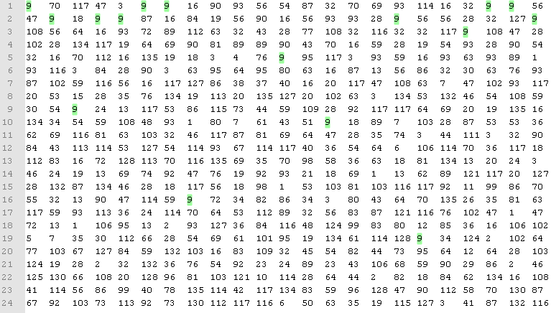
Single feature testing
排名選出較佳的features – Top 10 features
由於測試資料以胺基酸分割，所以將胺基酸為單位測試
由於之前選出的top 7 features套用在所有SVMs，我們調整為60個SVM各自選出自己的top 10 features
A C D E F G H I K L M O P Q R S T V W Y
CASP7-CASP7
Atom O Thresh=0.15 Atom N,C Thresh=0.10 | 0.34168 | 0.40119 | 0.39979 | 0.34693
PD2 | 0.3335 | 0.4042 | 0.4096 | 0.3386

Slide 28
Probability estimation
SVM –b 1
由於我們發現PD2的預測結果較好(RMSD較BBQ小)，因此利用機率預測將預測結果偏向PD2。
Threshold介於0～1
Threshold | 7-7 | 8-8 | 9-9 | 10-10
Non | 0.34168 | 0.40119 | 0.39979 | 0.34693
0.55 | 0.33544 | 0.40353 | 0.39997 | 0.34495
0.60 | 0.33391 | 0.40478 | 0.40956 | 0.33929
0.65 | 0.33396 | 0.40168 | 0.40494 | 0.34238
PD2 | 0.3335 | 0.4042 | 0.4096 | 0.3386

Slide 29
Probability estimation
New top10 features
由於之前選出的top 7 features套用在所有SVMs，我們調整為60個SVM各自選出自己的top 10 features
parameters | 7-7 | 8-8 | 9-9 | 10-10
NC=0.1, O=0.15, -b 0 | 0.34168 | 0.40119 | 0.39979 | 0.34693
PD2 | 0.3335 | 0.4042 | 0.4096 | 0.3386

Slide 30
Window size
Parameters NC=0.1, O=0.15, -b 0 | 7-7 | 8-8 | 9-9 | 10-10
Window size = 25 | 0.34168 | 0.40119 | 0.39979 | 0.34693
Window size = 13 | 0.33871 | 0.40215 | 0.39847 | 0.34367
Window size = 7 | 0.34084 | 0.40366 | 0.39706 | 0.34453
PD2 | 0.3335 | 0.4042 | 0.4096 | 0.3386

Slide 31
The Behavior-Knowledge Space Method
使用三種不同分類器，彼此之間預測結果相異，透過BKS修正預測結果。
C1 C2 C3 | 訓練集 |  | 測試集
0 0 0 | 250 | 11 | 2 | 7
0 0 1 | 13 | 17 | 0 | 0
0 1 0 | 118 | 2 | 0 | 0
0 1 1 | 32 | 12 | 2 | 3
1 0 0 | 15 | 16 | 5 | 1
1 0 1 | 3 | 127 | 1 | 0
1 1 0 | 16 | 8 | 1 | 3
1 1 1 | 8 | 270 | 4 | 2

Slide 32
The Behavior-Knowledge Space Method and Experimental Results
 | 7-7 | 8-8 | 9-9 | 10-10
PSSM, Top10, WU (features set) | 0.3465 | 0.43562 | 0.42217
PSSM, Top10, Btm10 (features set) | 0.34625 | 0.44081 | 0.41811 | 0.3522
SVM KERNEL=0(linear) | 0.35249 | 0.428 | 0.40849 | 0.34544
SVM KERNEL=1(polynomial) | 0.34745 | 0.4288 | 0.40551
SVM KERNEL=3(sigmoid) | 0.3546 | 0.42699 | 0.42847
SVM KERNEL=0, 1, 2(radial basis) | 0.34819 | 0.42697 | 0.41235 | 0.3572
WEKA, SVM | 0.34387 | 0.42528 | 0.40828 | 0.35993
WEKA | Method 1 | Method 2
CASP7 | rules.PART | rules.ZeroR
CASP8 | meta.AttributeSelectedClassifier | meta.RandomCommittee
CASP9 | meta.AttributeSelectedClassifier | meta.FilteredClassifier
CASP10 | meta.RandomCommittee | trees.RandomForest

Slide 33
Conclusions and Future Work

