Slide 1
An Algorithm for Computing the Invariant Distance from Word Position
Sergio Luján-Mora, Universitat d’Alacant
Technical report. June 2000.
http://www.dlsi.ua.es/~slujan/files/idwp.ps
Presenter: Chan-Yi Chou
Date: 2015/02/04

Slide 2
Abstract
There are many problems involving string matching. The string matching bases in a number of similarity or distance measures, and many of them are special cases or generalizations of the Levenshtein distance. In this paper, we focus on the problem of evaluating an invariant distance from word position between two strings: e.g., the strings “Universidad de Alicante” and “Alicante, Universidad de” refer to the same concept, so the distance ought to be low, in order to consider them as very similar strings.

Slide 3
Levenshtein Distance
兩字串X、Y，長度分別為m與n，Levenshtein Distance要求的是使用最少的editing operation，使得X轉換為Y。
三種基本的editing operation：
Insertion
Deletion
Substitution
這篇論文中的每個operation都假設為cost 1
利用dynamic programming可以完成計算

Slide 4
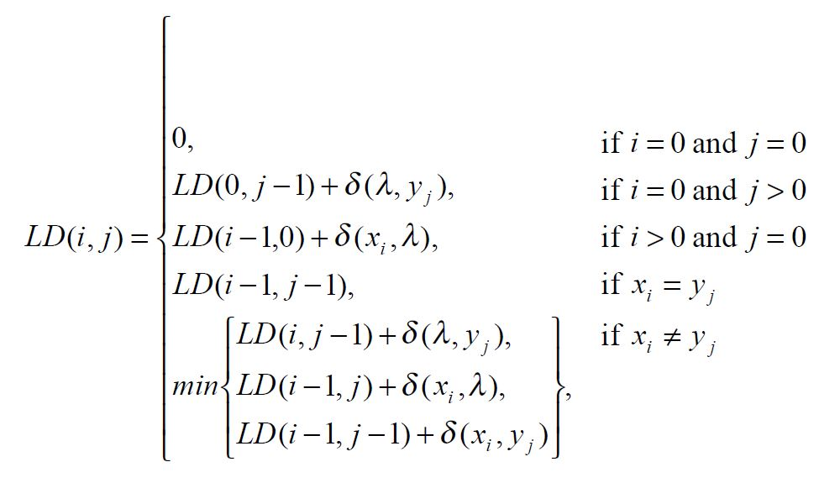
Example
X = sitting
Y = kitten
 |  | k | i | t | t | e | n
 | 0 | 1 | 2 | 3 | 4 | 5 | 6
s | 1 | 1 | 2 | 3 | 4 | 5 | 6
i | 2 | 2 | 1 | 2 | 3 | 4 | 5
t | 3 | 3 | 2 | 1 | 2 | 3 | 4
t | 4 | 4 | 3 | 2 | 1 | 2 | 3
i | 5 | 5 | 4 | 3 | 2 | 2 | 3
n | 6 | 6 | 5 | 4 | 3 | 3 | 2
g | 7 | 7 | 6 | 5 | 4 | 4 | 3
Levenshtein Distance = 3

Slide 5
IDWP
S: Ciencias, Universidad de Valencia
T: Universitat de València, Ciències
單字相似，但順序不同
Length of S and T are both 33
Levenshtein Distance of S and T = 22
改變字句的紀錄方式，以單字為單位，將標點符號移除，並皆改為小寫。
S可改寫成：ciencias universidad de valencia
T可改寫成：universitat de valencia ciencies

Slide 6
IDWP
T S | 0 | 1 | 2 | 3 | 4
0 | 0 | 11 | 2 | 8 | 8
1 | 8 | 7 | 7 | 4 | 1
2 | 11 | 2 | 11 | 10 | 9
3 | 2 | 10 | 0 | 7 | 7
4 | 8 | 8 | 8 | 0 | 5
S：ciencias universidad de valencia
T：universitat de valencia ciencies
算出每個word對應時的edit distance
第一行與第一列填對應的word長度

Slide 7
IDWP
T S | 0 | 1 | 2 | 3 | 4
0 | 0 | 11 | 2 | 8 | 8
1 | 8 | 7 | 7 | 4 | 1
2 | 11 | 2 | 11 | 10 | 9
3 | 2 | 10 | 0 | 7 | 7
4 | 8 | 8 | 8 | 0 | 5
S：ciencias universidad de valencia
T：universitat de valencia ciencies
將edit distance為0的部分
標記為配對完成，
接下來的過程中不考慮這些word

Slide 8
IDWP
T S | 0 | 1 | 2 | 3 | 4
0 | 0 | 11 | 2 | 8 | 8
1 | 8 | 7 | 7 | 4 | 1
2 | 11 | 2 | 11 | 10 | 9
3 | 2 | 10 | 0 | 7 | 7
4 | 8 | 8 | 8 | 0 | 5
S：ciencias universidad de valencia
T：universitat de valencia ciencies
找出edit distance
最小的配對：branch and bound
(ciencias, universitat) +
(universidad, ciencies) = 7 + 9 = 16
IDWP = 16

Slide 9
IDWP
T S | 0 | 1 | 2 | 3 | 4
0 | 0 | 11 | 2 | 8 | 8
1 | 8 | 7 | 7 | 4 | 1
2 | 11 | 2 | 11 | 10 | 9
3 | 2 | 10 | 0 | 7 | 7
4 | 8 | 8 | 8 | 0 | 5
S：ciencias universidad de valencia
T：universitat de valencia ciencies
找出edit distance
最小的配對：branch and bound
(ciencias, ciencies) +
(universidad, universitat) = 1 + 2 = 3
IDWP = 3
若有一邊的word配對完成 還有剩下的另外一邊word，則加上 其所剩word長度即可。

Slide 10
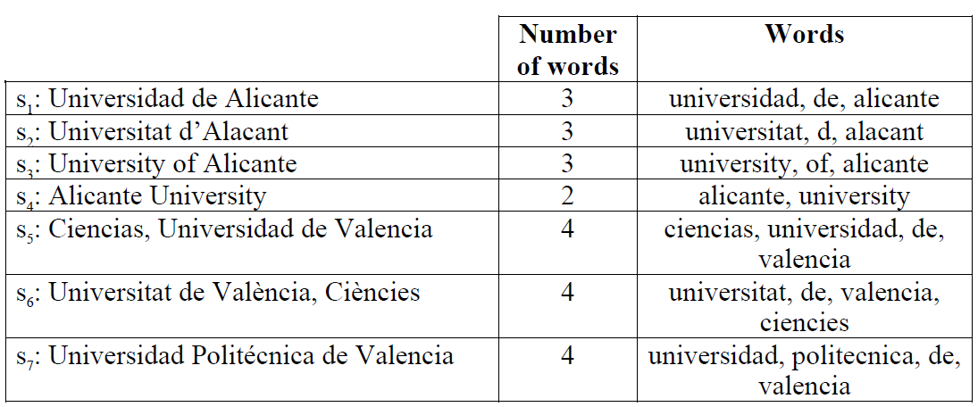
LD V.S. IDWP
 | S₁ | S₂ | S₃ | S₄ | S₅ | S₆ | S₇
S₁ | 0 | 6/5 | 5/5 | 19/5 | 17/15 | 14/17 | 19/16
S₂ |  | 0 | 7/6 | 18/5 | 20/17 | 15/15 | 21/20
S₃ |  |  | 0 | 18/2 | 22/20 | 16/19 | 21/21
S₄ |  |  |  | 0 | 23/20 | 25/19 | 28/21
S₅ |  |  |  |  | 0 | 22/3 | 16/8
S₆ |  |  |  |  |  | 0 | 19/10
S₇ |  |  |  |  |  |  | 0

