Slide 1
An Experimental Evaluation of Nearest Neighbour Time Series Classification
Anthony Bagnall and Jason Lines
arXiv:1406.4757v1 [cs.LG] 18 Jun 2014
Presenter：Guan-Cheng Guo Date：2015/2/3

Slide 2
Abstract
Data mining research into time series classification (TSC) has focussed on alternative distance measures for nearest neighbour classifiers. It is standard practice to use 1-NN with Euclidean or dynamic time warping (DTW) distance as a straw man for comparison. As part of a wider investigation into elastic distance measures for TSC, we perform a series of experiments to test whether this standard practice is valid.

Slide 3
Abstract
Specifically, we compare 1-NN classifiers with Euclidean and DTW distance to standard classifiers, examine whether the performance of 1-NN Euclidean approaches that of 1-NN DTW as the number of cases increases, assess whether there is any benefit of setting k for k-NN through cross validation whether it is worth setting the warping path for DTW through cross validation and finally is it better to use a window or weighting for DTW. Based on experiments on 77 problems, we conclude that 1-NN with Euclidean distance is fairly easy to beat but 1-NN with DTW is not, if window size is set through cross validation.

Slide 4
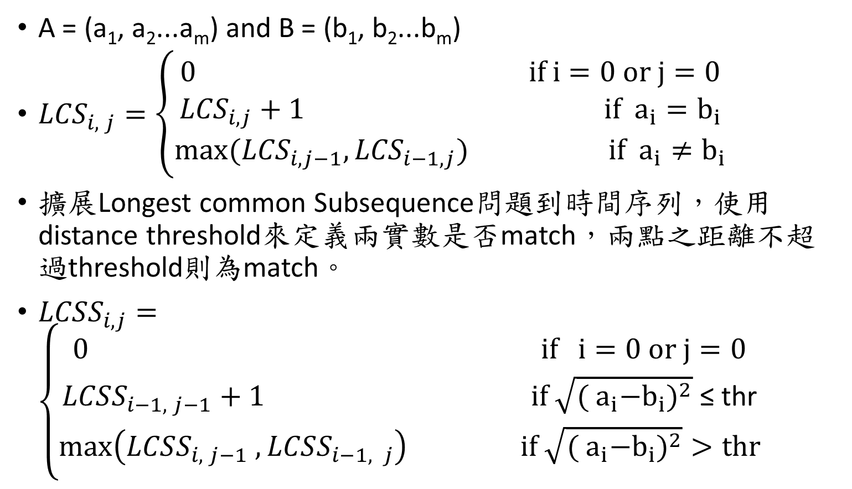
Longest common Subsequence Distance (LCSS)
A = (a₁, a₂...a_{m}) and B = (b₁, b₂...b_{m})
${LCS}_{i, j}=\left\{\begin{aligned}0 if i=0 or j=0 \\ {LCS}_{i, j}+1 if { a}_{i}=b_{i} \\ max({LCS}_{i, j−1},{LCS}_{i−1, j}) if { a}_{i}≠b_{i}\end{aligned}\right.$
擴展Longest common Subsequence問題到時間序列，使用 distance threshold來定義兩實數是否match，兩點之距離不超過threshold則為match。
${LCSS}_{i, j}=\left\{\begin{aligned}0 if i=0 or j=0 \\ {LCSS}_{i−1, j−1}+1 if \sqrt{{({ a}_{i}−b_{i})}^{2}} \text{≤ }\text{thr} \\ max\left({LCSS}_{i, j−1} ,{LCSS}_{i−1, j}\right) if \sqrt{({{ a}_{i}−b_{i})}^{2}}>thr\end{aligned}\right.$

Slide 5
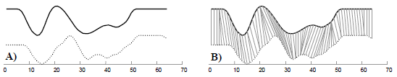

Dynamic Time Warping (DTW)
${DTW}_{i, j} =d(x_{i},y_{j})+min\left\{\begin{aligned}{DTW}_{i−1,j} \\ {DTW}_{i,j−1} \\ {DTW}_{i−1,j−1}\end{aligned}\right.$
$d is Euclidean distance$

Slide 6
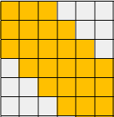
Warping Window
限制DTW的match path只能經過設定的範圍內。

Slide 7
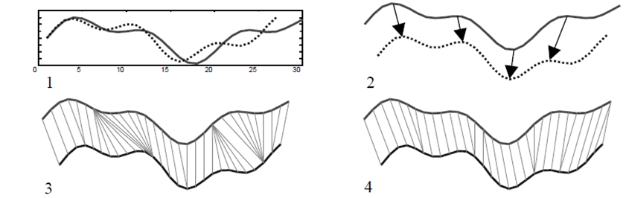

Derivative Dynamic Time Warping (DDTW)
$d\left(A_{i},B_{j}\right)⇒d′(D_{x}[A_{i}],D_{x}[B_{j}])$
$D_{X}\left[x_{i}\right]= \frac{\left(x_{i}−x_{i−1}\right)+(\frac{x_{i+1}−x_{i−1}}{2})}{2}$
$D_{X}\left[x_{i}\right]$計算$x_{i}$點附近的平均斜率，將比較距離變成比較兩點的平均斜率

Slide 8
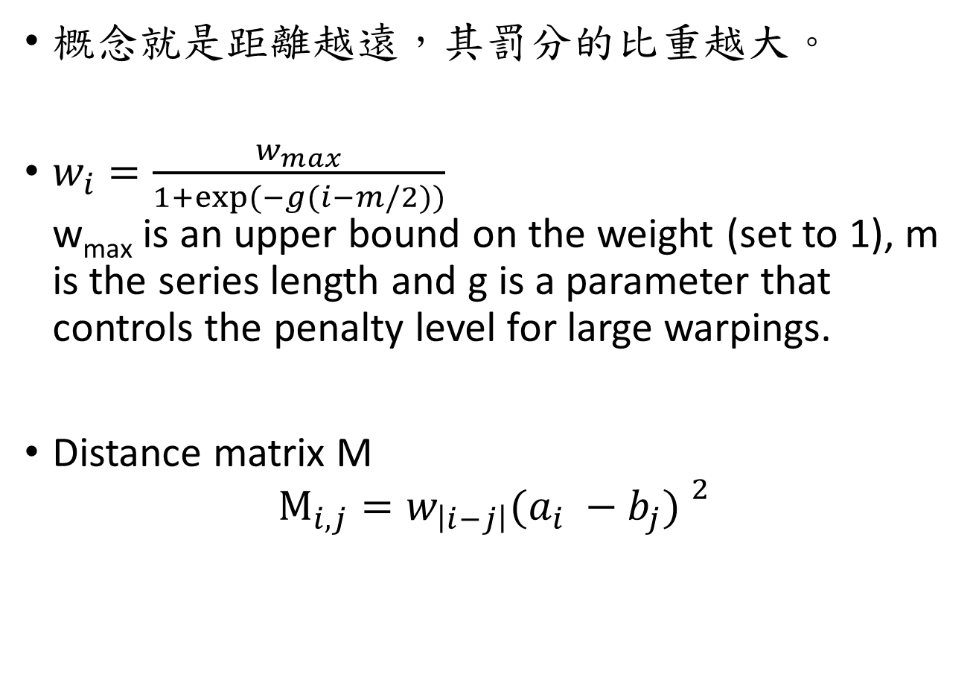
Weighted Dynamic Time Warping (WDTW)
概念就是距離越遠，其罰分的比重越大。
$w_{i}=\frac{w_{max}}{1+exp⁡(−g(i−m/2))}$ w_{max} is an upper bound on the weight (set to 1),m isthe series length and g is a parameter that controls the penaltylevel for large warpings.
Distance matrixM $M_{i,j}=w_{\left|i−j\right|}{(a_{i} −b_{j}) }^{2}$

Slide 9
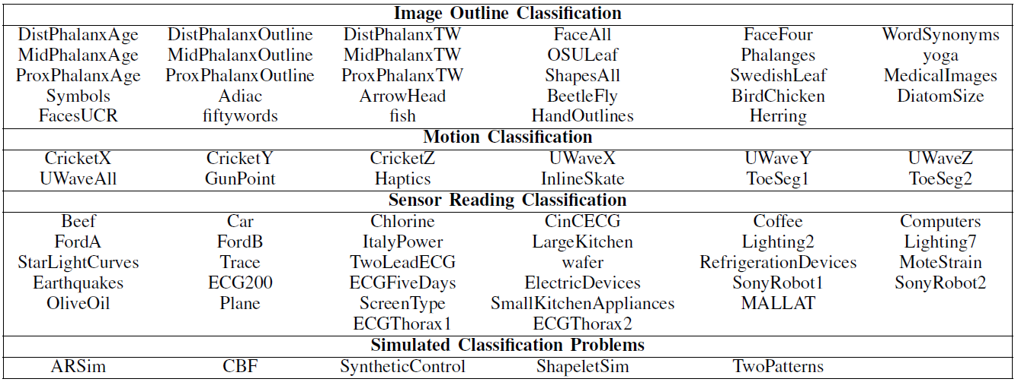
Time Series Data Set
Data sets grouped by problem type

Slide 10
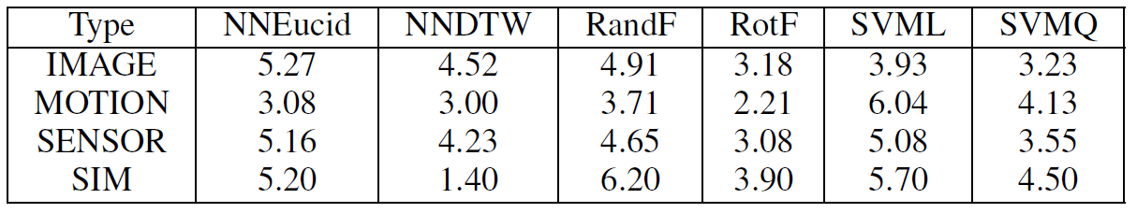
Experimental Results
Average ranks of 6 classifiers split by problem type. (1-NN Euclidean , 1-NN with DTW, Random Forest, rotation forest, linear support vector machine and quadratic support vector machine).

Slide 11
Is it worth setting k through cross validation?
We are using 7 variants of distance measure with nearest neighbour classifiers:
Euclidean (Euclid)
DTW with full warping window (DTWR1)
DTW with warping window set through cross validation (DTWRN)
Derivative DTW with full and CV set warping windows (DDTWR1 and DDTWRN)
weighted DTW and DDTW (WDTW and WDDTW)

Slide 12
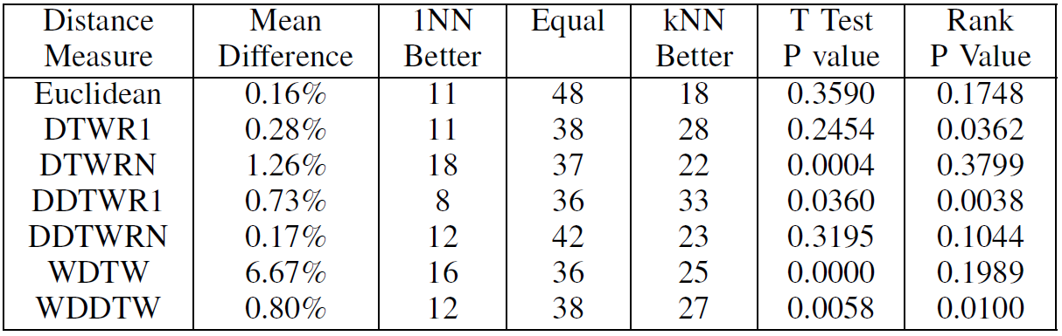
Is it worth setting k through cross validation?
Euclidean (Euclid), DTW with full warping window (DTWR1), DTW with warping window set through cross validation (DTWRN), Derivative DTW with full and CV set warping windows (DDTWR1 and DDTWRN) weighted DTW and DDTW (WDTW and WDDTW).
Summary statistics on the difference in accuracy between 1-nn and k-nn classifiers. The final two columns give the p value for a paired two sample t test for difference in means and a Wilcoxon signed-rank test for difference in Medians.

Slide 13
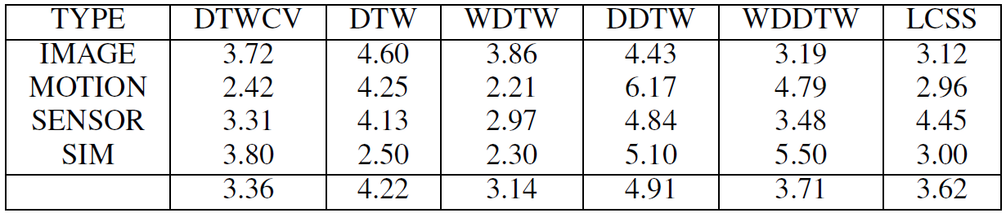
Experimental Results
LCSS performs well on the motion data and image, but ranks poorly on sensor.
weighted and windowed DTW rank highly on motion and sensor but relatively poorly on image outlines.
Average ranks of 6 1-nn elastic measure classifiers split by problem type.

Slide 14
Conclusions
When using a NN classifier with DTW on a new problem, we would advise that it is not particularly important to set k through cross validation, but that setting the warping window size is worthwhile.
Weighting algorithm for DTW described is significantly better than DTW with a full warping window, but not significantly different to DTW with the window set through cross validation.

