Slide 1
Exemplar Longest Common Subsequence
Paola Bonizzoni, Gianluca Della Vedova, Riccardo Dondi,
Guillaume Fertin, Raffaella Rizzi, and Stephane Vialette
IEEE/ACM TRANSACTIONS ON COMPUTATIONAL BIOLOGY AND BIOINFORMATICS, VOL. 4, NO. 4, OCTOBER-DECEMBER 2007
PP.535-543
Presenter: Shian-Liang Lin

Slide 2
Abstract(1/2)
In this paper, we investigate the computational and approximation complexity of the Exemplar Longest Common Subsequence (ELCS) of a set of sequences (ELCS problem), a generalization of the Longest Common Subsequence problem, where the input sequences are over the union of two disjoint sets of symbols, a set of mandatory symbols and a set of optional symbols.

Slide 3
Abstract(2/2)
We show that different versions of the problem are APX-hard even for instances with two sequences.
Moreover, we show that the related problem of determining the existence of a feasible solution of the ELCS of two sequences is NP-hard. On the positive side, we first present an efficient algorithm for the ELCS problem over instances of two sequences where each mandatory symbol can appear in total at most three times in the sequences.
Furthermore, we present two fixed-parameter algorithms for the ELCS problem over instances of two sequences where the parameter is the number of mandatory symbols.

Slide 4
Versions of Exemplar LCS
A_{m}={a,b} A_{o}={c,e} S₁=a b c e b c a e S₂=c a b e c a b e
Problem name | Occurrences Mandatory symbols(A_{m}) | Occurrences Optional symbols(A₀) | Example
ELCS(1,≤1) | exactly 1 | at most 1 | a b e c
ELCS(1) | exactly 1 | unrestricted | a b e c e
ELCS(≥1,≤1) | at least 1 | at most 1 | a b c a e
ELCS(≥1) | at least 1 | unrestricted | a b e c a e

Slide 5
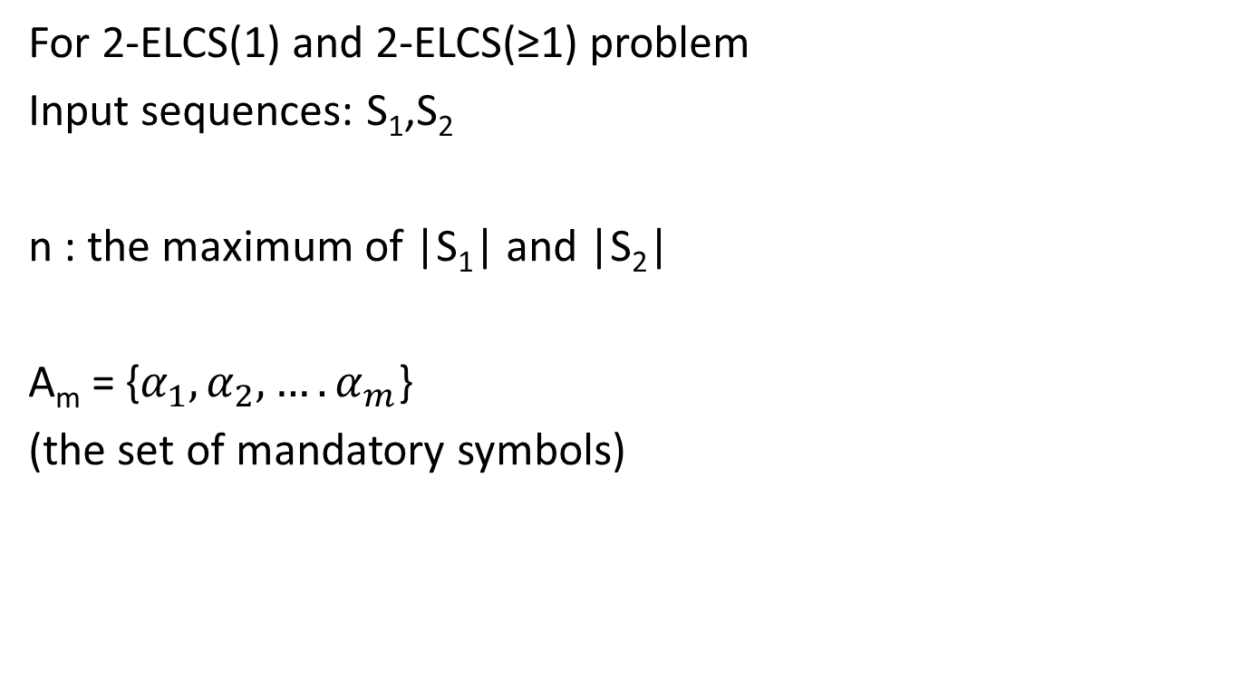
Fixed-parameter Algorithms
For 2-ELCS(1) and 2-ELCS(≥1) problem
Input sequences: S₁,S₂
n : the maximum of |S₁| and |S₂|
A_{m} = {$α_{1},α_{2},….α_{m}$}
(the set of mandatory symbols)

Slide 6
Naive Approach(1/3)
First step:
Guessing the exact ordering of all mandatory symbols in the optimal solution
Example:
A_{m}={a,b}
“ab” or “ba”
Time complexity : O(m!)

Slide 7
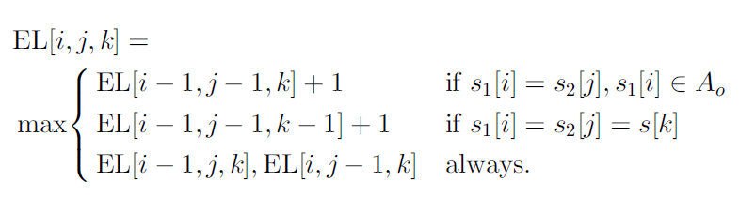
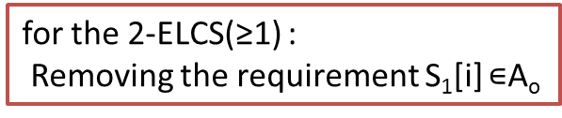
Naive Approach(2/3)
Second step(for 2ELCS(1) ):
boundary conditions:
EL[ 0, j, 0 ]=0 and EL[ i, 0, 0 ] =0
for 0 ≤ i ≤ |S₁| and 0 ≤ j ≤ |S₂|
optimal solution : In EL[|S₁| , |S₂| , |S|]
for the 2-ELCS(≥1) :
Removing the requirement S₁[i]$∊$A_{o}

Slide 8
Naive Approach(3/3)
A_{m}={a,b} A_{o}={c,e}
S₁=a b c e b c a e
S₂=c a b e c a b e
K=a b
2-ELCS(1)= a b e c e
K[1] =a |  | c | a | b | e | c | a | b | e
 |  | 1 | 2 | 3 | 4 | 5 | 6 | 7 | 8
a | 1 | 0 | 1 | 1 | 1 | 1 | 1 | 1 | 1
b | 2 | 0 | 1 | 1 | 1 | 1 | 1 | 1 | 1
c | 3 | 1 | 1 | 1 | 1 | 2 | 2 | 2 | 2
e | 4 | 1 | 1 | 1 | 2 | 2 | 2 | 2 | 3
b | 5 | 1 | 1 | 1 | 2 | 2 | 2 | 2 | 3
c | 6 | 1 | 1 | 1 | 2 | 3 | 3 | 3 | 3
a | 7 | 1 | 1 | 1 | 2 | 3 | 3 | 3 | 3
e | 8 | 1 | 1 | 1 | 2 | 3 | 3 | 3 | 4
K[2] =b |  | c | a | b | e | c | a | b | e
 |  | 1 | 2 | 3 | 4 | 5 | 6 | 7 | 8
a | 1 | 0 | 0 | 0 | 0 | 0 | 0 | 0 | 0
b | 2 | 0 | 0 | 2 | 2 | 2 | 2 | 2 | 2
c | 3 | 0 | 0 | 2 | 2 | 3 | 3 | 3 | 3
e | 4 | 0 | 0 | 2 | 3 | 3 | 3 | 3 | 4
b | 5 | 0 | 0 | 2 | 3 | 3 | 3 | 3 | 4
c | 6 | 0 | 0 | 2 | 3 | 4 | 4 | 4 | 4
a | 7 | 0 | 0 | 2 | 3 | 4 | 4 | 4 | 4
e | 8 | 0 | 0 | 2 | 3 | 4 | 4 | 4 | 5
time complexity:
O(m!n²)

Slide 9
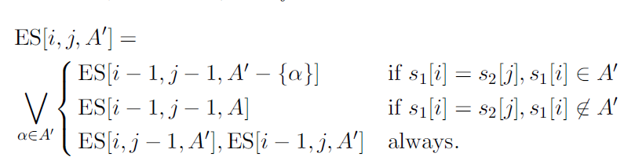
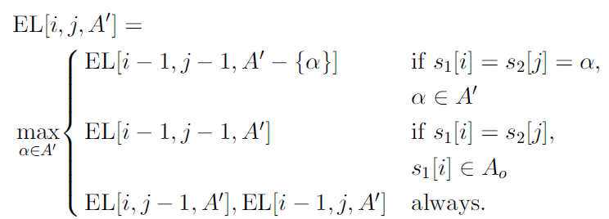
Dynamic Programming Algorithm
First step:
Computing the existence of a feasible solution of 2-ELCS by:
Second step (for 2ELCS(1) ):

Slide 10
Dynamic Programming Algorithm First step(1/2)
S₁=a b c e b c a e (1≤i≤|S₁|)
S₂=c a b e c a b e (1≤j≤|S₂|)
A_{m}={a,b} , A’ ⊆A_{m}
=>A’={a} or {b} or {a,b}
Boundary conditions
A’=∅ |  |  | c | a | b | e | c | a | b | e
 |  | 0 | 1 | 2 | 3 | 4 | 5 | 6 | 7 | 8
 | 0 | T | T | T | T | T | T | T | T | T
a | 1 | T | T | T | T | T | T | T | T | T
b | 2 | T | T | T | T | T | T | T | T | T
c | 3 | T | T | T | T | T | T | T | T | T
e | 4 | T | T | T | T | T | T | T | T | T
b | 5 | T | T | T | T | T | T | T | T | T
c | 6 | T | T | T | T | T | T | T | T | T
a | 7 | T | T | T | T | T | T | T | T | T
e | 8 | T | T | T | T | T | T | T | T | T
A’= {a} |  |  | c | a | b | e | c | a | b | e
 |  | 0 | 1 | 2 | 3 | 4 | 5 | 6 | 7 | 8
 | 0 | F | F | F | F | F | F | F | F | F
a | 1 | F | F | T | T | T | T | T | T | T
b | 2 | F | F | T | T | T | T | T | T | T
c | 3 | F | F | T | T | T | T | T | T | T
e | 4 | F | F | T | T | T | T | T | T | T
b | 5 | F | F | T | T | T | T | T | T | T
c | 6 | F | F | T | T | T | T | T | T | T
a | 7 | F | F | T | T | T | T | T | T | T
e | 8 | F | F | T | T | T | T | T | T | T
A’= {b} |  |  | c | a | b | e | c | a | b | e
 |  | 0 | 1 | 2 | 3 | 4 | 5 | 6 | 7 | 8
 | 0 | F | F | F | F | F | F | F | F | F
a | 1 | F | F | F | F | F | F | F | F | F
b | 2 | F | F | F | T | T | T | T | T | T
c | 3 | F | F | F | T | T | T | T | T | T
e | 4 | F | F | F | T | T | T | T | T | T
b | 5 | F | F | F | T | T | T | T | T | T
c | 6 | F | F | F | T | T | T | T | T | T
a | 7 | F | F | F | T | T | T | T | T | T
e | 8 | F | F | F | T | T | T | T | T | T

Slide 11
Dynamic Programming Algorithm First step(2/2)
S₁=a b c e b c a e (1≤i≤|S₁|)
S₂=c a b e c a b e (1≤j≤|S₂|)
A_{m}={a,b} , A’ ⊆A_{m}
=>A’={a} or {b} or {a,b}
A’= {a} |  |  | c | a | b | e | c | a | b | e
 |  | 0 | 1 | 2 | 3 | 4 | 5 | 6 | 7 | 8
 | 0 | F | F | F | F | F | F | F | F | F
a | 1 | F | F | T | T | T | T | T | T | T
b | 2 | F | F | T | T | T | T | T | T | T
c | 3 | F | F | T | T | T | T | T | T | T
e | 4 | F | F | T | T | T | T | T | T | T
b | 5 | F | F | T | T | T | T | T | T | T
c | 6 | F | F | T | T | T | T | T | T | T
a | 7 | F | F | T | T | T | T | T | T | T
e | 8 | F | F | T | T | T | T | T | T | T
A’= {b} |  |  | c | a | b | e | c | a | b | e
 |  | 0 | 1 | 2 | 3 | 4 | 5 | 6 | 7 | 8
 | 0 | F | F | F | F | F | F | F | F | F
a | 1 | F | F | F | F | F | F | F | F | F
b | 2 | F | F | F | T | T | T | T | T | T
c | 3 | F | F | F | T | T | T | T | T | T
e | 4 | F | F | F | T | T | T | T | T | T
b | 5 | F | F | F | T | T | T | T | T | T
c | 6 | F | F | F | T | T | T | T | T | T
a | 7 | F | F | F | T | T | T | T | T | T
e | 8 | F | F | F | T | T | T | T | T | T
A’= {a,b} |  |  | c | a | b | e | c | a | b | e
 |  | 0 | 1 | 2 | 3 | 4 | 5 | 6 | 7 | 8
 | 0 | F | F | F | F | F | F | F | F | F
a | 1 | F | F | F | F | F | F | F | F | F
b | 2 | F | F | F | T | T | T | T | T | T
c | 3 | F | F | F | T | T | T | T | T | T
e | 4 | F | F | F | T | T | T | T | T | T
b | 5 | F | F | F | T | T | T | T | T | T
c | 6 | F | F | F | T | T | T | T | T | T
a | 7 | F | F | F | T | T | T | T | T | T
e | 8 | F | F | F | T | T | T | T | T | T
a feasible solution
exist

Slide 12
Dynamic Programming Algorithm Second step(1/3)
S₁=a b c e b c a e (1≤i≤|S₁|) S₂=c a b e c a b e (1≤j≤|S₂|)
A_{m}={a,b} => A’={a} or {b} or {a,b}
LSO[j₁, j₂]: the size of an LCS with input sequences S₁ [1…j₁],
S₂ [1…j₂], where all mandatory symbols in A_{m} are removed
Example:
LSO[8,8]=4(LCO: c e c e )
LSO[4,3]=1(LCO: c)
Boundary conditions:
EL[i, j, ∅] = LSO[i, j]
EL[i, 0, A’] =-∞ and EL[0, j, A’] =-∞
(0≤i≤|S₁| and 0≤j≤|S₂| )
A’=∅ |  |  | c | a | b | e | c | a | b | e | b
 |  | 0 | 1 | 2 | 3 | 4 | 5 | 6 | 7 | 8 | 9
 | 0 | 0 | 0 | 0 | 0 | 0 | 0 | 0 | 0 | 0 | 0
a | 1 | 0 | 0 | 0 | 0 | 0 | 0 | 0 | 0 | 0 | 0
b | 2 | 0 | 0 | 0 | 0 | 0 | 0 | 0 | 0 | 0 | 0
c | 3 | 0 | 1 | 1 | 1 | 1 | 1 | 1 | 1 | 1 | 1
e | 4 | 0 | 1 | 1 | 1 | 2 | 2 | 2 | 2 | 2 | 2
b | 5 | 0 | 1 | 1 | 1 | 2 | 2 | 2 | 2 | 2 | 2
c | 6 | 0 | 1 | 1 | 1 | 2 | 3 | 3 | 3 | 3 | 3
a | 7 | 0 | 1 | 1 | 1 | 2 | 3 | 3 | 3 | 3 | 3
e | 8 | 0 | 1 | 1 | 1 | 2 | 3 | 3 | 3 | 4 | 4
b | 9 | 0 | 1 | 1 | 1 | 2 | 3 | 3 | 3 | 4 | 4
(EL[i,j, ∅])

Slide 13
Dynamic Programming Algorithm Second step(2/3)
S₁=a b c e b c a e b(1≤i≤|S₁|)
S₂=c a b e c a b e b(1≤j≤|S₂|)
A_{m}={a,b} A_{o}={c,e}
A’={a} or {b} or {a,b}
2-ELCS(1)= c e c a e b
A’=∅ |  |  | c | a | b | e | c | a | b | e | b
 |  | 0 | 1 | 2 | 3 | 4 | 5 | 6 | 7 | 8 | 9
 | 0 | 0 | 0 | 0 | 0 | 0 | 0 | 0 | 0 | 0 | 0
a | 1 | 0 | 0 | 0 | 0 | 0 | 0 | 0 | 0 | 0 | 0
b | 2 | 0 | 0 | 0 | 0 | 0 | 0 | 0 | 0 | 0 | 0
c | 3 | 0 | 1 | 1 | 1 | 1 | 1 | 1 | 1 | 1 | 1
e | 4 | 0 | 1 | 1 | 1 | 2 | 2 | 2 | 2 | 2 | 2
b | 5 | 0 | 1 | 1 | 1 | 2 | 2 | 2 | 2 | 2 | 2
c | 6 | 0 | 1 | 1 | 1 | 2 | 3 | 3 | 3 | 3 | 3
a | 7 | 0 | 1 | 1 | 1 | 2 | 3 | 3 | 3 | 3 | 3
e | 8 | 0 | 1 | 1 | 1 | 2 | 3 | 3 | 3 | 4 | 4
b | 9 | 0 | 1 | 1 | 1 | 2 | 3 | 3 | 3 | 4 | 4
A’= {a} |  |  | c | a | b | e | c | a | b | e | b
 |  | 0 | 1 | 2 | 3 | 4 | 5 | 6 | 7 | 8 | 9
 | 0
a | 1 |  |  | 0 | 0 | 0 | 0 | 0 | 0 | 0 | 0
b | 2 |  |  | 0 | 0 | 0 | 0 | 0 | 0 | 0 | 0
c | 3 |  |  | 0 | 0 | 0 | 0 | 0 | 0 | 0 | 0
e | 4 |  |  | 0 | 0 | 0 | 0 | 0 | 0 | 0 | 0
b | 5 |  |  | 0 | 0 | 0 | 0 | 0 | 0 | 0 | 0
c | 6 |  |  | 0 | 0 | 0 | 0 | 0 | 0 | 0 | 0
a | 7 |  |  | 1 | 1 | 1 | 1 | 3 | 3 | 3 | 3
e | 8 |  |  | 1 | 1 | 1 | 1 | 3 | 3 | 3 | 3
b | 9 |  |  | 1 | 1 | 1 | 1 | 3 | 3 | 3 | 3
A’= {b} |  |  | c | a | b | e | c | a | b | e | b
 |  | 0 | 1 | 2 | 3 | 4 | 5 | 6 | 7 | 8 | 9
 | 0
a | 1
b | 2 |  |  |  | 0 | 0 | 0 | 0 | 0 | 0 | 0
c | 3 |  |  |  | 0 | 0 | 0 | 0 | 0 | 0 | 0
e | 4 |  |  |  | 0 | 0 | 0 | 0 | 0 | 0 | 0
b | 5 |  |  |  | 1 | 1 | 1 | 1 | 2 | 2 | 2
c | 6 |  |  |  | 1 | 1 | 1 | 1 | 2 | 2 | 2
a | 7 |  |  |  | 1 | 1 | 1 | 1 | 2 | 2 | 2
e | 8 |  |  |  | 1 | 1 | 1 | 1 | 2 | 2 | 2
b | 9 |  |  |  | 1 | 1 | 1 | 1 | 3 | 3 | 4

Slide 14
Dynamic Programming Algorithm Second step(3/3)
S₁=a b c e b c a e b(1≤i≤|S₁|)
S₂=c a b e c a b e b(1≤j≤|S₂|)
A_{m}={a,b} A_{o}={c,e}
A’={a} or {b} or {a,b}
2-ELCS(1)= c e c a e b
A’= {a} |  |  | c | a | b | e | c | a | b | e | b
 |  | 0 | 1 | 2 | 3 | 4 | 5 | 6 | 7 | 8 | 9
 | 0
a | 1 |  |  | 0 | 0 | 0 | 0 | 0 | 0 | 0 | 0
b | 2 |  |  | 0 | 0 | 0 | 0 | 0 | 0 | 0 | 0
c | 3 |  |  | 0 | 0 | 0 | 0 | 0 | 0 | 0 | 0
e | 4 |  |  | 0 | 0 | 0 | 0 | 0 | 0 | 0 | 0
b | 5 |  |  | 0 | 0 | 0 | 0 | 0 | 0 | 0 | 0
c | 6 |  |  | 0 | 0 | 0 | 0 | 0 | 0 | 0 | 0
a | 7 |  |  | 1 | 1 | 1 | 1 | 3 | 3 | 3 | 3
e | 8 |  |  | 1 | 1 | 1 | 1 | 3 | 3 | 3 | 3
b | 9 |  |  | 1 | 1 | 1 | 1 | 3 | 3 | 3 | 3
A’= {b} |  |  | c | a | b | e | c | a | b | e | b
 |  | 0 | 1 | 2 | 3 | 4 | 5 | 6 | 7 | 8 | 9
 | 0
a | 1
b | 2 |  |  |  | 0 | 0 | 0 | 0 | 0 | 0 | 0
c | 3 |  |  |  | 0 | 0 | 0 | 0 | 0 | 0 | 0
e | 4 |  |  |  | 0 | 0 | 0 | 0 | 0 | 0 | 0
b | 5 |  |  |  | 1 | 1 | 1 | 1 | 2 | 2 | 2
c | 6 |  |  |  | 1 | 1 | 1 | 1 | 2 | 2 | 2
a | 7 |  |  |  | 1 | 1 | 1 | 1 | 2 | 2 | 2
e | 8 |  |  |  | 1 | 1 | 1 | 1 | 2 | 2 | 2
b | 9 |  |  |  | 1 | 1 | 1 | 1 | 3 | 3 | 4
A’= {a,b} |  |  | c | a | b | e | c | a | b | e | b
 |  | 0 | 1 | 2 | 3 | 4 | 5 | 6 | 7 | 8 | 9
 | 0
a | 1
b | 2 |  |  |  | 0 | 0 | 0 | 0 | 0 | 0 | 0
c | 3 |  |  |  | 0 | 0 | 0 | 0 | 0 | 0 | 0
e | 4 |  |  |  | 0 | 0 | 0 | 0 | 0 | 0 | 0
b | 5 |  |  |  | 0 | 0 | 0 | 0 | 0 | 0 | 0
c | 6 |  |  |  | 0 | 0 | 0 | 0 | 0 | 0 | 0
a | 7 |  |  |  | 0 | 0 | 0 | 1 | 1 | 1 | 1
e | 8 |  |  |  | 0 | 0 | 0 | 1 | 1 | 1 | 1
b | 9 |  |  |  | 0 | 0 | 0 | 1 | 3 | 3 | 3

Slide 15
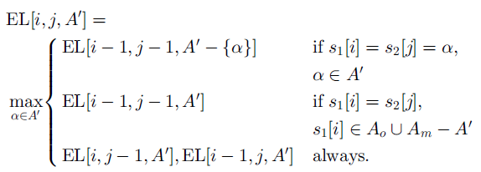
Dynamic Programming Algorithm (for 2-ELCS(≥1))
Boundary conditions:
EL[i, j, ∅] = LSO[i, j] => EL[i, j, ∅] = LSM[i, j]
LSM[j₁, j₂]: the size of an LCS with input sequences S₁ [1…j₁], S₂ [1…j₂]

Slide 16
Time complexity
Each partial solution: O(m)
Possible subsets A’⊆A_{m} are O(2^{m})
Indices i and j range : O(n²)
=>
time complexity of the algorithm is O(m2^{m}n²)

Slide 17

END

Slide 18
S₁=a b c e b c a e a b
S₂=c a b e c a b e a b
2-ELCS(1)= c e c a e b
c e c e a b
A’= {b} |  |  | c | a | b | e | c | a | b | e | a | b
 |  | 0 | 1 | 2 | 3 | 4 | 5 | 6 | 7 | 8 | 9 | 10
 | 0
a | 1
b | 2 |  |  |  | 0 | 0 | 0 | 0 | 0 | 0 | 0 | 0
c | 3 |  |  |  | 0 | 0 | 0 | 0 | 0 | 0 | 0 | 0
e | 4 |  |  |  | 0 | 0 | 0 | 0 | 0 | 0 | 0 | 0
b | 5 |  |  |  | 1 | 1 | 1 | 1 | 2 | 2 | 2 | 2
c | 6 |  |  |  | 1 | 1 | 1 | 1 | 2 | 2 | 2 | 2
a | 7 |  |  |  | 1 | 1 | 1 | 1 | 2 | 2 | 2 | 2
e | 8 |  |  |  | 1 | 1 | 1 | 1 | 2 | 2 | 2 | 2
a | 9 |  |  |  | 1 | 1 | 1 | 1 | 2 | 2 | 2 | 2
b | 10 |  |  |  | 1 | 1 | 1 | 1 | 3 | 3 | 3 | 4
A’= {a} |  |  | c | a | b | e | c | a | b | e | a | b
 |  | 0 | 1 | 2 | 3 | 4 | 5 | 6 | 7 | 8 | 9 | 10
 | 0
a | 1 |  |  | 0 | 0 | 0 | 0 | 0 | 0 | 0 | 0 | 0
b | 2 |  |  | 0 | 0 | 0 | 0 | 0 | 0 | 0 | 0 | 0
c | 3 |  |  | 0 | 0 | 0 | 0 | 0 | 0 | 0 | 0 | 0
e | 4 |  |  | 0 | 0 | 0 | 0 | 0 | 0 | 0 | 0 | 0
b | 5 |  |  | 0 | 0 | 0 | 0 | 0 | 0 | 0 | 0 | 0
c | 6 |  |  | 0 | 0 | 0 | 0 | 0 | 0 | 0 | 0 | 0
a | 7 |  |  | 1 | 1 | 1 | 1 | 3 | 3 | 3 | 3 | 3
e | 8 |  |  | 1 | 1 | 1 | 1 | 3 | 3 | 3 | 3 | 3
a | 9 |  |  | 1 | 1 | 1 | 1 | 3 | 3 | 3 | 4 | 4
b | 10 |  |  | 1 | 1 | 1 | 1 | 3 | 3 | 3 | 4 | 4
A’= {a,b} |  |  | c | a | b | e | c | a | b | e | a | b
 |  | 0 | 1 | 2 | 3 | 4 | 5 | 6 | 7 | 8 | 9 | 10
 | 0
a | 1
b | 2 |  |  |  | 0 | 0 | 0 | 0 | 0 | 0 | 0 | 0
c | 3 |  |  |  | 0 | 0 | 0 | 0 | 0 | 0 | 0 | 0
e | 4 |  |  |  | 0 | 0 | 0 | 0 | 0 | 0 | 0 | 0
b | 5 |  |  |  | 0 | 0 | 0 | 0 | 0 | 0 | 0 | 0
c | 6 |  |  |  | 0 | 0 | 0 | 0 | 0 | 0 | 0 | 0
a | 7 |  |  |  | 0 | 0 | 0 | 1 | 1 | 1 | 1 | 1
e | 8 |  |  |  | 0 | 0 | 0 | 1 | 1 | 1 | 1 | 1
a | 9 |  |  |  | 0 | 0 | 0 | 1 | 1 | 1 | 2 | 2
b | 10 |  |  |  | 1 | 1 | 1 | 1 | 1 | 3 | 3 | 4

Slide 19
Complexity of 2-ELCS(1,≤1)&2-ELCS(≥1,≤1)
=> APX-hard
Each symbol appears at most twice in each input sequence
V_{i} | Occurrences Optional symbols(A₀)
X_{i} | Mandatory symbols(A_{m})
edges | Mandatory symbols(A_{m})
L-reduction from the MAX INDEPENDENT SET problem on a cubic graph (MISC) to 2-ELCS(1,≤1)

Slide 20
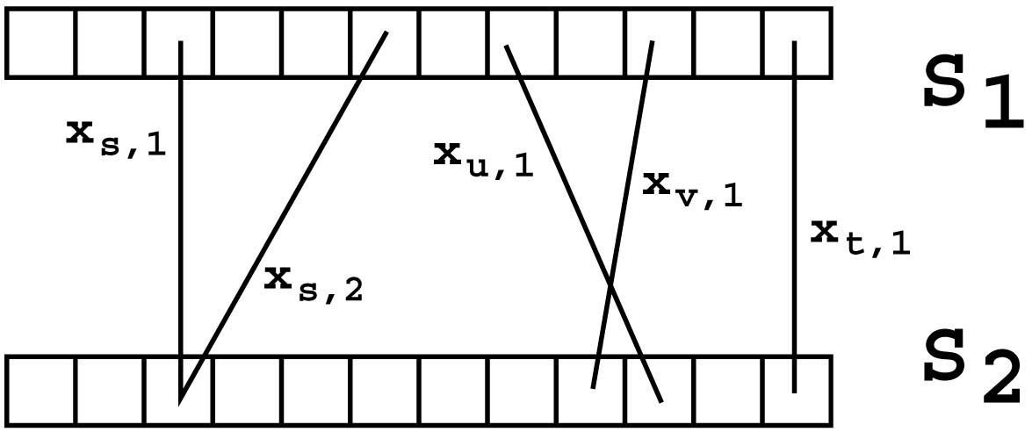
A Polynomial-Time Algorithm
each mandatory symbol appears in total at most three times in the input sequences
By reducing 2-ELCS to 2SAT

