Slide 1
Effective Sparse Dynamic Programming Algorithms for Merged and Block Merged LCS Problems
AHM Mahfuzur Rahmanª and M. Sohel Rahmanª JOURNAL OF COMPUTERS, VOL. 9, NO. 8, AUGUST 2014
Presenter:De-Sheng Jhan
2015/02/09

Slide 2
Abstract(1/3)
Abstract—The longest common subsequence problem has been widely studied and used to find out the relationship between sequences. In this paper, we study the interleaving relationship between sequences, that is, we measure the relationship among three sequences, where two of those are interleaved in different ways and then the interleaved sequences are subsequently matched with the third remaining sequence, as pairwise longest common subsequence problems. Given a target sequence T and two other sequences A and B, we need to find out the LCS between M(A, B) and T, where M(A,B) denotes the merged-sequence which consists of A and B.

Slide 3
Abstract(2/3)
We first present an improved O((Rr + Pm)loglogr) time algorithm, where we consider only the matches between sequences; here |T| = n, |A| = m and |B| = r (m≥r); R is the total number of ordered pairs of positions at which the two strings A and T match and P denotes the total number of ordered pairs of positions at which the two strings B and T match. Basing on the same idea, we also propose an improved algorithm to solve a block constrained variation of the problem. Running time of the blocked version is O(max{Rαloglog r,Pβloglogr}), where α denotes the number of blocks in A and β denotes the number of blocks in B.

Slide 4
Abstract(3/3)
However, these improved algorithms do not provide best output in every cases. Therefore we finally fabricate a hybrid algorithm which utilizes the advantages of our proposed algorithms and previous state of the arts algorithms to provide best output in every possible cases, from both time efficiency and space efficiency.

Slide 5
Merged LCS
A = a₁a₂a₃a₄ = actt, |A| = m = 4
B = b₁b₂b₃ = ctg, |B| = r = 3
T = tcatcg, |T| = n = 6
MLCS(A, B, T) = LCS (M(A, B), T)

Slide 6
Merged LCS
A = actt, B = ctg, T = tcatcg
M₁(A, B) = a₁b₁a₂b₂b₃a₃a₄ = acctgtt
M₂(A, B) = a₁a₂a₃a₄b₁b₂b₃ = acttctg
M₃(A, B) = b₁a₁b₂a₂b₃a₃a₄ = catcgtt
MLCS(A, B, T) = LCS (M₃(A, B), T) = catcg

Slide 7
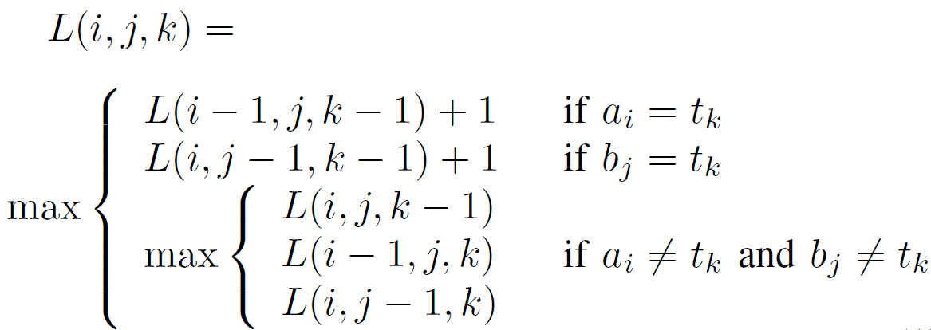
Merged LCS
L(i, j, 0) = 0, L(0, 0, k) = 0,
L(i, 0, k) = LLCS(A_{i}, T_{k}), L(0, j, k) = LLCS (B_{j}, T_{k})
O(mnr)

Slide 8
Block Merged LCS
A = A₁A₂ = ac#tt#, B = B₁B₂ = ct#g#, T = tcatcg
= A₁B₁B₂ A₂ = acctgtt
= A₁A₂B₁B₂ = acttctg
= B₁A₁A₂B₂ = ctacttg
BMLCS(A, B, T) = LCS( , T) = actg and
BMLCS(A, B, T) = LCS( , T) = ctcg

Slide 9
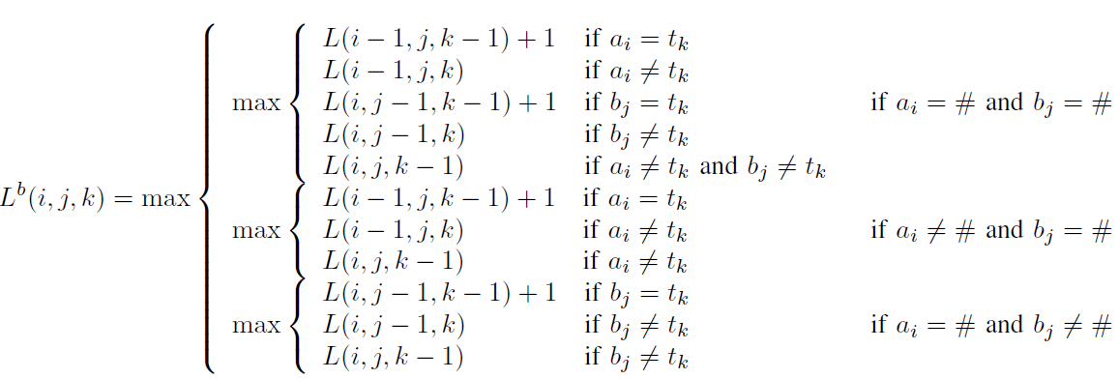
Block Merged LCS
O(n²r)

Slide 10
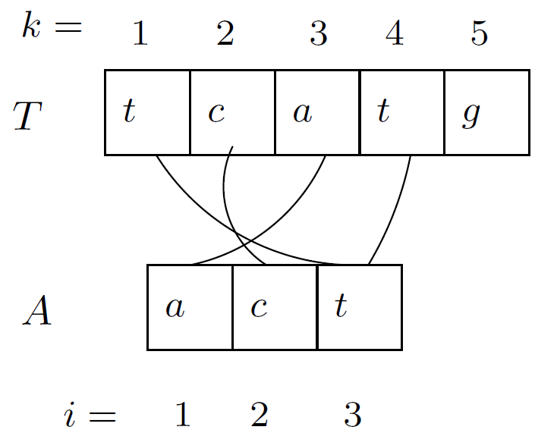
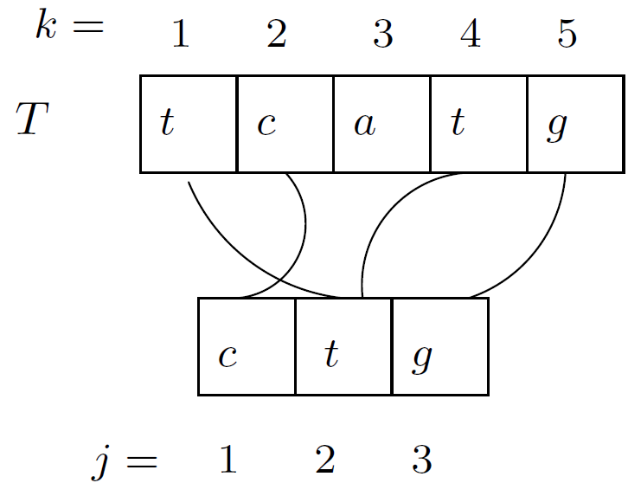
Algorithm for Merged LCS Problem
= {(i, k)|a_{i}=t_{k}, 1≦i≦|A|, 1≦k≦|T|}
= {(j, k)|b_{j}=t_{k}, 1≦j≦|B|, 1≦k≦|T|}
B
={(1, 3), (2, 2), (3, 1), (3, 4)}
={(1, 2), (2, 1), (2, 4), (3, 5)}

Slide 11
Algorithm for Merged LCS Problem
M = U
|M| = R + P , where R =| | and P = | |

Slide 12
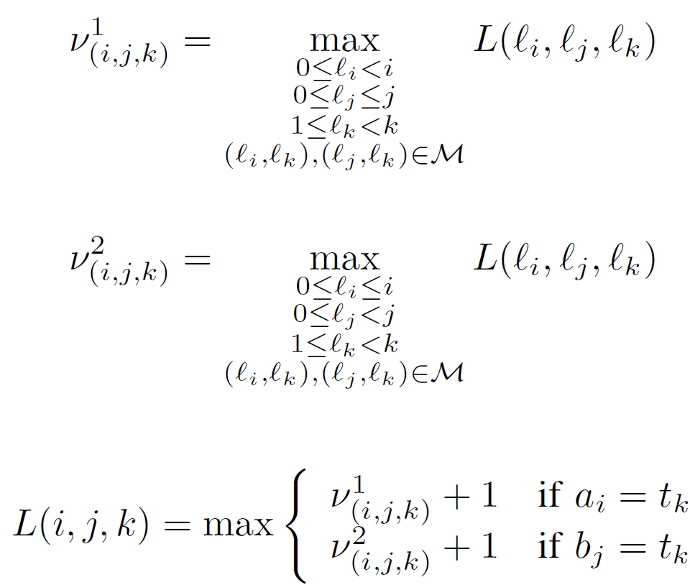
Algorithm for Merged LCS Problem

Slide 13
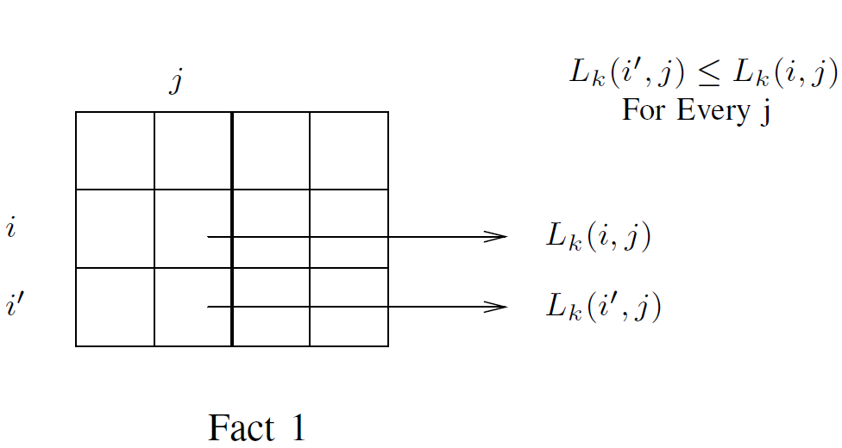
Fact
L(i, j, k) = L_{k}(i, j), 0≦k≦n

Slide 14
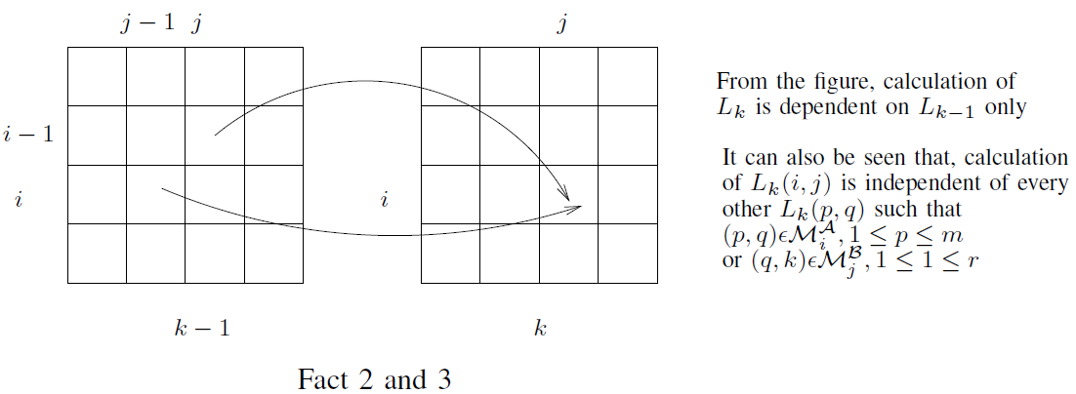

Slide 15
Bounded Heap data structure
Using van Emde Boas trees.
Insert(H, pos, val, data)
IncVal(H, pos, val, data)
BoundedMax(H, pos)
above operations in O(loglogn) amortized time.

Slide 16
Bounded Heap data structure
Each of the bounded heap, , contains values for
LCS(M(a₁a₂…a_{i}, b₀), t₁t₂…t_{k}),
LCS(M(a₁a₂…a_{i}, b₀ b₁), t₁t₂…t_{k}),
LCS(M(a₁a₂…a_{i}, b₀ b₁…b_{j}), t₁t₂…t_{k})
0 ≦j ≦r

Slide 17
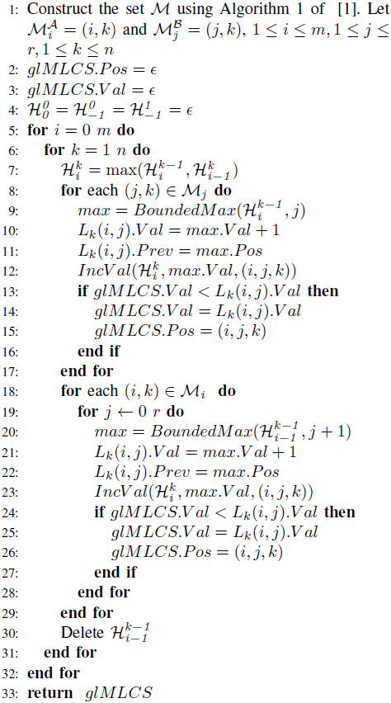
Algorithm MLCS(A, B, T)

Slide 18
Construct the set M
= {(i, k)|a_{i}=t_{k}, 1≦i≦|A|, 1≦k≦|T|}
= {(j, k)|b_{j}=t_{k}, 1≦j≦|B|, 1≦k≦|T|}
A = actt,T = tcatcg
={(1, 3), (2, 2), (3, 1), (3, 4)}
O(|A||T|)

Slide 19
Construct the set M
A = actt,T = tcatcg
L_{A}[a] = {1}, L_{T}[a] = {3}
L_{A}[c] = {2}, L_{T}[c] = {2, 5}
L_{A}[g] = {}, L_{T}[g] = {6}
L_{A}[t] = {3, 4}, L_{T}[t] = {1, 4}
={(1, 3), (2, 2), (2,5),
(3, 1), (3, 4), (4,1), (4, 4))}
We construct an Emde Boas data structure Ep
where we insert each pair(i,j), i∈L_{A}[a], j∈L_{T}[a], a∈∑
O(loglogn²) = O(loglogn) per insertion
require O(Rloglogn + n) time to compute the set

Slide 20
Construct the set M
A = aaa, B = aaa, T = aaaaaa
L_{A}[a] = {1, 2, 3}, L_{T}[a] = {1, 2, 3, 4, 5, 6}
O(loglogn) per insertion
O(R) = O(|A||T|) and O(P) = O(|B||T|) in the worst case.

Slide 21
Algorithm MLCS(A, B, T)
O((Rr + Pm)loglogr)
| |=R, | |=P
21

Slide 22
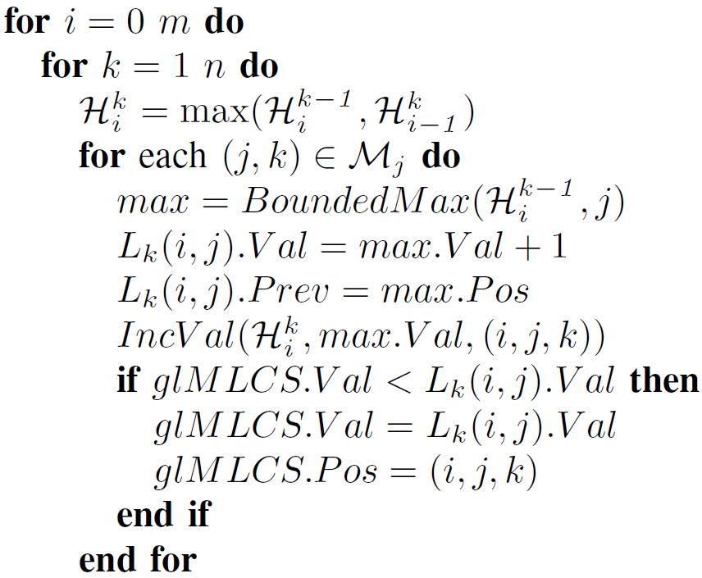
A = actt, B = ctg, T = tcatcg
={(1, 3), (2, 2), (2, 5), (3, 1), (3, 4), (4, 1), (4, 4)}
={(1, 2), (1, 5), (2, 1), (2, 4), (3, 6)}
k = 1, (2, 1) ∈
max = BoundMax( , 2) = 0
L₁(0 ,2) = 1
=
0 | 1 | 2 | 3
0 | 0 | 1 | 0

Slide 23
Algorithm MLCS(A, B, T)
O((Rr + Pm)loglogr)
| |=R, | |=P

Slide 24
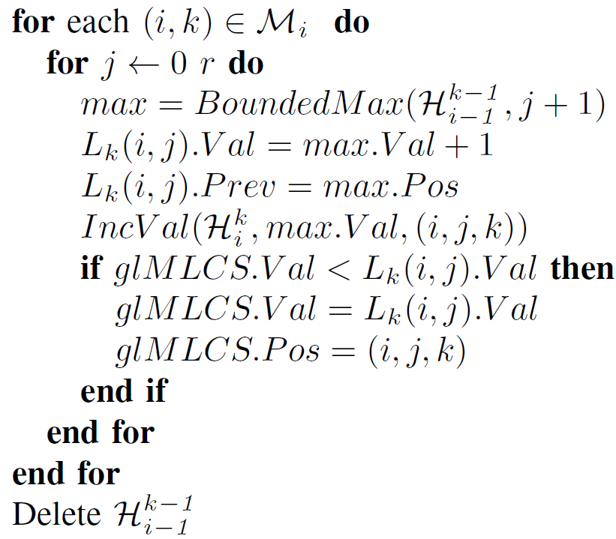
A = actt, B = ctg, T = tcatcg
={(1, 3), (2, 2), (2, 5), (3, 1), (3, 4), (4, 1), (4, 4)}
={(1, 2), (1, 5), (2, 1), (2, 4), (3, 6)}
i = 1, k = 3, (1, 3) ∈
max = BoundMax( , 1) = 0
L₃(1 ,0) = 1
=
0 | 1 | 2 | 3
1 | 0 | 0 | 0

Slide 25
Algorithm MLCS(A, B, T)
O((Rr + Pm)loglogr)
| |=R, | |=P

Slide 26
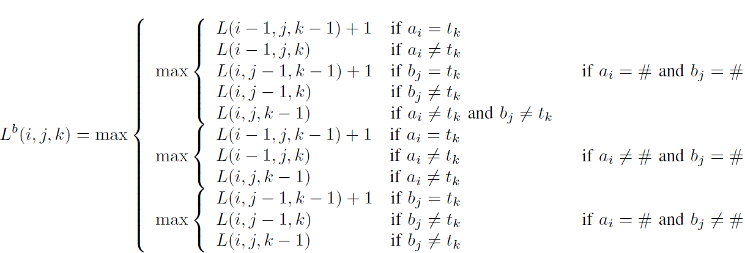
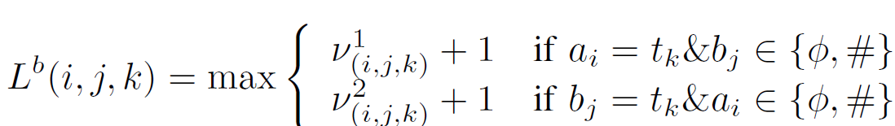
Block Merged LCS

Slide 27
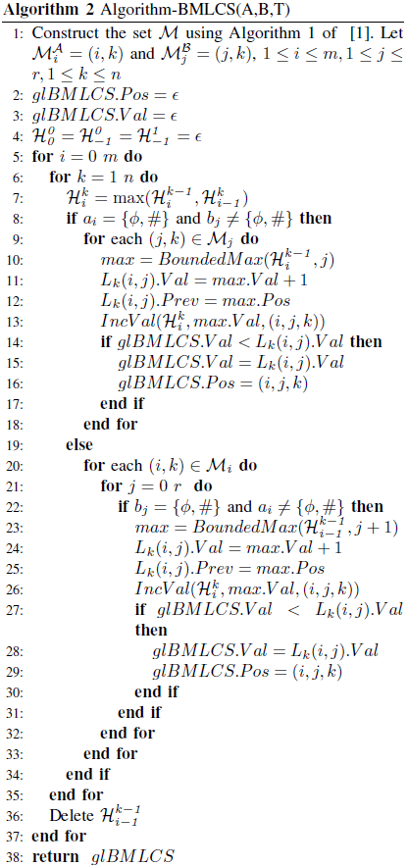
O(max{Rαloglog r,Pβloglogr})
α denotes the number of blocks in A
β denotes the number of blocks in B

Slide 28
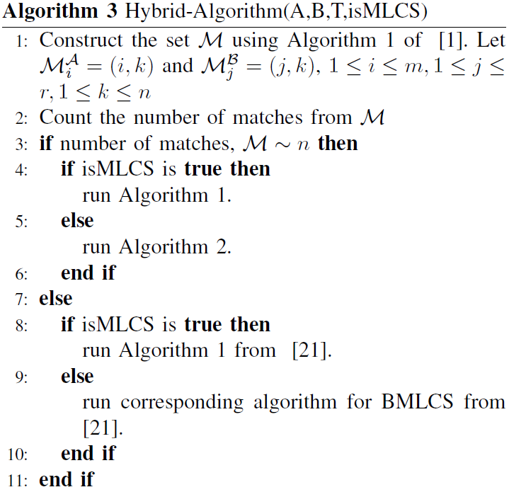
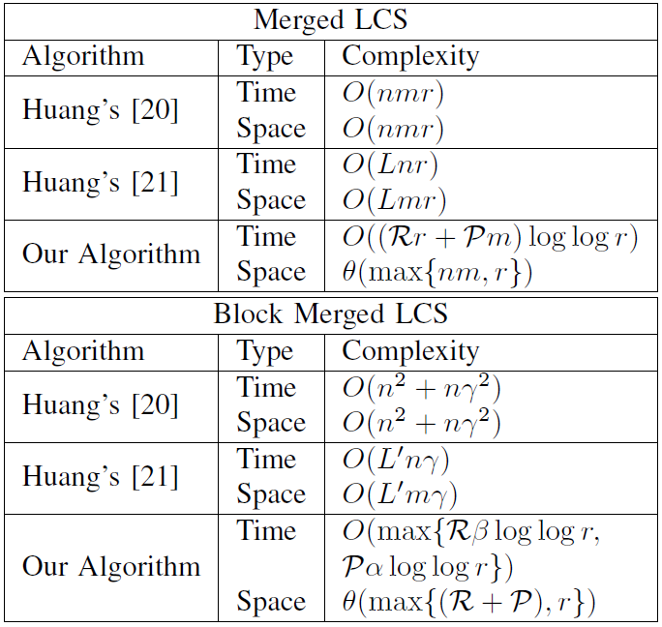
Hybrid-Algorithm
O((Rr + Pm)loglogr)
| |=R, | |=P
O(nmloglogr)

Slide 29
Thanks for listening

