Slide 1
A multiple-kernel support vector regression approach for stock market price forecasting
Chi-Yuan Yeh, Chi-Wei Huang, Shie-Jue Lee
Expert Systems with Applications 38 (2011) 2177–2186
Presenter: Ding-Yao Huang
Date:2015/02/09

Slide 2
Abstract (1/2)
Support vector regression has been applied to stock market forecasting problems. However, it is usually needed to tune manually the hyperparameters of the kernel functions.
Multiple-kernel learning was developed to deal with this problem, by which the kernel matrix weights and Lagrange multipliers can be simultaneously derived through semidefinite programming. However, the amount of time and space required is very demanding.
We develop a two-stage multiple-kernel learning algorithm by incorporating sequential minimal optimization and the gradient projection method. By this algorithm, advantages from different hyperparameter settings can be combined and overall system performance can be improved.
Notes:
Sequential minimal optimization, SMO
是一種用於解決支持向量機訓練過程中所產生優化問題的演算

Slide 3
Abstract(2/2)
Besides, the user need not specify the hyperparameter settings in advance, and trial-and-error for determining appropriate hyperparameter settings can then be avoided. Experimental results, obtained by running on datasets taken from Taiwan Capitalization Weighted Stock Index, show that our method performs better than other methods.

Slide 4
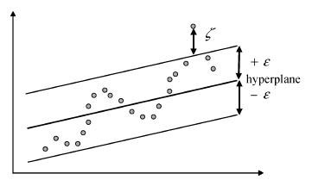

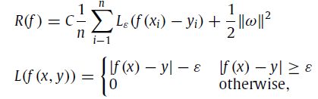

Introduction (Support Vector Regression)
Support Vector Regression 是結構誤差風險最小化原則，兼具經驗誤差風險和信賴區間雙方影響，而不是單方面求經驗誤差最小化
x_{i} 是輸入向量，y_{i} 是實際目標值
是經驗誤差風險(empirical error risk)

Slide 5
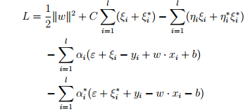
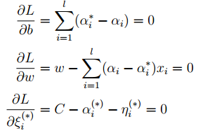

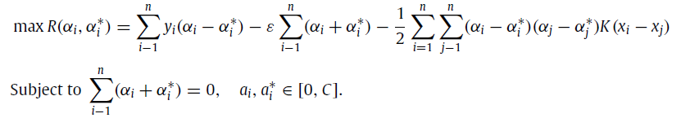
Introduction (Support Vector Regression)
對偶最大化

Slide 6


Support vector regression (kernel function)
根據Karush-Kuhn-Tucker(KKT) conditions 解b
Support Vector (α_{i} − α_{i}∗ 不為零的 instances) 的個數有關
將線性系統 轉成 非線性系統
kernel function
linear: u'*v
polynomial: (gamma*u'*v + coef0)^degree
radial basis function: exp(-gamma*|u-v|^2)
sigmoid: tanh(gamma*u'*v + coef0)

Slide 7
Multiple-kernel support vector regression
linear
polynomial
radial basis function
sigmoid
K

Slide 8
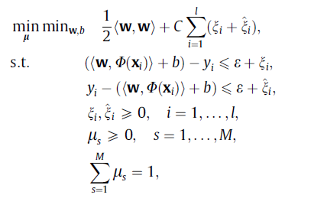


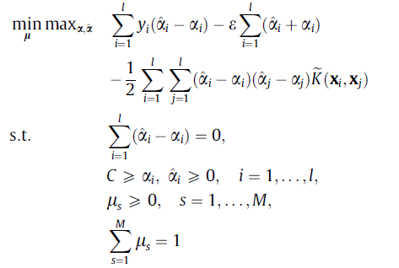
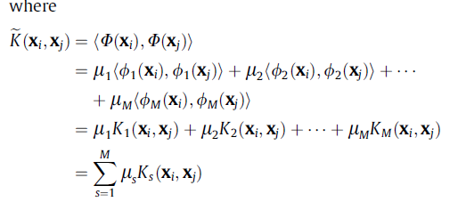

Multiple-kernel support vector regression

Slide 9
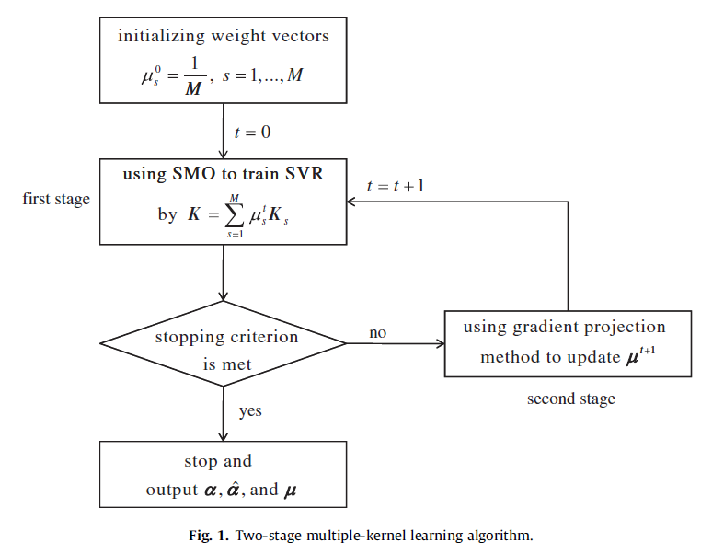
Two-stage multi-kernel learning

Slide 10
Two-stage multi-kernel learning

Slide 11
Two-stage multi-kernel learning

Slide 12
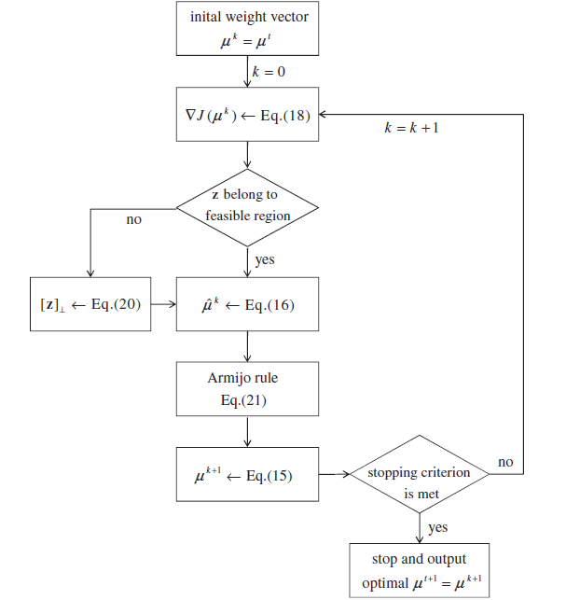
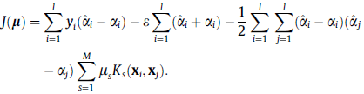

Gradient projection for multi-kernel learning

Slide 13

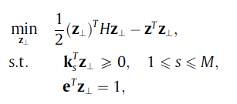
Gradient projection for multi-kernel learning

Slide 14


Gradient projection for multi-kernel learning

Slide 15
Two-stage multi-kernel learning

Slide 16
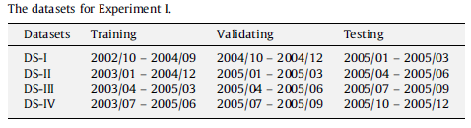
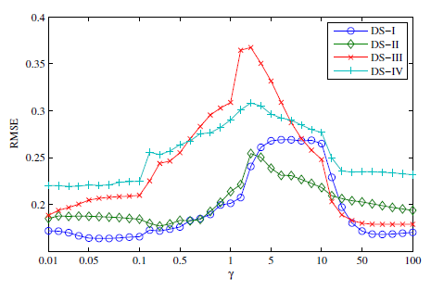


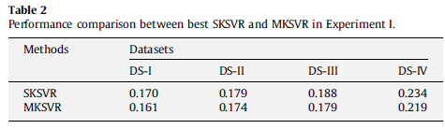


Experiment I

Slide 17
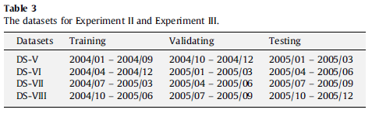

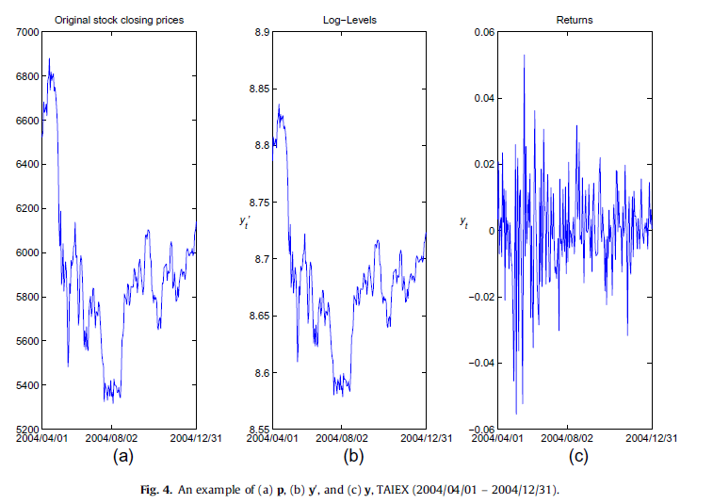
Experiment I I

Slide 18
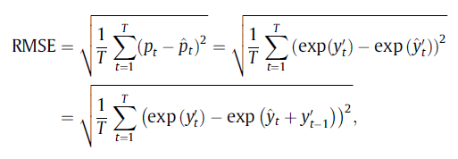
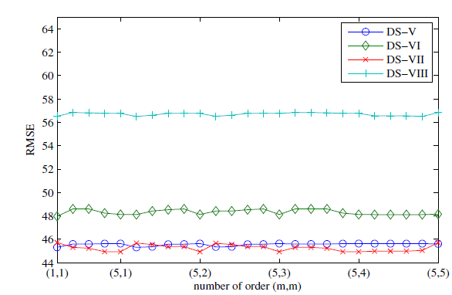
Experiment I I

Slide 19
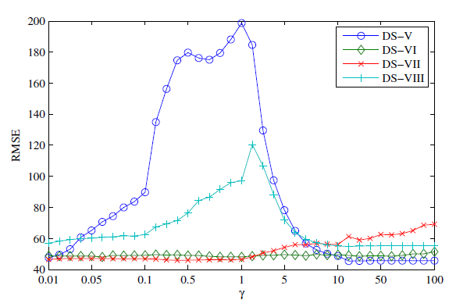
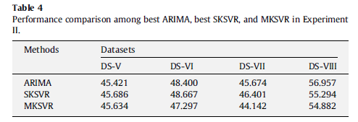
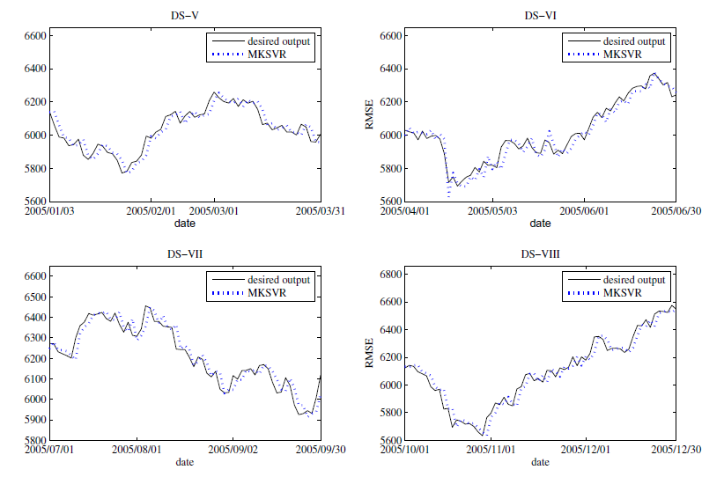

Slide 20

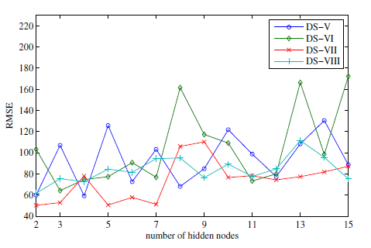



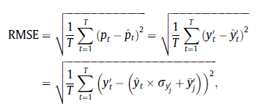
Experiment I I I

Slide 21
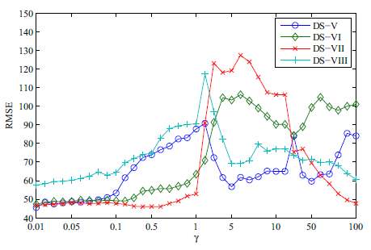
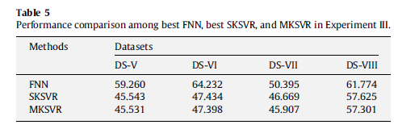
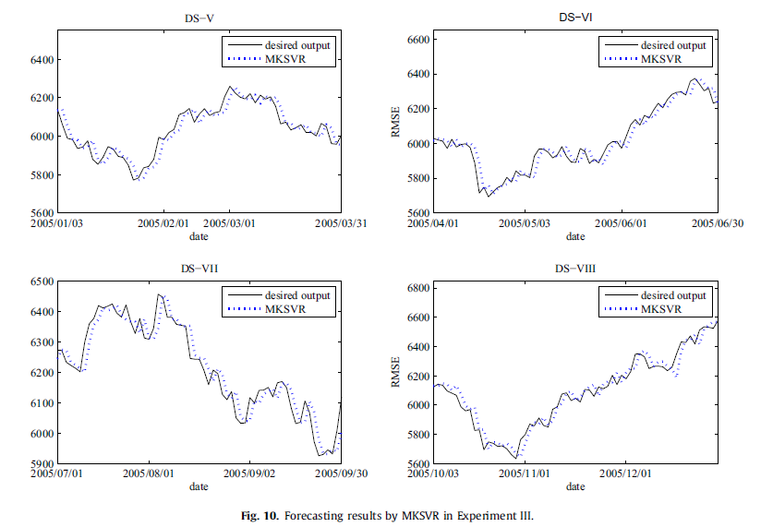

Slide 22
Conclusion
We have proposed a multiple-kernel support vector regression approach for stock market price forecasting. A two-stage multiple-kernel learning algorithm is developed to optimally combine multiple-kernel matrices for support vector regression.
The learning algorithm applies sequential minimal optimization and gradient projection iteratively to obtain Lagrange multipliers and optimal kernel weights. By this algorithm, advantages from different hyperparameter settings can be combined and overall system performance can be improved.
Besides, the user need not specify the hyperparameter settings in advance, and trial-and-error for determining appropriate hyperparameter settings can then be avoided.
Experimental results, obtained by running on datasets taken from Taiwan Capitalization Weighted Stock Index, have shown that our method performs better than other methods.

