Slide 1
Color-Based Image Salient Region Segmentation Using Novel Region Merging Strategy
Yu-Hsin Kuan, Chung-Ming Kuo, and Nai-Chung Yang
IEEE TRANSACTIONS ON MULTIMEDIA, VOL. 10, NO. 5, pp. 832-845, AUGUST 2008
Presenter: Tsai-Ming Sun
Date:2015/2/9

Slide 2
Abstract
In this paper, we propose a novel unsupervised algorithm for the segmentation of salient regions in color images. There are three phases in this algorithm. In the first phase, we use nonparametric density estimation to extract candidates of dominant colors in an image, which are then used for the quantization of the image. The label map of the quantized image forms initial regions of segmentation. In the second phase, we define salient region with two properties; i.e., conspicuous; compact and complete. According to the definition, two new parameters are proposed. One is called “Importance index”, which is used to measure the importance of a region, and the other is called “Merging likelihood”, which is utilized to measure the suitability of region merging. Initial regions are merged based on the two new parameters. In the third phase, a similarity check is performed to further merge the surviving regions. Experimental results show that the proposed method achieves excellent segmentation performance for most of our test images. In addition, the computation is very efficient.

Slide 3
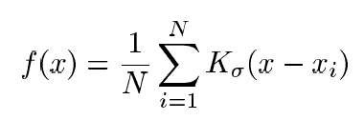
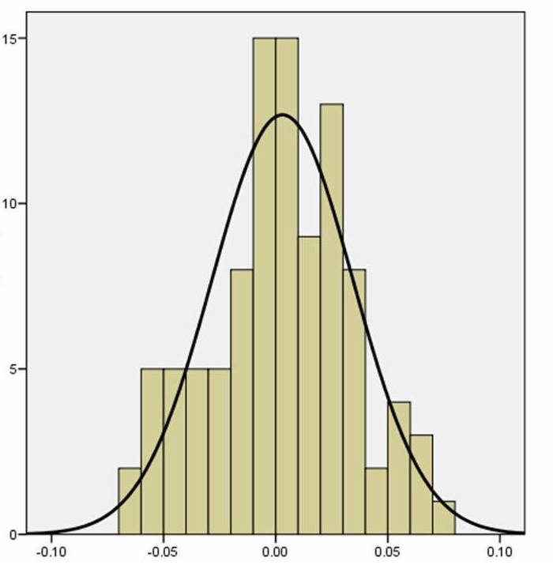
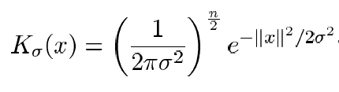
nonparametric density function
Gaussian kernel

Slide 4

YUV color space
Y(Luminance) = 0.299R + 0.587G + 0.114B U(Chrominance) = -0.147R - 0.289G + 0.436B V(Chrominance) = 0.615R - 0.515G - 0.100B

Slide 5
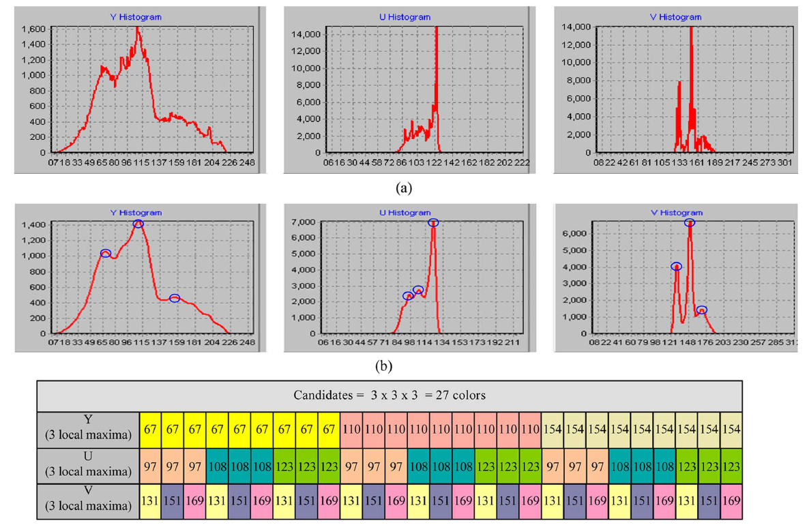
dominant color extraction

Slide 6
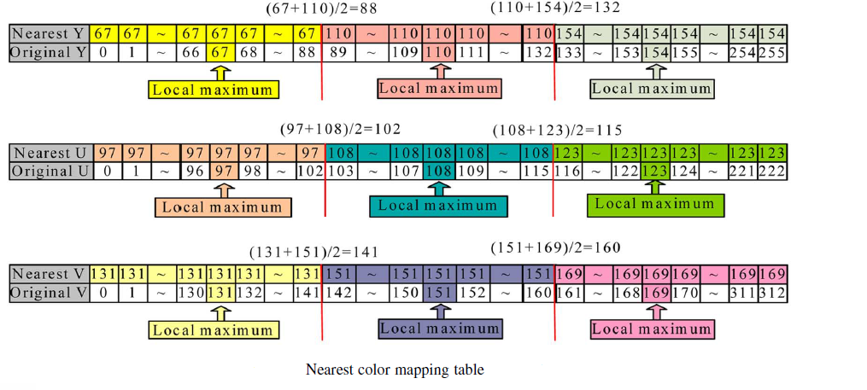
Image Pixel Assignments

Slide 7
Region-Merging Strategy
Importance index
Merging likelihood

Slide 8
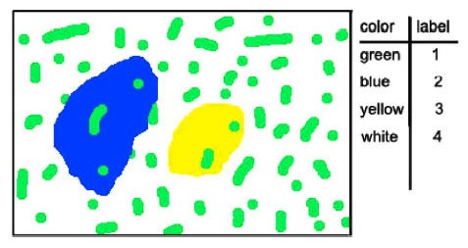
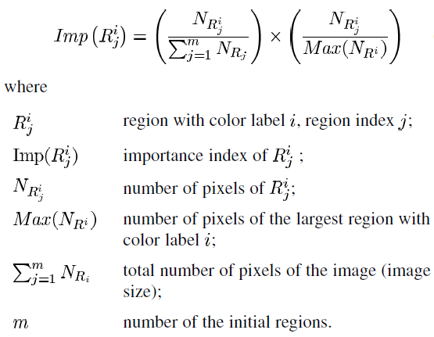
Importance index
Threshold T_{m}:
If the importance index of a region is less than the merging threshold T_{m}, then the region is called a less important region

Slide 9
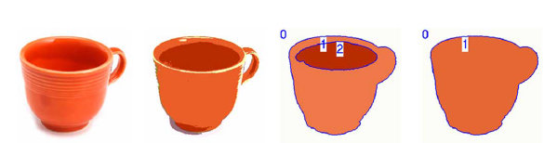
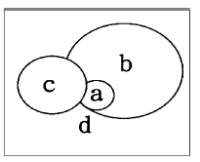
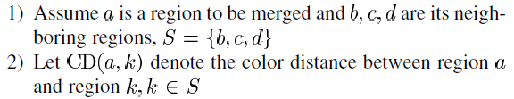
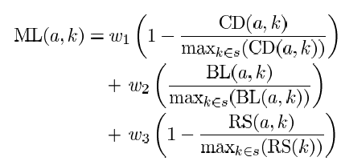
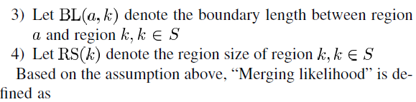
Merging Likelihood Computation
Color distance between regions
Boundary length between regions
Region sizes of neighboring regions

Slide 10
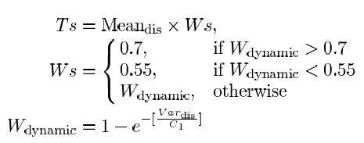
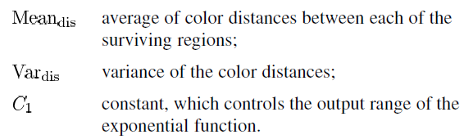
Similarity of Important Regions
Important regions may still be similar to their adjacent regions and should be further merged. The further checking criterion is to measure the color similarity with an adaptive threshold T_{s}
If the color distance between two connected important regions is less than T_{s}, they are similar and should be merged.

Slide 11
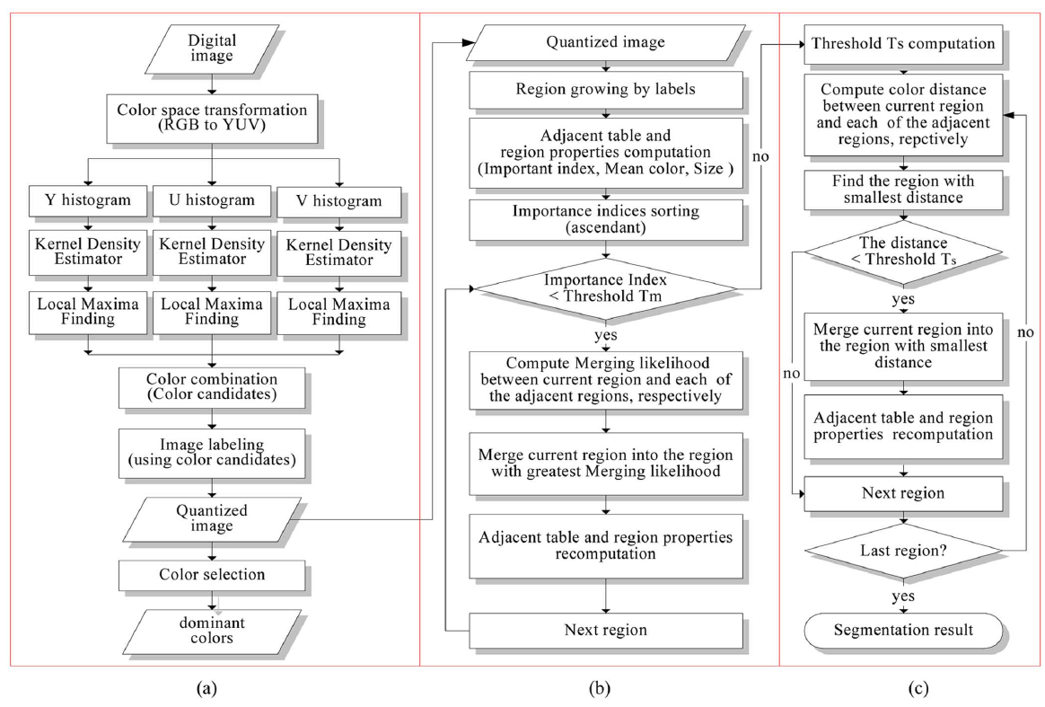
Flowchart of the proposed segmentation algorithm. (a) Dominant color extraction. (b) Region merging based on merging likelihood. (c) Region merging based on color similarity.

Slide 12
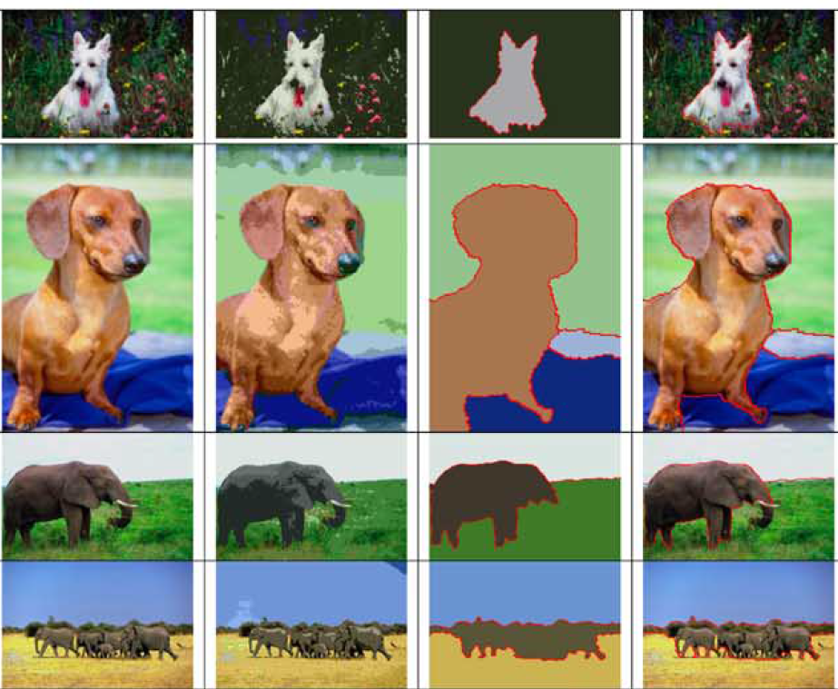
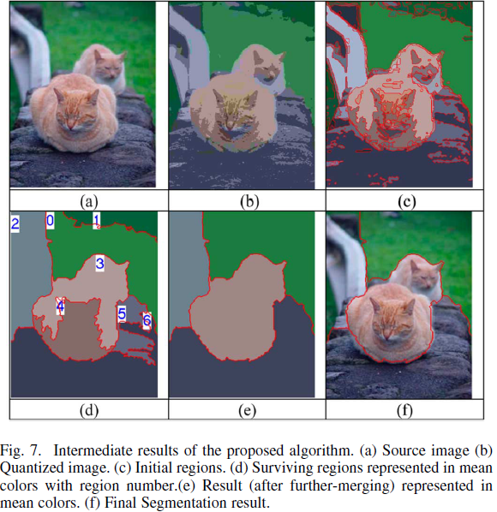
EXPERIMENTS

Slide 13
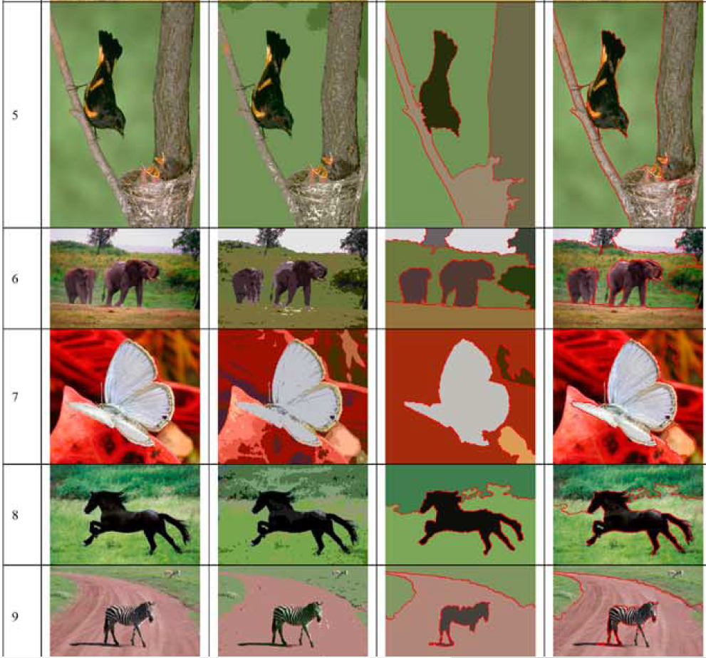
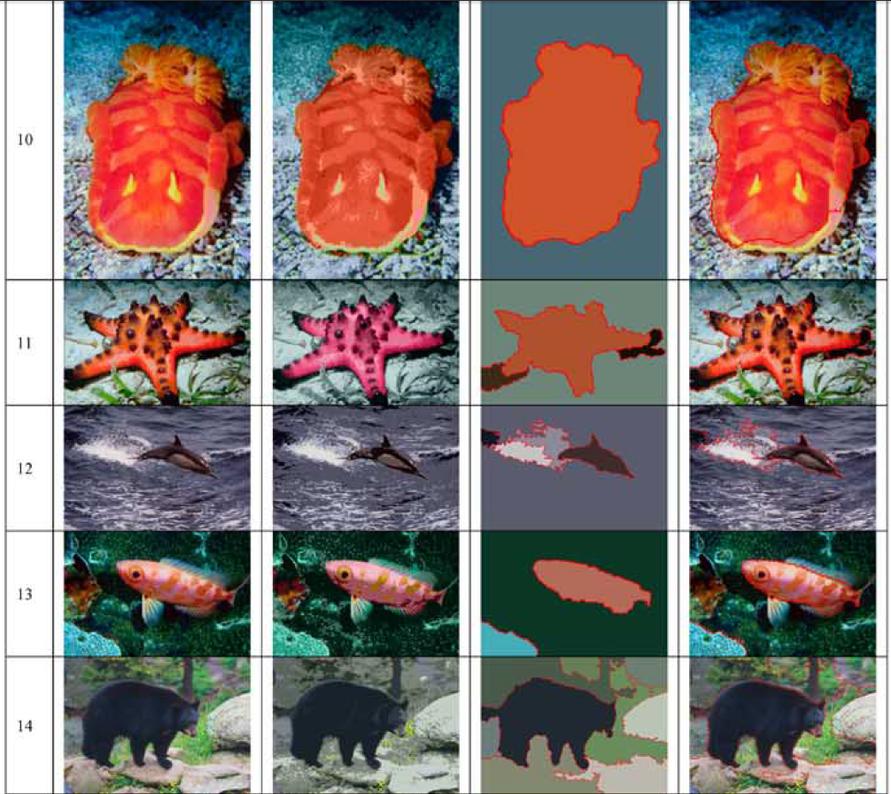

Slide 14
