Slide 1
Computing the Number of Longest Common Subsequences
Ronald I. Greenberg
http://www.cs.luc.edu/~rig
Jan 2003
Presenter: Huang-Ting Chan
Date:2015/2/25

Slide 2
Abstract
This note provides very simple, efficient algorithms for computing the number of distinct longest common subsequences of two input strings and for computing the number of LCS embeddings.

Slide 3
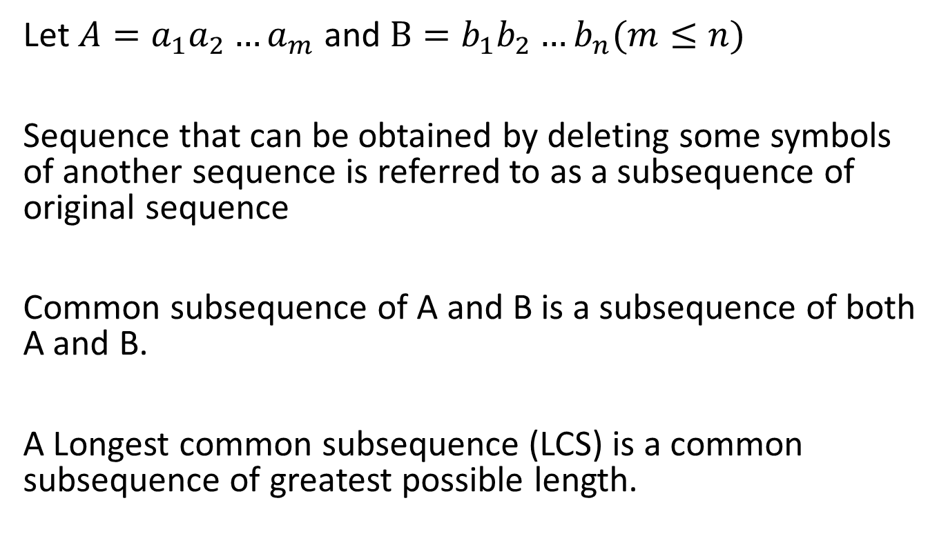
Introduction
Let $A=a_{1}a_{2}…a_{m}$and $B=b_{1}b_{2}…b_{n}(m≤n)$
Sequence that can be obtained by deleting some symbols of another sequence is referred to as a subsequence of original sequence
Common subsequence of A and B is a subsequence of both A and B.
A Longest common subsequence (LCS) is a common subsequence of greatest possible length.

Slide 4
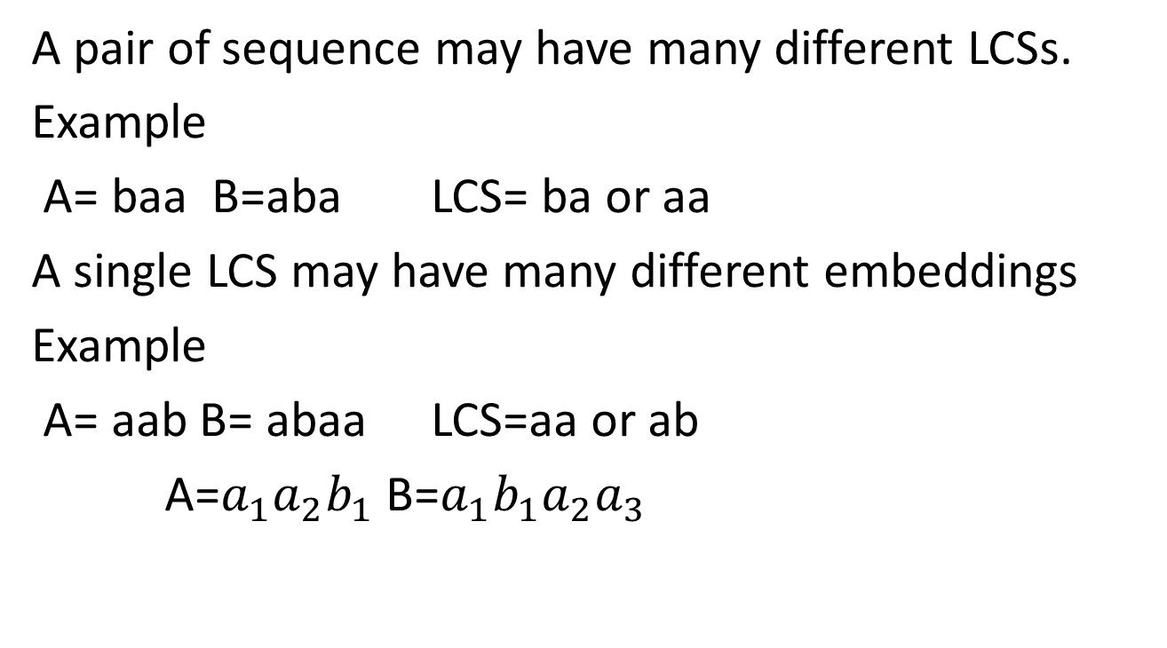
A pair of sequence may have many different LCSs.
Example
A= baa B=aba LCS= ba or aa
A single LCS may have many different embeddings
Example
A= aab B= abaa LCS=aa or ab
A=$a_{1}a_{2}b_{1}$B=${a_{1}b}_{1}a_{2}a_{3}$

Slide 5
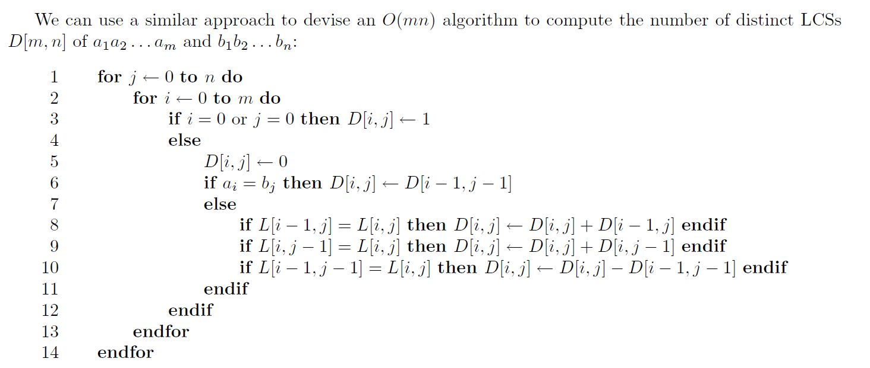

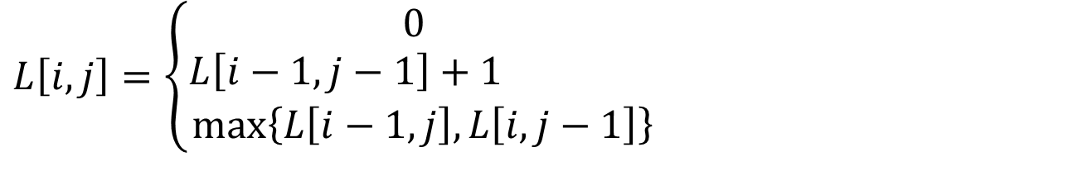

Computing the number of LCSs
$$if i=0 or j=0$$
$$L\left[i,j\right]=\left\{\begin{aligned}0 \\ L\left[i−1,j−1\right]+1 \\ \max\left\{L\left[i−1,j\right],L\left[i,j−1\right]\right\} \end{aligned}\right.$$
$$if i,j>0 and a_{i}=b_{j}$$
otherwise

Slide 6
Example
A= aba B=baa
L[I,j]
D[I,j]
 |  | b | a | a
 | 0 | 0 | 0 | 0
a | 0 | 0 | 1 | 1
b | 0 | 1 | 1 | 1
a | 0 | 1 | 2 | 2
 |  | b | a | a
 | 1 | 1 | 1 | 1
a | 1 | 1 | 1 | 1
b | 1 | 1 | 2 | 2
a | 1 | 1 | 1 | 2

Slide 7
D[I,j]
 |  | b | a | a
 | 1 | 1 | 1 | 1
a | 1
b | 1
a | 1

Slide 8
L[I,j]
D[I,j]
 |  | b | a | a
 | 0 | 0 | 0 | 0
a | 0 | 0 | 1 | 1
b | 0 | 1 | 1 | 1
a | 0 | 1 | 2 | 2
 |  | b | a | a
 | 1 | 1 | 1 | 1
a | 1
b | 1
a | 1
0+1+1-1=1

Slide 9
L[I,j]
D[I,j]
 |  | b | a | a
 | 0 | 0 | 0 | 0
a | 0 | 0 | 1 | 1
b | 0 | 1 | 1 | 1
a | 0 | 1 | 2 | 2
 |  | b | a | a
 | 1 | 1 | 1 | 1
a | 1 | 1 | 1
b | 1
a | 1

Slide 10
L[I,j]
D[I,j]
 |  | b | a | a
 | 0 | 0 | 0 | 0
a | 0 | 0 | 1 | 1
b | 0 | 1 | 1 | 1
a | 0 | 1 | 2 | 2
 |  | b | a | a
 | 1 | 1 | 1 | 1
a | 1 | 1 | 1 | 1
b | 1 | 1
a | 1
0+1+1

Slide 11
0
 | 0
0 | 0
0 | 0
L[I,j]
D[I,j]
 |  | b | a | a
 | 0 | 0 | 0 | 0
a | 0 | 0 | 1 | 1
b | 0 | 1 | 1 | 1
a | 0 | 1 | 2 | 2
 |  | b | a | a
 | 1 | 1 | 1 | 1
a | 1 | 1 | 1 | 1
b | 1 | 1 | 2 | 2
a | 1 | 1 | 1 | 2

Slide 12
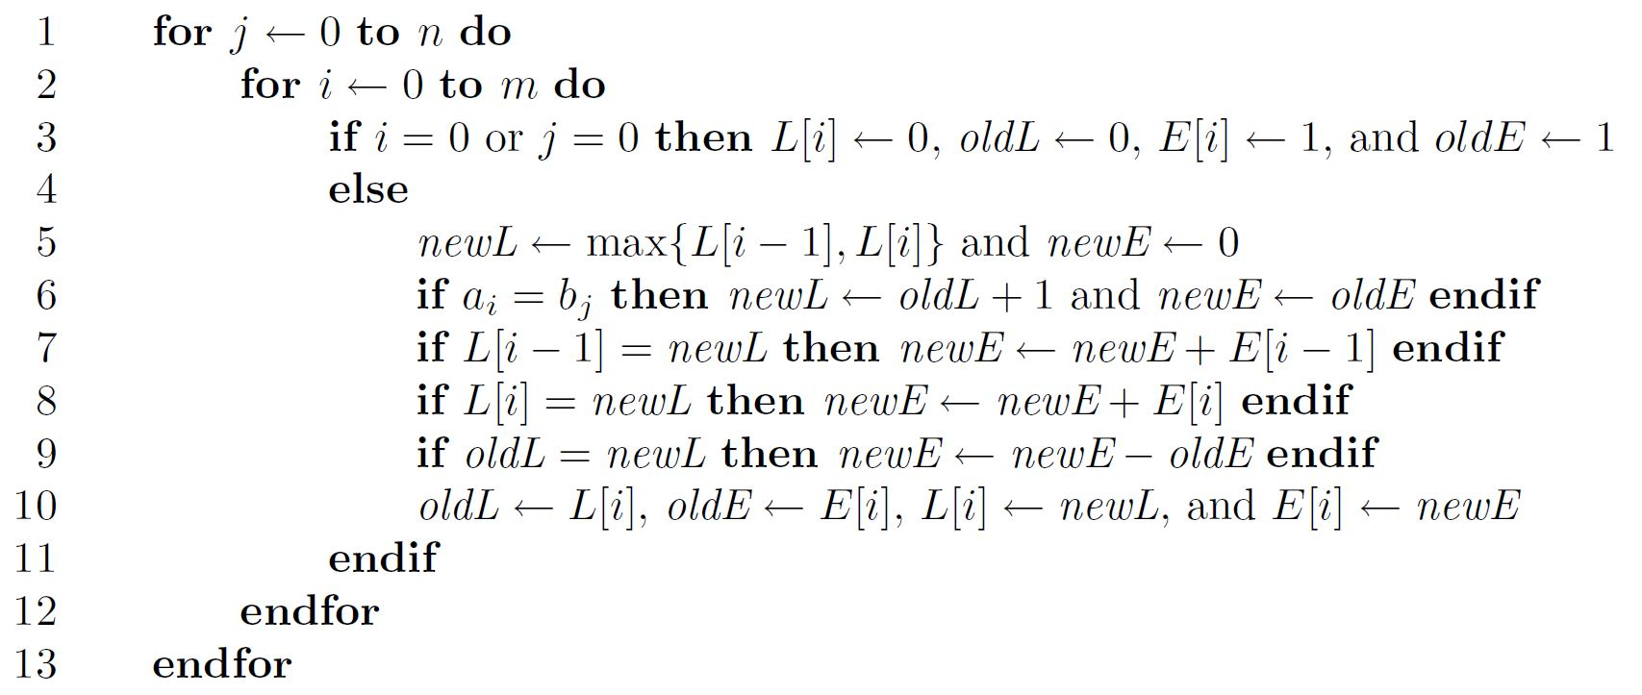

Improve
$O\left(m\right)$spacesuffices for the computation, since we really only need a portion of two columns of the L and D arrays at any time.

Slide 13
Example
A= aba B=baa
1
1
1
2
E[i]

Slide 14
i=0 j=0 L[0]=0, oldL =0, E[0]=1, oldE=1
i=1 j=0 L[1]=0, oldL =0, E[1]=1, oldE=1
i=m j=0 L[m]=0, oldL=0, E[m]=1, oldE=1
0
0
0
0
1
1
1
1

Slide 15
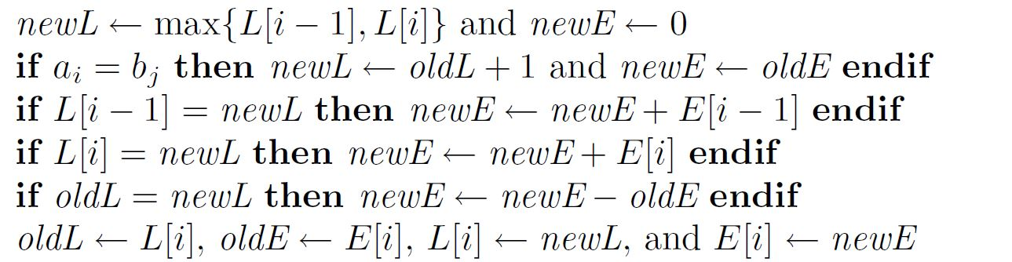
i=1 j=1 A=a B=b oldL=0 oldE=1
newL=0 newE=0
newE=0+1=1
newE=1+1=2
newE=2-1=1
0
0
0
0
1
1
1
1

Slide 16
 |  | b | a | a
 |  | L[0] E[0]
a | L[1] E[1] | newL newE
b | L[2] E[2]
a | L[3] E[3]
newL= Max{L[0],L[1]}

Slide 17
 |  | b | a | a
 |  | L[0] E[0]
a | oldL oldE | L[1] E[1]
b | L[2] E[2]
a | L[3] E[3]

Slide 18

Conclusion
$O\left(mn\right) time$and $O(m)$space

