Slide 1
A Fast Heuristic Search Algorithm for Finding the Longest Common Subsequence of Multiple Strings
Qingguo Wang, Mian Pan, Yi Shang, and Dmitry Korkin
Conference: Proceedings of the Twenty-Fourth AAAI Conference on Artificial Intelligence, AAAI 2010, Atlanta, Georgia, USA, July 11-15, 2010
Presenter: Chan-Yi Chou
Date: 2015/02/25

Slide 2
Abstract
Finding the longest common subsequence (LCS) of multiple strings is an NP-hard problem, with many applications in the areas of bioinformatics and computational genomics. Although significant efforts have been made to address the problem and its special cases, the increasing complexity and size of biological data require more efficient methods applicable to an arbitrary number of strings. In this paper, a novel search algorithm,MLCS-A*, is presented for the general case of multiple LCS (or MLCS) problems. MLCS-A* is a variant of the A* algorithm. It maximizes a new heuristic estimate of the LCS in each search step so that the longest common subsequence can be found. As a natural extension of MLCS-A*, a fast algorithm, MLCS-APP, is also proposed to deal with large volume of biological data for which finding a LCS within reasonable time is impossible. The benchmark test shows that MLCS-APP is able to extract common subsequences close to the optimal ones and that MLCS-APP significantly outperforms existing heuristic approaches. When applied to 8 protein domain families, MLCS-APP produced more accurate results than existing multiple sequence alignment methods.

Slide 3
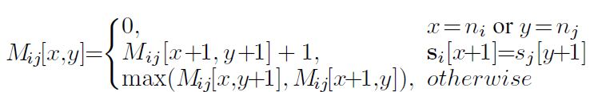
Introduction
S = {s₁, s₂, …, s_{d}}
p = (p₁, p₂, …, p_{d})
MLCS，找出這些序列的LCS
Scoring matrix M：

Slide 4
MLCS-A*
S₁ = G A T T A C A
S₂ = G T A A T C T A A C
S₃ = G C T A A T C G

Slide 5
M₁₃ | G | A | T | T | A | C | A
G | 4 | 3 | 3 | 3 | 2 | 2 | 1
C | 3 | 3 | 3 | 3 | 2 | 2 | 1
T | 3 | 3 | 3 | 3 | 2 | 1 | 1
A | 3 | 3 | 2 | 2 | 2 | 1 | 1
A | 3 | 2 | 2 | 2 | 2 | 1 | 1
T | 2 | 2 | 2 | 2 | 1 | 1 | 0
C | 1 | 1 | 1 | 1 | 1 | 1 | 0
G | 1 | 0 | 0 | 0 | 0 | 0 | 0
將S中的序列兩兩建立M表格，挑選M[1, 1] 值最小的表格當作參考。此範例中為M₁₃。
從(0, 0, 0)開始，用priority queue紀錄後繼者。
PQ((1, 1, 1,), (2, 3, 4), (3, 2, 3), (6, 6, 2))
priority queue以M值排序紀錄後繼者，
並將其parent設為(0, 0, 0)。
M₁₂ | G | A | T | T | A | C | A
G | 6 | 5 | 4 | 4 | 3 | 2 | 1
T | 5 | 5 | 4 | 4 | 3 | 2 | 1
A | 5 | 5 | 4 | 3 | 3 | 2 | 1
A | 5 | 5 | 4 | 3 | 3 | 2 | 1
T | 4 | 4 | 4 | 3 | 2 | 2 | 1
C | 3 | 3 | 3 | 3 | 2 | 2 | 1
T | 3 | 3 | 3 | 3 | 2 | 1 | 1
A | 3 | 3 | 2 | 2 | 2 | 1 | 1
A | 2 | 2 | 2 | 2 | 2 | 1 | 1
C | 1 | 1 | 1 | 1 | 1 | 1 | 0
M₂₃ | G | T | A | A | T | C | T | A | A | C
G | 6 | 5 | 5 | 5 | 5 | 5 | 4 | 3 | 2 | 1
C | 5 | 5 | 5 | 5 | 5 | 5 | 4 | 3 | 2 | 1
T | 5 | 5 | 4 | 4 | 4 | 4 | 4 | 3 | 2 | 1
A | 4 | 4 | 4 | 3 | 3 | 3 | 3 | 3 | 2 | 1
A | 3 | 3 | 3 | 3 | 2 | 2 | 2 | 2 | 2 | 1
T | 2 | 2 | 2 | 2 | 2 | 2 | 2 | 1 | 1 | 1
C | 1 | 1 | 1 | 1 | 1 | 1 | 1 | 1 | 1 | 1
G | 1 | 0 | 0 | 0 | 0 | 0 | 0 | 0 | 0 | 0

Slide 6
M₁₃ | G | A | T | T | A | C | A
G | 4 | 3 | 3 | 3 | 2 | 2 | 1
C | 3 | 3 | 3 | 3 | 2 | 2 | 1
T | 3 | 3 | 3 | 3 | 2 | 1 | 1
A | 3 | 3 | 2 | 2 | 2 | 1 | 1
A | 3 | 2 | 2 | 2 | 2 | 1 | 1
T | 2 | 2 | 2 | 2 | 1 | 1 | 0
C | 1 | 1 | 1 | 1 | 1 | 1 | 0
G | 1 | 0 | 0 | 0 | 0 | 0 | 0
取出(1, 1, 1)，PQ((2, 3, 4), (3, 2, 3), (6, 6, 2))
並將(1, 1, 1)的parent紀錄為(0, 0, 0)
若其後繼者尚未在PQ中，則加入PQ
若已經在PQ中，檢查MLCS值，更新其parent。
若以(0, 0, 0)為parent，MLCS為0
若以(1, 1, 1)為parent，MLCS為1
故更新(2, 3, 4), (3, 2, 3),
(6, 6, 2)的parent為(1, 1, 1)
M₁₂ | G | A | T | T | A | C | A
G | 6 | 5 | 4 | 4 | 3 | 2 | 1
T | 5 | 5 | 4 | 4 | 3 | 2 | 1
A | 5 | 5 | 4 | 3 | 3 | 2 | 1
A | 5 | 5 | 4 | 3 | 3 | 2 | 1
T | 4 | 4 | 4 | 3 | 2 | 2 | 1
C | 3 | 3 | 3 | 3 | 2 | 2 | 1
T | 3 | 3 | 3 | 3 | 2 | 1 | 1
A | 3 | 3 | 2 | 2 | 2 | 1 | 1
A | 2 | 2 | 2 | 2 | 2 | 1 | 1
C | 1 | 1 | 1 | 1 | 1 | 1 | 0
M₂₃ | G | T | A | A | T | C | T | A | A | C
G | 6 | 5 | 5 | 5 | 5 | 5 | 4 | 3 | 2 | 1
C | 5 | 5 | 5 | 5 | 5 | 5 | 4 | 3 | 2 | 1
T | 5 | 5 | 4 | 4 | 4 | 4 | 4 | 3 | 2 | 1
A | 4 | 4 | 4 | 3 | 3 | 3 | 3 | 3 | 2 | 1
A | 3 | 3 | 3 | 3 | 2 | 2 | 2 | 2 | 2 | 1
T | 2 | 2 | 2 | 2 | 2 | 2 | 2 | 1 | 1 | 1
C | 1 | 1 | 1 | 1 | 1 | 1 | 1 | 1 | 1 | 1
G | 1 | 0 | 0 | 0 | 0 | 0 | 0 | 0 | 0 | 0

Slide 7
M₁₃ | G | A | T | T | A | C | A
G | 4 | 3 | 3 | 3 | 2 | 2 | 1
C | 3 | 3 | 3 | 3 | 2 | 2 | 1
T | 3 | 3 | 3 | 3 | 2 | 1 | 1
A | 3 | 3 | 2 | 2 | 2 | 1 | 1
A | 3 | 2 | 2 | 2 | 2 | 1 | 1
T | 2 | 2 | 2 | 2 | 1 | 1 | 0
C | 1 | 1 | 1 | 1 | 1 | 1 | 0
G | 1 | 0 | 0 | 0 | 0 | 0 | 0
取出(2, 3, 4)，PQ((3, 2, 3), (6, 6, 2))
其後繼者(3, 5, 6), (5, 4, 5), (6, 6, 7)
的parent設為(2, 3, 4)，並將後繼者加入PQ
PQ((3, 2, 3), (3, 5, 6), (5, 4, 5), (6, 6, 2), (6, 6, 7))
M₁₂ | G | A | T | T | A | C | A
G | 6 | 5 | 4 | 4 | 3 | 2 | 1
T | 5 | 5 | 4 | 4 | 3 | 2 | 1
A | 5 | 5 | 4 | 3 | 3 | 2 | 1
A | 5 | 5 | 4 | 3 | 3 | 2 | 1
T | 4 | 4 | 4 | 3 | 2 | 2 | 1
C | 3 | 3 | 3 | 3 | 2 | 2 | 1
T | 3 | 3 | 3 | 3 | 2 | 1 | 1
A | 3 | 3 | 2 | 2 | 2 | 1 | 1
A | 2 | 2 | 2 | 2 | 2 | 1 | 1
C | 1 | 1 | 1 | 1 | 1 | 1 | 0
M₂₃ | G | T | A | A | T | C | T | A | A | C
G | 6 | 5 | 5 | 5 | 5 | 5 | 4 | 3 | 2 | 1
C | 5 | 5 | 5 | 5 | 5 | 5 | 4 | 3 | 2 | 1
T | 5 | 5 | 4 | 4 | 4 | 4 | 4 | 3 | 2 | 1
A | 4 | 4 | 4 | 3 | 3 | 3 | 3 | 3 | 2 | 1
A | 3 | 3 | 3 | 3 | 2 | 2 | 2 | 2 | 2 | 1
T | 2 | 2 | 2 | 2 | 2 | 2 | 2 | 1 | 1 | 1
C | 1 | 1 | 1 | 1 | 1 | 1 | 1 | 1 | 1 | 1
G | 1 | 0 | 0 | 0 | 0 | 0 | 0 | 0 | 0 | 0

Slide 8
M₁₃ | G | A | T | T | A | C | A
G | 4 | 3 | 3 | 3 | 2 | 2 | 1
C | 3 | 3 | 3 | 3 | 2 | 2 | 1
T | 3 | 3 | 3 | 3 | 2 | 1 | 1
A | 3 | 3 | 2 | 2 | 2 | 1 | 1
A | 3 | 2 | 2 | 2 | 2 | 1 | 1
T | 2 | 2 | 2 | 2 | 1 | 1 | 0
C | 1 | 1 | 1 | 1 | 1 | 1 | 0
G | 1 | 0 | 0 | 0 | 0 | 0 | 0
取出(3, 2, 3)，PQ (3, 5, 6), (5, 4, 5), (6, 6, 2), (6, 6, 7))
其尚未加入PQ的後繼者為(4, 5, 6)
的parent設為(3, 2, 3)，並將其加入PQ
PQ((3, 5, 6), (4, 5, 6), (5, 4, 5), (6, 6, 2), (6, 6, 7))
M₁₂ | G | A | T | T | A | C | A
G | 6 | 5 | 4 | 4 | 3 | 2 | 1
T | 5 | 5 | 4 | 4 | 3 | 2 | 1
A | 5 | 5 | 4 | 3 | 3 | 2 | 1
A | 5 | 5 | 4 | 3 | 3 | 2 | 1
T | 4 | 4 | 4 | 3 | 2 | 2 | 1
C | 3 | 3 | 3 | 3 | 2 | 2 | 1
T | 3 | 3 | 3 | 3 | 2 | 1 | 1
A | 3 | 3 | 2 | 2 | 2 | 1 | 1
A | 2 | 2 | 2 | 2 | 2 | 1 | 1
C | 1 | 1 | 1 | 1 | 1 | 1 | 0
M₂₃ | G | T | A | A | T | C | T | A | A | C
G | 6 | 5 | 5 | 5 | 5 | 5 | 4 | 3 | 2 | 1
C | 5 | 5 | 5 | 5 | 5 | 5 | 4 | 3 | 2 | 1
T | 5 | 5 | 4 | 4 | 4 | 4 | 4 | 3 | 2 | 1
A | 4 | 4 | 4 | 3 | 3 | 3 | 3 | 3 | 2 | 1
A | 3 | 3 | 3 | 3 | 2 | 2 | 2 | 2 | 2 | 1
T | 2 | 2 | 2 | 2 | 2 | 2 | 2 | 1 | 1 | 1
C | 1 | 1 | 1 | 1 | 1 | 1 | 1 | 1 | 1 | 1
G | 1 | 0 | 0 | 0 | 0 | 0 | 0 | 0 | 0 | 0

Slide 9
M₁₃ | G | A | T | T | A | C | A
G | 4 | 3 | 3 | 3 | 2 | 2 | 1
C | 3 | 3 | 3 | 3 | 2 | 2 | 1
T | 3 | 3 | 3 | 3 | 2 | 1 | 1
A | 3 | 3 | 2 | 2 | 2 | 1 | 1
A | 3 | 2 | 2 | 2 | 2 | 1 | 1
T | 2 | 2 | 2 | 2 | 1 | 1 | 0
C | 1 | 1 | 1 | 1 | 1 | 1 | 0
G | 1 | 0 | 0 | 0 | 0 | 0 | 0
取出(3, 5, 6)，PQ ((4, 5, 6), (5, 4, 5), (6, 6, 2), (6, 6, 7))
其後繼者為(6, 6, 7)的parent設為(3, 5, 6)
PQ((4, 5, 6), (5, 4, 5), (6, 6, 2), (6, 6, 7))
M₁₂ | G | A | T | T | A | C | A
G | 6 | 5 | 4 | 4 | 3 | 2 | 1
T | 5 | 5 | 4 | 4 | 3 | 2 | 1
A | 5 | 5 | 4 | 3 | 3 | 2 | 1
A | 5 | 5 | 4 | 3 | 3 | 2 | 1
T | 4 | 4 | 4 | 3 | 2 | 2 | 1
C | 3 | 3 | 3 | 3 | 2 | 2 | 1
T | 3 | 3 | 3 | 3 | 2 | 1 | 1
A | 3 | 3 | 2 | 2 | 2 | 1 | 1
A | 2 | 2 | 2 | 2 | 2 | 1 | 1
C | 1 | 1 | 1 | 1 | 1 | 1 | 0
M₂₃ | G | T | A | A | T | C | T | A | A | C
G | 6 | 5 | 5 | 5 | 5 | 5 | 4 | 3 | 2 | 1
C | 5 | 5 | 5 | 5 | 5 | 5 | 4 | 3 | 2 | 1
T | 5 | 5 | 4 | 4 | 4 | 4 | 4 | 3 | 2 | 1
A | 4 | 4 | 4 | 3 | 3 | 3 | 3 | 3 | 2 | 1
A | 3 | 3 | 3 | 3 | 2 | 2 | 2 | 2 | 2 | 1
T | 2 | 2 | 2 | 2 | 2 | 2 | 2 | 1 | 1 | 1
C | 1 | 1 | 1 | 1 | 1 | 1 | 1 | 1 | 1 | 1
G | 1 | 0 | 0 | 0 | 0 | 0 | 0 | 0 | 0 | 0

Slide 10
M₁₃ | G | A | T | T | A | C | A
G | 4 | 3 | 3 | 3 | 2 | 2 | 1
C | 3 | 3 | 3 | 3 | 2 | 2 | 1
T | 3 | 3 | 3 | 3 | 2 | 1 | 1
A | 3 | 3 | 2 | 2 | 2 | 1 | 1
A | 3 | 2 | 2 | 2 | 2 | 1 | 1
T | 2 | 2 | 2 | 2 | 1 | 1 | 0
C | 1 | 1 | 1 | 1 | 1 | 1 | 0
G | 1 | 0 | 0 | 0 | 0 | 0 | 0
取出(4, 5, 6)，PQ ((5, 4, 5), (6, 6, 2), (6, 6, 7))
PQ((5, 4, 5), (6, 6, 2), (6, 6, 7))
M₁₂ | G | A | T | T | A | C | A
G | 6 | 5 | 4 | 4 | 3 | 2 | 1
T | 5 | 5 | 4 | 4 | 3 | 2 | 1
A | 5 | 5 | 4 | 3 | 3 | 2 | 1
A | 5 | 5 | 4 | 3 | 3 | 2 | 1
T | 4 | 4 | 4 | 3 | 2 | 2 | 1
C | 3 | 3 | 3 | 3 | 2 | 2 | 1
T | 3 | 3 | 3 | 3 | 2 | 1 | 1
A | 3 | 3 | 2 | 2 | 2 | 1 | 1
A | 2 | 2 | 2 | 2 | 2 | 1 | 1
C | 1 | 1 | 1 | 1 | 1 | 1 | 0
M₂₃ | G | T | A | A | T | C | T | A | A | C
G | 6 | 5 | 5 | 5 | 5 | 5 | 4 | 3 | 2 | 1
C | 5 | 5 | 5 | 5 | 5 | 5 | 4 | 3 | 2 | 1
T | 5 | 5 | 4 | 4 | 4 | 4 | 4 | 3 | 2 | 1
A | 4 | 4 | 4 | 3 | 3 | 3 | 3 | 3 | 2 | 1
A | 3 | 3 | 3 | 3 | 2 | 2 | 2 | 2 | 2 | 1
T | 2 | 2 | 2 | 2 | 2 | 2 | 2 | 1 | 1 | 1
C | 1 | 1 | 1 | 1 | 1 | 1 | 1 | 1 | 1 | 1
G | 1 | 0 | 0 | 0 | 0 | 0 | 0 | 0 | 0 | 0

Slide 11
M₁₃ | G | A | T | T | A | C | A
G | 4 | 3 | 3 | 3 | 2 | 2 | 1
C | 3 | 3 | 3 | 3 | 2 | 2 | 1
T | 3 | 3 | 3 | 3 | 2 | 1 | 1
A | 3 | 3 | 2 | 2 | 2 | 1 | 1
A | 3 | 2 | 2 | 2 | 2 | 1 | 1
T | 2 | 2 | 2 | 2 | 1 | 1 | 0
C | 1 | 1 | 1 | 1 | 1 | 1 | 0
G | 1 | 0 | 0 | 0 | 0 | 0 | 0
取出(5, 4, 5)，PQ ((6, 6, 2), (6, 6, 7))
PQ((6, 6, 2), (6, 6, 7))
M₁₂ | G | A | T | T | A | C | A
G | 6 | 5 | 4 | 4 | 3 | 2 | 1
T | 5 | 5 | 4 | 4 | 3 | 2 | 1
A | 5 | 5 | 4 | 3 | 3 | 2 | 1
A | 5 | 5 | 4 | 3 | 3 | 2 | 1
T | 4 | 4 | 4 | 3 | 2 | 2 | 1
C | 3 | 3 | 3 | 3 | 2 | 2 | 1
T | 3 | 3 | 3 | 3 | 2 | 1 | 1
A | 3 | 3 | 2 | 2 | 2 | 1 | 1
A | 2 | 2 | 2 | 2 | 2 | 1 | 1
C | 1 | 1 | 1 | 1 | 1 | 1 | 0
M₂₃ | G | T | A | A | T | C | T | A | A | C
G | 6 | 5 | 5 | 5 | 5 | 5 | 4 | 3 | 2 | 1
C | 5 | 5 | 5 | 5 | 5 | 5 | 4 | 3 | 2 | 1
T | 5 | 5 | 4 | 4 | 4 | 4 | 4 | 3 | 2 | 1
A | 4 | 4 | 4 | 3 | 3 | 3 | 3 | 3 | 2 | 1
A | 3 | 3 | 3 | 3 | 2 | 2 | 2 | 2 | 2 | 1
T | 2 | 2 | 2 | 2 | 2 | 2 | 2 | 1 | 1 | 1
C | 1 | 1 | 1 | 1 | 1 | 1 | 1 | 1 | 1 | 1
G | 1 | 0 | 0 | 0 | 0 | 0 | 0 | 0 | 0 | 0

Slide 12
M₁₃ | G | A | T | T | A | C | A
G | 4 | 3 | 3 | 3 | 2 | 2 | 1
C | 3 | 3 | 3 | 3 | 2 | 2 | 1
T | 3 | 3 | 3 | 3 | 2 | 1 | 1
A | 3 | 3 | 2 | 2 | 2 | 1 | 1
A | 3 | 2 | 2 | 2 | 2 | 1 | 1
T | 2 | 2 | 2 | 2 | 1 | 1 | 0
C | 1 | 1 | 1 | 1 | 1 | 1 | 0
G | 1 | 0 | 0 | 0 | 0 | 0 | 0
取出(6, 6, 2)，PQ ((6, 6, 7))
其後繼者為(7, 8, 4)將其parent設為(6, 6, 2)，
並加入PQ，PQ((6, 6, 7), (7, 8, 4))
M₁₂ | G | A | T | T | A | C | A
G | 6 | 5 | 4 | 4 | 3 | 2 | 1
T | 5 | 5 | 4 | 4 | 3 | 2 | 1
A | 5 | 5 | 4 | 3 | 3 | 2 | 1
A | 5 | 5 | 4 | 3 | 3 | 2 | 1
T | 4 | 4 | 4 | 3 | 2 | 2 | 1
C | 3 | 3 | 3 | 3 | 2 | 2 | 1
T | 3 | 3 | 3 | 3 | 2 | 1 | 1
A | 3 | 3 | 2 | 2 | 2 | 1 | 1
A | 2 | 2 | 2 | 2 | 2 | 1 | 1
C | 1 | 1 | 1 | 1 | 1 | 1 | 0
M₂₃ | G | T | A | A | T | C | T | A | A | C
G | 6 | 5 | 5 | 5 | 5 | 5 | 4 | 3 | 2 | 1
C | 5 | 5 | 5 | 5 | 5 | 5 | 4 | 3 | 2 | 1
T | 5 | 5 | 4 | 4 | 4 | 4 | 4 | 3 | 2 | 1
A | 4 | 4 | 4 | 3 | 3 | 3 | 3 | 3 | 2 | 1
A | 3 | 3 | 3 | 3 | 2 | 2 | 2 | 2 | 2 | 1
T | 2 | 2 | 2 | 2 | 2 | 2 | 2 | 1 | 1 | 1
C | 1 | 1 | 1 | 1 | 1 | 1 | 1 | 1 | 1 | 1
G | 1 | 0 | 0 | 0 | 0 | 0 | 0 | 0 | 0 | 0

Slide 13
M₁₃ | G | A | T | T | A | C | A
G | 4 | 3 | 3 | 3 | 2 | 2 | 1
C | 3 | 3 | 3 | 3 | 2 | 2 | 1
T | 3 | 3 | 3 | 3 | 2 | 1 | 1
A | 3 | 3 | 2 | 2 | 2 | 1 | 1
A | 3 | 2 | 2 | 2 | 2 | 1 | 1
T | 2 | 2 | 2 | 2 | 1 | 1 | 0
C | 1 | 1 | 1 | 1 | 1 | 1 | 0
G | 1 | 0 | 0 | 0 | 0 | 0 | 0
取出(6, 6, 7)，PQ ((7, 8, 4))
沒有後繼者，且後繼者範圍M值為0，結束
回傳(6, 6, 7) (3, 5, 6) (2, 3, 4) (1, 1, 1)
MLCS = 4
M₁₂ | G | A | T | T | A | C | A
G | 6 | 5 | 4 | 4 | 3 | 2 | 1
T | 5 | 5 | 4 | 4 | 3 | 2 | 1
A | 5 | 5 | 4 | 3 | 3 | 2 | 1
A | 5 | 5 | 4 | 3 | 3 | 2 | 1
T | 4 | 4 | 4 | 3 | 2 | 2 | 1
C | 3 | 3 | 3 | 3 | 2 | 2 | 1
T | 3 | 3 | 3 | 3 | 2 | 1 | 1
A | 3 | 3 | 2 | 2 | 2 | 1 | 1
A | 2 | 2 | 2 | 2 | 2 | 1 | 1
C | 1 | 1 | 1 | 1 | 1 | 1 | 0
M₂₃ | G | T | A | A | T | C | T | A | A | C
G | 6 | 5 | 5 | 5 | 5 | 5 | 4 | 3 | 2 | 1
C | 5 | 5 | 5 | 5 | 5 | 5 | 4 | 3 | 2 | 1
T | 5 | 5 | 4 | 4 | 4 | 4 | 4 | 3 | 2 | 1
A | 4 | 4 | 4 | 3 | 3 | 3 | 3 | 3 | 2 | 1
A | 3 | 3 | 3 | 3 | 2 | 2 | 2 | 2 | 2 | 1
T | 2 | 2 | 2 | 2 | 2 | 2 | 2 | 1 | 1 | 1
C | 1 | 1 | 1 | 1 | 1 | 1 | 1 | 1 | 1 | 1
G | 1 | 0 | 0 | 0 | 0 | 0 | 0 | 0 | 0 | 0

Slide 14
MLCS-APP
由於MLCS-A*需要紀錄的點較多，導致在序列長度較長或序列數量較多的時候，變得不夠實用，MLCS-APP有參數使得紀錄的點的數量有所限制，若PQ中的點數量超過設定的參數，將會剔除M值較低的點，直到PQ的數量在限制數量內，藉以減少紀錄的點，增加效率。

Slide 15
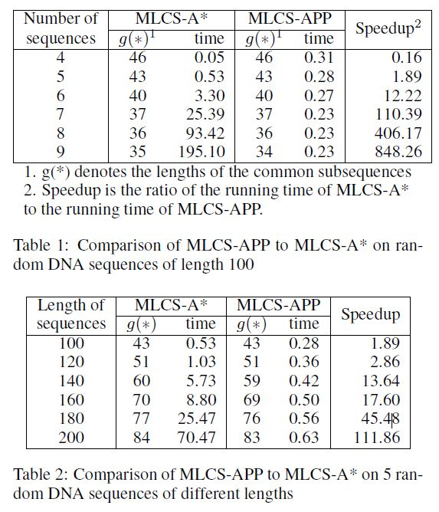
Experimental Results

Slide 16
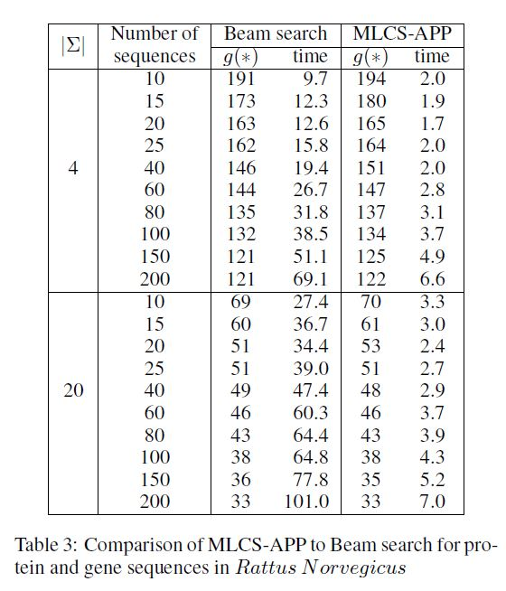
Experimental Results

Slide 17
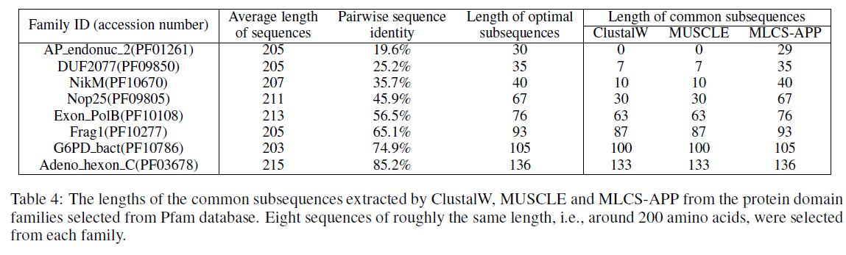
Experimental Results

