Slide 1
Effective caching techniques for accelerating pattern matching queries
2014 IEEE International Conference on Big Data,P.491–P.499
Fard,A; Manda,S; Ramaswamy, L ; Miller,J.A
報告者：何文娟
日期：2015/2/25

Slide 2
Abstract(1/2)
Using caching techniques to improve response time of queries is a proven approach in many contexts. However, it is not well explored for subgraph pattern matching queries, mainly because of subtleties enforced by traditional pattern matching models. Indeed, efficient caching can greatly impact the query answering performance for massive graphs in any query engine whether it is centralized or distributed.

Slide 3
Abstract(2/2)
This paper investigates the capabilities of the newly introduced pattern matching models in graph simulation family for this purpose. We propose a novel caching technique, and show how the results of a query can be used to answer the new similar queries according to the similarity measure that is introduced. Using large real-world graphs, we experimentally verify the efficiency of the proposed technique in answering subgraph pattern matching queries.

Slide 4
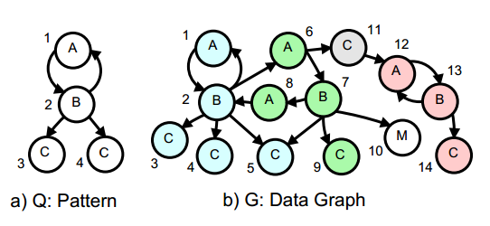
Subgraph Isomorphism
Q matches G_{s} if there exists a bijective function f: V_{Q}→ V_{Gs} such that
for each node u in Q, u and f(u) have the same label
An edge (u, u‘) in Q if and only if (f(u), f(u')) is an edge in G_{s}

Slide 5
Graph Simulation
Given pattern graph Q(Vq, Eq) and data graph G(V, E), a binary relation R ⊆ Vq × V
for each (u, v) ∈ R, u and v have the same label
for each edge (u, u′) ∈ Eq, there exists an edge (v, v′) in E such that (u′, v′) ∈ R

Slide 6
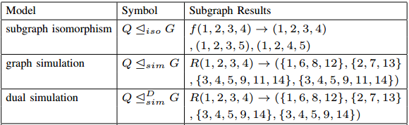
Pattern Matching Models(1/2)

Slide 7
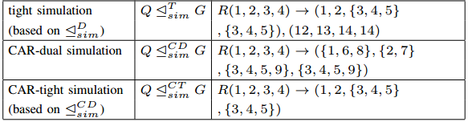
Pattern Matching Models(2/2)

Slide 8
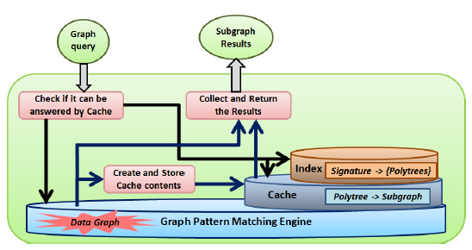
Architecture

Slide 9

Dual Simulation
The 4 conditions
Having the same lebel
All vertices of Q are covered
Child relationship
Parent relationship
→Maximum dual match set
R_{D}

Slide 10
CAR-dual Simulation
The number of matched children or parents with the same label in the data graph should not be less than their correspondents in the query

Slide 11

CAR-tight Simulation
Based on CAR-dual Simulation
Definition:
u is a center of Q with highest defined selectivity
(u,u’) ϵR_{D}
with maximum dual match set R^{b}
u’ is a member of at least one of the pairs in R_{D}
_{D}
_{b}

Slide 12
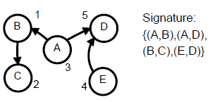
The caching mechanism(1/3)
Storing the result of an old query
Find the spanning polytree of the query graph
Perform a CAR-dual simulation for the polytree on the data graph
Find the set of vertices in the data graph
Calculate the signature of the polytree

Slide 13
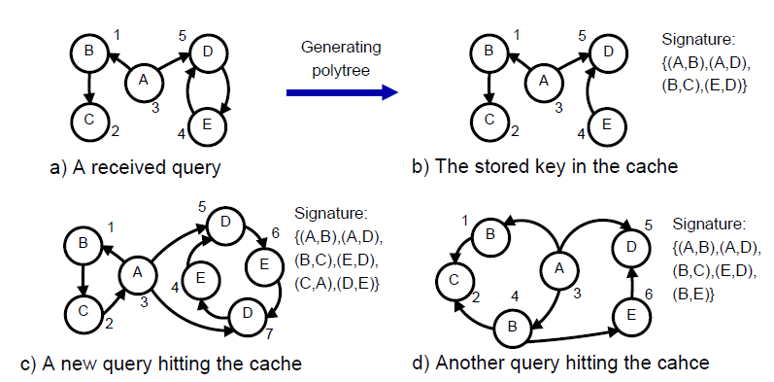
The caching mechanism(2/3)
Graph Q₂ cover-tight match to graph Q₁
There is a tight-simulation relation from Q₁ to Q₂
This relation covers all the vertices in Q₂

Slide 14
The caching mechanism(3/3)
Search in the cache
Calculate the signature of the new query
The signature is compared against all the signatures stored in the cache
To check for cover-tight match

Slide 15
Experimental setup
Three real-world labeled graphs
Patent graph
Citation graph
Amazon product co-purchase network

Slide 16
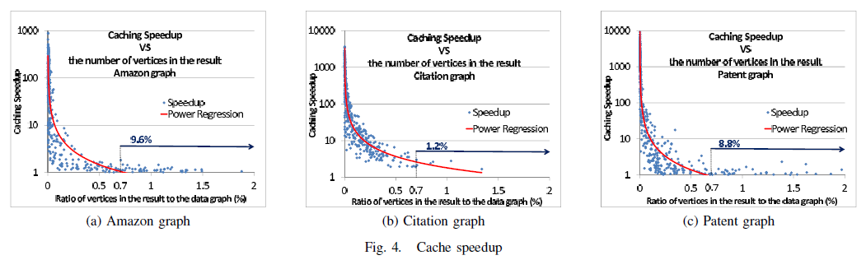
Experimental results(1/2)

Slide 17
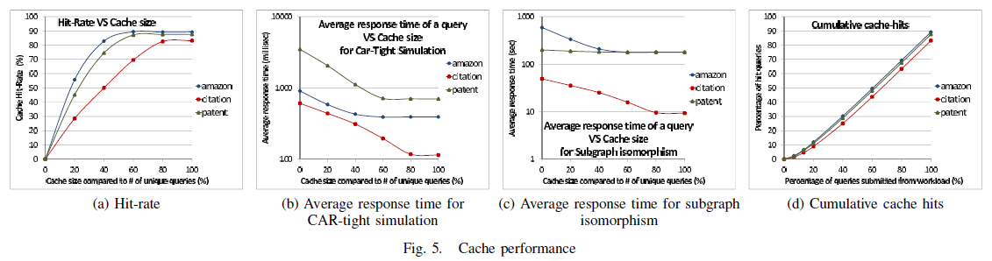
Experimental results(2/2)

Slide 18
THANK YOU

