Slide 1
Time Series Shapelets: A New Primitive for Data Mining
Lexiang Ye, Eamonn Keogh
Proceeding KDD '09 Proceedings of the 15th ACM SIGKDD international conference on Knowledge discovery and data mining Pages 947-956 (2009)
Presenter：Guan-Cheng Guo Date：2015/3/2

Slide 2
Abstract
Classification of time series has been attracting great interest over the past decade. Recent empirical evidence has strongly suggested that the simple nearest neighbor algorithm is very difficult to beat for most time series problems. While this may be considered good news, given the simplicity of implementing the nearest neighbor algorithm, there are some negative consequences of this. First, the nearest neighbor algorithm requires storing and searching the entire dataset, resulting in a time and space complexity that limits its applicability, especially on resource-limited sensors. Second, beyond mere classification accuracy, we often wish to gain some insight into the data.

Slide 3
Abstract
In this work we introduce a new time series primitive, time series shapelets, which addresses these limitations. Informally, shapelets are time series subsequences which are in some sense maximally representative of a class. As we shall show with extensive empirical evaluations in diverse domains, algorithms based on the time series shapelet primitives can be interpretable, more accurate and significantly faster than state-of-the-art classifiers.

Slide 4
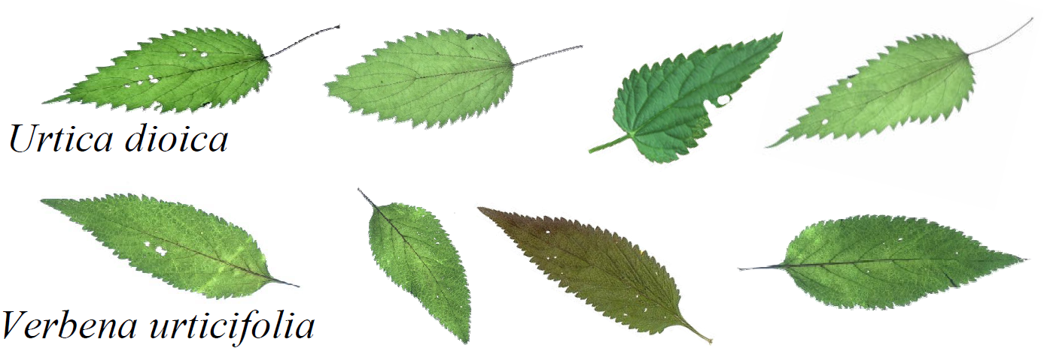
Time Series
Example of leaves from two classes, Urtica dioica (stinging nettles) and Verbena urticifolia(白馬鞭草). These two plants are commonly confused, hence the colloquial name “false nettle(假蕁麻)” for Verbena urticifolia.

Slide 5
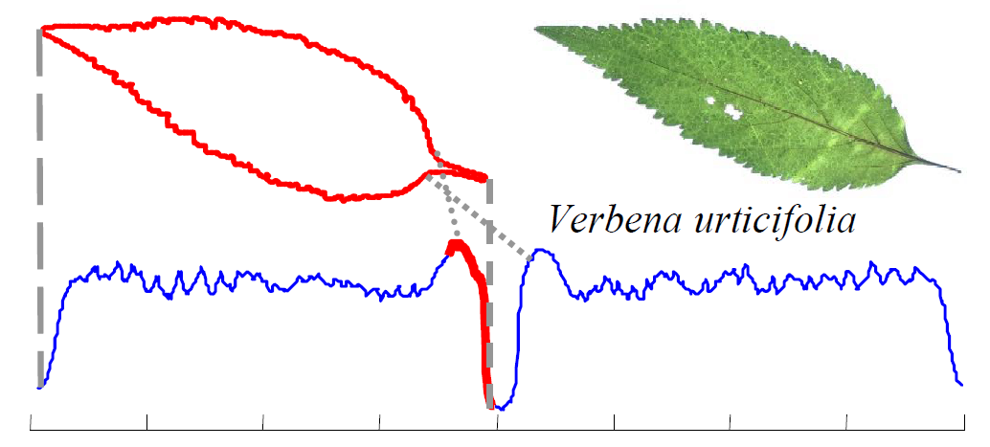
Time Series
A shape can be converted into a one dimensional “time series” representation.

Slide 6
Time Series
Using a nearest neighbor classifier with either the Euclidean distance or Dynamic Time Warping (DTW) distance does not significantly outperform random guessing.
The reason for the poor performance of these otherwise very competitive classifiers seems to be due to the fact that the data is somewhat noisy (i.e. insect bites, and different stem lengths), and this noise is enough to swamp the subtle differences in the shapes.

Slide 7
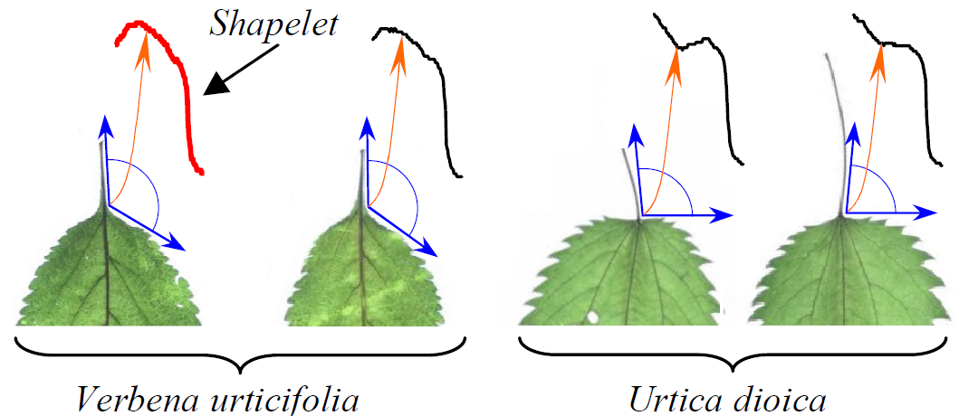
Shapelets
Instead of comparing the entire shapes, we only compare a small subsection of the shapes from the two classes that is particularly discriminating. We can call such subsections shapelets.

Slide 8
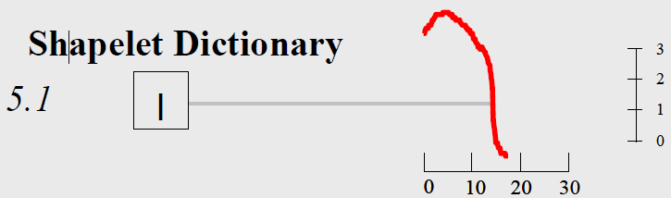
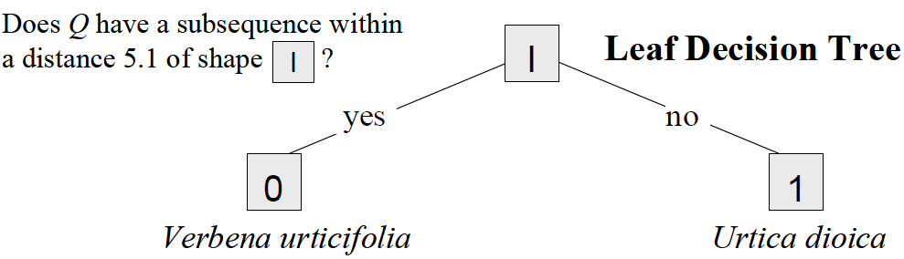
Shapelets
Having found the shapelet and recorded its distance to the nearest matching subsequence in all objects in the database, we can build the simple decision-tree classifier.

Slide 9
Definitions
A time series dataset D consists of two classes, A and B.
Each splitting strategy divides the whole dataset D into two subsets, D1 and D2.
Calculate the Information Gain after splitting D into D1 and D2.

Slide 10
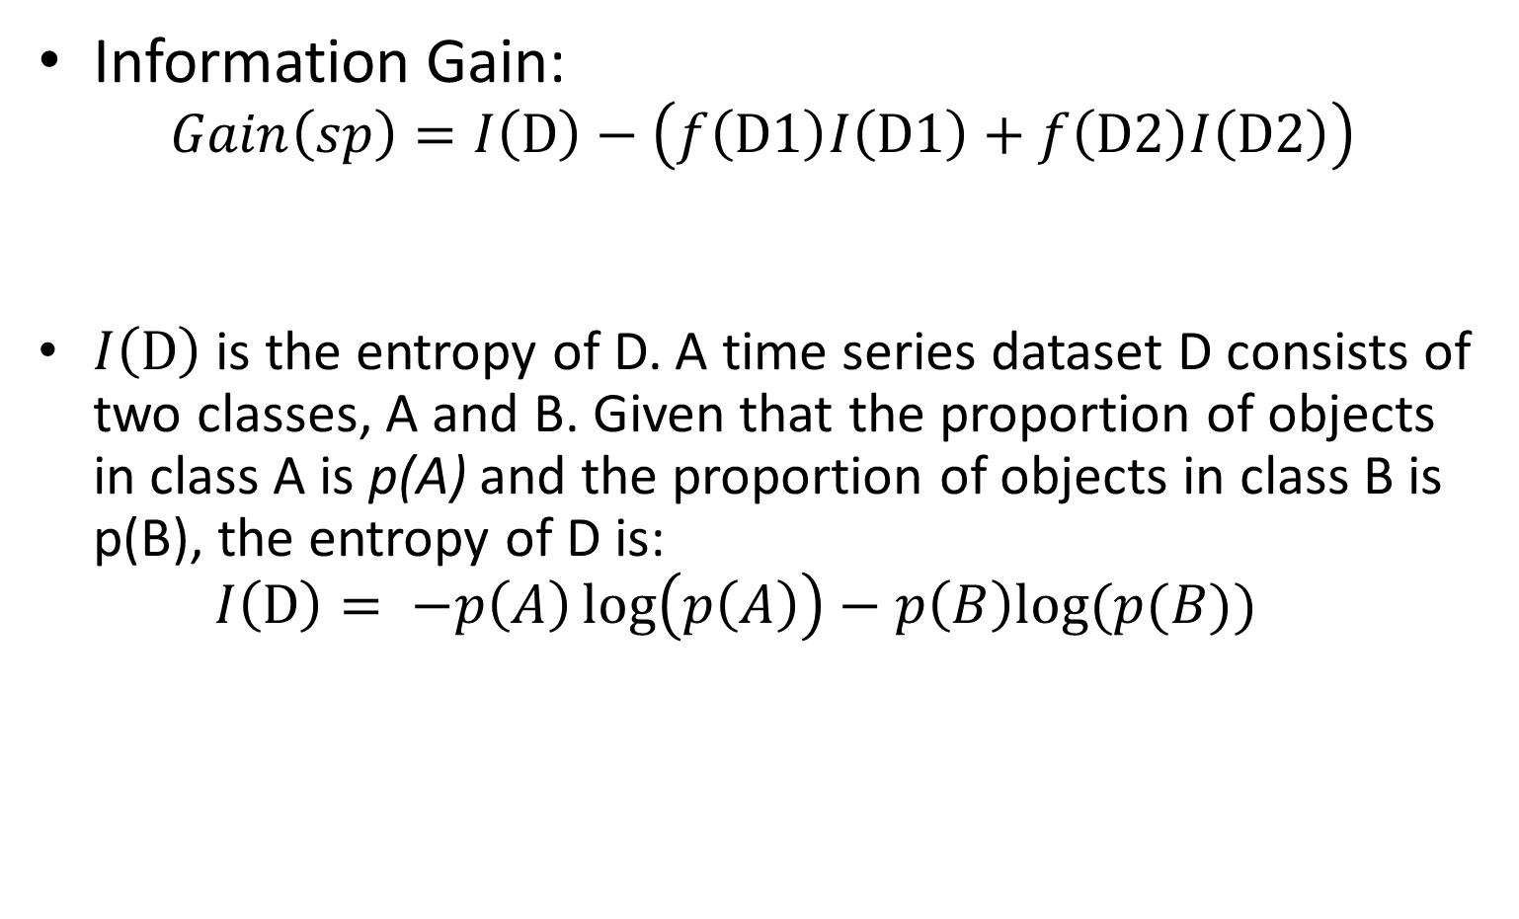
Definitions
Information Gain: $Gain\left(sp\right)=I\left(D\right)−\left(f\left(D1\right)I\left(D1\right)+f\left(D2\right)I\left(D2\right)\right)$
$I\left(D\right)$ is the entropy of D. A time series dataset D consists of two classes, A and B. Given that the proportion of objects in class A is p(A) and the proportion of objects in class B is p(B), the entropy of D is: $I\left(D\right)= −p\left(A\right)\log\left(p\left(A\right)\right)−p\left(B\right)log⁡(p(B))$

Slide 11
Definitions
Example: Ten time series objects are arranged in a one-dimensional representation by measuring their distance to the best-so-far candidate. This happens to be a good case, with five of the six objects from class A (represented by circles) closer to the candidate than any of the four objects from class B (represented by squares). In addition, of the five objects to the right of the split point, only one object from class A is mixed up with the class B. The optimal split point is represented by a vertical dashed line, and the best-so-far information gain is: [-(6/10)log(6/10) - (4/10)log(4/10)] – [(5/10)[-(5/5)log(5/5)] + (5/10)[-(4/5)log(4/5) - (1/5)log(1/5)]] = 0.4228

Slide 12
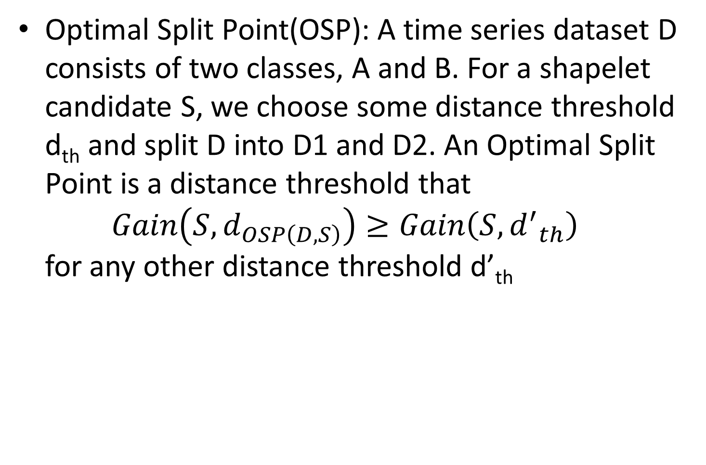
Definitions
Optimal Split Point(OSP): A time series dataset D consists of two classes, A and B. For a shapelet candidate S, we choose some distance threshold d_{th} and split D into D1 and D2. An Optimal Split Point is a distance threshold that $Gain\left(S, d_{OSP\left(D,S\right)}\right)≥Gain\left(S,{d^{′}}_{th}\right)$ for any other distance threshold d’_{th}

Slide 13
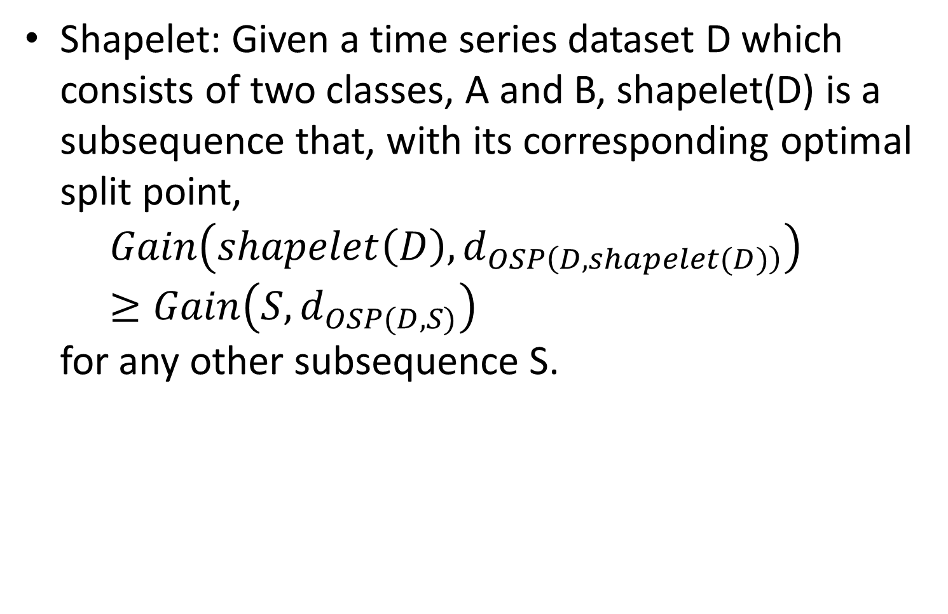
Definitions
Shapelet: Given a time series dataset D which consists of two classes, A and B, shapelet(D) is a subsequence that, with its corresponding optimal split point, $Gain\left(shapelet\left(D\right), d_{OSP\left(D,shapelet(D)\right)}\right)≥Gain\left(S,d_{OSP(D,S)}\right)$ for any other subsequence S.

Slide 14
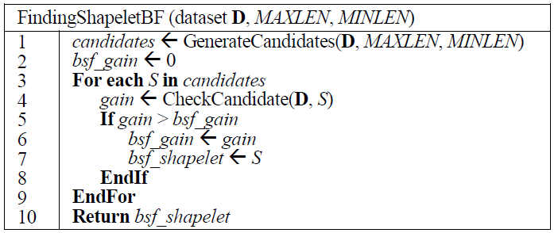
Algorithm
Given a combined dataset D, in which each time series object is labeled either class A or class B, along with the user-defined maximum and minimum lengths of the shapelet.

Slide 15
Algorithm
Time complexity: The number of the time series objects in the dataset is k and the average length of each time series is m. The size of the candidate set is O(m²k). Checking the utility of one candidate takes O(mk). The overall time complexity of the algorithm is O(m³k²).

Slide 16
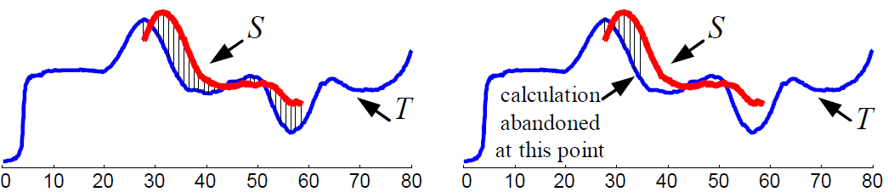
Subsequence Distance Early Abandon
In the brute force method, the distance from the time series T to the subsequence S is obtained by calculating the Euclidean distance of every subsequence of length |S| in T and S and choosing the minimum. This takes O(|T|) distance calculations between subsequences. We need to know is the minimum distance rather than all of the distances.

Slide 17

Admissible Entropy Pruning
Ten time series objects are arranged in a one-dimensional. Six objects from class A (represented by circles) and four objects from class B (represented by squares).
best-so-far information gain is 0.4228
The arrangement of first five distances from the time
series objects to the candidate.
The information gain of the better of the two optimistic predictions is:
[-(6/10)log(6/10)-(4/10)log(4/10)] - [(4/10)[-(4/4)log(4/4)]+(6/10)[-(4/6)log(4/6)-(2/6)log(2/6)]]=0.2911

Slide 18
Performance Comparison
We test the scalability of our shapelet finding algorithm on the Synthetic Lightning EMP Classification, which, with a 2,000/18,000 train/test split, is the largest class-labeled time series dataset we are aware of.

Slide 19
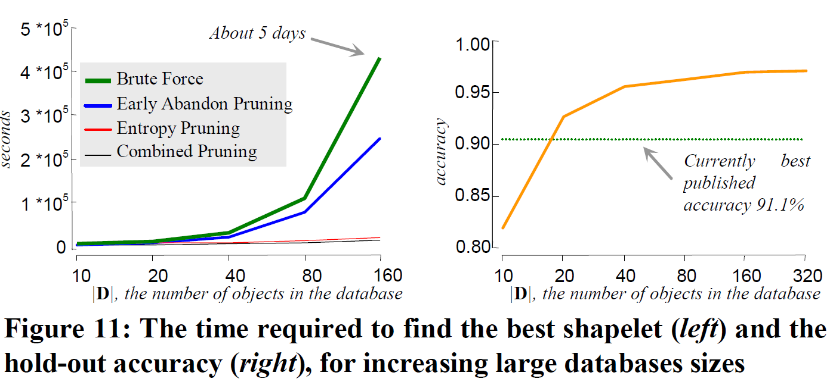
Performance Comparison

Slide 20
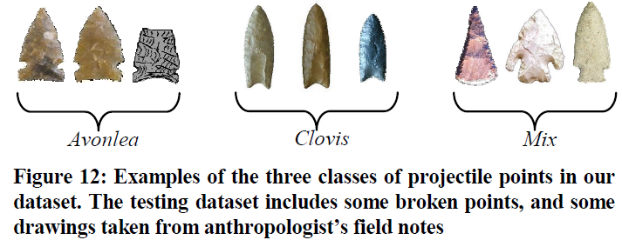
Results - Projectile Points (Arrowheads)

Slide 21
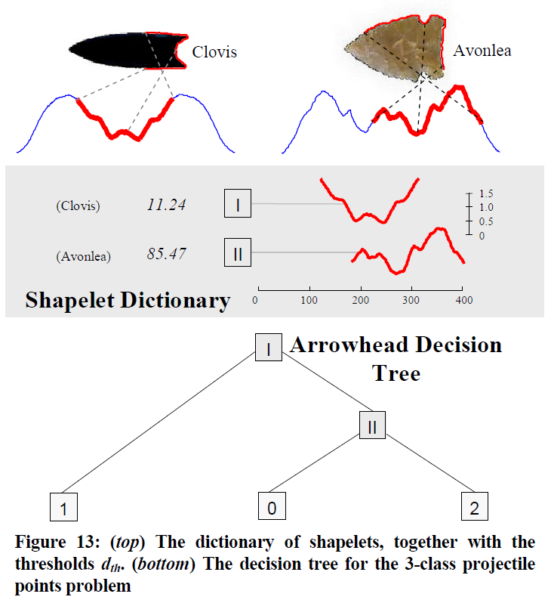
Results - Projectile Points (Arrowheads)

Slide 22
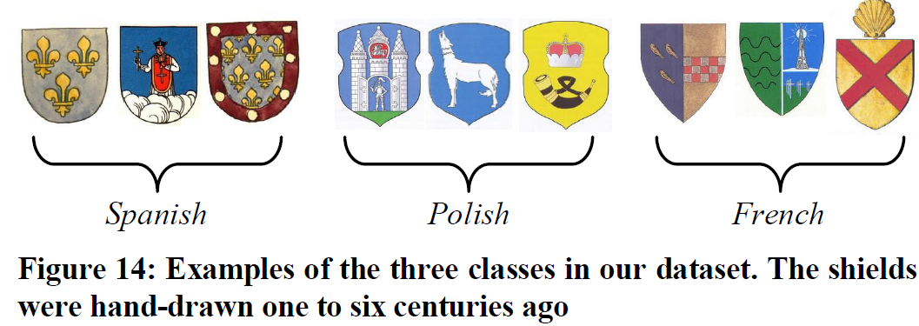
Results - Mining Historical Documents

Slide 23
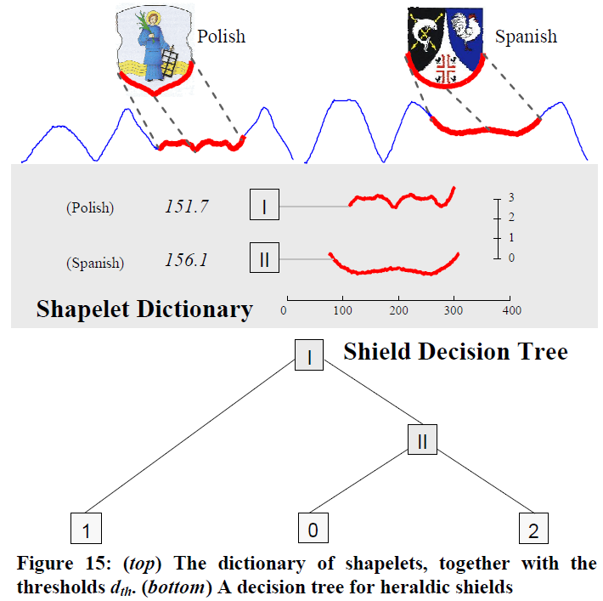
Results - Mining Historical Documents

