Slide 1
Parallel Breadth First Search on GPU Clusters
Zhisong Fu, Harish Kumar Dasari, Bradley Bebee,
Martin Berzins, Bryan Thompson
The University of Utah
2014 IEEE International Conference on Big Data
Presenter : Yao-Chou Tsai
Date : 2015/3/2

Slide 2
Abstract(1/2)
Fast, scalable, low-cost, and low-power execution of parallel graph algorithms is important for a wide variety of commercial and public sector applications. Breadth First Search (BFS) imposes an extreme burden on memory bandwidth and network communications and has been proposed as a benchmark that may be used to evaluate current and future parallel computers. Hardware trends and manufacturing limits strongly imply that many-core devices, such as NVIDIA GPUs and the Intel Xeon Phi , will become central components of such future systems.

Slide 3
Abstract(2/2)
GPUs are well known to deliver the highest FLOPS/watt and enjoy a very significant memory bandwidth advantage over CPU architectures. Recent work has demonstrated that GPUs can deliver high performance for parallel graph algorithms and, further, that it is possible to encapsulate that capability in a manner that hides the low level details of the GPU architecture and the CUDA language but preserves the high throughput of the GPU. We extend previous research on GPUs and on scalable graph processing on supercomputers and demonstrate that a high-performance parallel graph machine can be created using commodity GPUs and networking hardware.

Slide 4
References
MapGraph: A High Level API for Fast Development of High Performance Graph Analytics on GPUs; 2014
Parallel Breadth-First Search on Distributed Memory Systems; 2011
Breaking the speed and scalability barriers for graph exploration on distributed-memory machines; 2012
Parallel Breadth First Search on GPU Clusters; 2014

Slide 5
Conception
Alice
Sue
Bob
Mary
4 vertices, 3 edges

Slide 6
Why?
BFS
Least work per byte
The most reliance on memory bandwidth within the node while placing a severe stress on the communications network among the nodes.
GPUs
High performance : NVIDIA K40 => 1.43 Tflops
High energy efficieny

Slide 7
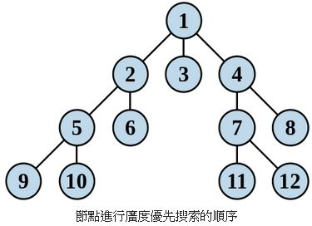
BFS(Breadth first search)(1/3)

Slide 8
BFS(Breadth first search)(2/3)
1 procedure BFS(G,v) is
2 let Q be a queue
3 Q.push(v)
4 label v as discovered
5 while Q is not empty
6 v ← Q.pop()
7 for all edges from v to w in G.adjacentEdges(v) do
8 if w is not labeled as discovered
9 Q.push(w)
10 label w as discovered

Slide 9
BFS(Breadth first search)(3/3)
Explain:
It is a graph search algorithm that begins at the root vertex and explores all the connected vertices, traversing all vertices of a particular level before traversing the vertices of the next level.
At the end of the BFS we can find out the level of a vertex if it is connected to the root element and also its predecessor.
Useful in social media, logistics and supply chains, e-commerce, counter-terrorism, fraud detection etc.

Slide 10
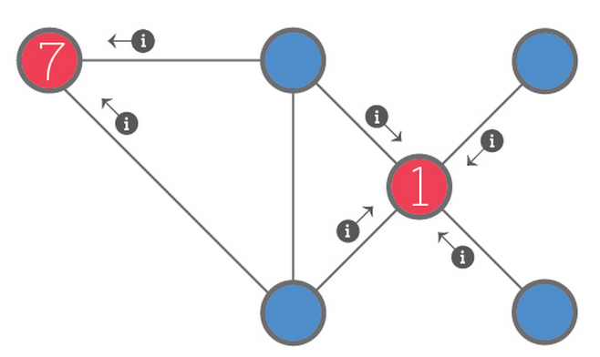
GAS abstraction(1/3)
Gather : The Gather phase collect information from the 1-hop neighborhood of a vertex using a generalized binary operator to perform a parallel reduction over the 1-hop edges and vertices in that 1-hop neighborhood.

Slide 11
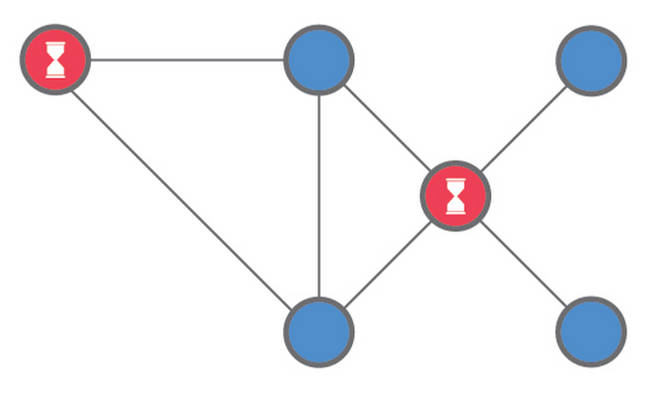
GAS abstraction(2/3)
Apply : The Apply phase integrates the information from the Gather phase, updating the state of the vertex. In the picture, the red vertices are the active vertices. Their state may change as a result of the apply operation.

Slide 12
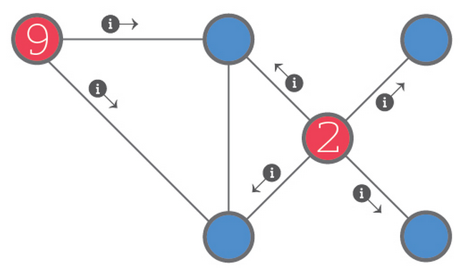
GAS abstraction(3/3)
Scatter : The Scatter phase redistributes information to the 1-hop neighborhood of a vertex. Again the red vertices are the active vertices. You can see that their state has changed. This change occurred during the Apply phase (above). The little (i) icons show the movement of messages along the edges leading to the 1-hop neighbors of the active vertices.

Slide 13
Compressed Sparse Row(CSR)(1/2)
1 | 7 | 0 | 0
0 | 2 | 8 | 0
5 | 0 | 3 | 9
0 | 6 | 0 | 4
Row offsets
0 | 2 | 4 | 7 | 9
Column indices
0 | 1 | 1 | 2 | 0 | 2 | 3 | 1 | 3
Values
1 | 7 | 2 | 8 | 5 | 3 | 9 | 6 | 4

Slide 14
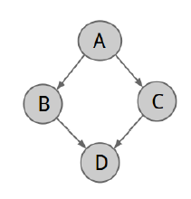
Compressed Sparse Row(CSR)(2/2)
A
B
C
Row offsets
1 | 3 | 4 | 5
B
D
Values
C
D
B | C | D | D
D
Column indices
1 | 2 | 1 | 1

Slide 15
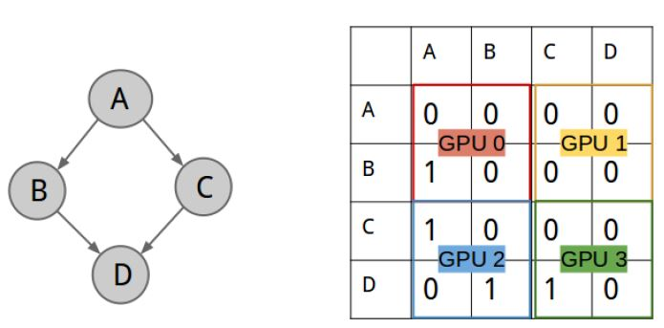
2-D partition

Slide 16
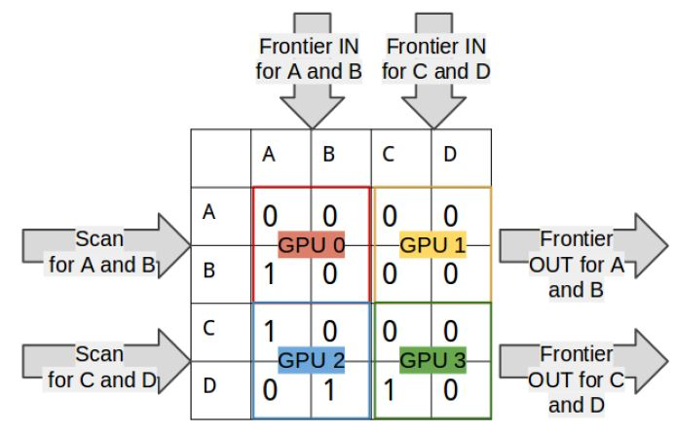
2-D partition

Slide 17
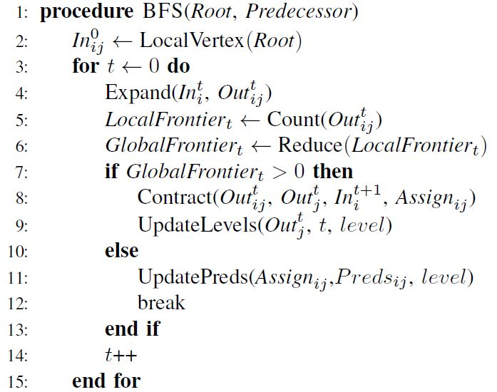
Pseudo code(1/3)

Slide 18
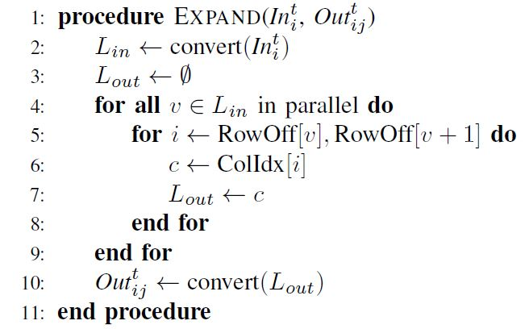
Pseudo code(2/3)

Slide 19
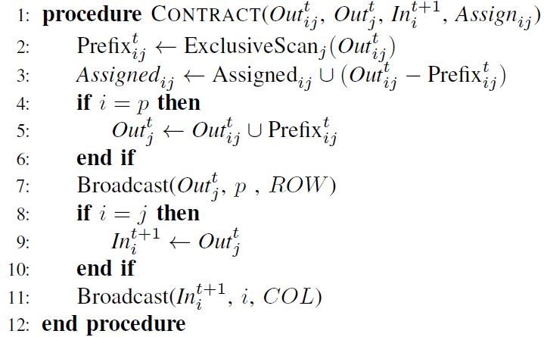
Pseudo code(3/3)

Slide 20
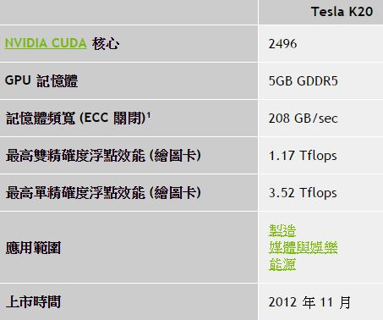
Experimental setup
32 nodes and 64 NVIDIA K20c GPUs with 5GB DDR5 memory
Two Mellanox InfiniBand SX6025 cards per node
CUDA 5.5 used for these results
Used GPUDirect support in MVAPICH2-GDR to avoid explicit copy of messages to host memory

Slide 21
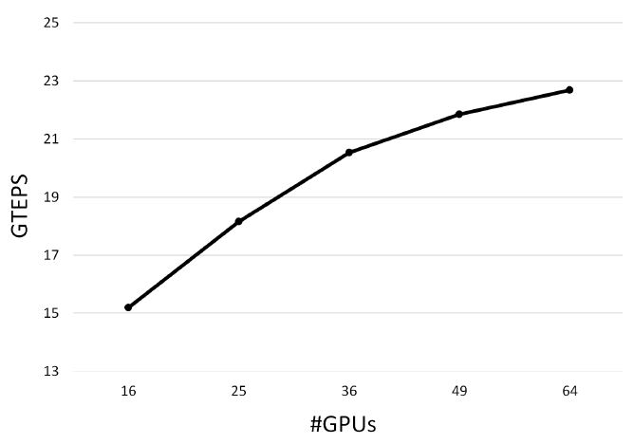
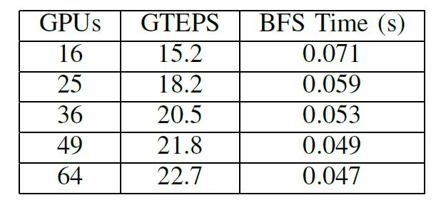

Results
Strong scaling : The scale of the problem remains the same as we increase the computational resources (GPUs)
GTEPS= Giga(Billion) Traversed Edges Per Second = ${10}^{9}$edges per second

Slide 22
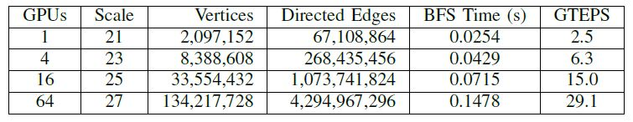
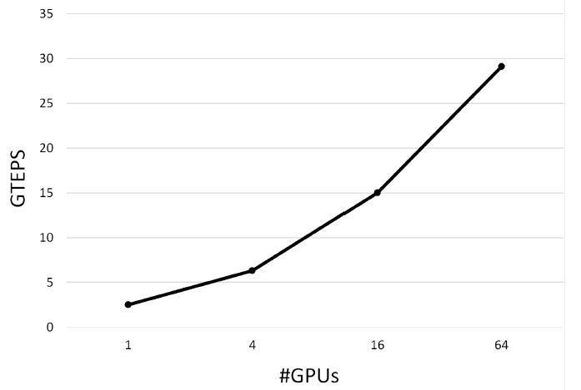
Results
2. Weak scaling: Problem size grows proportional to the growth in computational resources (GPUs)

Slide 23
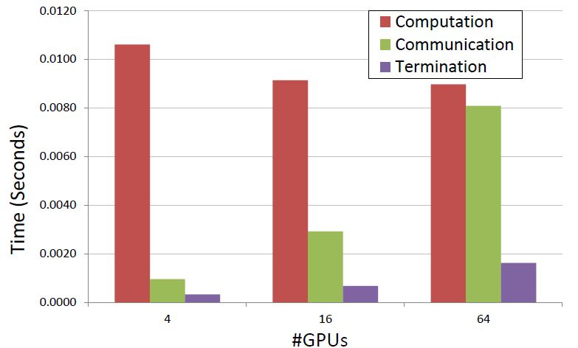
Results

