Slide 1
The Floyd-Warshall Algorithm on Graphs with Negative Cycles
Information Processing Letters 110 (2010) 279–281
Stefan Hougardy
Research Institute for Discrete Mathematics, University of Bonn, Lennestr. 2, 53113 Bonn, Germany
Presenter: 許竣傑
2013/1/8

Slide 2
Abstract
The Floyd–Warshall algorithm is a simple and widely used algorithm to compute shortest paths between all pairs of vertices in an edge weighted directed graph. It can also be used to detect the presence of negative cycles.
We will show that for this task many existing implementations of the Floyd–Warshall algorithm will fail because exponentially large numbers can appear during its execution

Slide 3
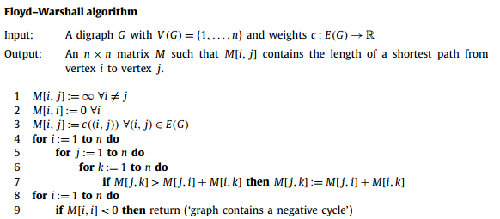
Floyd–Warshall Algorithm

Slide 4
Floyd–Warshall Algorithm
Negative cycle:
In a weighed graph, a negative cycle is a cycle whose sum of
edge weights is negative
-1
v1
-1
-1
v2
v3
-1

Slide 5
Floyd–Warshall Algorithm
v1
If M[j, k] > M[j, i]+M[i, k] then M[j, k] = M[j, i]+M[i, k]
5
1
S0 | v1 | v2 | v3
v1 | 0 | 5 | 1
v2 | 5 | 0 | 2
v3 | 1 | 2 | 0
i=v1 | v1 | v2 | v3
v1 | 0 | 5 | 1
v2 | 5 | 0 | 2
v3 | 1 | 2 | 0
v2
v3
2
i=v2 | v1 | v2 | v3
v1 | 0 | 5 | 1
v2 | 5 | 0 | 2
v3 | 1 | 2 | 0
i=v3 | v1 | v2 | v3
v1 | 0 | 3 | 1
v2 | 3 | 0 | 2
v3 | 1 | 2 | 0

Slide 6
Exponentially Large Numbers in the Floyd–Warshall Algorithm
Proposition 1. If the input graph of the Floyd–Warshall algorithm does not contain a negative cycle then
||M_{max}|| <= n*c_{max}
C_{max} : the largest absolute value that an edge weight in G
Proof. As such a path can consist of at most n -1 edges the result follows.

Slide 7



Exponentially Large Numbers in the Floyd–Warshall Algorithm
I = 1 | V1 | v2 | v3
V1 | (1) | (2) | (2)
V2 | (3) | (4) | (4)
V3 | (3) | (4) | (4)
Theorem 2. There exist graphs such that
||M_{max}|| = 2 · 6^{n-1} · c_{max}
during the execution of the Floyd–Warshall algorithm
Proof.
M[i, i] = - $\frac{1}{3}$ ·6^{i}， (1)
M[i, j] = - $\frac{1}{2}$ ·6^{i}，for j>i (2)
i = 2 | V1 | V2 | V3
V1 | - | - | -
V2 | - | (1) | (2)
V3 | - | (3) | (4)
M[j, i] = - $\frac{1}{2}$ ·6^{i}，for j>i (3)
M[i+1, j] = -6^{i}，for j>i (4)

Slide 8
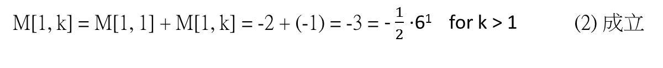
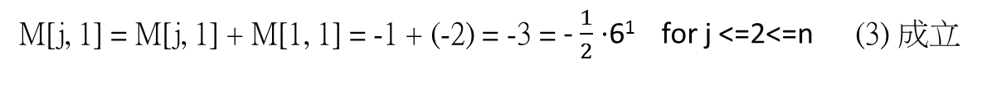
Exponentially Large Numbers in the Floyd–Warshall Algorithm
-1
v1
S0 | v1 | v2 | v3
v1 | -1 | -1 | -1
v2 | -1 | 0 | 2
v3 | -1 | 2 | 0
i=v1 | v1 | v2 | v3
v1 | -2 | -3 | -3
v2 | -3 | -6 | -6
v3 | -3 | -6 | -6
-1
-1
v2
v3
2
i = 1
M[1, 1] = M[1, 1] + M[1, 1] = -1 + (-1) = -2 = - $\frac{1}{3}$ ·6¹ (1) 成立
M[1, k] = M[1, 1] + M[1, k] = -2 + (-1) = -3 = - $\frac{1}{2}$ ·6¹ for k > 1 (2) 成立
M[j, 1] = M[j, 1] + M[1, 1] = -1 + (-2) = -3 = - $\frac{1}{2}$ ·6¹ for j <=2<=n (3) 成立
M[2, j] = M[2, 1] + M[1, j] = -3 + (-3) = -6 = -6¹ for j > i (4) 成立

Slide 9
Exponentially Large Numbers in the Floyd–Warshall Algorithm
i=v1 | v1 | v2 | v3
v1 | -2 | -3 | -3
v2 | -3 | -6 | -6
v3 | -3 | -6 | -6
i=v2 | v1 | v2 | v3
v1 | -2 | -3 | -3
v2 | -3 | -12 | -18
v3 | -3 | -18 | -36
i > 1
M[i, i] = M[i, i] + M[i, i] = - 6^{i-1} + (- 6^{i-1}) = -12 = - $\frac{1}{3}$ ·6^{i} use(4) proves(1)
From (4)
M[i, j] = M[i, i] + M[i, j] = - $\frac{1}{3}$ ·6^{i} + (-6^{i-1}) = -12 + (-6) = - $\frac{1}{2}$ ·6^{i} for j>i proves(2)
M[j, i] = M[j, i] + M[i, i] = -6^{i-1} +(- $\frac{1}{3}$ ·6^{i} )= -12 + (-6) = - $\frac{1}{2}$ ·6^{i} for j>i proves(3)
M[i+1, j] = M[i+1, i] + M[i, j] = - $\frac{1}{2}$ ·6^{i} +(- $\frac{1}{2}$ ·6^{i} )= -18 + (-18) = - 6^{i} for j>i prove (4)

Slide 10
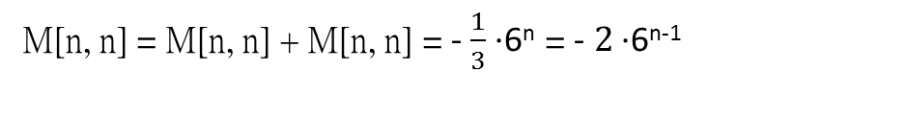
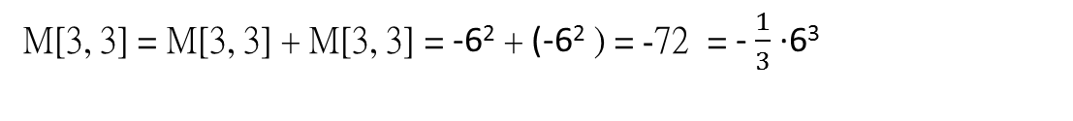
Exponentially Large Numbers in the Floyd–Warshall Algorithm
i=v2 | v1 | v2 | v3
v1 | -2 | -3 | -3
v2 | -3 | -12 | -18
v3 | -3 | -18 | -36
i=v3 | v1 | v2 | v3
v1 | -2 | -3 | -3
v2 | -3 | -12 | -18
v3 | -3 | -18 | -72
i = 3
 |  | v | vv | …
v1 | -1 | -1 | -1 | ... | -1
v2 | -1
v3 | -1
… | …
vn | -1
v1
v2
v3
…
vn
M[3, 3] = M[3, 3] + M[3, 3] = -6² + (-6² ) = -72 = - $\frac{1}{3}$ ·6³
when i = n
M[n, n] = M[n, n] + M[n, n] = - $\frac{1}{3}$ ·6^{n} = -$2$ ·6^{n-1}

