Slide 1
Image Retrieval from Databases: an Approach using Region Color and Indexing Technique IJCSNS International Journal of Computer Science and Network Security Vol.8, No.1, 2008
M. V. Sudhamani, C. R. Venugopal Visvesvaraya Technological University
Karnataka, India
Presentor：Hsin-Chuan Yuan

Slide 2
The paper focuses on a low-dimensional color-based indexing technique for achieving efficient and effective retrieval performance. We have implemented the technique of retrieval of images from databases based on color feature extracted from each region/regions of an image represented by dominant or representative color descriptor. Each image is segmented using Mean Shift algorithm, a robust clustering technique to extract color feature of a region of interest. Image databases have been designed and the image region features are ingested into them.

Slide 3
Indexing data structures are designed to support basic operations on image databases such as search, insertion, and deletion. Search efficiency is considered as the most important aspect because search is normally carried out on-line. The new algorithm cluster-based R*-tree indexing is proposed and compared the efficiency with R* -tree and sequential search. The accuracy of the retrieval system is measured and compared the results. Experimental results show the high performance of the proposed method. The toolbox is developed in JAVA to incorporate all these modules and retrieve images based on query-by-example.

Slide 4
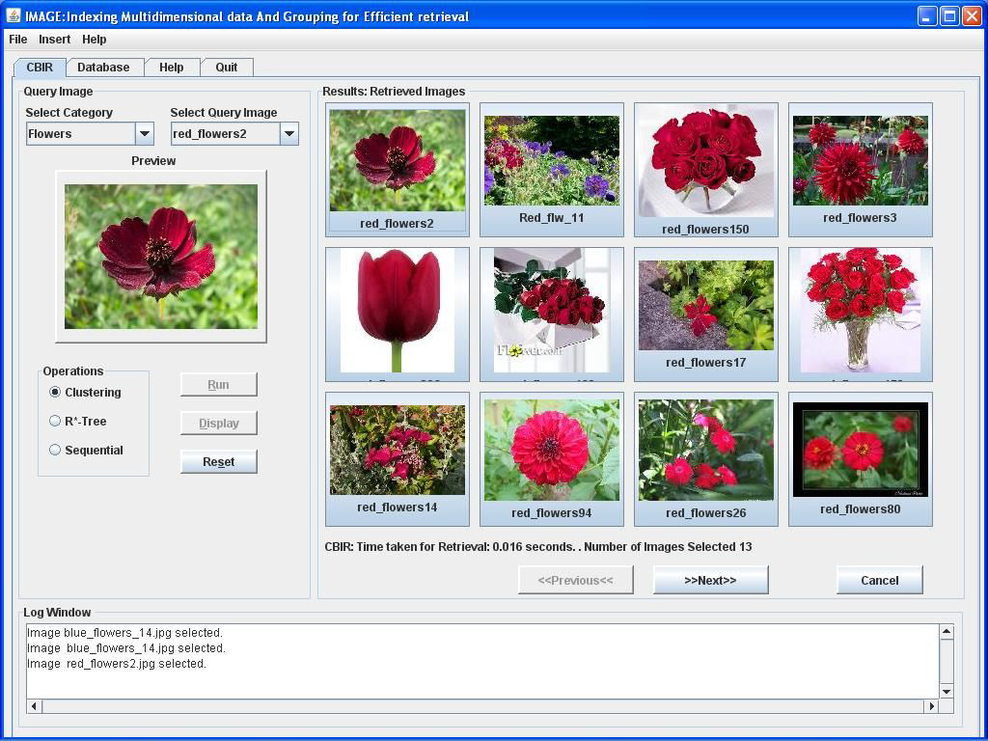
Introduction
Construct an image database which support basic operations such as search, insertion, and deletion.
Architecture
Feature Extraction
Mean Shift Segmentation
Database Design and Indexing
R-tree
Experimental Results

Slide 5
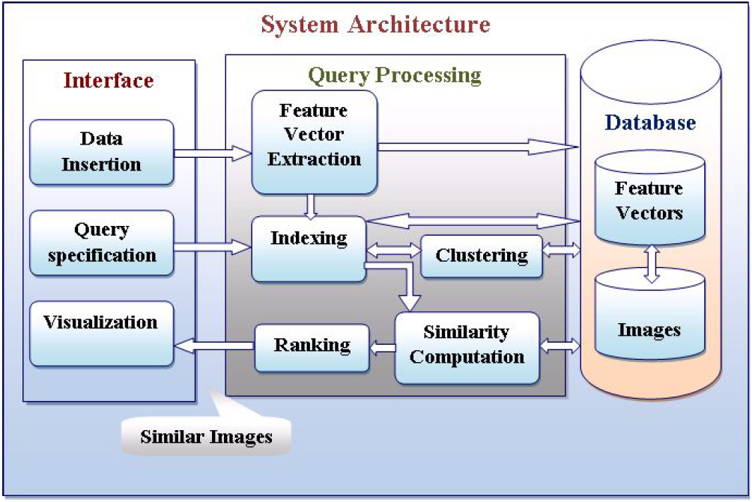
Architecture
Data insertion：extracting appropriate features from images and storing them into the image database.
Query processing：extracts a feature vector from a query pattern, evaluate the similarity between the query image and the database images.

Slide 6
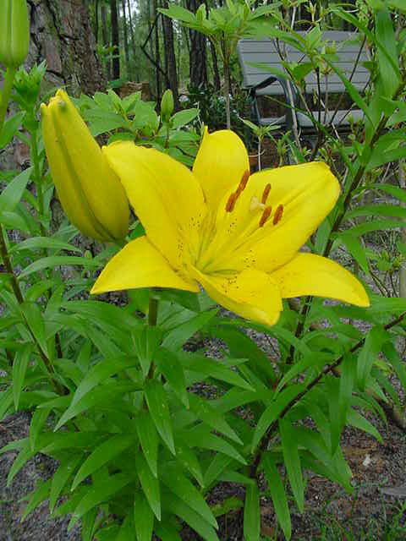
Feature Extraction
Mean Shift Segmentation

Slide 7
Mean Shift Clustering
Region of
interest
Center of
mass
Mean Shift
vector
Objective : Find the densest region

Slide 8
Mean Shift Clustering
Region of
interest
Center of
mass
Mean Shift
vector
Objective : Find the densest region

Slide 9
Mean Shift Clustering
Region of
interest
Center of
mass
Mean Shift
vector
Objective : Find the densest region

Slide 10
Mean Shift Clustering
Region of
interest
Center of
mass
Mean Shift
vector
Objective : Find the densest region

Slide 11
Mean Shift Clustering
Region of
interest
Center of
mass
Mean Shift
vector
Objective : Find the densest region

Slide 12
Mean Shift Clustering
Region of
interest
Center of
mass
Mean Shift
vector
Objective : Find the densest region

Slide 13
Mean Shift Clustering
Region of
interest
Center of
mass
Objective : Find the densest region

Slide 14
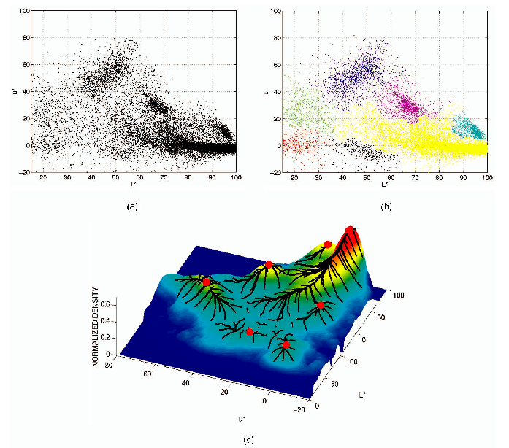
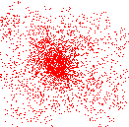
Mean Shift Clustering
Cluster : All data points in the attraction basin of a mode
Attraction basin : the region for which all trajectories lead to the same mode

Slide 15
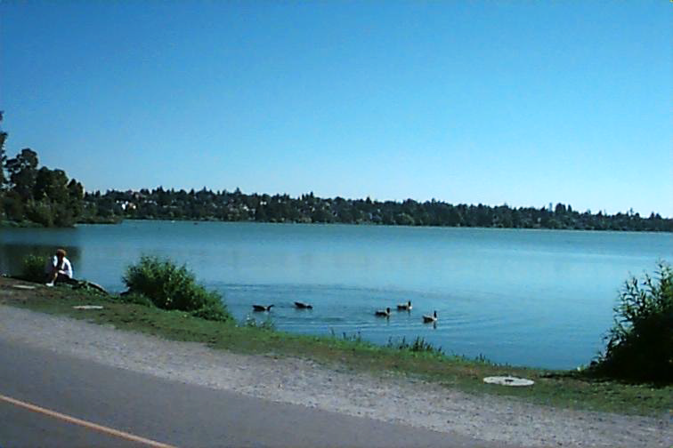
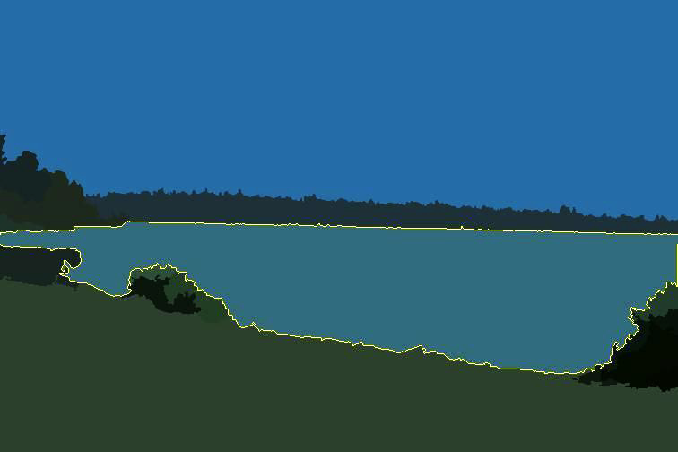
Mean Shift Segmentation
Clustering Algorithm
Define sample set of points
Apply the mean shift procedure
O(k x n)
Reapply on perturbed cluster center candidates
Derive the cluster centers y1......y p from the cluster center candidates
Validate the cluster centers
Clusters delineation
k- nearest neighbor technique

Slide 16
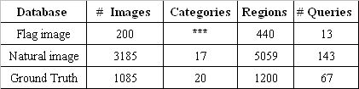
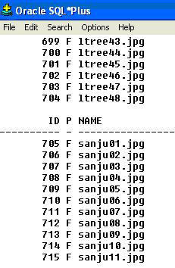
Database Design and Indexing
Each representative color descriptor F is defined to be F={ci}, i=1,., 3, where ci is 3-D color vector of a region.
The proposed indexing scheme allows the database to be dynamic, allowing straightforward insertion and deletions.

Slide 17

Database Design and Indexing
1. Given n the number of query regions, for each query region q_{j}, find the regions belonging to cluster c_{j}, where j = 1,.., n .
2. For each region r_{i} in the image database
a. Find the feature vector f_{i}, for region r_{i} .
b. For each query region q_{j}, in the query set
i. Find query feature vector f_{j} , for q_{j} .
ii. Find the Euclidean distance between fi and
iii. Measure the similarity between fi and f j using m_{ij} = d_{ij} -t , where t is the search range limit set by user.
iv. If m_{ij} != 0 , then f_{i} belongs to cluster c_{j} and go to step 2.
Index only representatives of c_{j}, using R-tree.

Slide 18
Database Design and Indexing
Query image
r_{i}
Feature Vectors
q_{j}
Images
R*-tree
Similar
Images
Similar
Images
Rank

Slide 19
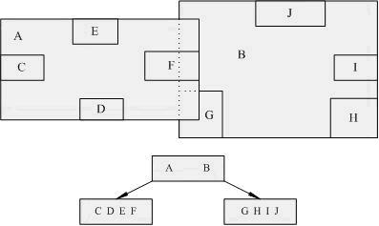
R-Tree
R-tree is a depth-balanced tree
Rectangular region is information
Given a fixed k
Branch:
Half full
e.g. k = 5
3 ~ 5
e.g. k = 4
2 ~ 4
2 groups
4 regions

Slide 20
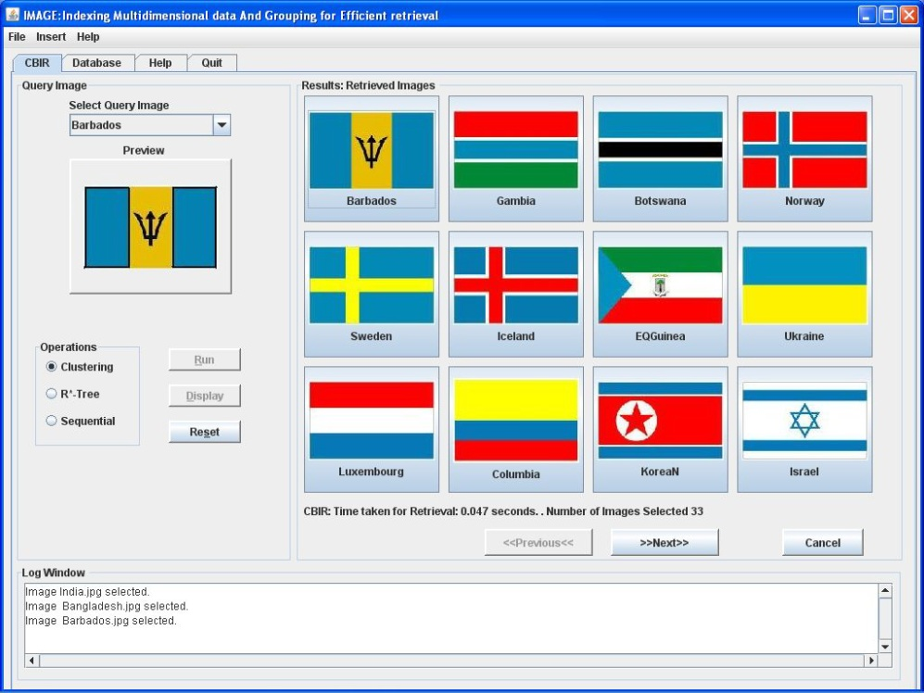
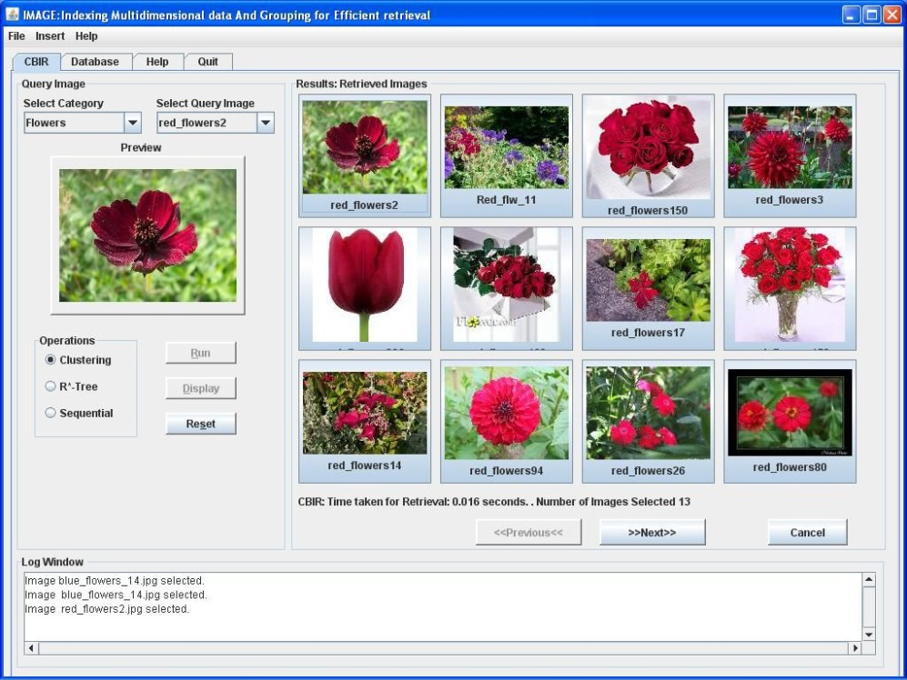
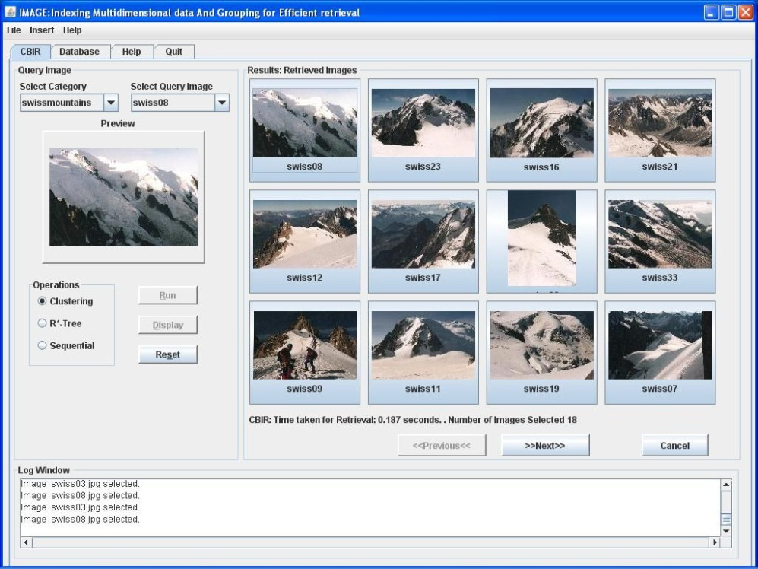
Experimental Results

Slide 21
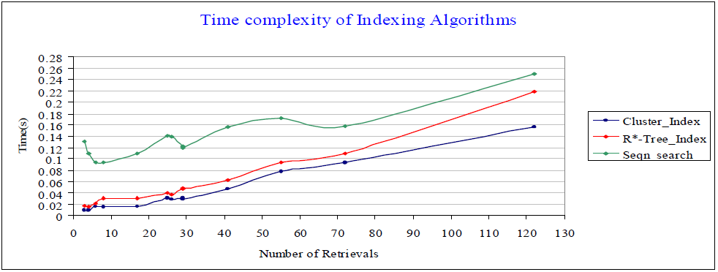
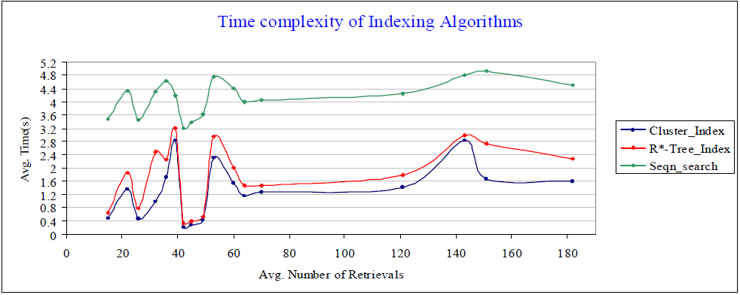
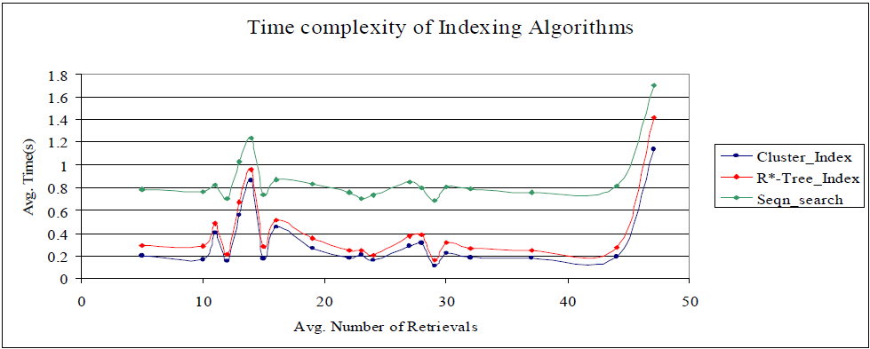
Experimental Results

Slide 22
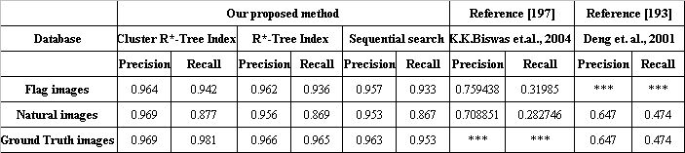
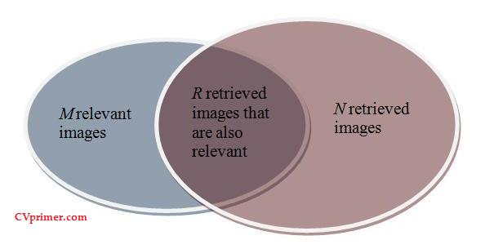
Experimental Results
Precision = R / N
Recall = R / M

Slide 23
Conclusions
The mean shift algorithm is used for segmentation to obtain regions of interest to improve the effectiveness of the retrieval system.
Experimental results depict the proposed method gives better performance over the R*-Tree.
Accuracy of retrieval is shown to be high.

