Slide 1
Dynamic time warping constraint learning for large margin nearest neighbor classification
Journal of Information Sciences 181 (2011) 2787–2796
Daren Yu, Xiao Yu , Qinghua Hu, Jinfu Liu, Anqi Wu
Harbin Institute of Technology, Harbin 150001, China
Presenter: Te-Sheng Chan
Data: 2013/11/12

Slide 2
Abstract
Nearest neighbor (NN) classifier with dynamic time warping (DTW) is considered to be an effective method for time series classification. The performance of NN-DTW is dependent on the DTW constraints because the NN classifier is sensitive to the used distance function. For time series classification, the global path constraint of DTW is learned for optimization of the alignment of time series by maximizing the nearest neighbor hypothesis margin. In addition, a reduction technique is combined with a search process to condense the prototypes. The approach is implemented and tested on UCR datasets. Experimental results show the effectiveness of the proposed method.

Slide 3
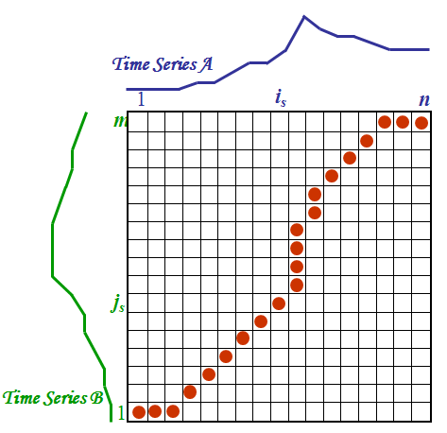
Dynamic Time Warping(1/3)
DTW(i,j) = cost(i,j) + minimum(DTW(i - 1, j),
DTW(i , j - 1),
DTW(i - 1, j - 1))
i
i
i+2
time

Slide 4
Dynamic Time Warping(2/3)
A[ ] = { 6 , 9 , 9 , 7 , 10 }
B[ ] = { 7 , 4 , 8 , 3 , 10 }
cost(i , j) : |A[ i ] - B[ j ]|

Slide 5
Dynamic Time Warping(3/3)
 |  | 7 | 4 | 8 | 3 | 10
 | 0 | ∞ | ∞ | ∞ | ∞ | ∞
6 | ∞ | 1 | 3 | 5 | 8 | 12
9 | ∞ | 3 | 6 | 4 | 10 | 9
9 | ∞ | 5 | 8 | 5 | 10 | 10
7 | ∞ | 5 | 8 | 6 | 9 | 12
10 | ∞ | 8 | 11 | 8 | 13 | 9

Slide 6
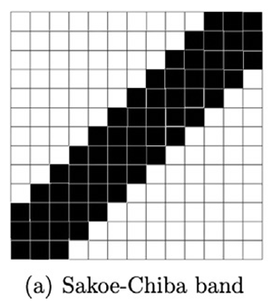

Constraints(1/2)
‧由 Hiroaki Sakoe 、Seibi Chiba 所提出。
‧

Slide 7
Constraints(2/2)
 |  | 7 | 4 | 8 | 3 | 10
 | 0 | ∞ | ∞ | ∞ | ∞ | ∞
6 | ∞ | 1 | 3 | ∞ | ∞ | ∞
9 | ∞ | 3 | 6 | 4 | ∞ | ∞
9 | ∞ | ∞ | 8 | 5 | 10 | ∞
7 | ∞ | ∞ | ∞ | 6 | 9 | 12
10 | ∞ | ∞ | ∞ | ∞ | 13 | 9
 |  | 7 | 4 | 8 | 3 | 10
 | 0 | ∞ | ∞ | ∞ | ∞ | ∞
6 | ∞ | 1 | ∞ | ∞ | ∞ | ∞
9 | ∞ | ∞ | 6 | ∞ | ∞ | ∞
9 | ∞ | ∞ | ∞ | 7 | ∞ | ∞
7 | ∞ | ∞ | ∞ | ∞ | 11 | ∞
10 | ∞ | ∞ | ∞ | ∞ | ∞ | 11
K = 1
K = 0
 |  | 7 | 4 | 8 | 3 | 10
 | 0 | ∞ | ∞ | ∞ | ∞ | ∞
6 | ∞ | 1 | 3 | 5 | ∞ | ∞
9 | ∞ | 3 | 6 | 4 | 10 | ∞
9 | ∞ | 5 | 8 | 5 | 10 | 10
7 | ∞ | ∞ | 8 | 6 | 9 | 12
10 | ∞ | ∞ | ∞ | 8 | 13 | 9
K = 2

Slide 8
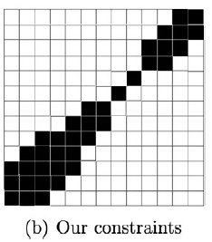

Our Constraints
Example:
k = 4 S =[2,1,0,1]

Slide 9
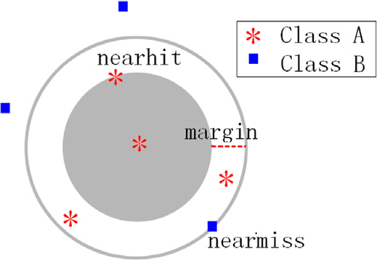
Margin

Slide 10

Evaluation Function
x is a sample in training set T
R means the radius of data
DTWs is calculated with DTW with the global path constraint S

Slide 11
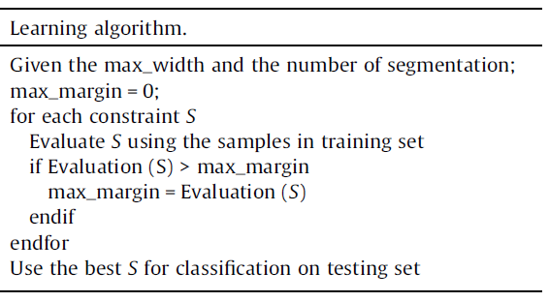
Learning Algorithm

Slide 12
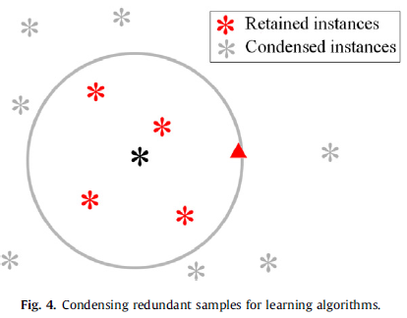
Condensing Redundant Samples
If DTW(X,Y) >
,Y can be ignored

Slide 13
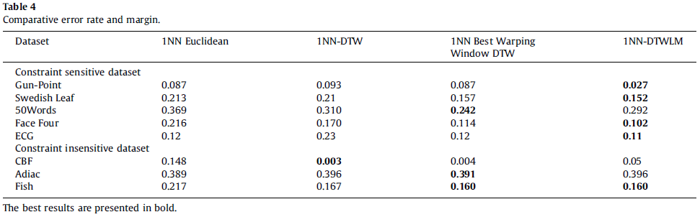
Experimental Results

Slide 14
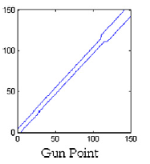
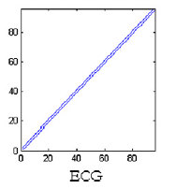
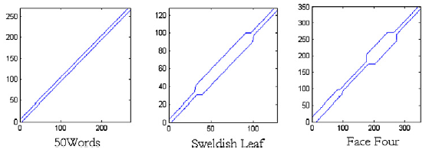
Shapes of Constraint

Slide 15
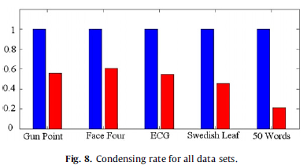
Condensing Rate

Slide 16
Thank you for listening

