Slide 1
A Common Interval Guided ACO Algorithm for Permutation Problems
Martin Clauß, Matthias Bernt and Martin Middendorf
2013 IEEE Symposium on Swarm Intelligence (SIS)64-71
Reporter : Cing-Yao Chen

Slide 2
Abstract
Ant Colony Optimization (ACO) has been successfully applied to many combinatorial optimization problems. In this work we propose a new solution construction scheme for ACO. This scheme uses the common intervals of the current iteration’s best solutions to guide the ants during solution construction. Firstly, we compared the performance of ACO and the proposed algorithm Common Interval ACO (CIACO). Secondly, we conducted an in-depth study for the CIACO algorithm to investigate the influence of the common interval guidance. For both experiments a large parameter space was used. The results show, that common intervals can be used to improve the solution quality in comparison to the standard ACO algorithm.

Slide 3
BACKGROUND

Slide 4
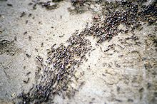
Ant Colony Optimization
procedure ACO_MetaHeuristic
while(not_termination)
generateSolutions()
daemonActions()
pheromoneUpdate()
end while
end procedure

Slide 5
Ant Colony Optimization
procedure ACO_MetaHeuristic
while(not_termination)
generateSolutions()
daemonActions()
pheromoneUpdate()
end while
end procedure

Slide 6
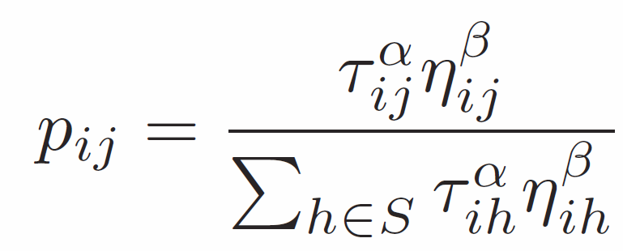
Ant Colony Optimization
procedure ACO_MetaHeuristic
while(not_termination)
generateSolutions()
daemonActions()
pheromoneUpdate()
end while
end procedure

Slide 7
Ant Colony Optimization
τ : Pheromone
η : Heuristic values
S : The nodes that have not been visited
p : The probability from node i to j.
τ (tauon) η (Eta)

Slide 8


Ant Colony Optimization
procedure ACO_MetaHeuristic
while(not_termination)
generateSolutions()
daemonActions()
pheromoneUpdate()
end while
end procedure
+=

Slide 9
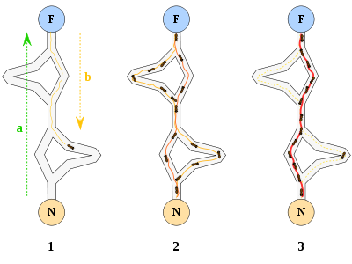
Ant Colony Optimization
procedure ACO_MetaHeuristic
while(not_termination)
generateSolutions()
daemonActions()
pheromoneUpdate()
end while
end procedure

Slide 10
Traveling Salesman Problem
NP-hard
N node
Min value for visited all node

Slide 11
Traveling Salesman Problem
brute force search
simple Branch and bound algorithm
Ant Colony Optimization Algorithm
Nearest Neighbor algorithm

Slide 12
COMMON INTERVAL ACO

Slide 13
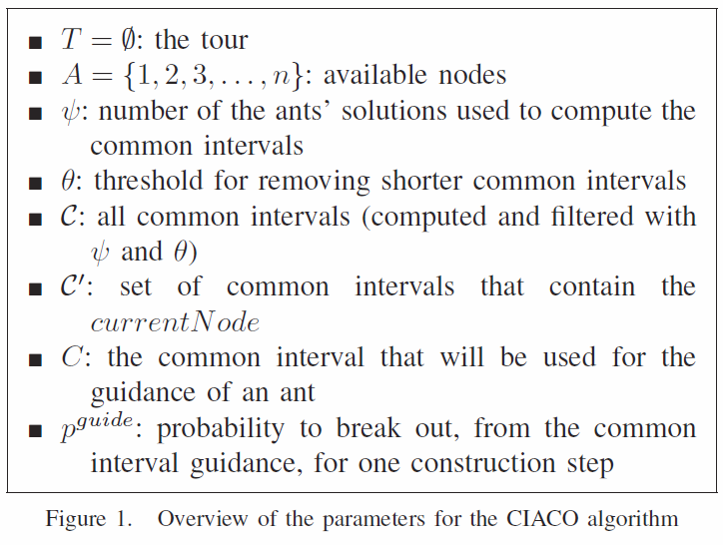
CIACO

Slide 14
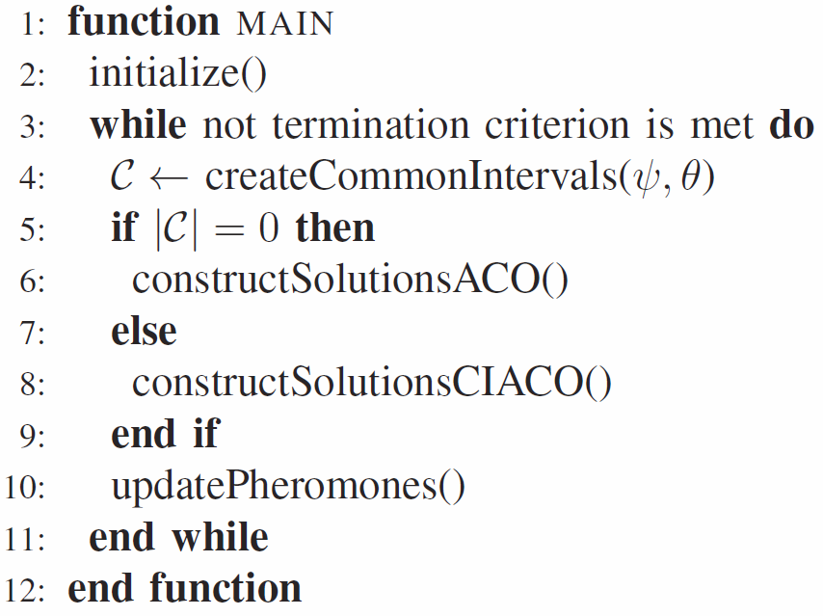
CIACO

Slide 15
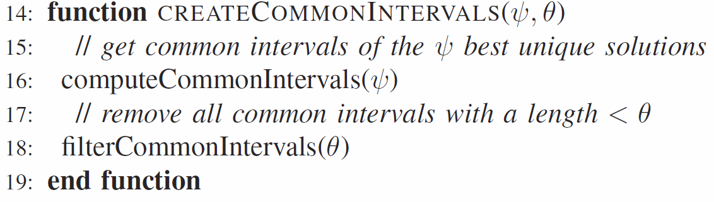
CIACO

Slide 16
CIACO

Slide 17
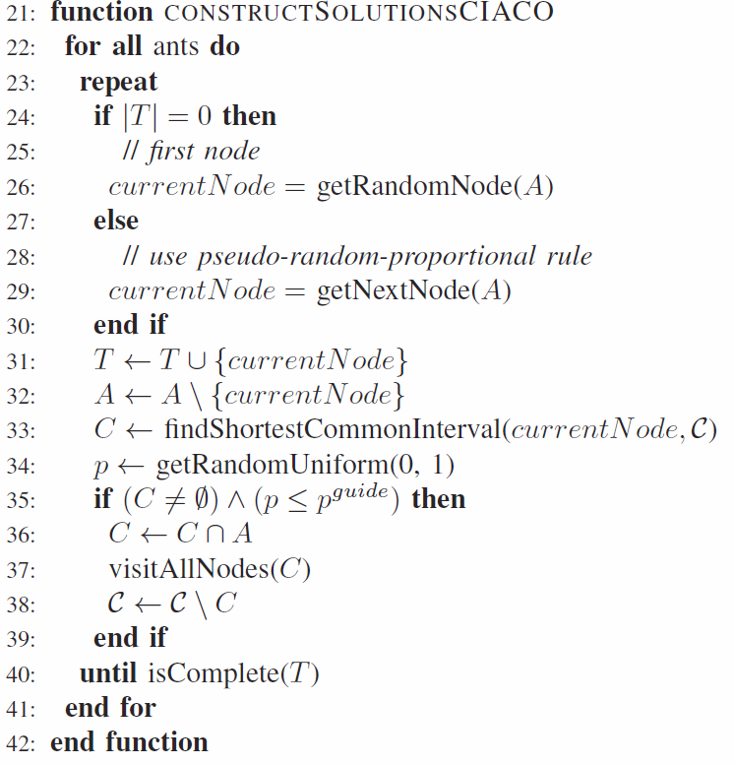
CIACO

Slide 18
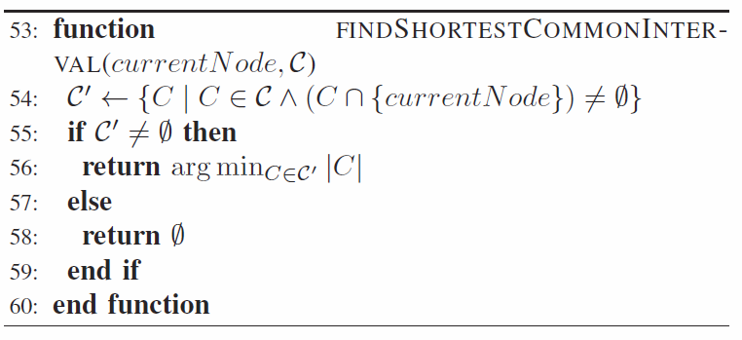
CIACO

Slide 19
CIACO

Slide 20
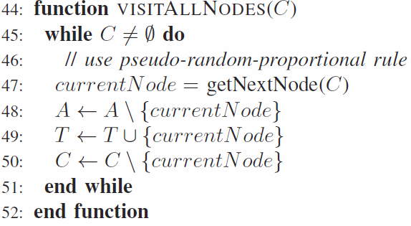
CIACO

Slide 21
CIACO

Slide 22
EXPERIMENTAL RESULTS

Slide 23
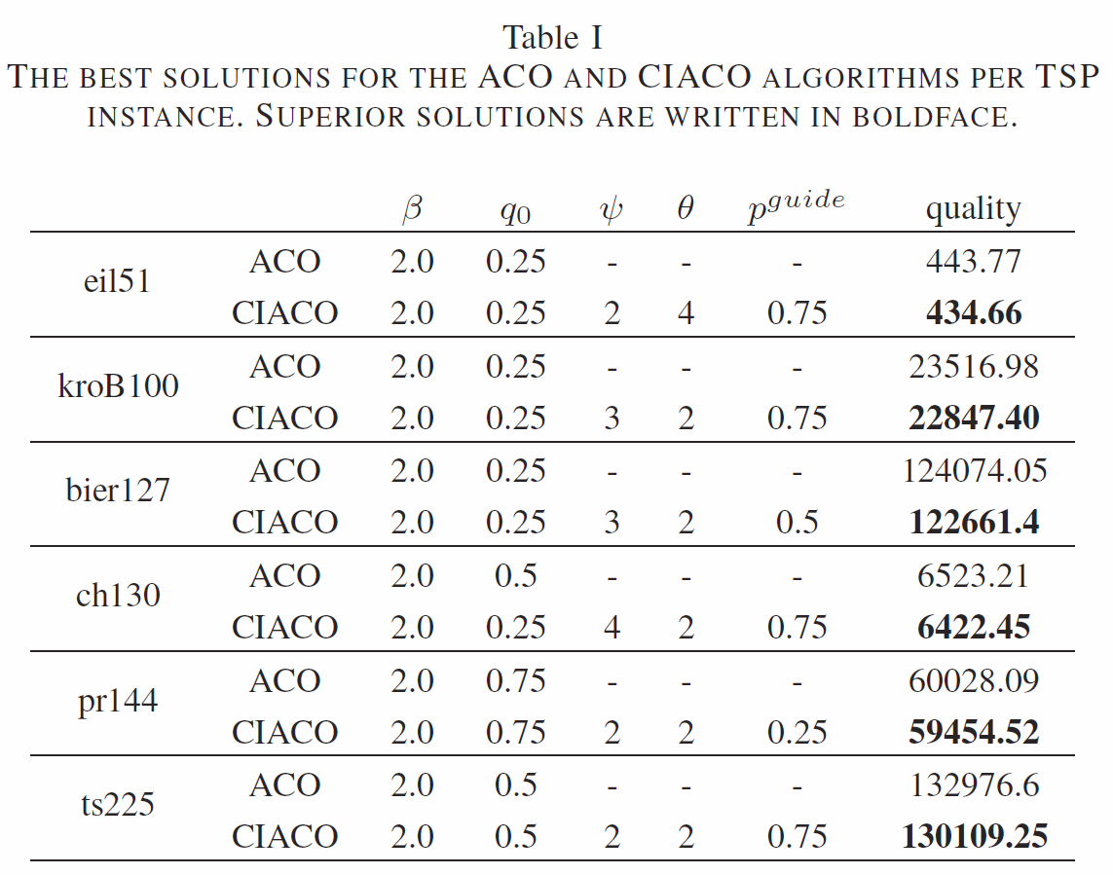
EXPERIMENTAL RESULTS
For a certain problem instance and algorithm using a given combination of parameter values (β, q0 and additionally ψ, θ, and p^{guide} for CIACO)
the quality is the average solution quality over 20 runs.
426(?
428.8718
22141
118282
6110
58537
126643

