Slide 1
A BIT-STRING LONGEST-COMMON-SUBSEQUENCE ALGORITHM
Lloyd ALLISON and Trevor I. DIX
Department of Computer Science, University of Western Australia. Nedlands, Western Australia 600
Reporter : Cing-Yao Chen Date:2013/12/4

Slide 2
ABSTRACT
A longest-common-subsequence algorithm is described which operates in terms of bit or bit-string operations. It offers a speedup of the order of the word-length on a conventional computer.

Slide 3
BACKGROUND
LCS
J.W.Hunt, T.G.Szymanski. A fast algorithm for computing longest common subsequences. CACM Vol.20 No.5 pp.350-353 1977.
Hunt and Szymanski
Lloyd Allison, Trevor I. Dix
A bit-string longest-common-subsequence algorithm
Information Processing Letters, Volume 23, Issue 5, 24 November 1986, Pages 305–310
Allison and Dix
CIPR
Maxime Crochemore, Costas S. Iliopoulos, Yoan J. Pinzon, James F. Reid
A fast and practical bit-vector algorithm for the Longest Common Subsequence problem
Information Processing Letters, Volume 80, Issue 6, 31 December 2001, Pages 279–285

Slide 4
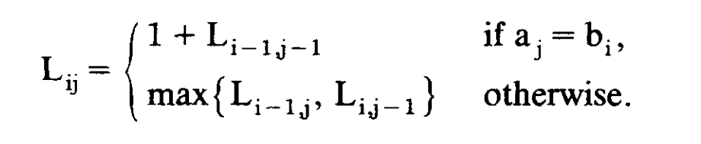
LCS
The rows and columns of L_{ij} contain ascending values for increasing i and j. This prompted Hunt and Szymanski and Hirschberg to 'contour' L and develop fast algorithms for special cases.

Slide 5
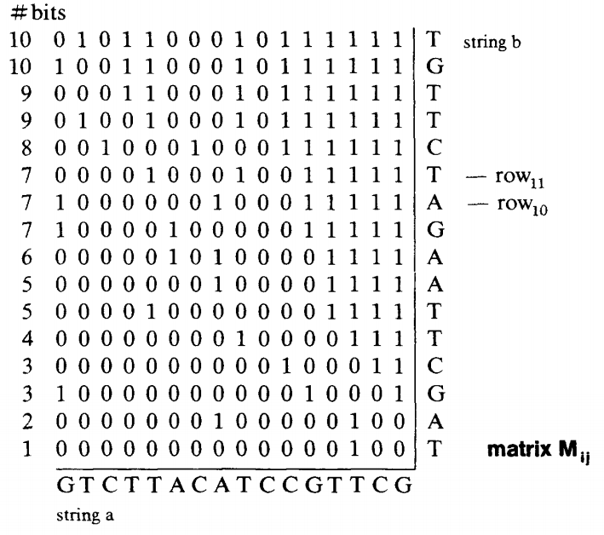
BIT-STRING ALGORITHM
Fig 1

Slide 6
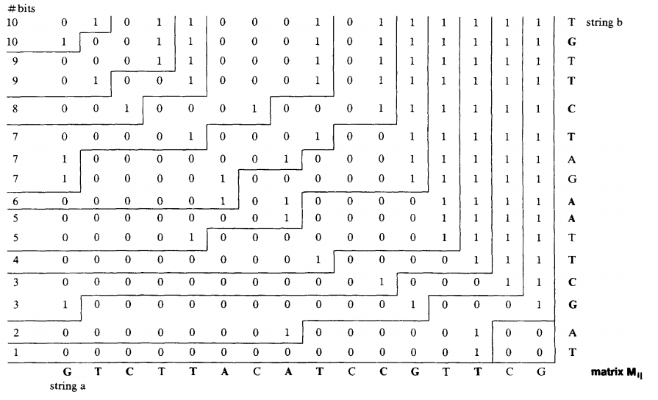
BIT-STRING ALGORITHM
Fig 1
Fig 2

Slide 7
BIT-STRING ALGORITHM

Slide 8
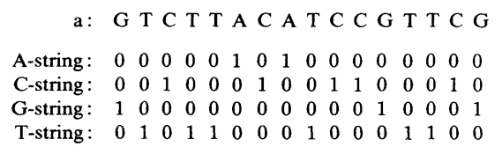
ALPHBET-STRINGS
O(|alphabet| x ceil(|a|/w) + |a|)
Fixed : O(|a|)
Nonfixed: O(|a| X |b|)

Slide 9
ROW₁₀ ➔ ROW₁₁
b_{i}-String ➔ v ROW₁₀ ➔ - ROW₁₀ << 1 !=X ➔ ^ X

Slide 10
ROW₁₀ ➔ ROW₁₁
b_{i}-String ➔ v ROW₁₀ ➔ - ROW₁₀ << 1 !=X ➔ ^ X
ROW₁₁
ROW₁₀

Slide 11

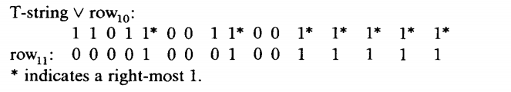
ROW₁₀ ➔ ROW₁₁
b_{i}-String ➔ v ROW₁₀ ➔ - ROW₁₀ << 1 !=X ➔ ^ X

Slide 12
ROW₁₀ ➔ ROW₁₁
b_{i}-String ➔ v ROW₁₀ ➔ - ROW₁₀ << 1!=X ➔ ^ X
X = ROW₁₀ v T-string

Slide 13
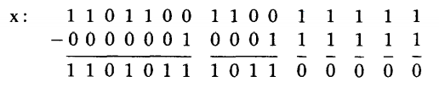
ROW₁₀ ➔ ROW₁₁
b_{i}-String ➔ v ROW₁₀ ➔ - ROW₁₀ << 1 !=X ➔ ^ X
XOR
X = ROW₁₀ v T-string

Slide 14
ROW₁₀ ➔ ROW₁₁
b_{i}-String ➔ v ROW₁₀ ➔ - ROW₁₀ << 1 !=X ➔ ^ X

Slide 15
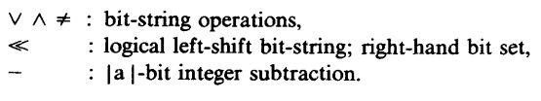
IN SUMMARY

Slide 16
A Fast and Practical Bit-Vector Algorithm for the Longest Common Subsequence Problem
Maxime Crochemore, Costas S. Iliopoulos,
Yoan J. Pinzon3, and James F. Reid

Slide 17
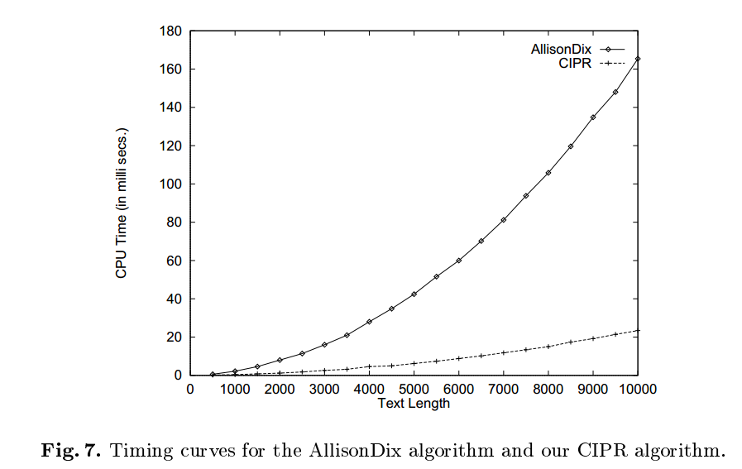
CONCULSION

