Slide 1
Cd-hit: a fast program for clustering and comparing large sets of protein or nucleotide sequences
Author：Weizhong Li and Adam Godzik Source：BIOINFORMATICS APPLICATIONS NOTE, Vol. 22, No. 13, 2006, pp. 1658–1659
Presenter：Guan-Cheng Guo Date：2013/12/4

Slide 2
Abstract
In 2001 and 2002, we published two papers (Bioinformatics, 17, 282–283, Bioinformatics, 18, 77–82) describing an ultrafast protein sequence clustering program called cd-hit. This program can efficiently cluster a huge protein database with millions of sequences. However, the applications of the underlying algorithm are not limited to only protein sequences clustering, here we present several new programs using the same algorithm including cd-hit-2d, cd-hit-est and cd-hit-est-2d. Cd-hit-2d compares two protein datasets and reports similar matches between them; cd-hit-est clusters a DNA/RNA sequence database and cd-hit-est-2d compares two nucleotide datasets. All these programs can handle huge datasets with millions of sequences and can be hundreds of times faster than methods based on the popular sequence comparison and database search tools, such as BLAST.

Slide 3
CD-HIT
CD-HIT stands for Cluster Database at High Identity with Tolerance.
CD-HIT clusters a protein database.
The algorithm behind cd-hit is short word filtering.
Short word filtering can determine that the similarity between two sequences is below a certain value without performing an actual sequence alignment.

Slide 4
Short word filtering
Two proteins with a certain sequence identity must have at least a specific number of identical dipeptides, tripeptides and etc.
We can effectively estimate that the similarity of two sequences is below a certain threshold by simple word counting and without an actual sequence alignment.

Slide 5
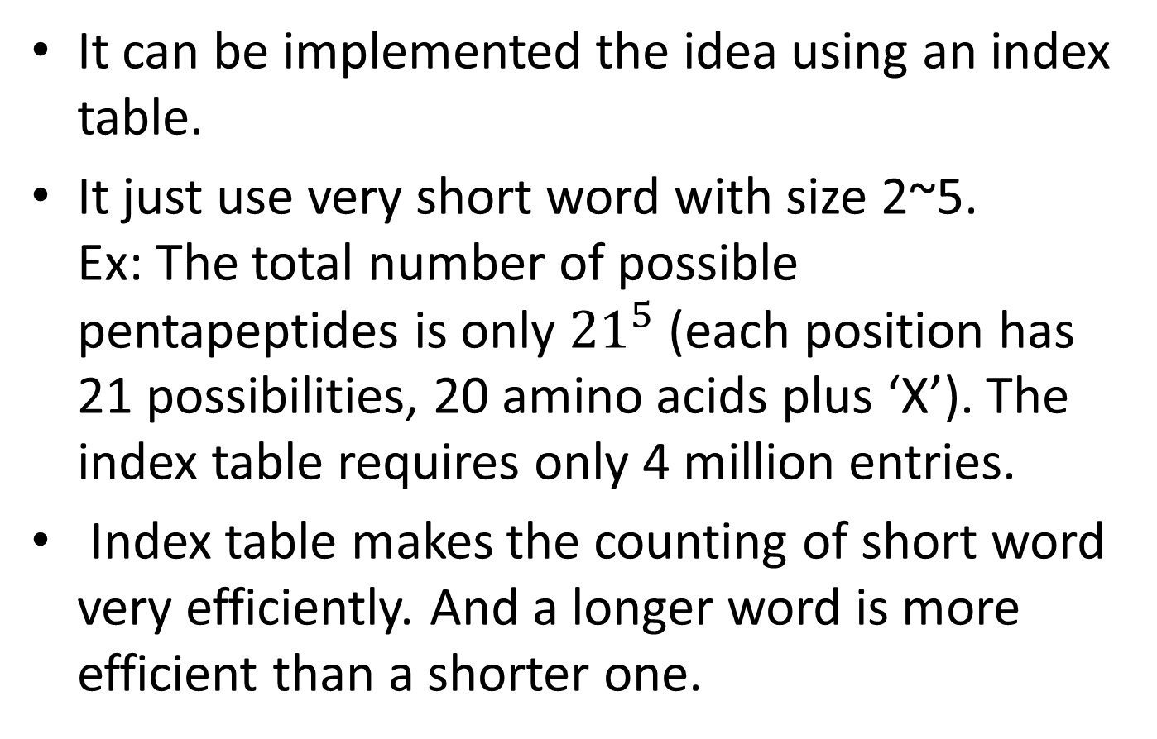
Short word filtering
It can be implemented the idea using an index table.
It just use very short word with size 2~5. Ex: The total number of possible pentapeptides is only ${21}^{5}$ (each position has 21 possibilities, 20 amino acids plus ‘X’). The index table requires only 4 million entries.
Index table makes the counting of short word very efficiently. And a longer word is more efficient than a shorter one.

Slide 6
Algorithm
Sequences are first sorted in order of decreasing length.
The longest one becomes the representative of the first cluster.
Then each remaining sequence is compared to the existing representatives.
If the similarity with any representative is above a given threshold, it is included into that cluster. Otherwise a new cluster starts with it as representative.

Slide 7
CD-HIT-est clustering
CD-HIT-est clusters a DNA/RNA database. For eukaryotic genes, long introns can cause long gaps in sequence alignments. It reduces the efficiency of short word filtering.
CD-HIT-est can be applied only for non-intron-containing sequences, such as ESTs.
Expressed sequence tag (EST) is a short sub-sequence of a cDNA sequence. They may be used to identify gene transcripts.

Slide 8
CD-HIT-2d and CD-HIT-est-2d
Given two databases, db1 and db2. Sequences in db1 are first sorted in order of decreasing length.
Each sequence in db2 is compared with db1 from the top (the longest one).
If the similarity to any one in db1 is above the threshold, this sequence is attached to the matched one in db1.

Slide 9
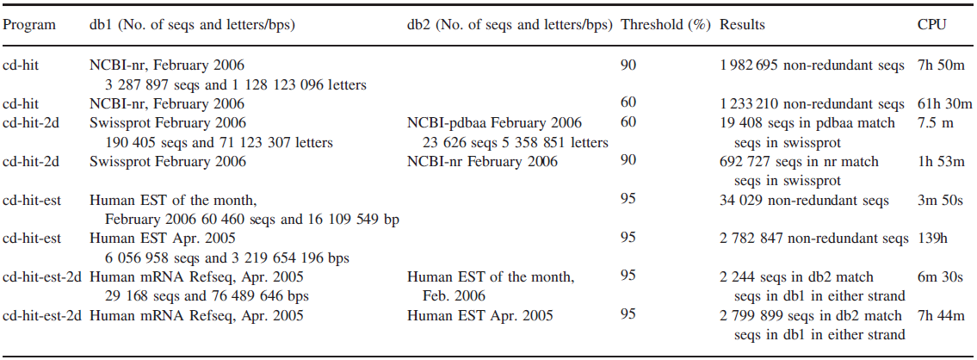
Results
The CD-HIT was written in C++, and tested on Linux workstation with dual 3.0 GHz Xeon processors and 4GB RAM.

Slide 10
Thank you for your watching

