Slide 1
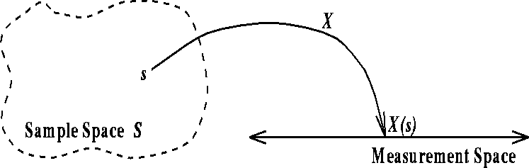
Measuring and Testing Dependence by Correlation of Distance
GÁBOR J. SZÉKELY, MARIA L. RIZZO AND NAIL K. BAKIROV
Bowling Green State University, Bowling Green State University and USC Russian Academy of Sciences
The Annals of Statistics, Vol.35, No. 6, pp.2769-2794, 2007
Presenter: Hung-Hsin Chen (陳紘昕)
Date: Dec. 24, 2013

Slide 2
Abstract
Distance correlation is a new measure of dependence between random vectors. Distance covariance and distance correlation are analogous to product-moment covariance and correlation, but unlike the classical definition of correlation, distance correlation is zero only if the random vectors are independent. The empirical distance dependence measures are based on certain Euclidean distances between sample elements rather than sample moments, yet have a compact representation analogous to the classical covariance and correlation. Asymptotic properties and applications in testing independence are discussed. Implementation of the test and Monte Carlo results are also presented.

Slide 3
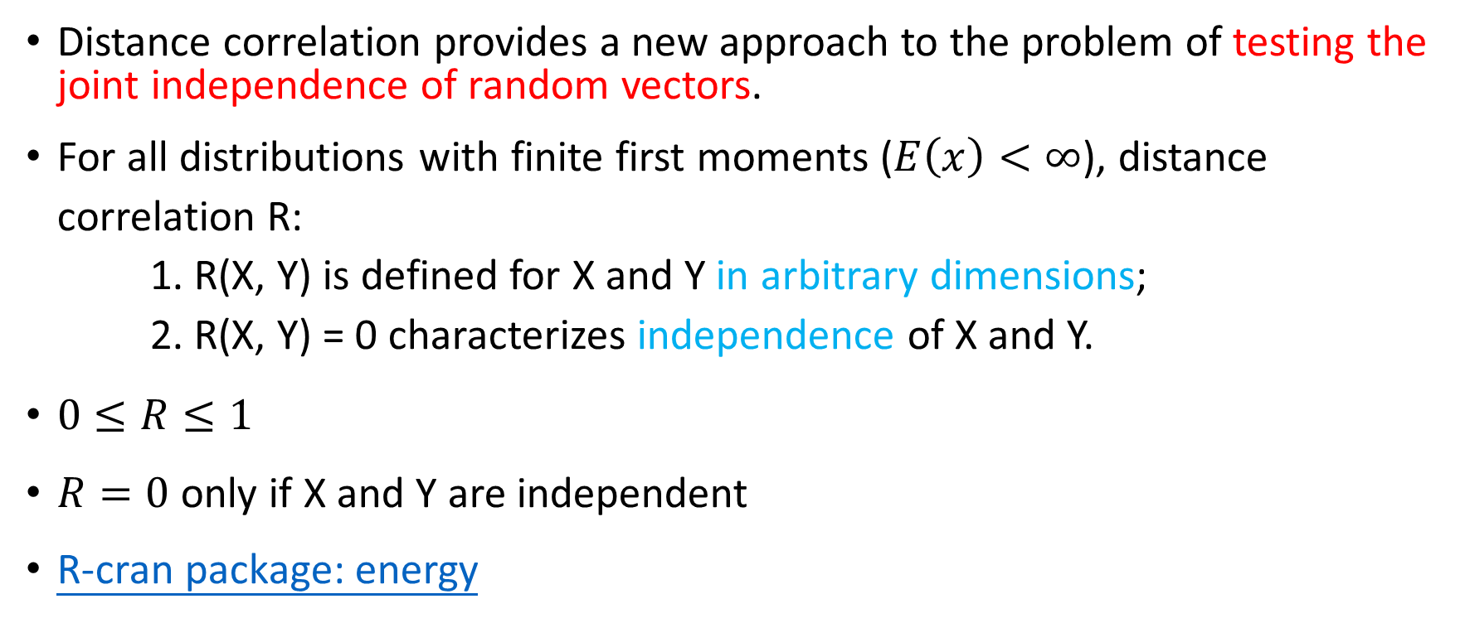
Introduction
Distance correlation provides a new approach to the problem of testing the joint independence of random vectors.
For all distributions with finite first moments ($E\left(x\right)<∞$), distance correlation R: 1. R(X, Y) is defined for X and Y in arbitrary dimensions; 2. R(X, Y) = 0 characterizes independence of X and Y.
$0≤R≤1$
$R=0$ only if X and Y are independent
R-cran package: energy

Slide 4
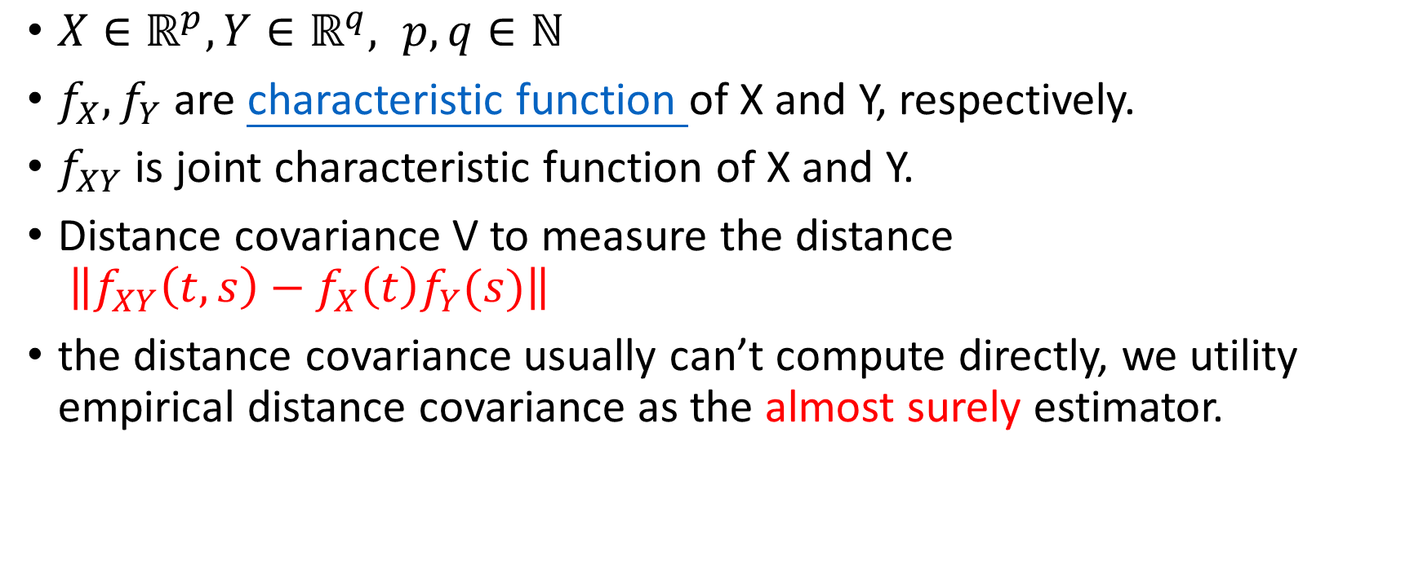
Introduction
$X∈ℝ^{p}, Y∈ℝ^{q}, p,q∈ℕ$
$f_{X},f_{Y}$ are characteristic function of X and Y, respectively.
$f_{XY}$ is joint characteristic function of X and Y.
Distance covariance V to measure the distance $\left\|f_{XY}\left(t,s\right)−f_{X}\left(t\right)f_{Y}(s)\right\|$
the distance covariance usually can’t compute directly, we utility empirical distance covariance as the almost surely estimator.

Slide 5
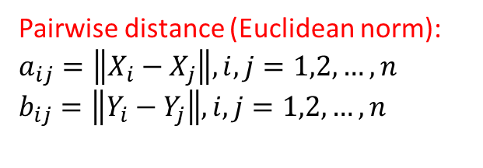
Empirical distance correlation (1/3)
X=
[[ 0.55121671 -0.48911358]
[ 1.03359242 0.06681187]
[-0.80828891 0.17698972]
[-0.18922866 -0.10681709]
[-0.08933404 1.35171931]]
Y=
[ 0.75407815
0.40138421
0.70709364
1.67310307
-2.32533163]
Pairwise distance matrix :
a=
[[ 0. 0.7360295 1.51391848 0.83331264 1.94909492]
[ 0.7360295 0. 1.84517371 1.2350864 1.70644396]
[ 1.51391848 1.84517371 0. 0.68101534 1.37727475]
[ 0.83331264 1.2350864 0.68101534 0. 1.46195327]
[ 1.94909492 1.70644396 1.37727475 1.46195327 0. ]]
Pairwise distance (Euclidean norm):
$$a_{ij}=\left\|X_{i}−X_{j}\right\|, i,j=1,2,…,n$$
$$b_{ij}=\left\|Y_{i}−Y_{j}\right\|, i,j=1,2,…,n$$
b: [[ 0. 0.35269394 0.04698451 0.91902492 3.07940978]
[ 0.35269394 0. 0.30570943 1.27171886 2.72671584]
[ 0.04698451 0.30570943 0. 0.96600943 3.03242527]
[ 0.91902492 1.27171886 0.96600943 0. 3.9984347 ]
[ 3.07940978 2.72671584 3.03242527 3.9984347 0. ]]
(wiki)

Slide 6

Empirical distance correlation (2/3)
Double centered distances (average of row and column are zero).
$$A_{ij}=a_{ij}−\overline{a_{i⋅}}−\overline{a_{⋅j}}+\overline{a_{⋅⋅}}$$
$$B_{ij}=b_{ij}−\overline{b_{i⋅}}−\overline{b_{⋅j}}+\overline{b_{⋅⋅}}$$
A=
[[-0.94579798 -0.30784408 0.49111515 0.05171224 0.71081467]
[-0.30784408 -1.14194919 0.72429478 0.35541039 0.3700881 ]
[ 0.49111515 0.72429478 -1.09980867 -0.17759041 0.06198915]
[ 0.05171224 0.35541039 -0.17759041 -0.61740283 0.3878706 ]
[ 0.71081467 0.3700881 0.06198915 0.3878706 -1.53076252]]
B: [[ -4.23315124e-01 -1.22366169e-01 -3.66933716e-01 -5.57051565e-02 9.68320165e-01]
[ -1.22366169e-01 -5.26805095e-01 -1.59953774e-01 2.45243799e-01 5.63881239e-01]
[ -3.66933716e-01 -1.59953774e-01 -4.04521322e-01 6.76251724e-04 9.30732560e-01]
[ -5.57051565e-02 2.45243799e-01 6.76251724e-04 -1.52614503e+00 1.33593013e+00]
[ 9.68320165e-01 5.63881239e-01 9.30732560e-01 1.33593013e+00 -3.79886410e+00]]

Slide 7
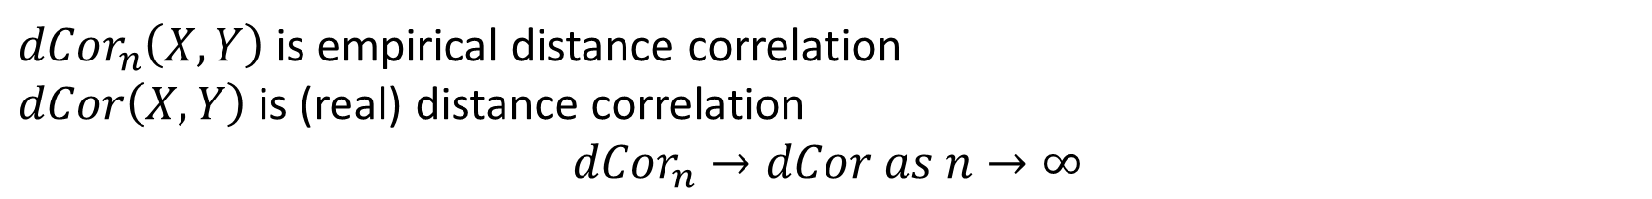
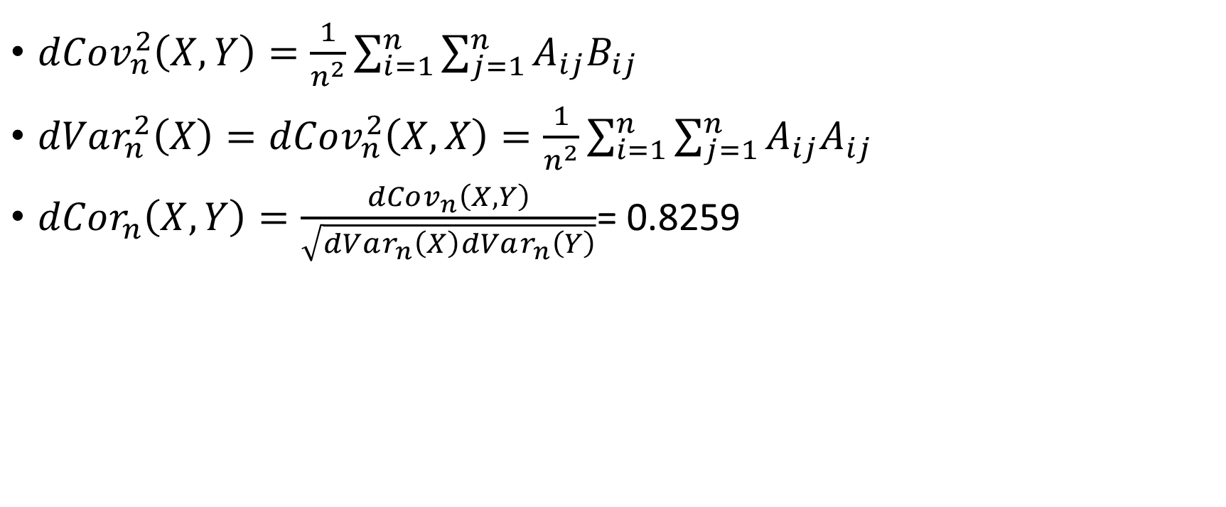
Empirical distance correlation (3/3)
$dCov_{n}^{2}\left(X, Y\right)=\frac{1}{n^{2}}\sum_{i=1}^{n}{\sum_{j=1}^{n}{A_{ij}B_{ij}}}$
$dVar_{n}^{2}\left(X\right)=dCov_{n}^{2}\left(X,X\right)=\frac{1}{n^{2}}\sum_{i=1}^{n}{\sum_{j=1}^{n}{A_{ij}A_{ij}}}$
$dCor_{n}\left(X,Y\right)=\frac{dCov_{n}\left(X,Y\right)}{\sqrt{dVar_{n}\left(X\right)dVar_{n}\left(Y\right)}}$= 0.8259
$dCor_{n}\left(X,Y\right)$ is empirical distance correlation
$dCor\left(X,Y\right)$ is (real) distance correlation
$$dCor_{n}→dCor as n→∞$$

Slide 8
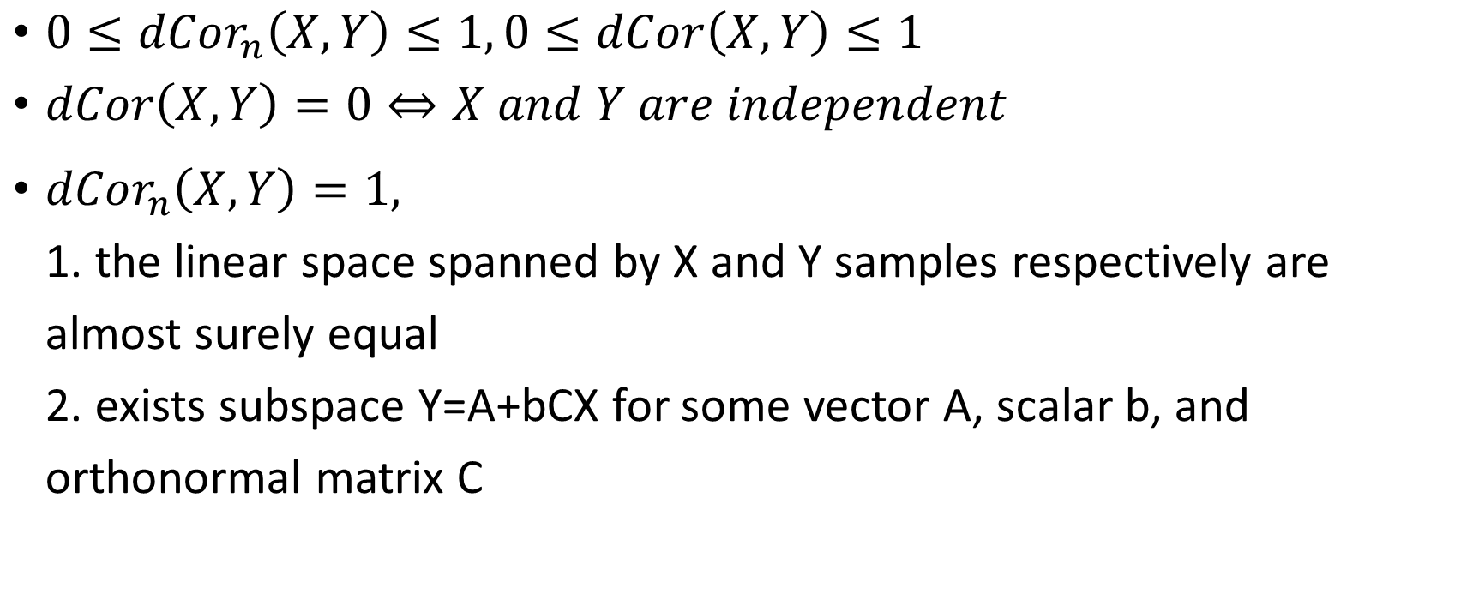
Distance correlation properties
$0≤dCor_{n}\left(X,Y\right)≤1, 0≤dCor\left(X,Y\right)≤1$
$dCor\left(X,Y\right)=0⇔X and Y are independent$
$dCor_{n}\left(X,Y\right)=1,$ 1. the linear space spanned by X and Y samples respectively are almost surely equal 2. exists subspace Y=A+bCX for some vector A, scalar b, and orthonormal matrix C

Slide 9
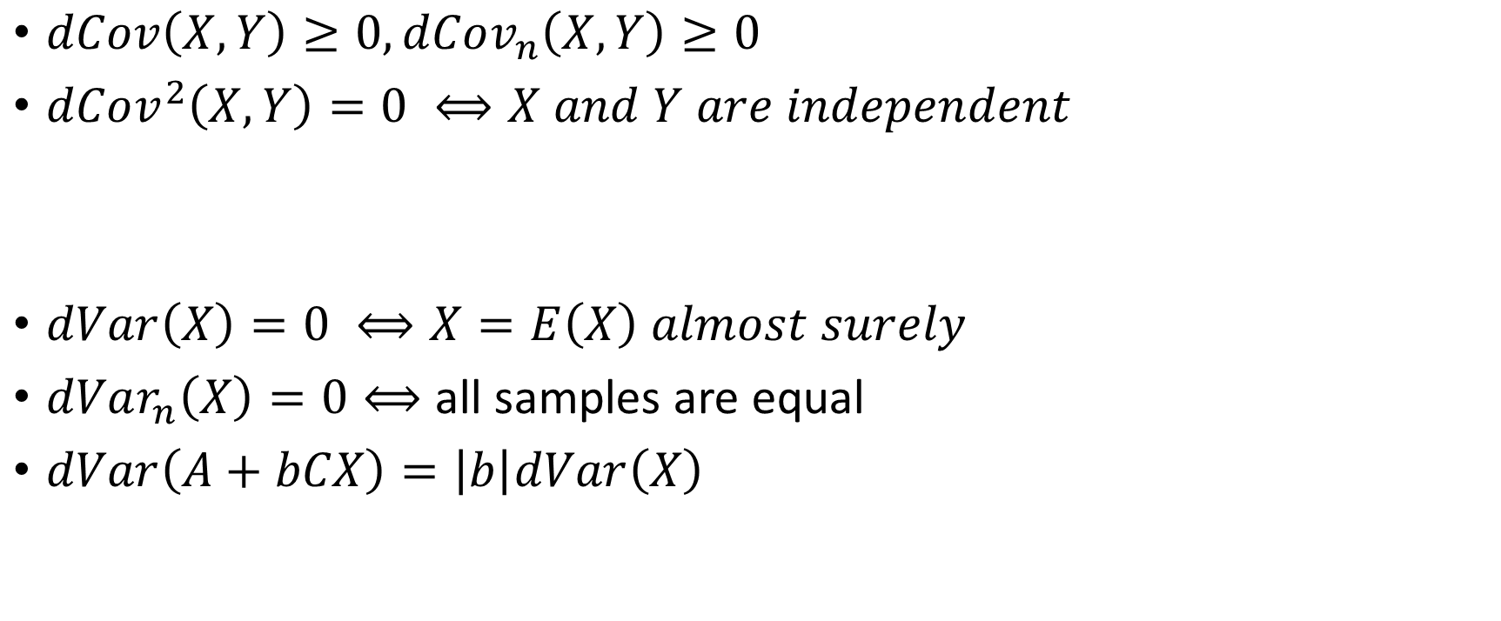
Distance covariance and variance properties
$dCov\left(X,Y\right)≥0,dCov_{n}\left(X,Y\right)≥0$
$dCov^{2}\left(X,Y\right)=0 ⟺X and Y are independent$
$dVar\left(X\right)=0 ⟺X=E\left(X\right) almost surely$
$dVar_{n}\left(X\right)=0⟺$ all samples are equal
$dVar\left(A+bCX\right)=\left|b\right|dVar\left(X\right)$

Slide 10
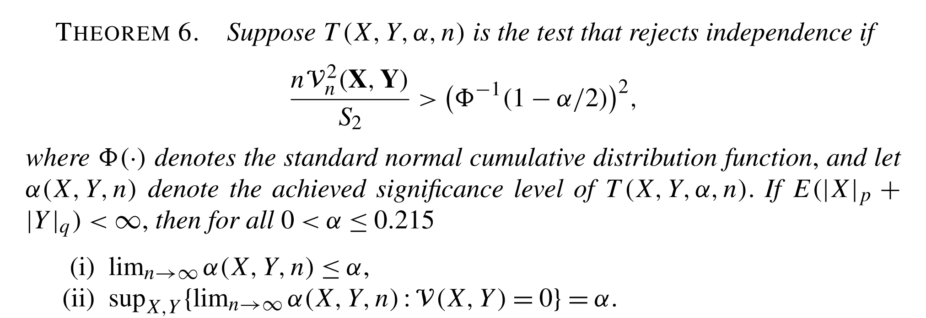

Distance covariance test

Slide 11
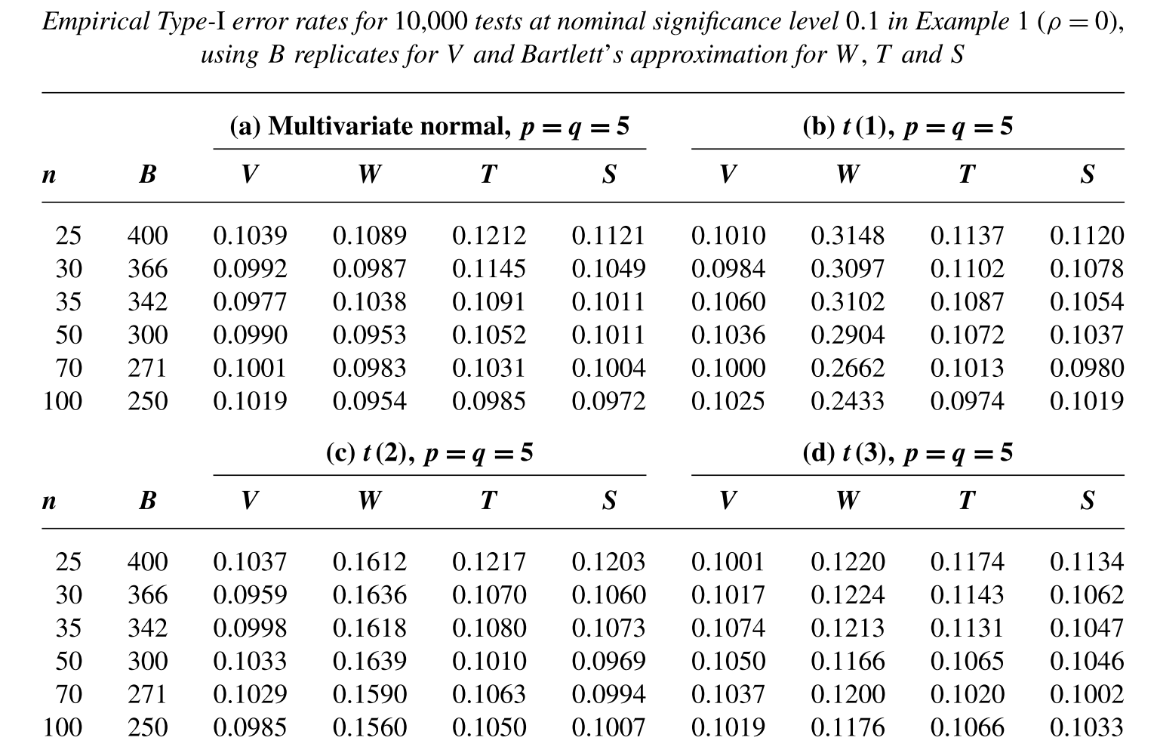
Example
Wilks Lambda-statistic (W)
Puri-Sen rank correlation statistics (S)
Puri-Sen statistics (T)
10,000 samples

Slide 12
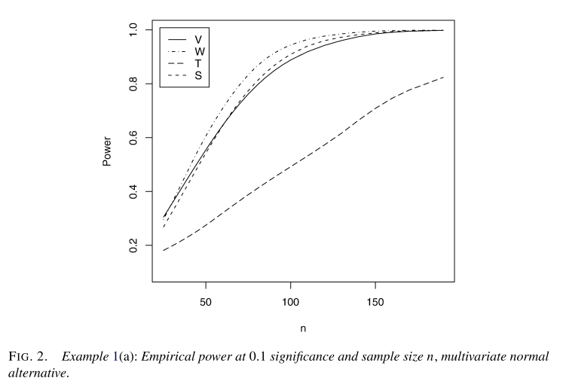
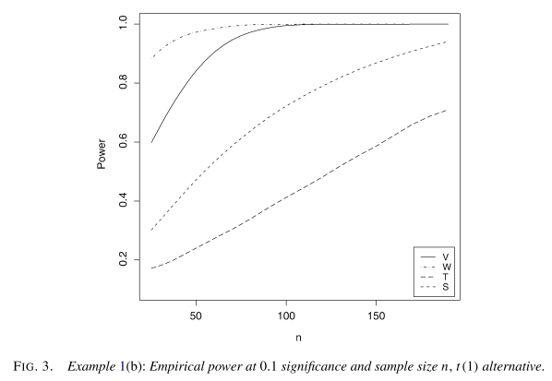
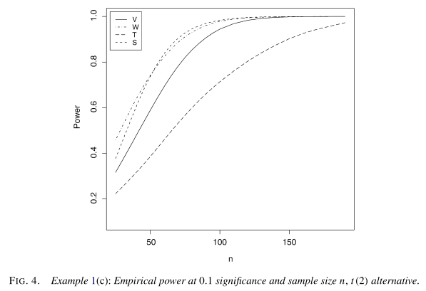
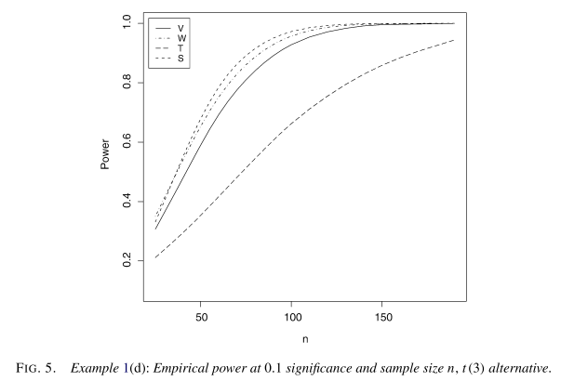

Slide 13
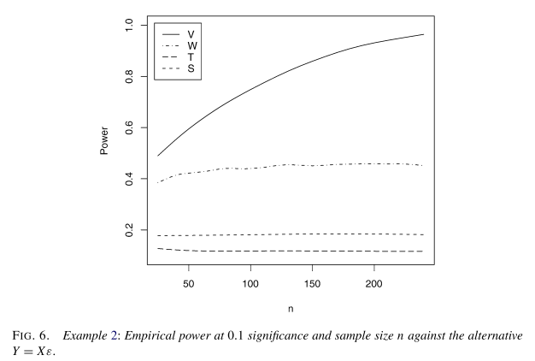
Example 2
$Y_{kj}=X_{kj}ε_{kj}, j=1,…,p,$ $ε_{kj} is independent standard normal and independent to X$

Slide 14
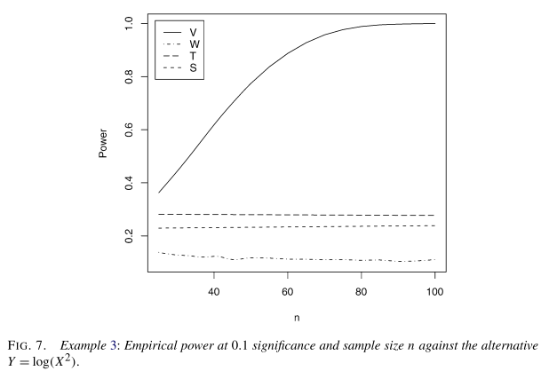
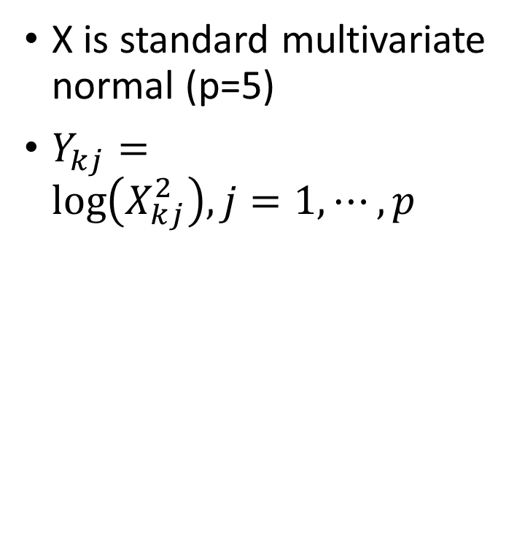
Example 3
X is standard multivariate normal (p=5)
$Y_{kj}=\log\left(X_{kj}^{2}\right), j=1,⋯,p$

Slide 15
The distance correlation t-test of independence in high dimension
GÁBOR J. SZÉKELY and MARIA L. RIZZO
Journal of Multivariate Analysis, Vol. 117, pp. 94, 2013.
Presenter: Hung-Hsin Chen (陳紘昕)
Date: Dec. 24, 2013

Slide 16
Abstract
Distance correlation is extended to the problem of testing the independence of random vectors in high dimension. Distance correlation characterizes independence and determines a test of multivariate independence for random vectors in arbitrary dimension. In this work, a modified distance correlation statistic is proposed, such that under independence the distribution of a transformation of the statistic converges to Student t, as dimension tends to infinity. Thus we obtain a distance correlation t-test for independence of random vectors in arbitrarily high dimension, applicable under standard conditions on the coordinates that ensure the validity of certain limit theorems. This new test is based on an unbiased estimator of distance covariance, and the resulting t-test is unbiased for every sample size greater than three and all significance levels. The transformed statistic is approximately normal under independence for sample size greater than nine, providing an informative sample coefficient that is easily interpretable for high dimensional data.

Slide 17
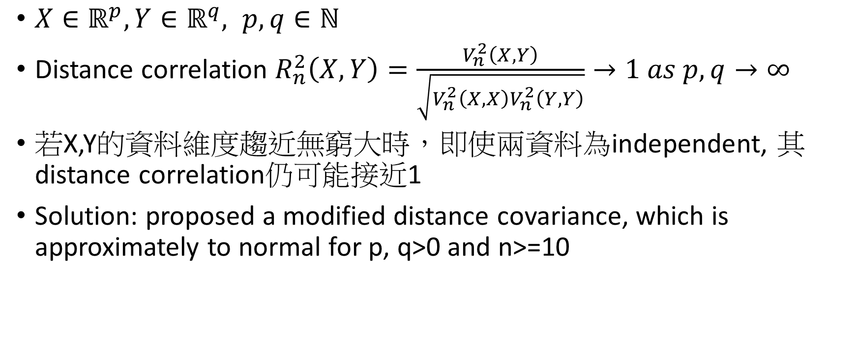
Problem
$X∈ℝ^{p}, Y∈ℝ^{q}, p,q∈ℕ$
Distance correlation $R_{n}^{2}\left(X,Y\right)=\frac{V_{n}^{2}\left(X, Y\right)}{\sqrt{V_{n}^{2}\left(X,X\right)V_{n}^{2}\left(Y,Y\right)}}→1 as p, q→∞$
若X,Y的資料維度趨近無窮大時，即使兩資料為independent, 其distance correlation仍可能接近1
Solution: proposed a modified distance covariance, which is approximately to normal for p, q>0 and n>=10

Slide 18
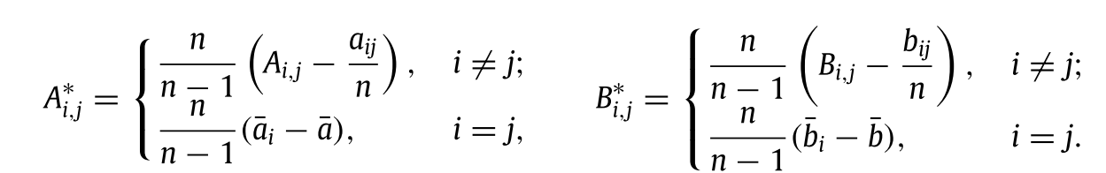
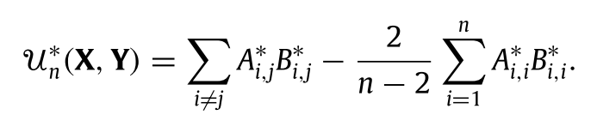
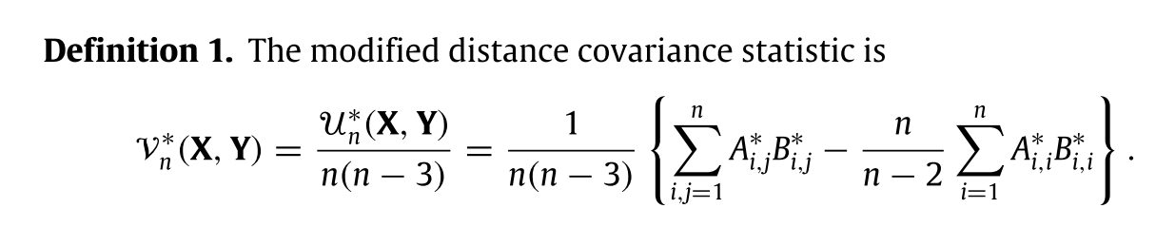
Modified covariance

Slide 19
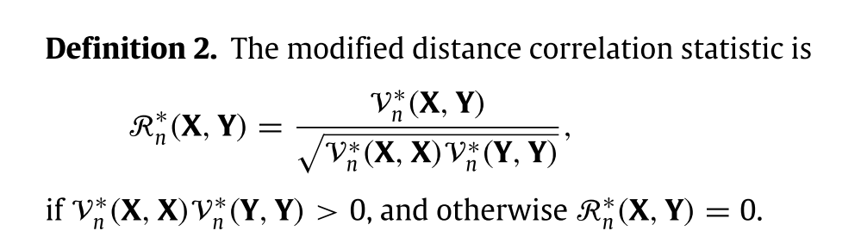

Slide 20
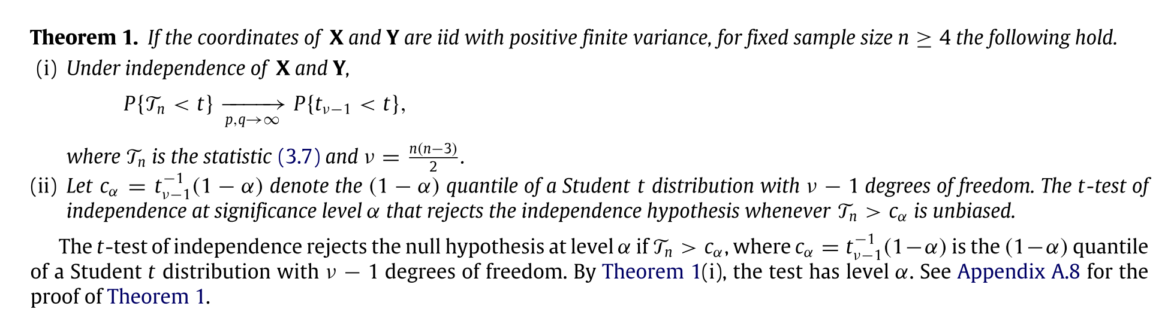

Statistics
Null hypothesis $H_{0}$ as $p,q→∞ and X, Y are independent$
$T_{n}=\sqrt{v−1}\frac{R_{n}^{∗}}{\sqrt{1−{\left(R_{n}^{∗}\right)}^{2}}}\sim t_{v−1}, v=\frac{n\left(n−3\right)}{2}$

Slide 21
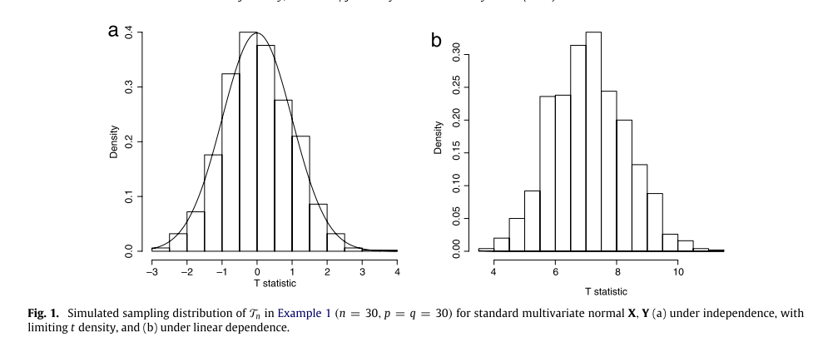
Simulation

Slide 22
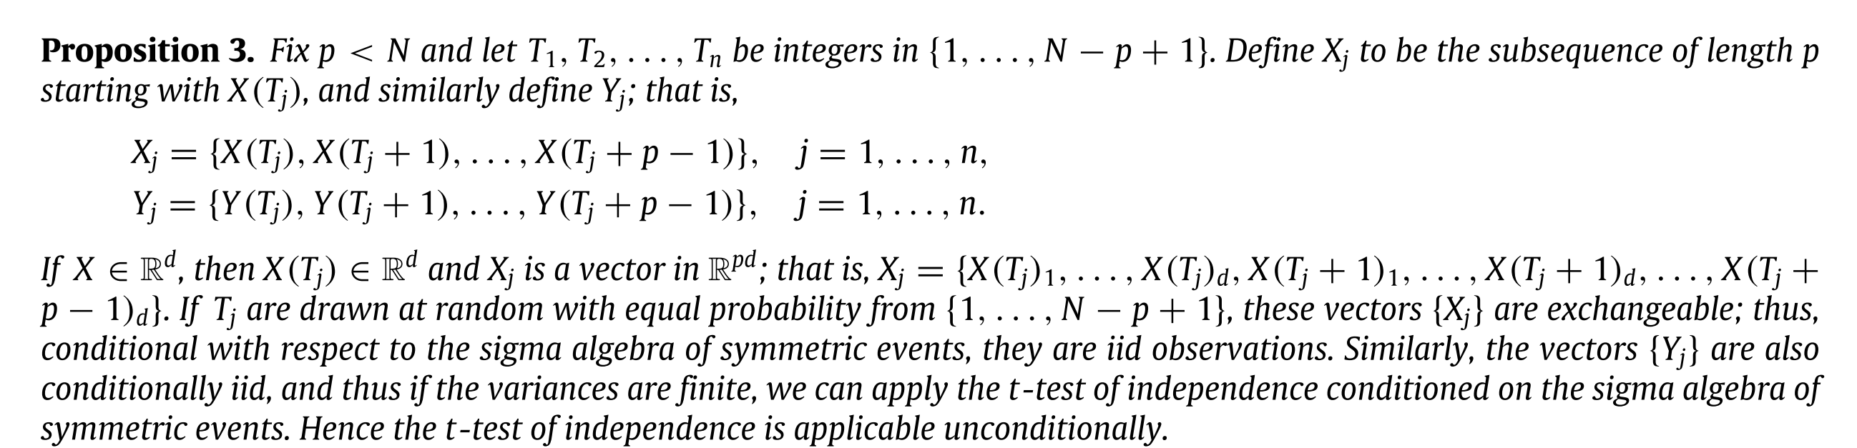
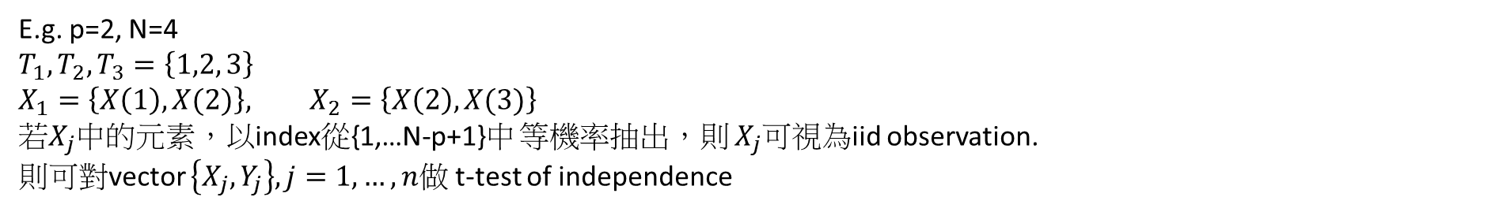
Application to time series
E.g. p=2, N=4
$$T_{1}, T_{2}, T_{3}=\left\{1,2, 3\right\}$$
$$X_{1}=\left\{X\left(1\right), X(2)\right\}, X_{2}=\left\{X\left(2\right), X(3)\right\}$$
若$X_{j}$中的元素，以index從{1,…N-p+1}中 等機率抽出，則 $X_{j}$可視為iid observation.
則可對vector $\left\{X_{j}, Y_{j}\right\}, j=1,…,n$做 t-test of independence

Slide 23
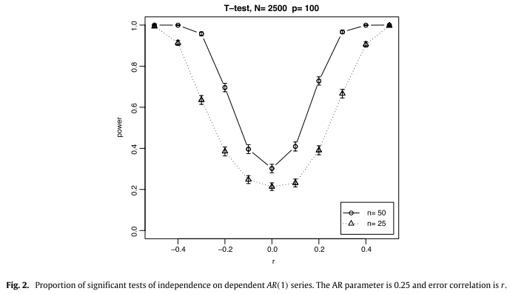

Simulation: AR(1)
N=2500, $X_{t}=AX_{t−1}+e_{t}$
$A=\left[\begin{matrix}0.25 & 0 \\ 0 & 0.25\end{matrix}\right],$ $Cov\left(e_{t}\right)=\left[\begin{matrix}1 & r \\ r & 1\end{matrix}\right], p=100$

Slide 24
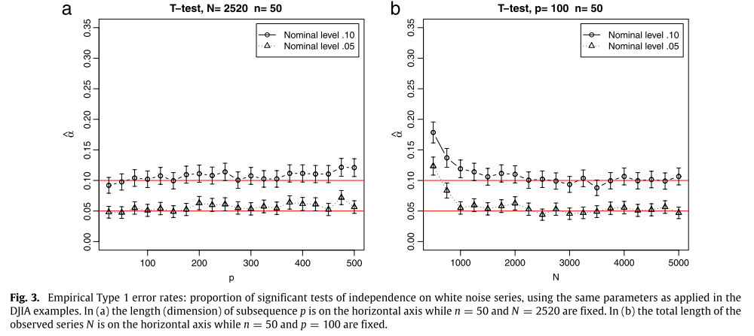
Simulation: two white noise series(Gaussian, the same parameters, N=2520, p100, n=50)

Slide 25
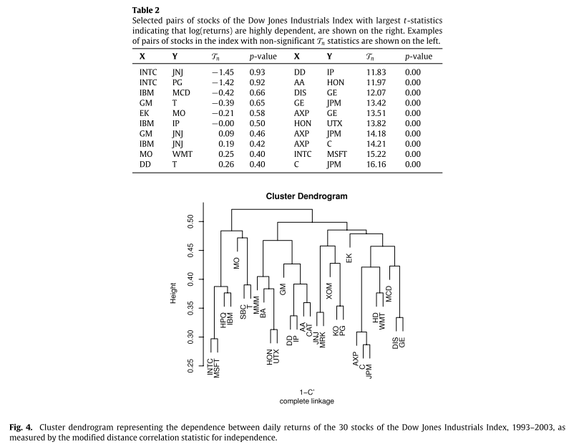
Simulation: Dow Jones Industrial Index (DJIA)
Daily (log) returns of 30 stocks in DJIA from Aug. 30, 1993 ~ Aug. 29, 2003.
Pair of stocks are tested for independence, p=100, n=50.

Slide 26

Thanks for your listening!

