Slide 1
The Complexity of Some Problems on Subsequences and Supersequences
DAVID MAIER
Journal of the ACM (JACM)
Volume 25 Issue 2, April 1978 Pages 322-336
Presenter: Chun-Yi Fang
Date:2013.12.24

Slide 2
Abstract
The complexity of finding the Longest Common subsequence (LCS) and the Shortest Common Supersequence (SCS) of an arbitrary number of sequences is considered.
We show that the yes/no version of the LCS problem is NP-complete for sequences over an alphabet of size 2, and that the yes/no SCS problem is NP-complete for sequences over an alphabet of size 5.

Slide 3
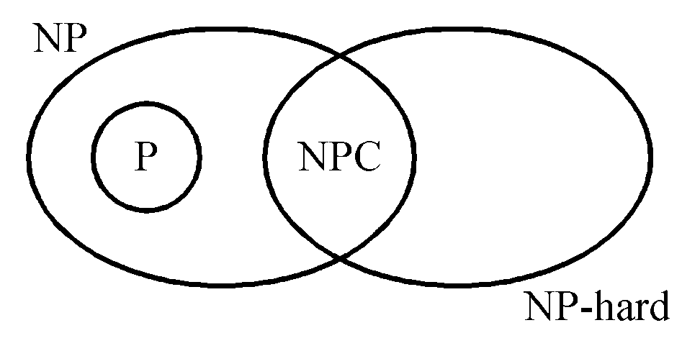
NP-Completeness
P: the class of problems which can be solved by a deterministic polynomial algorithm.
NP : the class of decision problem which can be solved by a non-deterministic polynomial algorithm.
NP-hard: the class of problems to which every NP problem reduces.
NP-complete (NPC): the class of problems which are NP-hard and belong to NP.

Slide 4
Some concepts of NPC
Problem A reduces to problem B (A ∝ B) iff A can be solved by a deterministic polynomial time algorithm using a deterministic algorithm that solves B in polynomial time.
If A, B ∈ NPC, then A ∝ B and B ∝ A.

Slide 5
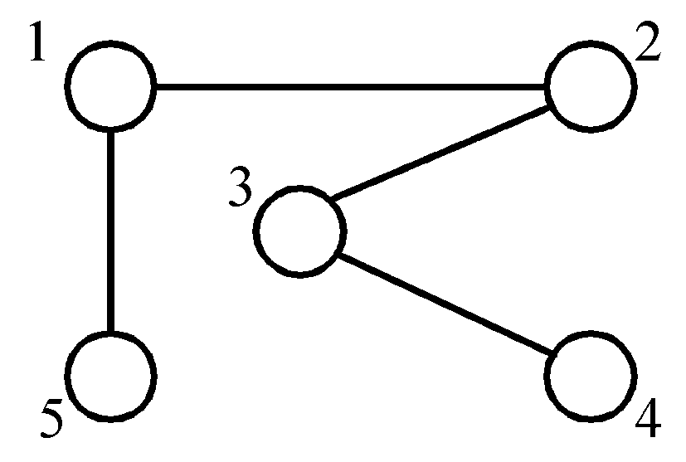
The node cover problem
Def: Given a graph G=(V, E), S is the node cover if S ⊆ V and for every edge (u, v) ∈ E, either u ∈ S or v ∈ S.
node cover :
{1, 3}
{5, 2, 4}

Slide 6
t:總點數//(v₁,v₂,....v_{t})
k: size of node cover (node cover點數)
r:邊數=node cover邊數
Node cover問題可表示成
k;( x₁, y₁ );( x₂, y₂ );...;( x_{r}, y_{r} ) //x_{i} ,y_{i} belong to t
R:欲求的 LCS, SCS 的集合

Slide 7
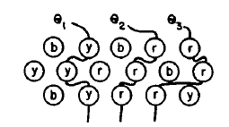
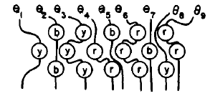
Thread scheme
LCS
SCS
在同一列中不會有thread同時穿過兩個字元。
threads之間彼此不會交叉。

Slide 8
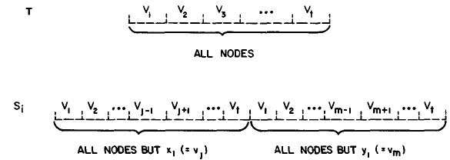
The LCS problem is NP-complete for arbitrary size of R.
node cover problem of size k. k;( x₁, y₁ );( x₂, y₂ );...;( x_{r}, y_{r} )
R = {T, s₁ , s₂ , ...., s_{t}} has a common subsequence of size t - k.

Slide 9
t = 4 ,r = 6, k = 3
V = {v₁, v₂, v₃, v₄}; V’ = {v₁, v₂, v₃}
T: v₁v₂v₃v₄ ; T’:v₃
S₁ :v₂v₃v₄ v₁v₃v₄
S₂:v₂v₃v₄ v₁v₂v₄
S₃:v₂v₃v₄ v₁v₂v₃
S₄:v₁v₃v₄ v₁v₂v₄
S₅:v₁v₃v₄ v₁v₂v₃
S₆:v₁v₂v₄ v₁v₂v₃
T’is the LCS for R with size t-k = 1
v1
v2
v4
v3

Slide 10
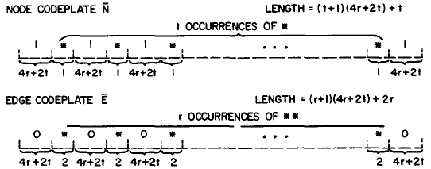
The LCS problem is NP-complete for IRI = 3.
node cover of size k
R = {T, s₁ , s₂ , ...., s_{t}} has a common subsequence of size (2r + t + 3)(4r + 2t)+ (2r + t- k).

Slide 11
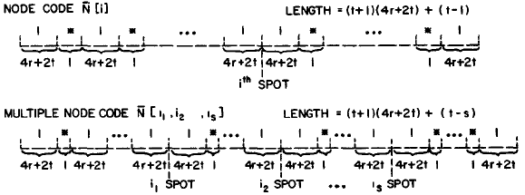
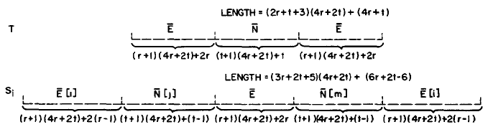

Slide 12

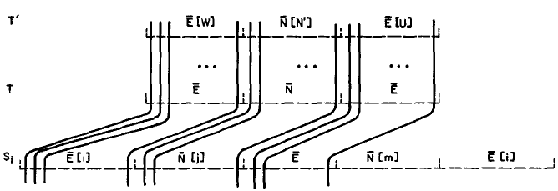
N’ is the set of node cover size k;
Let W be the set of all edges e_{i} = (x_{i}, y_{i}) such that x_{i} belong to N'. Let U be the set of the rest of the edges in N.
T’is the LCS for R with size (2r + t + 3)(4r + 2t)+ (2r + t- k).

Slide 13
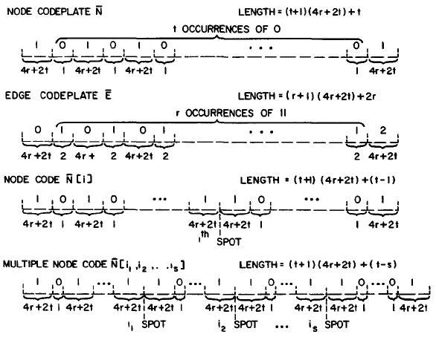
The LCS problem is NP-complete for |R| ≧ 2.

Slide 14
The SCS problem is NP-complete for arbitrary size of R.
node cover of stze k
R has a common supersequence of length
8c + 6r + 2t + k
The SCS problem is NP-complete for |R| = 5.

Slide 15
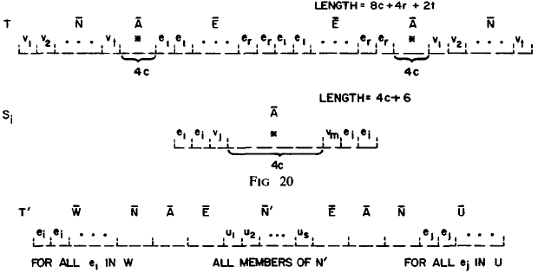
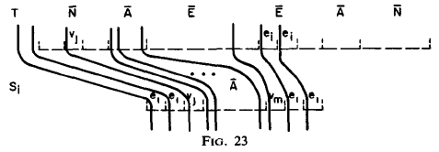

Slide 16
