Slide 1
Improved tools for biological sequence comparison
William R. Person and David J. Lipman
Proceedings of the National Academy of Sciences of the United States of America Vol. 85, pp. 2444-2448, April 1988
Presenter: Che-Jui Hsu (許哲睿)
Date: 2013/12/22
Notes:
http://www.pnas.org/content/85/8/2444.abstract

Slide 2
Abstract
We have developed three computer programs for comparisons of protein and DNA sequences. They can be used to search sequence data bases, evaluate similarity scores, and identify periodic structures based on local sequence similarity. The FASTA program is a more sensitive derivative of the FASTP program, which can be used to search protein or DNA sequence data bases and can compare a protein sequence to a DNA sequence data base by translating the DNA data base as it is searched. FASTA includes an additional step in the calculation of the initial pairwise similarity score that allows multiple regions of similarity to be joined to increase the score of related sequences. The RDF2 program can be used to evaluate the significance of similarity scores using a shuffling method that preserves local sequence composition. The LFASTA program can display all the regions of local similarity between two sequences with scores greater than a threshold, using the same scoring parameters and a similar alignment algorithm; these local similarities can be displayed as a "graphic matrix" plot or as individual alignments. In addition, these programs have been generalized to allow comparison of DNA or protein sequences based on a variety of alternative scoring matrices.

Slide 3
FASTA (1/5)
Identify common k-words between I and J
Score diagonals with k-word matches, identify 10 best diagonals
Rescore initial regions with a substitution score matrix
Join initial regions using gaps, penalise for gaps
Perform dynamic programming to find final alignments

Slide 4

FASTA (2/5)
$\text{I}=gcatcggc$, $\text{J}=ccatcgccatcg$, $\text{k}=2$
 | c | c | a | t | c | g | c | c | a | t | c | g
g |  |  |  |  |  | *
c |  | * |  |  |  |  |  | *
a |  |  | * |  |  |  |  |  | *
t |  |  |  | * |  |  |  |  |  | *
c |  |  |  |  | * |  |  |  |  |  | *
g
g |  |  |  |  |  | *
c
Notes:
http://www.cs.helsinki.fi/bioinformatiikka/mbi/courses/07-08/itb/slides/itb0708_slides_83-116.pdf

Slide 5
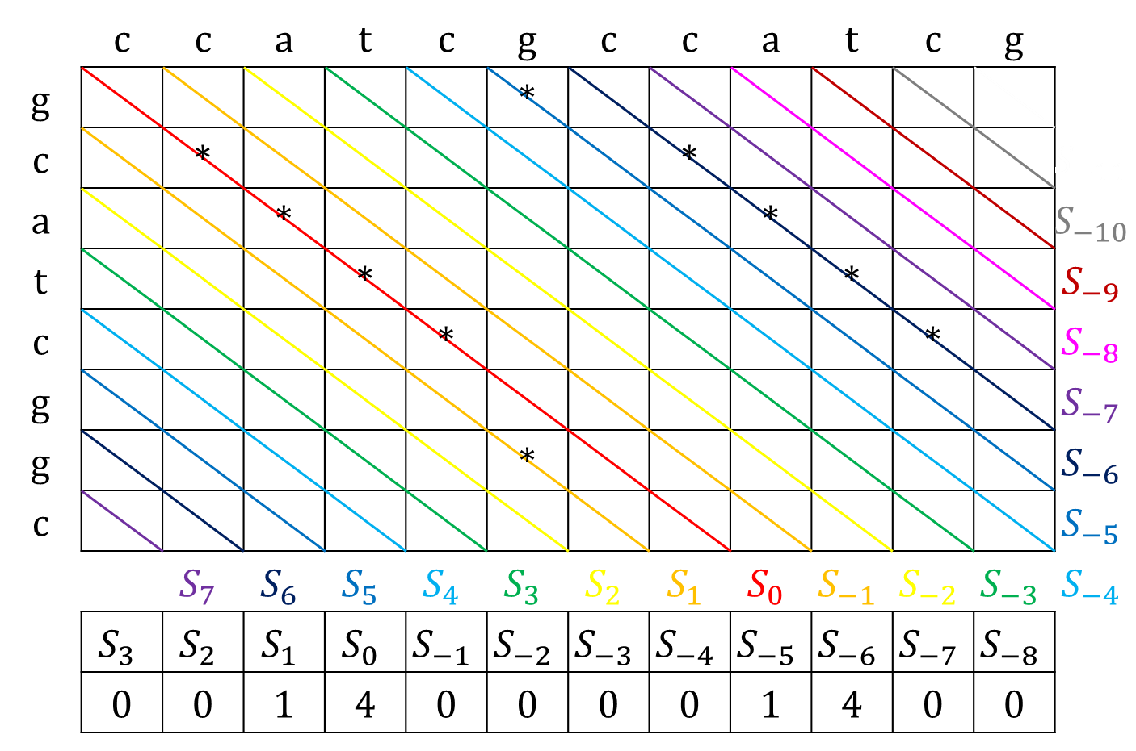
FASTA (3/5)
 | c | c | a | t | c | g | c | c | a | t | c | g
g |  |  |  |  |  | *
c |  | * |  |  |  |  |  | * |  |  |  |  | $$S_{−11}$$
a |  |  | * |  |  |  |  |  | * |  |  |  | $$S_{−10}$$
t |  |  |  | * |  |  |  |  |  | * |  |  | $$S_{−9}$$
c |  |  |  |  | * |  |  |  |  |  | * |  | $$S_{−8}$$
g |  |  |  |  |  |  |  |  |  |  |  |  | $$S_{−7}$$
g |  |  |  |  |  | * |  |  |  |  |  |  | $$S_{−6}$$
c |  |  |  |  |  |  |  |  |  |  |  |  | $$S_{−5}$$
 |  | $$S_{7}$$ | $$S_{6}$$ | $$S_{5}$$ | $$S_{4}$$ | $$S_{3}$$ | $$S_{2}$$ | $$S_{1}$$ | $$S_{0}$$ | $$S_{−1}$$ | $$S_{−2}$$ | $$S_{−3}$$ | $$S_{−4}$$
 | $$S_{3}$$ | $$S_{2}$$ | $$S_{1}$$ | $$S_{0}$$ | $$S_{−1}$$ | $$S_{−2}$$ | $$S_{−3}$$ | $$S_{−4}$$ | $$S_{−5}$$ | $$S_{−6}$$ | $$S_{−7}$$ | $$S_{−8}$$
 | 0 | 0 | 1 | 4 | 0 | 0 | 0 | 0 | 1 | 4 | 0 | 0
Notes:
http://www.cs.helsinki.fi/bioinformatiikka/mbi/courses/07-08/itb/slides/itb0708_slides_83-116.pdf

Slide 6
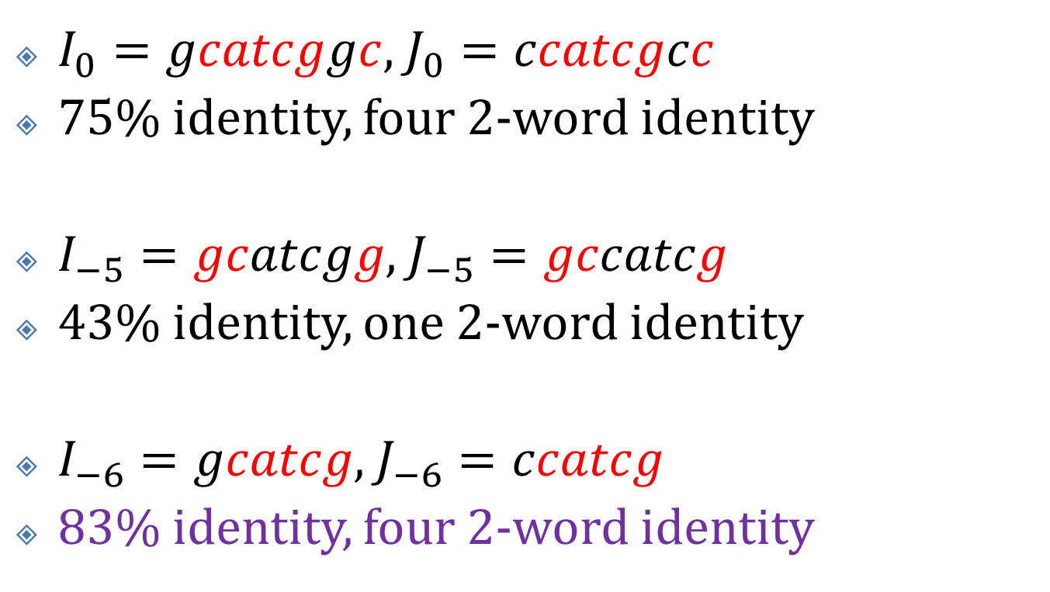
FASTA (4/5)
$I_{0}=gcatcggc$, $J_{0}=ccatcgcc$
75% identity, four 2-word identity
$I_{−5}=gcatcgg$, $J_{−5}=gccatcg$
43% identity, one 2-word identity
$I_{−6}=gcatcg$, $J_{−6}=ccatcg$
83% identity, four 2-word identity

Slide 7
FASTA (5/5)

Slide 8
Experiments (1/3)

Slide 9
Experiments (2/3)

Slide 10
Experiments (3/3)

