Slide 1
Similarity Measure Based on Incremental Warping Window for Time Series Data Mining
Hailin Li and Cheng Wang
IEEE Access
Vol. 7, pp. 3909-3917, 2019
Presenter: Shan-Ru Liu
Date: March 27, 2019
H
C

Slide 2
Abstract (1/2)
A similarity measure is one of the most important tasks in the fields of time series data mining. Its quality often affects the efficiency and effectiveness of the related algorithms that need to measure the similarity between two time series in advance. Dynamic time warping is one of the most robust methods to compare one time series with another based on warping alignments. In this paper, the design of an incremental warping window is used to improve the performance of dynamic time warping.

Slide 3
Abstract (2/2)
The incremental warping window is changeable for various time series with different lengths. Moreover, the improved dynamic time warping based on the novel window considers the recent alignments as much as possible, which indicates that the proposed method concentrates on more information of the recent data points than that of the previous data points. In addition, it is suitable for online similarity measure between data stream. The experimental evaluation shows that the proposed method is effective and efficient for time series mining.

Slide 4
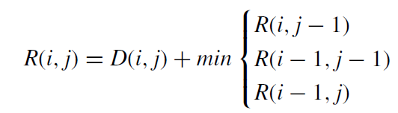
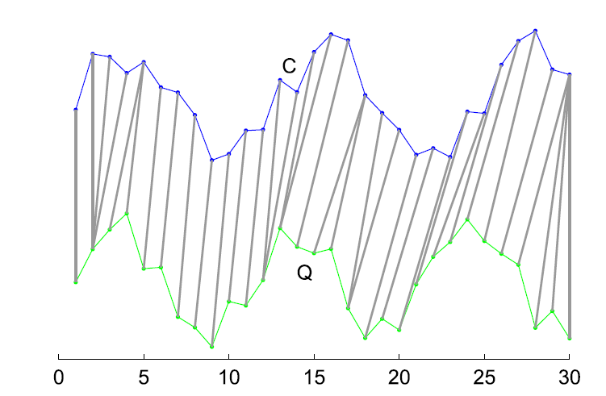

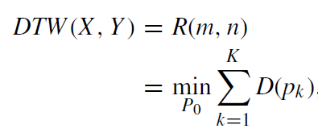
Dynamic Time Warping (DTW)

Slide 5
DTW based on Incremental Warping Window
Work Motivation
Incremental Warping Window (IWW)
Algorithm of DTW based on Incremental Warping Window (IWW)

Slide 6
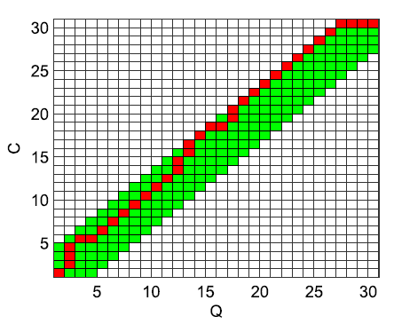

Work Motivation
DTW based on Sakoe-Chiba Band (SDTW)
Warping window :
Disadvantages
r is often set to be 0.1, the long compared time series makes the warping window is large.
Warping window is a const value, different time points have the same size of the matching area.
SDTW is not robust for the stream time series with the changeable lengths.

Slide 7
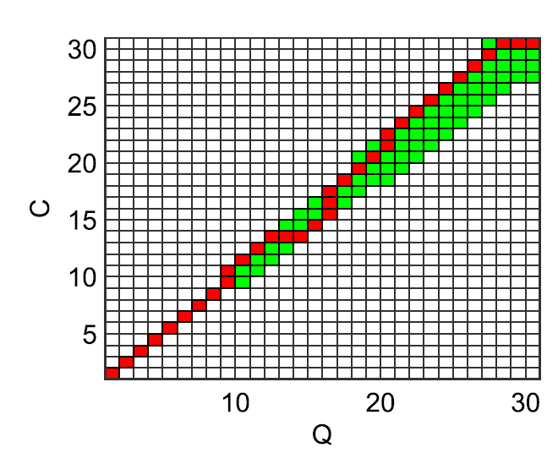

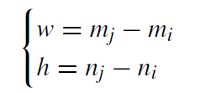
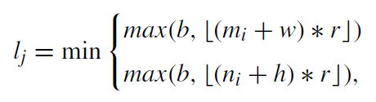

Incremental Warping Window (IWW) (1/2)
Given two stream time series
X^{mi} = {x₁, x₂, ..., x_{m0}} and Y^{ni} = {y₁, y₂, …, y_{n0}}
Two increased stream time series X^{mi} and Y^{ni}
where i = 2, 3, …, m_{i} > m₀ and n_{i} > n₀

Slide 8
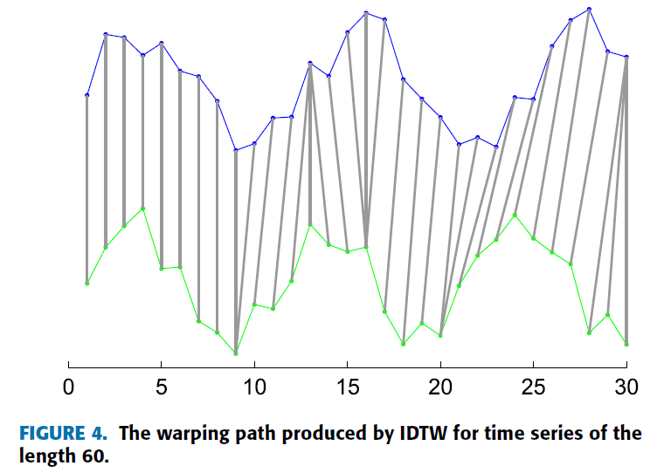
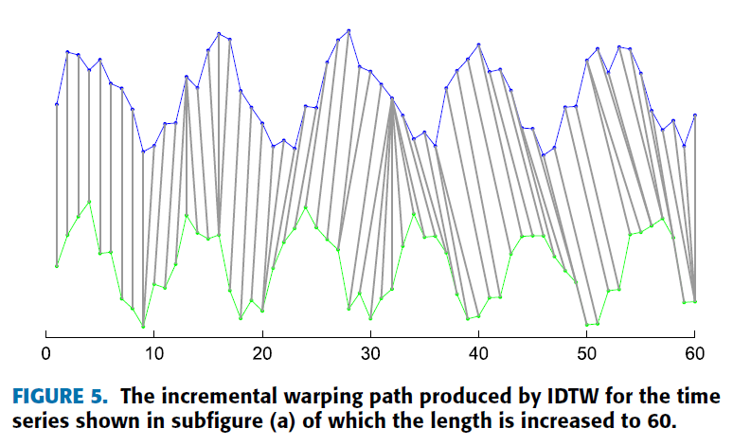
Incremental Warping Window (IWW) (2/2)
b is 0
w and h are set to 1 -> The length of the coming subsequences is 1

Slide 9
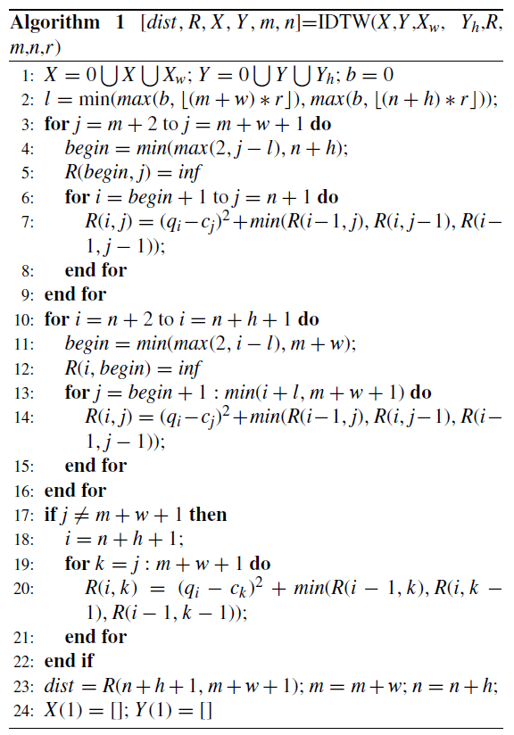
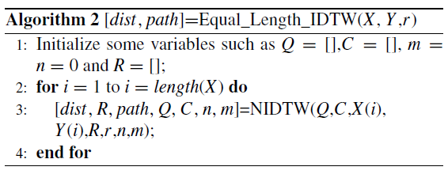
Algorithm of DTW based on IWW

Slide 10
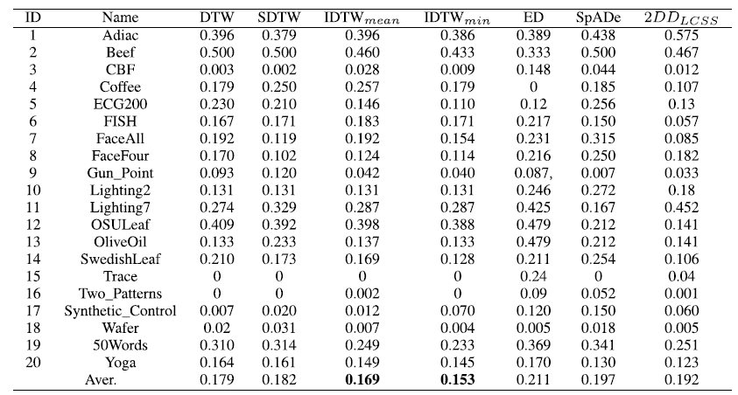
Experimental Results (1/3)
Error Rate

Slide 11
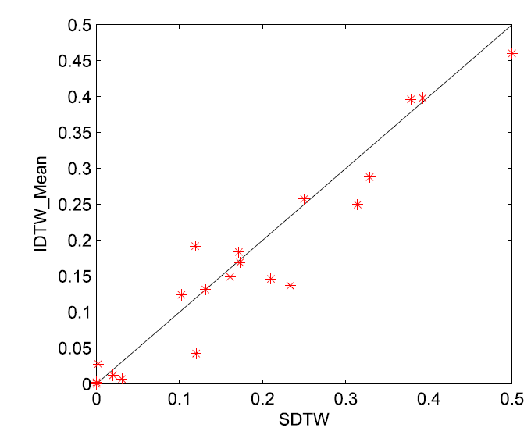
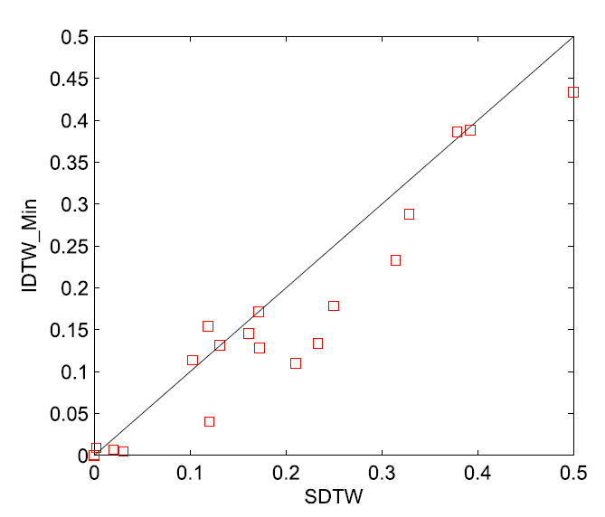
Experimental Results (2/3)
Error Rate

Slide 12
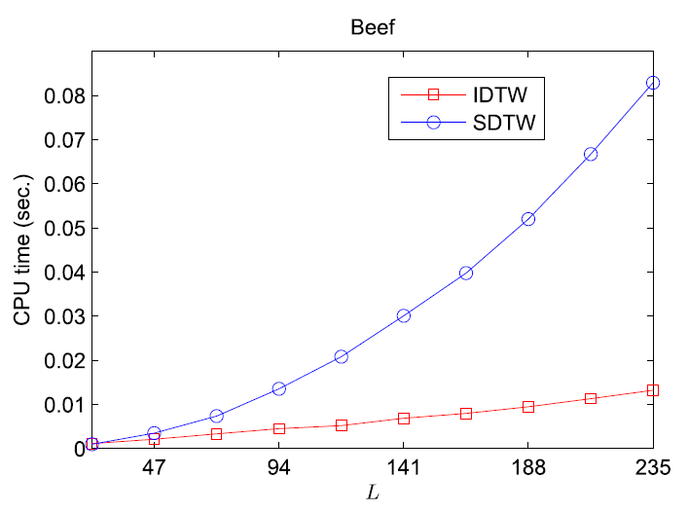
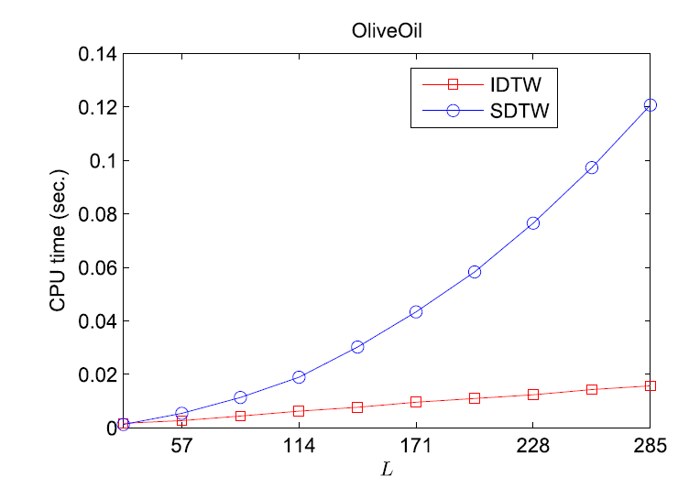
Experimental Results (3/3)

