Slide 1
Fuzzy Control Systems: Past, Present and Future
Anh-Tu Nguyen, Tadanari Taniguchi, Luka Eciolaza, Víctor Campos and Reinaldo Palhares, Michio Sugeno
IEEE Computational intelligence magazine | February 2019
Presenter: KeXin Zhu
Date: 2019/05/27
Notes:
https://www.microsoft.com/en-us/research/project/academic/articles/microsoft-academic-analytics/
https://www.bing.com/academic/?mkt=zh-CN

Slide 2
Abstract (1/2)
More than 40 years after fuzzy logic control appeared as an effective tool to deal with complex processes, the research on fuzzy control systems has constantly evolved. Mamdani fuzzy control was originally introduced as a model-free control approach based on expert’s experience and knowledge. Due to the lack of a systematic framework to study Mamdani fuzzy systems, we have witnessed growing interest in fuzzy model-based approaches with Takagi-Sugeno fuzzy systems and singleton-type fuzzy systems (also called piecewise multi-affine systems) over the past decades.

Slide 3
Abstract (2/2)
This paper reviews the key features of the three above types of fuzzy systems. Through these features, we point out the historical rationale for each type of fuzzy systems and its current research mainstreams. However, the focus is put on fuzzy model-based approaches developed via Lyapunov stability theorem and linear matrix inequality (LMI) formulations. Finally, our personal viewpoint on the perspectives and challenges of the future fuzzy control research is discussed.

Slide 4
1 Introduction: Why Fuzzy？
傳統電腦決策：
不是對(1)就是錯(0)
例如：180cm以上是高，那179cm就是矮?
60分以上是及格，那60分以下就是不及格。
模糊：
在對(1)與錯(0)之間，再多加幾個等級
幾乎對(0.8)
可能對(0.6)
可能錯(0.4)
幾乎錯(0.2)

Slide 5
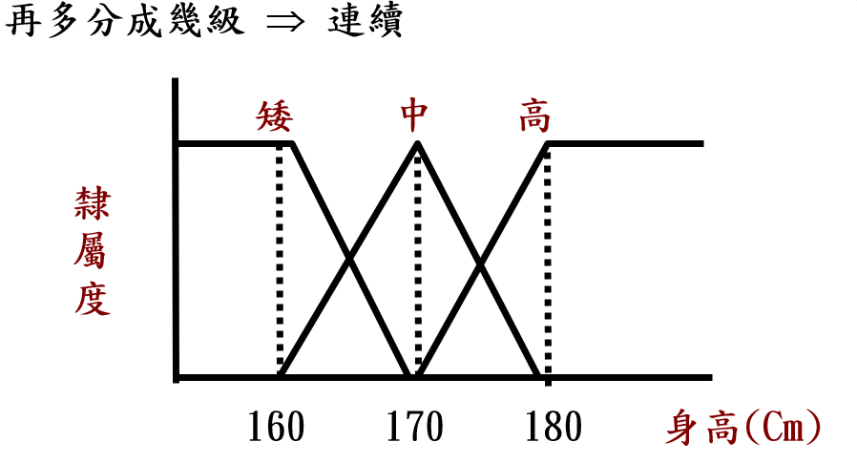
1 Introduction: Why Fuzzy？

Slide 6
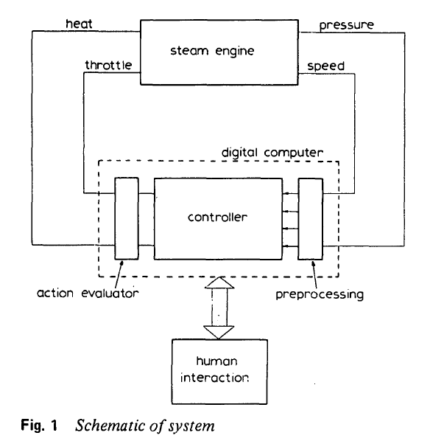
1 Introduction: Fuzzy control system
Notes:
.Mamdani, E. H. (1974). Application of fuzzy algorithms for control of simple dynamic plant. Proceedings of the institution of electrical engineers, IET.

Slide 7

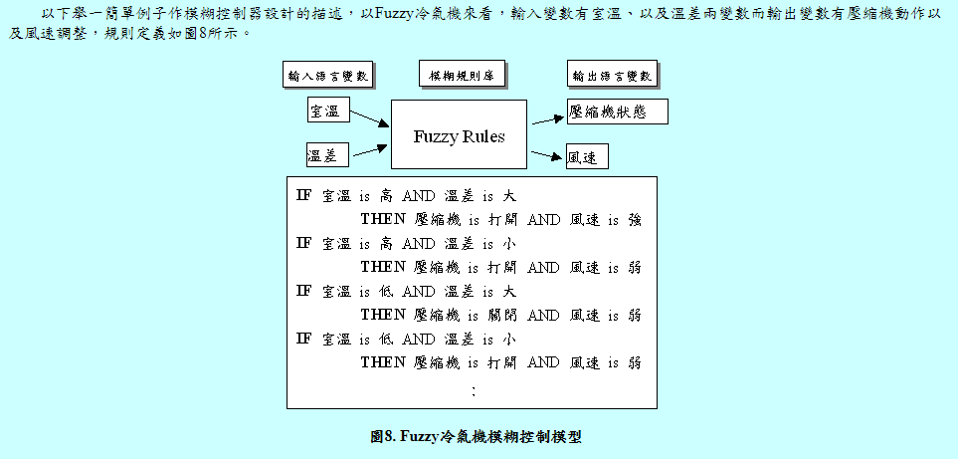
1.1 Mamdani fuzzy systems
Notes:
.Mamdani, E. H. and S. Assilian (1975). "An experiment in linguistic synthesis with a fuzzy logic controller." International journal of man-machine studies 7(1): 1-13.

Slide 8
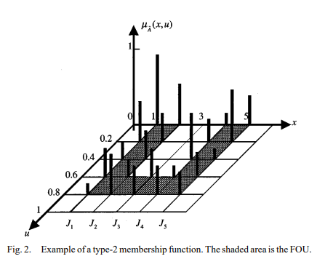

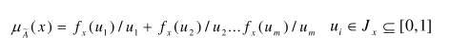
1.2 Type 2 fuzzy rules
Notes:
Mendel, J. M. and R. B. John (2002). "Type-2 fuzzy sets made simple." IEEE Transactions on Fuzzy systems 10(2): 117-127.

Slide 9

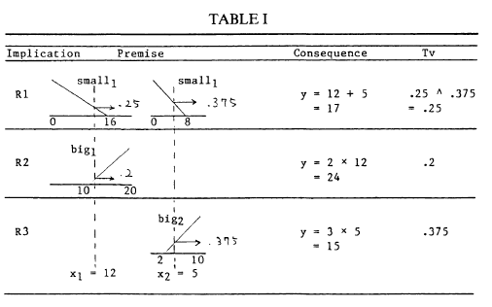
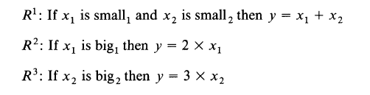
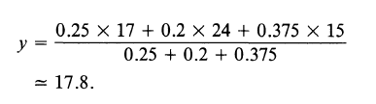
1.3 T-S fuzzy systems
Sample：
Notes:
.Takagi, T. and M. Sugeno (1993). Fuzzy identification of systems and its applications to modeling and control. Readings in Fuzzy Sets for Intelligent Systems, Elsevier: 387-403.

Slide 10
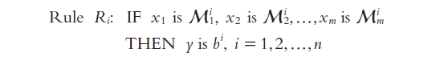

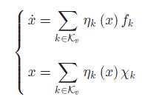
1.4 PMA fuzzy systems
Notes:
.Sugeno, M. (1999). "On stability of fuzzy systems expressed by fuzzy rules with singleton consequents." IEEE Transactions on Fuzzy systems 7(2): 201-224.
Nguyen, A.-T., et al. (2017). "LMI-based stability analysis for piecewise multi-affine systems." IEEE Transactions on Fuzzy systems 25(3): 707-714.

Slide 11

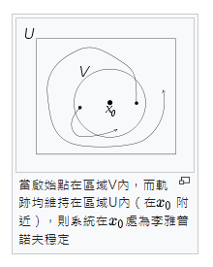

1.5 Lyapunov stability
Lyapunov stable：
Notes:
https://en.wikipedia.org/wiki/Lyapunov_stability
Tanaka, K. and M. Sugeno (1992). "Stability analysis and design of fuzzy control systems." Fuzzy sets and systems 45(2): 135-156.

Slide 12
1.5 Lyapunov stability
Asymptotically stable:
Exponentially stable:
Notes:
https://en.wikipedia.org/wiki/Lyapunov_stability
Tanaka, K. and M. Sugeno (1992). "Stability analysis and design of fuzzy control systems." Fuzzy sets and systems 45(2): 135-156.

Slide 13
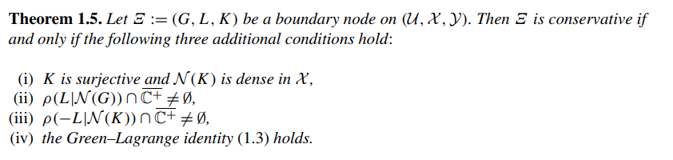
1.6 Conservative system
Notes:
https://zh.wikipedia.org/zh-tw/%E9%B2%81%E6%A3%92%E6%8E%A7%E5%88%B6
Malinen, J. and O. J. Staffans (2006). "Conservative boundary control systems." Journal of Differential Equations 231(1): 290-312.

Slide 14
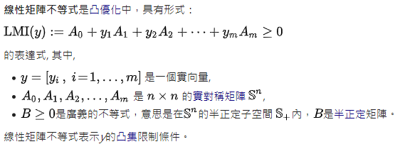
1.7 Linear matrix inequalities (LMIs)
Notes:
https://zh.wikipedia.org/zh-tw/%E7%BA%BF%E6%80%A7%E7%9F%A9%E9%98%B5%E4%B8%8D%E7%AD%89%E5%BC%8F

Slide 15
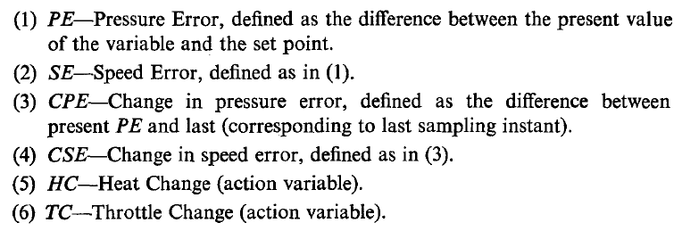
2 Mamdani Fuzzy Systems
Notes:
.

Slide 16
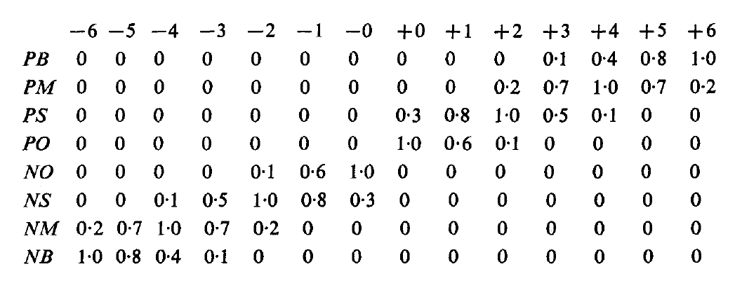
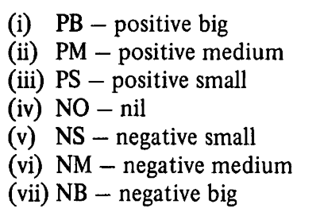
2 Mamdani Fuzzy Systems
Notes:
.

Slide 17
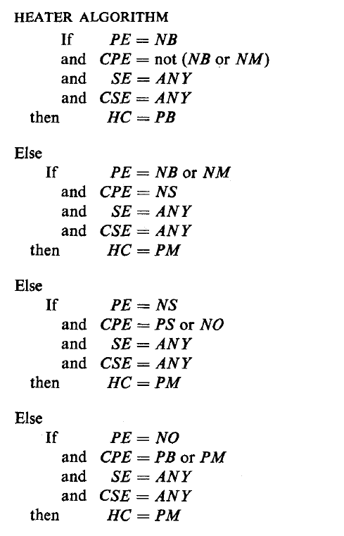



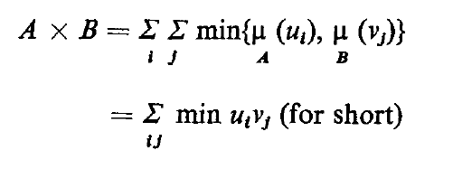
2 Mamdani Fuzzy Systems
OR：
AND：
NOT：
Notes:
.
.Mamdani, E. H. and S. Assilian (1975). "An experiment in linguistic synthesis with a fuzzy logic controller." International journal of man-machine studies 7(1): 1-13.

Slide 18
2 Mamdani Fuzzy Systems
Effectiveness:
No math-model
Human operators
Task-oriented control
Multi-objective goals
Notes:
.

Slide 19
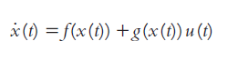
2 Mamdani Fuzzy Systems
Drawback : Model-free
Overcome:
Fuzzy model-based control approaches:
Notes:
.

Slide 20
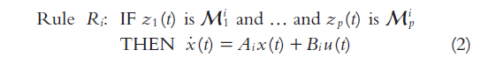
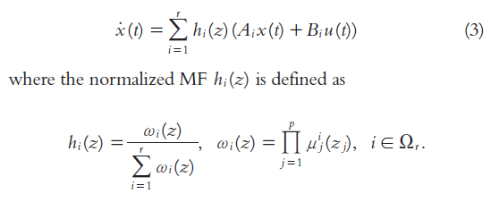

3 Takagi-Sugeno Fuzzy Systems
A. System Description:
Defuzzification：
Convex sum property:
Notes:
.

Slide 21


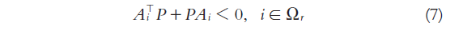
3 Takagi-Sugeno Fuzzy Systems
B. Lyapunov-Based Stability Analysis:
Quadratic Lyapunov function (QLF):
LMIs conditions:
Notes:
.Takagi, T. and M. Sugeno (1993). Fuzzy identification of systems and its applications to modeling and control. Readings in Fuzzy Sets for Intelligent Systems, Elsevier: 387-403.

Slide 22
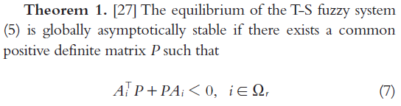
3 Takagi-Sugeno Fuzzy Systems
B. Lyapunov-Based Stability Analysis:
LMIs easily checked with numerical solvers.
P has to exist for all local linear subsystems.
MFs are considered as uncertainty.
Embedded in the conventional robust control theory.
Notes:
.Takagi, T. and M. Sugeno (1993). Fuzzy identification of systems and its applications to modeling and control. Readings in Fuzzy Sets for Intelligent Systems, Elsevier: 387-403.

Slide 23
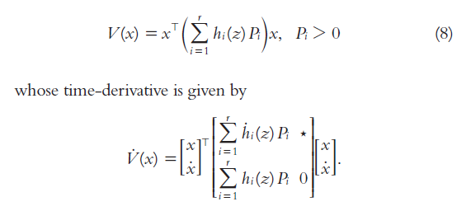
3 Takagi-Sugeno Fuzzy Systems
C. Conservativeness issue:
1. Relaxations with Different Choices of Lyapunov Functions:
1) Fuzzy Lyapunov functions (FLFs):
Notes:
.Takagi, T. and M. Sugeno (1993). Fuzzy identification of systems and its applications to modeling and control. Readings in Fuzzy Sets for Intelligent Systems, Elsevier: 387-403.

Slide 24

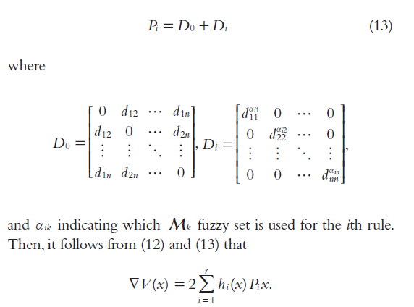
3 Takagi-Sugeno Fuzzy Systems
C. Conservativeness issue:
1. Relaxations with Different Choices of Lyapunov Functions:
2) Line integral Lyapunov functions (LILFs):
Notes:
.Takagi, T. and M. Sugeno (1993). Fuzzy identification of systems and its applications to modeling and control. Readings in Fuzzy Sets for Intelligent Systems, Elsevier: 387-403.

Slide 25
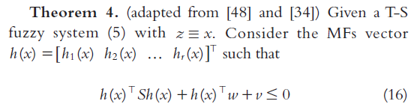
3 Takagi-Sugeno Fuzzy Systems
C. Conservativeness issue:
2. Exploiting the Knowledge of the Membership Functions for Stability Relaxations :
Notes:
.Takagi, T. and M. Sugeno (1993). Fuzzy identification of systems and its applications to modeling and control. Readings in Fuzzy Sets for Intelligent Systems, Elsevier: 387-403.

Slide 26
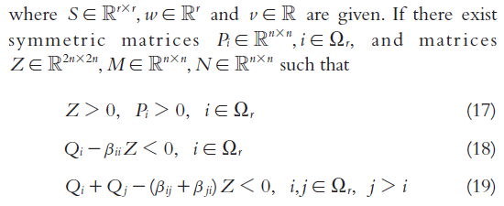
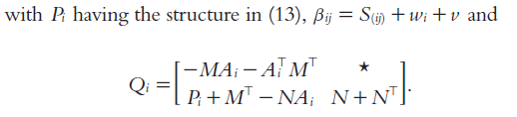
3 Takagi-Sugeno Fuzzy Systems
C. Conservativeness issue:
2. Exploiting the Knowledge of the Membership Functions for Stability Relaxations :
Notes:
.Takagi, T. and M. Sugeno (1993). Fuzzy identification of systems and its applications to modeling and control. Readings in Fuzzy Sets for Intelligent Systems, Elsevier: 387-403.

Slide 27
3 Takagi-Sugeno Fuzzy Systems
D. Takagi-Sugeno Fuzzy Control Design:
The control design of T-S fuzzy models are with the following steps:
(1) Choose a specific form of the control law
(2) Find the respective closed-loop T-S fuzzy representation
(3) Apply a set of stability analysis conditions to the closed-loop representation
(4) Transform these conditions into LMI-based formulations.
Notes:
.Takagi, T. and M. Sugeno (1993). Fuzzy identification of systems and its applications to modeling and control. Readings in Fuzzy Sets for Intelligent Systems, Elsevier: 387-403.

Slide 28


3 Takagi-Sugeno Fuzzy Systems
D. Takagi-Sugeno Fuzzy Control Design:
(1) PDC control law:
(2) The closed-loop T-S fuzzy system:
Notes:
.Takagi, T. and M. Sugeno (1993). Fuzzy identification of systems and its applications to modeling and control. Readings in Fuzzy Sets for Intelligent Systems, Elsevier: 387-403.

Slide 29


3 Takagi-Sugeno Fuzzy Systems
D. Takagi-Sugeno Fuzzy Control Design:
(3) The closed-loop stability analysis:
(4) LMI constraint:
Notes:
.Takagi, T. and M. Sugeno (1993). Fuzzy identification of systems and its applications to modeling and control. Readings in Fuzzy Sets for Intelligent Systems, Elsevier: 387-403.

Slide 30


4 Piecewise Multiaffine Systems
A. Description of PMA Systems:
(1) Extension of T-S system:
(2) Partition of the state-space:
Notes:
.Takagi, T. and M. Sugeno (1993). Fuzzy identification of systems and its applications to modeling and control. Readings in Fuzzy Sets for Intelligent Systems, Elsevier: 387-403.

Slide 31
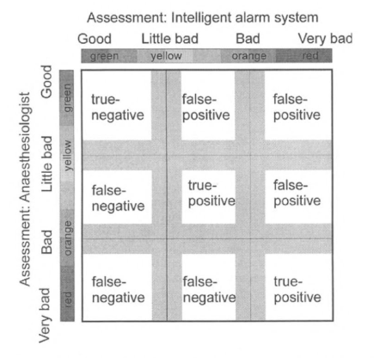
4 Piecewise Multiaffine Systems
A. Description of PMA Systems:
(3) Set of multi-indexes to all the vertices:
(4) Set of multi-indexes to the regions:
Notes:
.Takagi, T. and M. Sugeno (1993). Fuzzy identification of systems and its applications to modeling and control. Readings in Fuzzy Sets for Intelligent Systems, Elsevier: 387-403.

Slide 32
4 Piecewise Multiaffine Systems
A. Description of PMA Systems:
(5)Region vector Ri:
(6) Set of multi-indexes to all vertices of Ri:
Notes:
.Takagi, T. and M. Sugeno (1993). Fuzzy identification of systems and its applications to modeling and control. Readings in Fuzzy Sets for Intelligent Systems, Elsevier: 387-403.

Slide 33

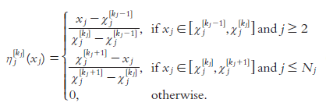
4 Piecewise Multiaffine Systems
A. Description of PMA Systems:
(7) Fuzzy rules:
(8) MFs:
Notes:
.Takagi, T. and M. Sugeno (1993). Fuzzy identification of systems and its applications to modeling and control. Readings in Fuzzy Sets for Intelligent Systems, Elsevier: 387-403.

