Slide 1
Shortest Unique Palindromic Substring Queries on Run-Length Encoded Strings
Kiichi Watanabe, Yuto Nakashima, Shunsuke Inenaga, Hideo Bannai, and Masayuki Takeda Proceedings of International Workshop on Combinatorial Algorithms (IWOCA) Pisa, Italy, 23-25 July, pp. 430-441, 2019 Speaker: Kuan-Lin Lai
Date: July 23, 2019
Notes:
維羅納

Slide 2
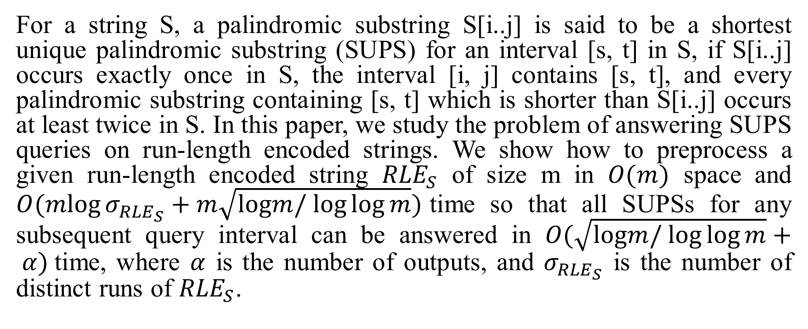
Abstract
For a string S, a palindromic substring S[i..j] is said to be a shortest unique palindromic substring (SUPS) for an interval [s, t] in S, if S[i..j] occurs exactly once in S, the interval [i, j] contains [s, t], and every palindromic substring containing [s, t] which is shorter than S[i..j] occurs at least twice in S. In this paper, we study the problem of answering SUPS queries on run-length encoded strings. We show how to preprocess a given run-length encoded string ${RLE}_{S}$ of size m in $O(m)$ space and $O(mlog⁡σ_{{RLE}_{S}}+m\sqrt{logm/ log⁡log⁡m})$time so that all SUPSs for any subsequent query interval can be answered in $O(\sqrt{logm/ log⁡log⁡m}+ α)$time, where $α$ is the number of outputs, and $σ_{{RLE}_{S}}$ is the number of distinct runs of ${RLE}_{S}$.

Slide 3
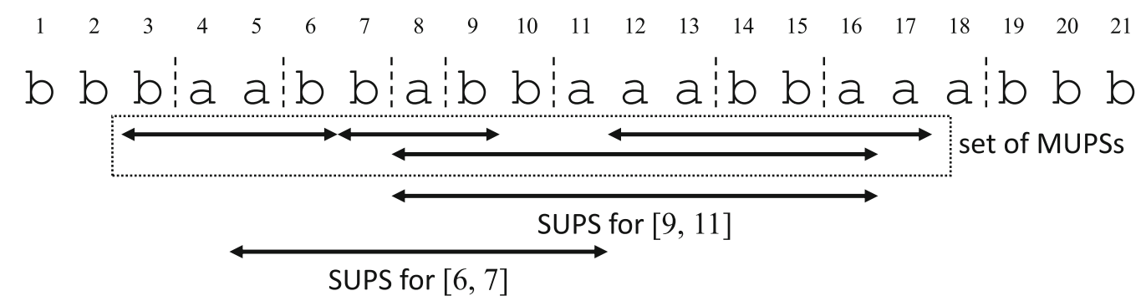
MUPS
MUPS: minimal unique palindrome substring

Slide 4

SUPS
SUPS: shortest unique palindromic substring
$$P = S[i..j]of string S is called a shortest unique palindromic substring (SUPS)for interval [s, t]of S iff$$
$P is a unique palindromic substring of S$
$[s, t] ⊆ [i, j]$
$there is no unique palindromic substring Q = S[i′..j′] such that [s, t] ⊆ [i′..j′] and |Q| < |P|$

Slide 5
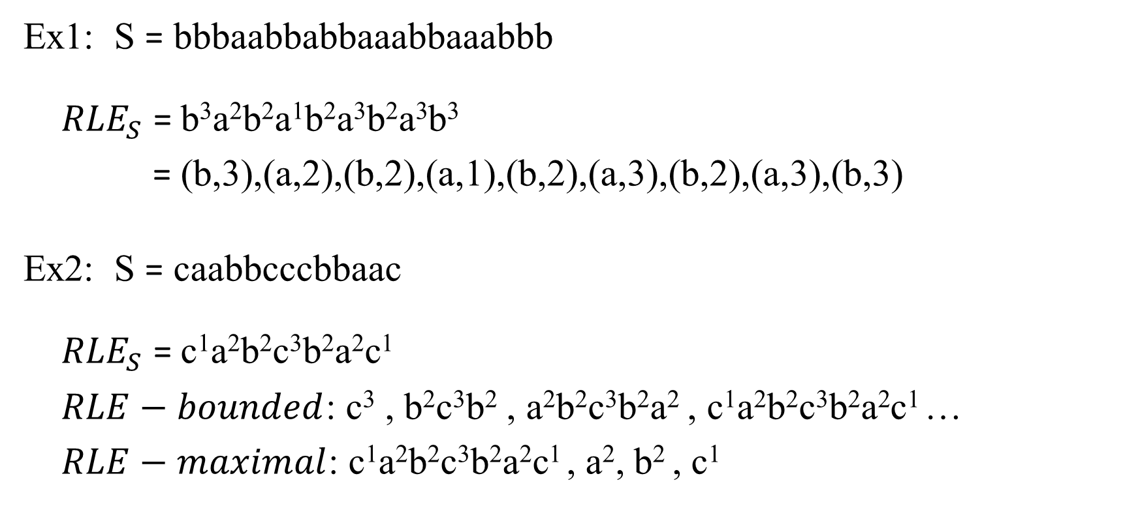
Run Length Encoding (RLE)
Ex1: S = bbbaabbabbaaabbaaabbb ${RLE}_{S}$ = b³a²b²a¹b²a³b²a³b³
= (b,3),(a,2),(b,2),(a,1),(b,2),(a,3),(b,2),(a,3),(b,3)
Ex2: S = caabbcccbbaac ${RLE}_{S}$ = c¹a²b²c³b²a²c¹
$RLE−bounded$: c³ , b²c³b² , a²b²c³b²a² , c¹a²b²c³b²a²c¹ …
$RLE−maximal$: c¹a²b²c³b²a²c¹ , a², b² , c¹

Slide 6
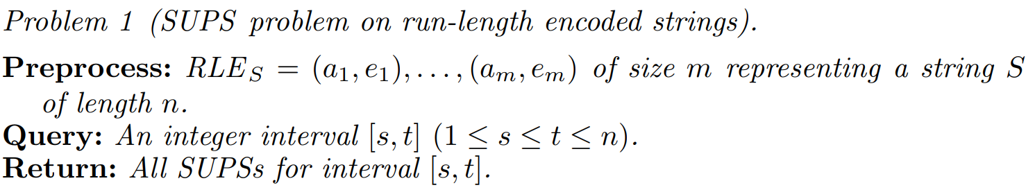
Problem

Slide 7
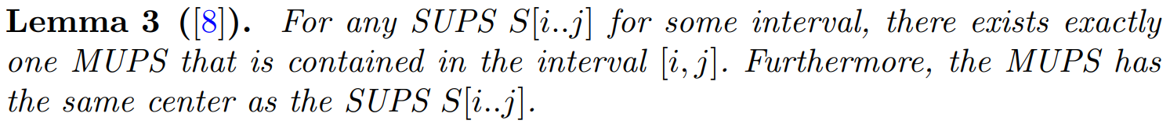

Slide 8
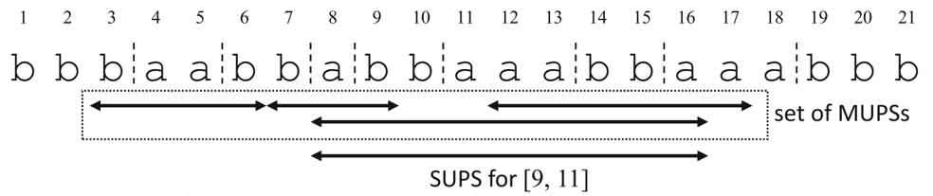
MUPS and SUPS
MUPS: minimal unique palindrome substring SUPS: shortest unique palindrome substring
SUPS for [6, 7]

Slide 9
RLE Version of Manacher’s Algorithm
S = bbbaabbbab => #b#b#b#a#a#b#b#b#a#b#
S = b³a²b²a¹b²a³b²a³b³
S | # | b | # | b | # | b | # | a | # | a | # | b | # | b | # | a | # | b | #
P | 0 | 1 | 2 | 3 | 2 | 1 | 0 | 1 | 6 | 1 | 0 | 1 | 4 | 1 | 0 | 1 | 0 | 1 | 0
S | b | a | b | a | b | a | b | a | b
P | 0 | 0 | 0 | 1 | 0 | 1 | 1 | 0 | 0

Slide 10
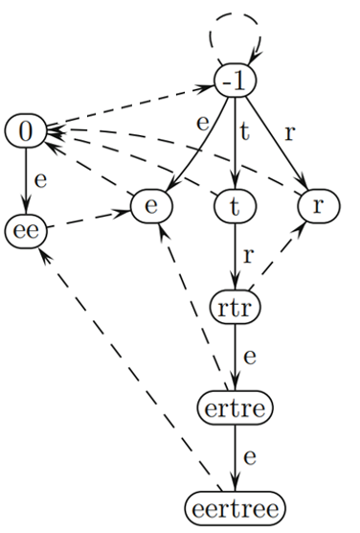
Basic version EERTREE
Edge( )
Suffix link ( )
node -1: imaginary string
node 0 : empty string

Slide 11
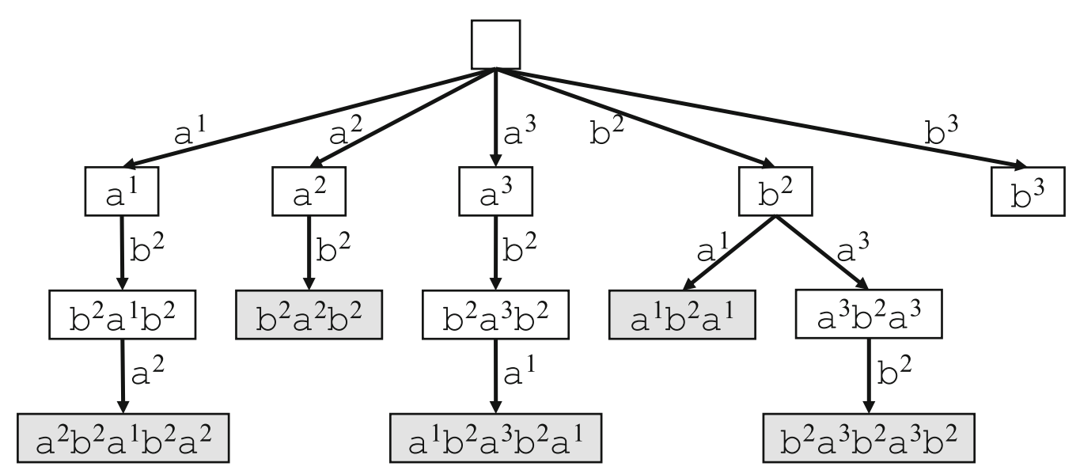
RLE version of EERTREE
S = b³a²b²a¹b²a³b²a³b³
S | b | a | b | a | b | a | b | a | b
CPal | 0 | 0 | 0 | 1 | 0 | 1 | 1 | 0 | 0

Slide 12

The form of MUPS
$ae$ form MUPS $ae is a MUPS iff e is the largest exponent for all runs of a’s in S and occS(ae) = 1$
$a^{e}Pa^{e}$ form MUPS
1 | 2 | 3 | 4 | 5 | 6 | 7 | 8 | 9 | 10 | 11 | 12 | 13 | 14 | 15 | 16 | 17 | 18 | 19 | 20 | 21
b | b | a | b | a | b | a | a | b | a | a | b | b | b | b | a | a | b | b | b | b

Slide 13
Get MUPS from e²rtre²
S = b³a²b²a¹b²a³b²a³b³ MUPS: baab, bab, abbaaabba, aabbaa

Slide 14
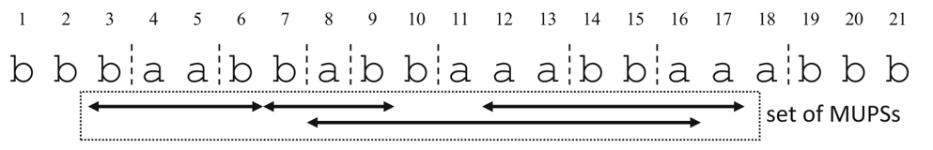
Query algorithm
Condition 1: [3, 9]
Condition 2: [6, 11]
Condition 3: [6, 7], [9, 11]

Slide 15
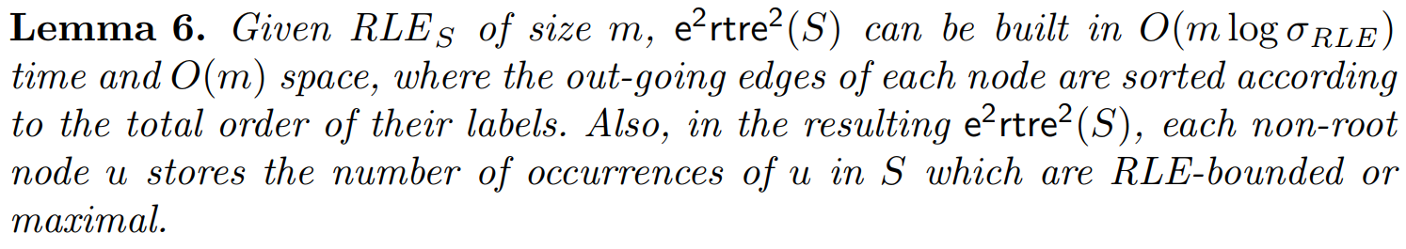
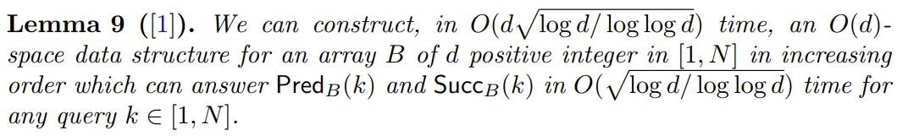
Complexity analysis

Slide 16
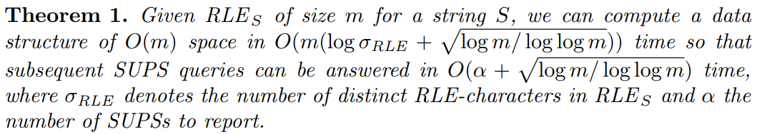
Complexity analysis

