Slide 1
Protein Structure Alignment by Incremental Combinatorial Extension (CE) of the Optimal Path
Ilya N. Shindyalov, Philip E. Bourne
Protein Engineering vol.11 no.9 pp.739–747, 1998
Presenter : Feng-Yang Tsai
Date:Jul. 23, 2019.

Slide 2
Abstract(1/2)
A new algorithm is reported which builds an alignment between two protein structures. The algorithm involves a combinatorial extension (CE) of an alignment path deﬁned by aligned fragment pairs (AFPs) rather than the more conventional techniques using dynamic programming and Monte Carlo optimization. AFPs, as the name suggests, are pairs of fragments, one from each protein, which confer structure similarity. AFPs are based on local geometry, rather than global features such as orientation of secondary structures and overall topology. Combinations of AFPs that represent possible continuous alignment paths are selectively extended or discarded thereby leading to a single optimal alignment.

Slide 3
Abstract(2/2)
The algorithm is fast and accurate in ﬁnding an optimal structure alignment and hence suitable for database scanning and detailed analysis of large protein families. The method has been tested and compared with results from Dali and VAST using a representative sample of similar structures. Several new structural similarities not detected by these other methods are reported.

Slide 4
Alignment Fragment Pairs
For a pair of proteins A and B, an alignment fragment pair (AFP) is defined as a continuous segment of A aligned against a continuous segment of B of the same size (without gaps).
If n₁ and n₂ are the lengths of A and B, and AFP length is set to m, then there is a total of
(n₁− m)×(n₂− m) AFPs.

Slide 5
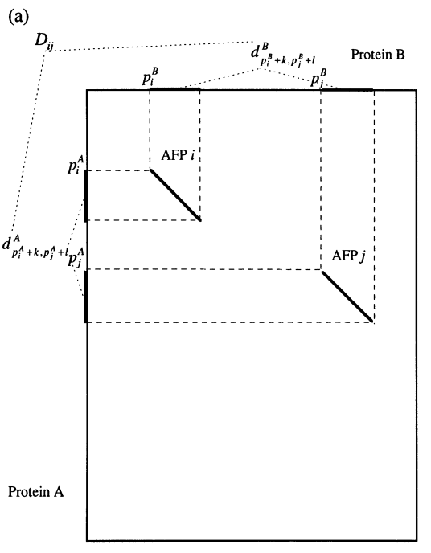
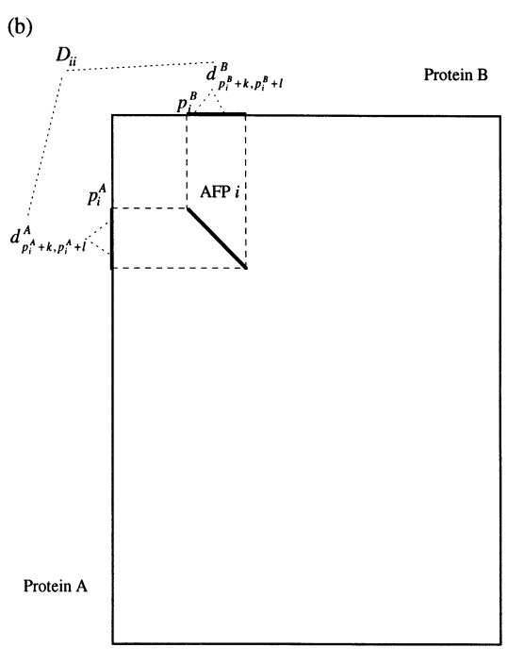
Alignment Fragment Pairs

Slide 6
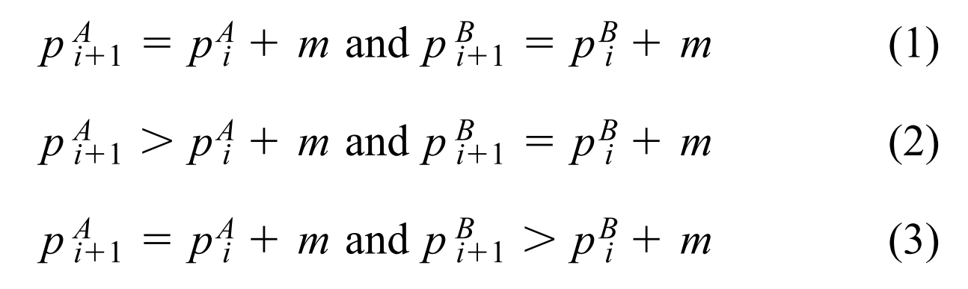
Defining an Alignment
An alignment is defined as a continuous path of AFPs of fixed length m s.t. for every two consecutive AFPs there may be gaps inserted into either A or B, but not into both. That is, for every two consecutive AFPs i and i+1, we have
Where p_{i}^{A} represents the starting position of AFP i in
protein A
Notes:
Give an example of valid and invalid alignments here (draw pictures)

Slide 7
The CE Algorithm
Goal: Find a “good” local alignment for structures of proteins A and B.
Basic idea:
Select some initial AFP.
Build an alignment path by incrementally adding AFPs in a way that satisfies the conditions on the previous slide.
Repeat step (2) until the length of each protein is traversed, or until no “good” AFPs remain.

Slide 8
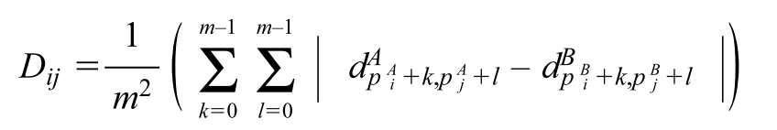
AFP Distances
We can define the distance between two different AFPs i and j as:
Independent set
(4)
Full set
(5)

Slide 9
Alignment Fragment Pairs

Slide 10
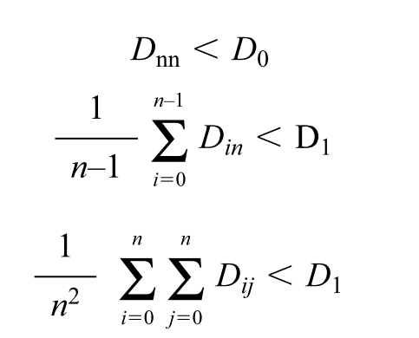
Extending the Alignment Path
Suppose our alignment path already consists of AFPs 0…n−1, and we are trying to decide whether to add AFP n to the path. We will do so only if:
(6)
(7)
(8)

Slide 11
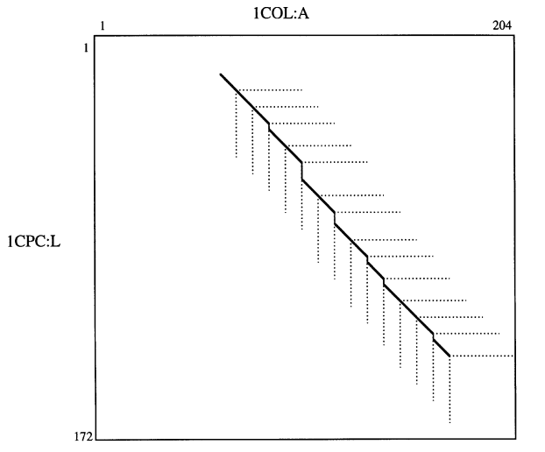
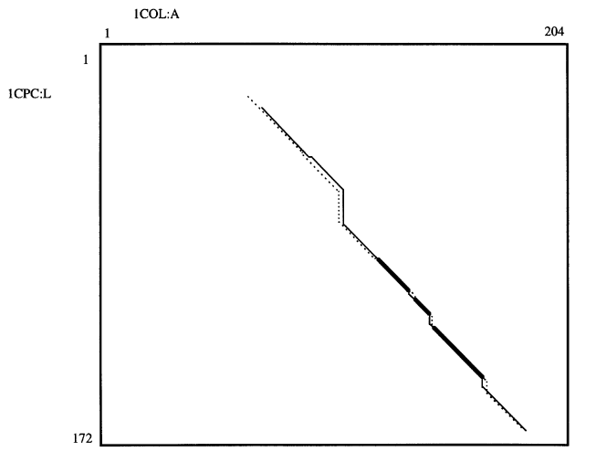
Results and Conclusion
The CE method is highly configurable, which is at once its strength and weakness. Adjusting multiple parameters, such as AFP length m, cutoff distances D₀ and D₁, and definitions for AFP distances, can result varying alignments and execution speeds.
Notes:
1CPC藻藍蛋白
1COL大腸桿菌

Slide 12
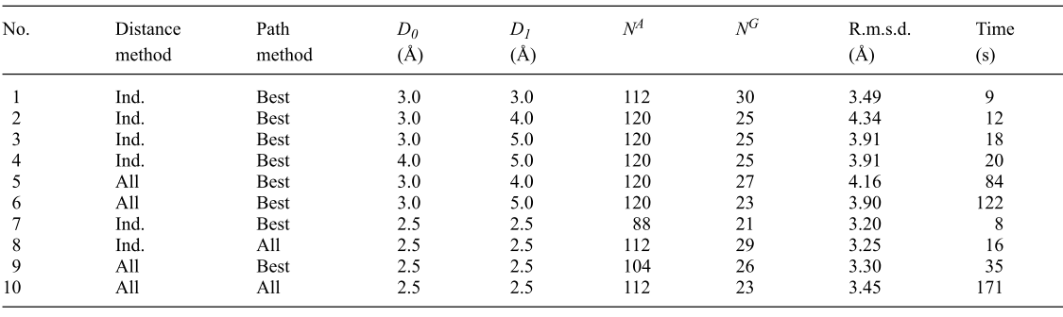
Results and Conclusion
Notes:
1CPC藻藍蛋白
1COL大腸桿菌

Slide 13
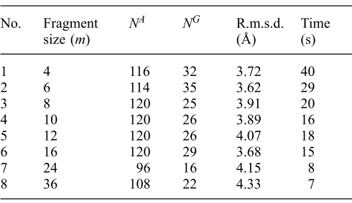
Results and Conclusion
Notes:
1CPC藻藍蛋白
1COL大腸桿菌

Slide 14
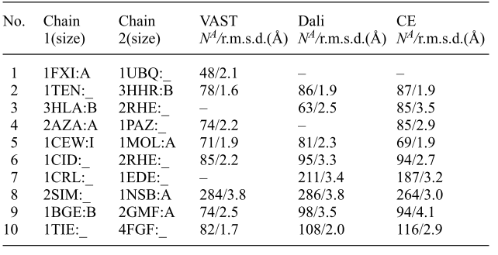
Results and Conclusion
In general, CE does not outperform previously existing structural alignment methods, such as Dali and VAST.

