Slide 1
Constrained longest common subsequence computing algorithms in practice
Deorowicz, S. and J. Obstój
Computing and Informatics, Vol. 29, 2010, 427–445.
Presenter: KeXin Zhu
Date: 2019/08/06

Slide 2
Abstract
The problem of finding a constrained longest common subsequence
(CLCS) for the sequences A and B with respect to sequence P was introduced recently. Its goal is to find a longest subsequence C of A and B such that P is a subsequence of C. There are several algorithms solving the CLCS problem, but there is no real experimental comparison of them. The paper has two aims. Firstly, we propose an improvement to the algorithms by Chin et al. and Deorowicz based on an entry-exit points technique by He and Arslan. Secondly, we compare experimentally the existing algorithms for solving the CLCS problem.

Slide 3
1 Introduction
Common subsequence：
X = “abcac”,
Y = “cacab”.
Common subsequence of X and Y:
CS = “ab”, “aa”, “aca”, “cac”.

Slide 4
1 Introduction
Longest Common subsequence：
X = “abcac”,
Y = “cacab”.
Longest Common subsequence of X and Y:
LCS = “aca”, “cac”.

Slide 5
1 Introduction
Constrained Longest Common subsequence：
X = “abcac”,
Y = “cacab”,
Z=“b”.
Longest Common subsequence of X and Y:
CLCS = “ab”.

Slide 6
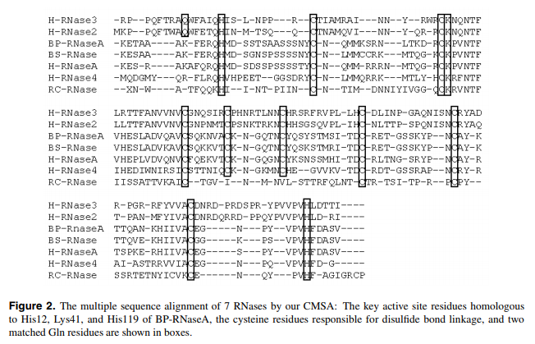
1 Introduction
Application of CLCS：HKH of RNase sequences
Notes:
Tang, C. Y., et al. (2003). "Constrained multiple sequence alignment tool development and its application to RNase family alignment." Journal of Bioinformatics and Computational Biology 1(02): 267-287.

Slide 7
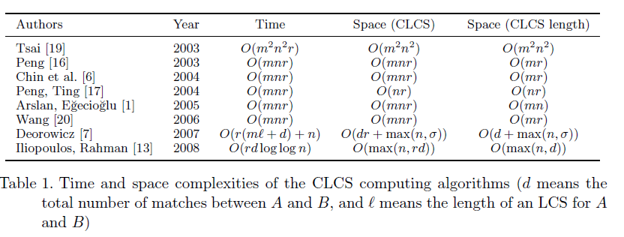
2 Algorithm for the CLCS problem

Slide 8
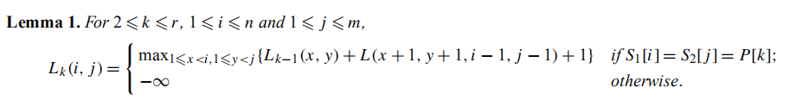
2.1 Tsai Algorithm
Algorithm:
Time complexity：
O(n²m² + rn²m² + nm) = O(rn²m²)
( LCS(x, y, x’, y’)-Lookup table + Lemma1 + Lemma2 )
Notes:
Tsai, Y.-T. (2003). "The constrained longest common subsequence problem." Information Processing Letters 88(4): 173-176.

Slide 9
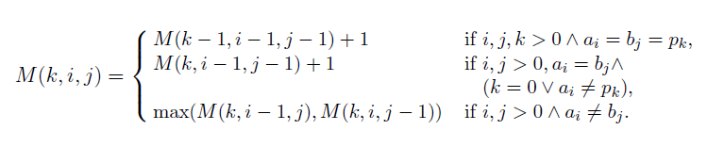
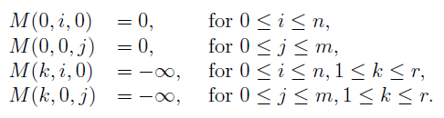
2.2 Chin et al. Algorithm
Algorithm:
Boundary conditions:
Complexity：O(rnm) time and space.
Notes:
Chin, F. Y., et al. (2004). "A simple algorithm for the constrained sequence problems." Information Processing Letters 90(4): 175-179.

Slide 10
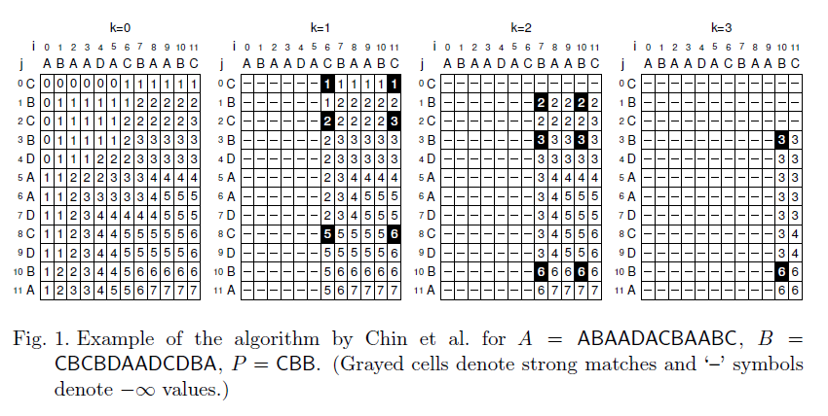
2.2 Chin et al. Algorithm
Example:

Slide 11
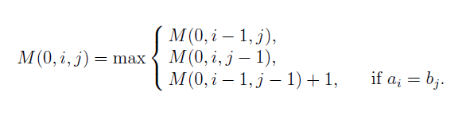
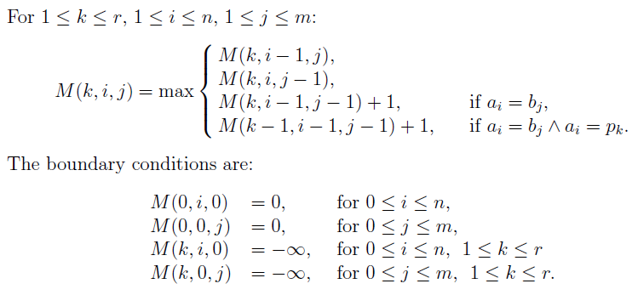
2.3 Peng Algorithm
Algorithm:
Notes:
Peng, C.-L. (2003). An approach for solving the constrained longest common subsequence problem, Master Thesis, Department of Computer Science and Engineering, National Sun ….

Slide 12
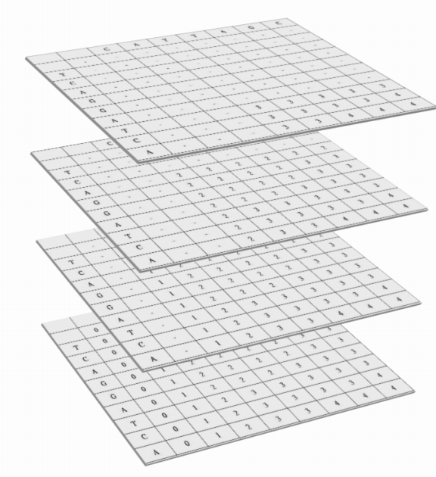
2.3 Peng Algorithm
Structure of matrices:
X = “CATTAGC”,
Y = “TCAGGATCA”,
Z = “CAT”.
Notes:
Peng, C.-L. (2003). An approach for solving the constrained longest common subsequence problem, Master Thesis, Department of Computer Science and Engineering, National Sun ….

Slide 13
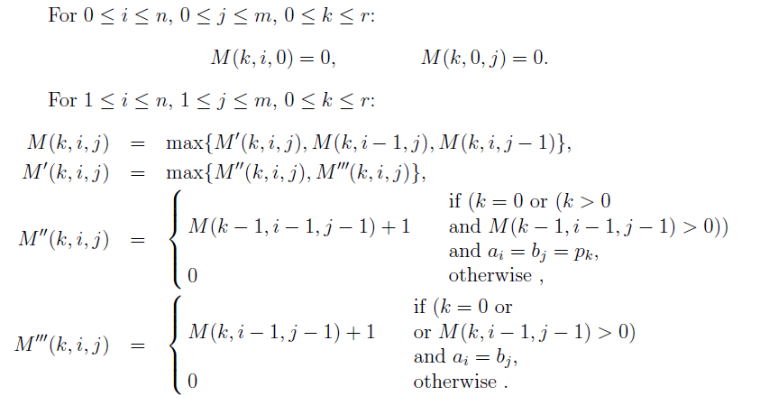
2.4 Arslan–Egecioglu Algorithm
Algorithm:
Boundary:
Strong match:
Match:
Notes:
Arslan, A. N. and Ö. Eğecioğlu (2005). "Algorithms for the constrained longest common subsequence problems." International Journal of Foundations of Computer Science 16(06): 1099-1109.

Slide 14
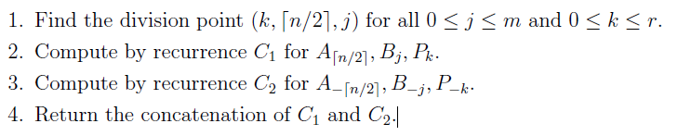

2.5 Peng-Ting Algorithm
Divide-and-conquer scheme:
Key point – Find(j, k):
Notes:
Peng, Z. and H.-F. Ting (2004). Time and space efficient algorithms for constrained sequence alignment. International Conference on Implementation and Application of Automata, Springer.

Slide 15
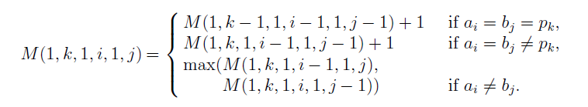
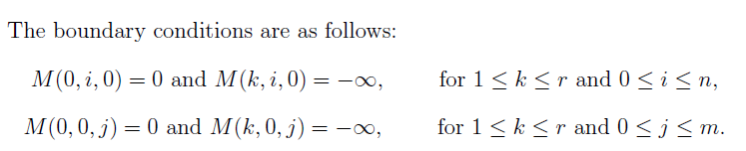
2.5 Peng-Ting Algorithm
Recurrence for calculation of M:

Slide 16
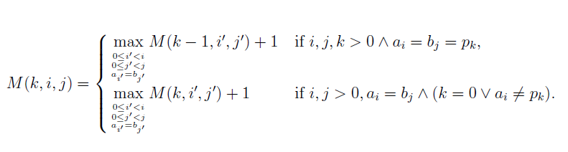
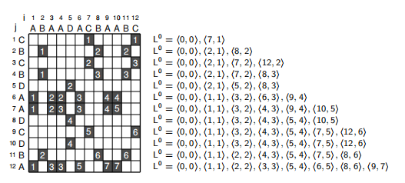
2.6 Deorowicz Algorithm
Algorithm:
Example of only length:
Notes:
Deorowicz, S. (2007). "Fast algorithm for constrained longest common subsequence problem." Theoretical and Applied Informatics 19(2): 91-102.

Slide 17
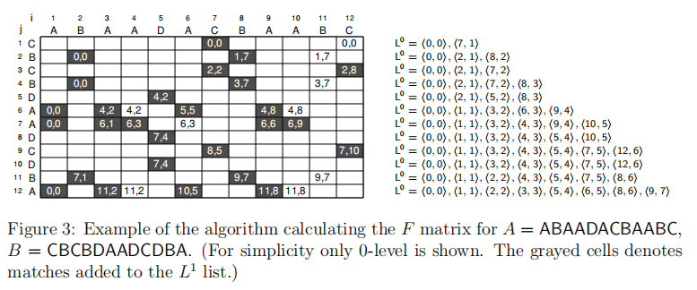
2.6 Deorowicz Algorithm
Example of Traceback:
Complexity： O(r(ml + d) + n) time, O(dr) space.
Notes:
Deorowicz, S. (2007). "Fast algorithm for constrained longest common subsequence problem." Theoretical and Applied Informatics 19(2): 91-102.

Slide 18
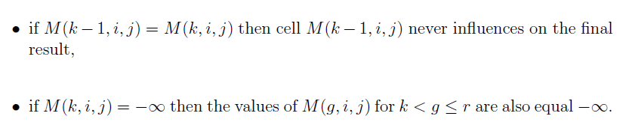
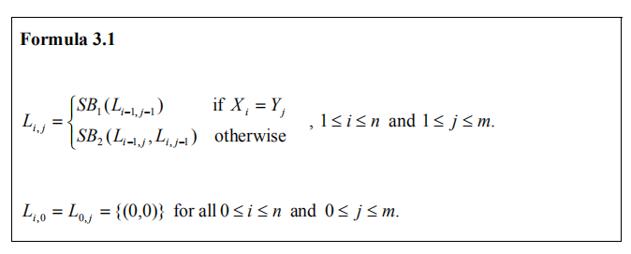
2.7 Wang Algorithm
Reduce properties:
Formula:
Notes:
Wang, W.-L. (2006). "Longest Common Subsequence with Constraints."

Slide 19
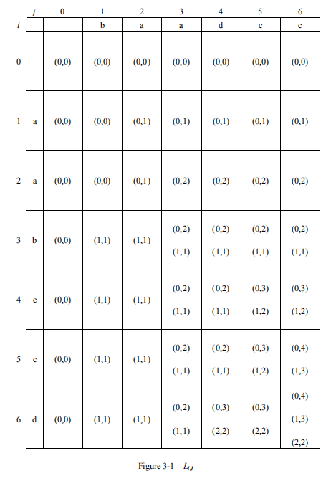
2.7 Wang Algorithm
Example:
Complexity：
O(rnm) time,
O(rnm) space.
Notes:
Wang, W.-L. (2006). "Longest Common Subsequence with Constraints."

Slide 20
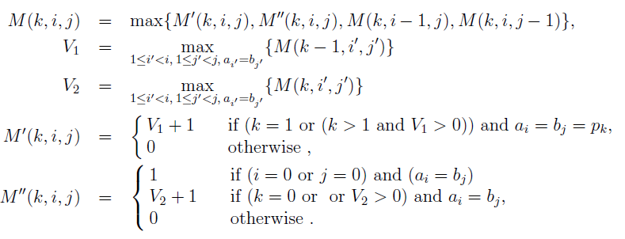
2.8 liopoulos-Rahman Algorithm
Formula:
Notes:
Iliopoulos, C. S. and M. S. Rahman (2008). "New efficient algorithms for the LCS and constrained LCS problems." Information Processing Letters 106(1): 13-18.

Slide 21
2.8 liopoulos-Rahman Algorithm
Bounded Heap data structure operations:
Insert(H, Pos, Value, Data):
Insert into the Bounded Heap H the position Pos with value Value and associated information Data.
IncreaseValue(H, Pos, Value, Data):
If H does not already contain the position Pos, perform Insert(H, Pos, Value, Data). Otherwise, set this position’s value to max{Value, Value}, where Value is its previous value. Also, update Data accordingly.
BoundedMax(H, Pos):
Return the item (with additional data) that has maximum value among all items in H with position smaller than Pos. If H does not contain any items with position smaller than Pos, return 0.
Notes:
Iliopoulos, C. S. and M. S. Rahman (2008). "New efficient algorithms for the LCS and constrained LCS problems." Information Processing Letters 106(1): 13-18.

Slide 22
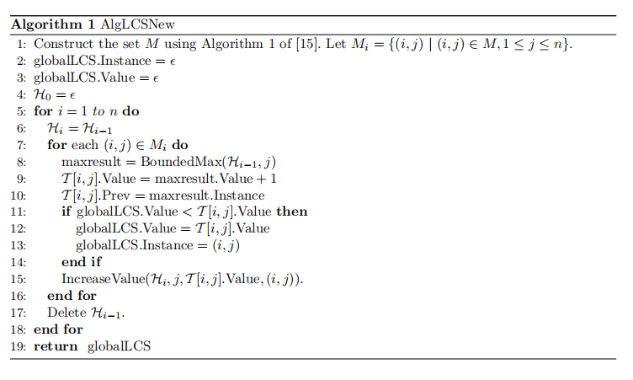
2.8 liopoulos-Rahman Algorithm
Modified LCS:
Complexity：
Time:
O(R log log n + n).
Space:
θ(max{R, n}) .
Notes:
Iliopoulos, C. S. and M. S. Rahman (2008). "New efficient algorithms for the LCS and constrained LCS problems." Information Processing Letters 106(1): 13-18.

Slide 23
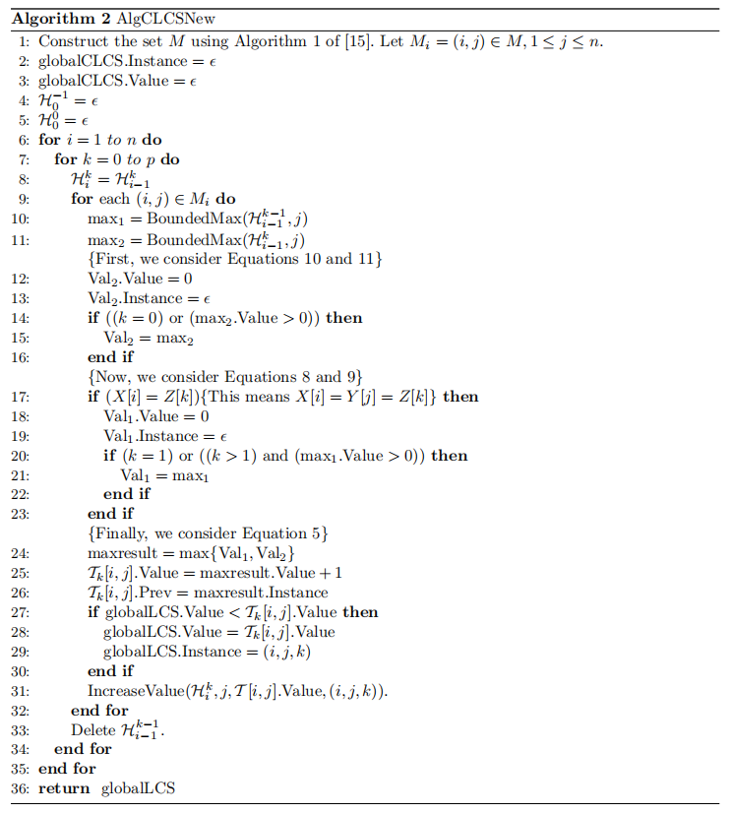
2.8 liopoulos-Rahman Algorithm
Modified CLCS :
Complexity：
Time:
O(pR log log n+n).
Space:
θ(max{R, n}) .
Notes:
Iliopoulos, C. S. and M. S. Rahman (2008). "New efficient algorithms for the LCS and constrained LCS problems." Information Processing Letters 106(1): 13-18.

Slide 24
3 Improvements of the algorithms
Unnecessary parts in matrices:
If the LCS(A_{i ,} P_{k}) < k , k > 0, then all the cells M(k, i, j) for any j store −∞.
If the LCS(Ai...n, Pk...r) < r − k + 1 , for 0 < k <= r, then all cells M(k−1, i−1, j) for any j have no way to impact on M(r, n, m).
A similar observation can be made for sequence B.

Slide 25
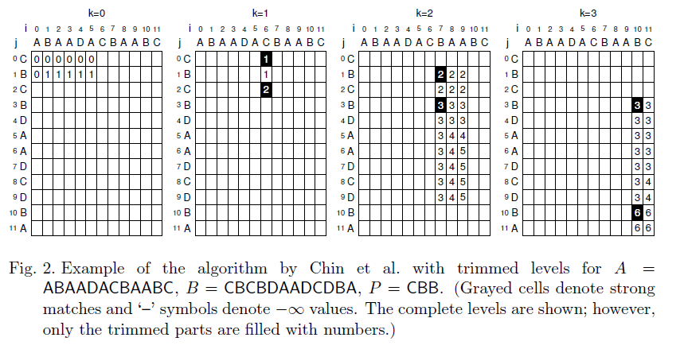
3 Improvements of the algorithms
Trimmed parts in matrices - EEP:

Slide 26
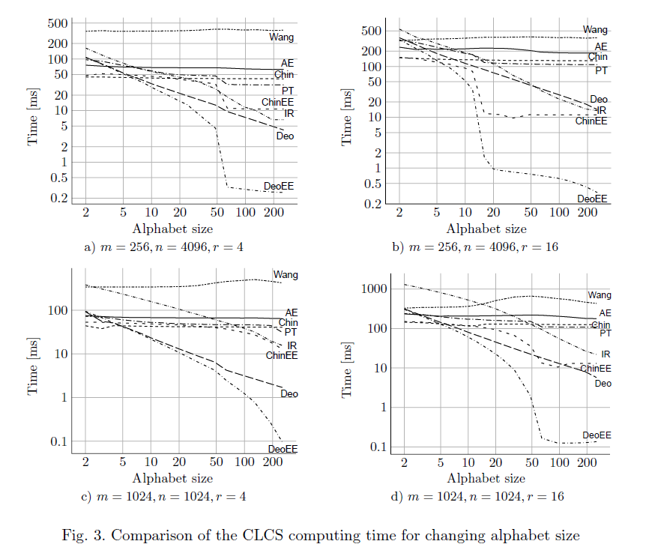
4 Experimental results

Slide 27
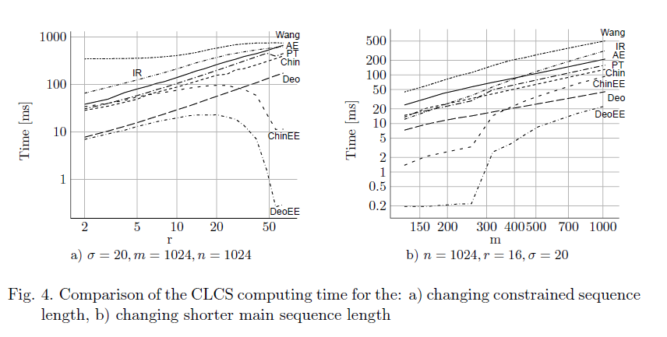
4 Experimental results

Slide 28
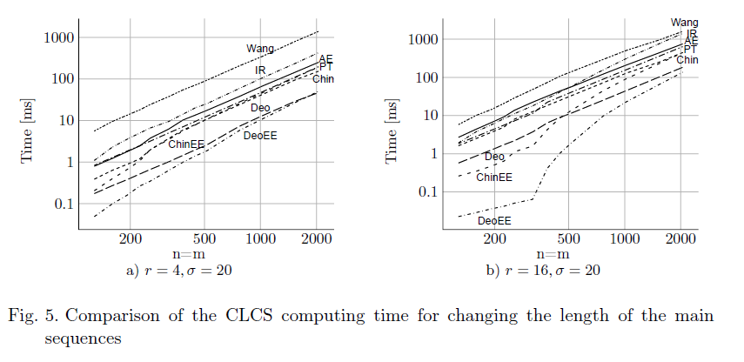
4 Experimental results

Slide 29
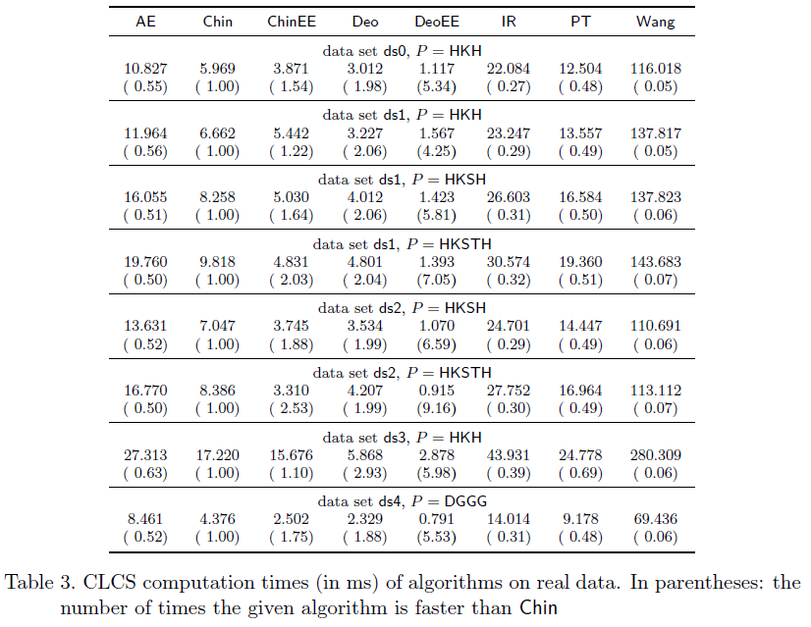
4 Experimental results

