Slide 1

BERT: Pre-training of Deep Bidirectional Transformers for
Language Understanding
Jacob Devlin, Ming-Wei Chang, Kenton Lee, Kristina Toutanova
NCCAL 2019, conference in June 3rd -June 6th
Presenter : Chia-Lin Chen
August 6, 2019

Slide 2
Abstract(1/3)
We introduce a new language representation
model called BERT, which stands for
Bidirectional Encoder Representations from
Transformers. Unlike recent language representation
models (Peters et al., 2018a; Radford
et al., 2018), BERT is designed to pretrain
deep bidirectional representations from
unlabeled text by jointly conditioning on both
left and right context in all layers.
BERT: Pre-training of Deep Bidirectional Transformers for
Language Understanding

Slide 3
Abstract(2/3)
As a result, the pre-trained BERT model can be fine tuned
with just one additional output layer to create state-of-the-art models for a wide range of tasks, such as question answering and language inference, without substantial task specific architecture modifications. BERT is conceptually simple and empirically powerful.

Slide 4
Abstract(3/3)
It obtains new state-of-the-art results on eleven natural language processing tasks, including pushing the GLUE score to 80.5% (7.7% point absolute improvement), MultiNLI accuracy to 86.7% (4.6% absolute improvement), SQuAD v1.1 question answering
Test F1 to 93.2 (1.5 point absolute improvement)
and SQuAD v2.0 Test F1 to 83.1.(5.1 point absolute improvement).
BERT: Pre-training of Deep Bidirectional Transformers for
Language Understanding

Slide 5

Context
1.Word Embedding
2.ELMO(Embeddings from Language Models)
3.BERT(Bidirectional Encoder Representations from Transformers)

Slide 6

ELMO
BERT
BERT: Pre-training of Deep Bidirectional Transformers for
Language Understanding

Slide 7
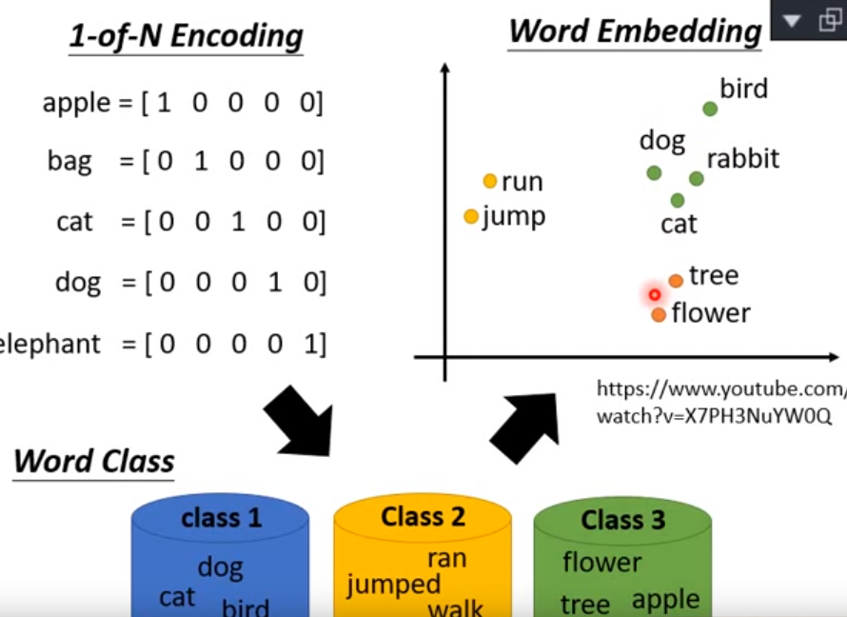
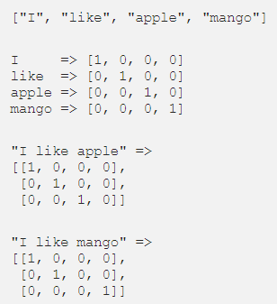
(One Hot Encoding)
BERT: Pre-training of Deep Bidirectional Transformers for
Language Understanding

Slide 8

ELMO(Embeddings from Language Models)(1/3)
Special: linearly combine word vectors in different layers
Input: sentence, but with unlimited word vectors
Output:
Model:
1.first layer: can use word2vec or glove or token embedding(general embedding)
2.two biLSTM layers
3.(l+1) word vectors: l is number of biLSTM layers.
Solve: different meaning in one word problem
Common word embedding model: word2vec, CBOW, skip grams
BERT: Pre-training of Deep Bidirectional Transformers for
Language Understanding

Slide 9
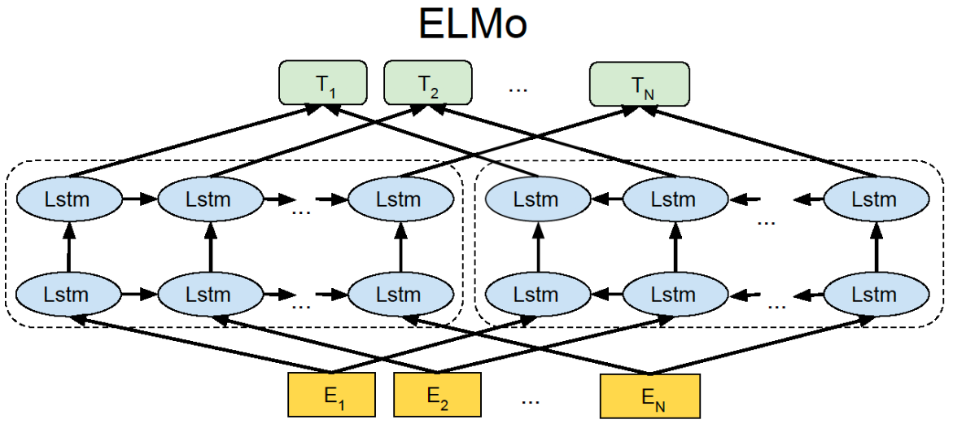

Slide 10
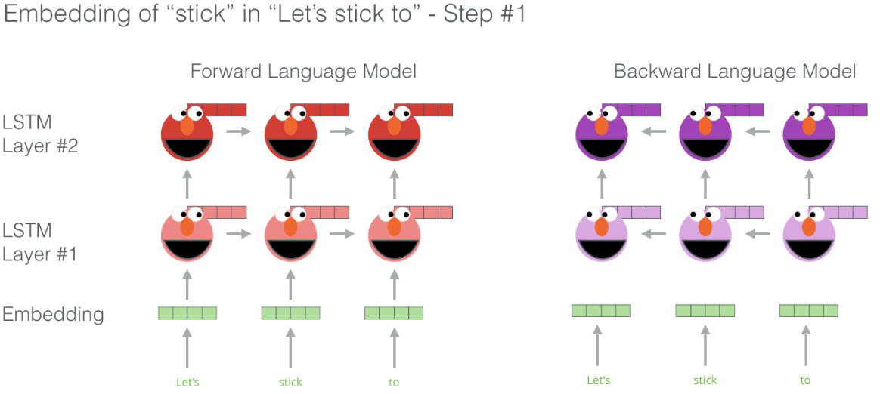
ELMO(2/3)
BERT: Pre-training of Deep Bidirectional Transformers for
Language Understanding

Slide 11
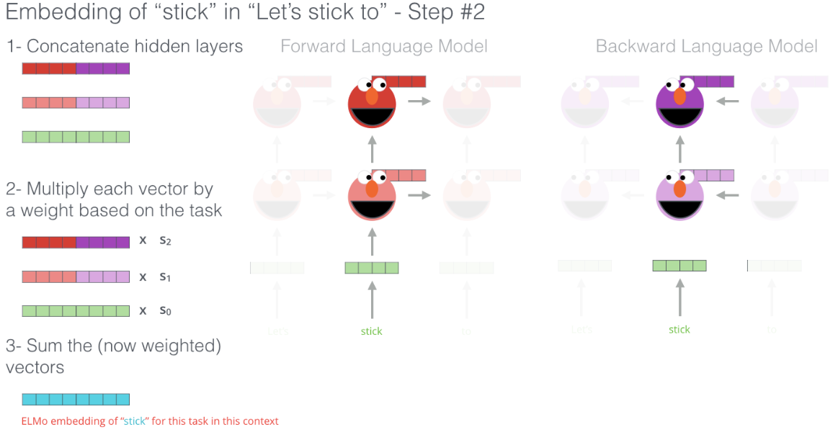
ELMO(3/3)
BERT: Pre-training of Deep Bidirectional Transformers for
Language Understanding

Slide 12
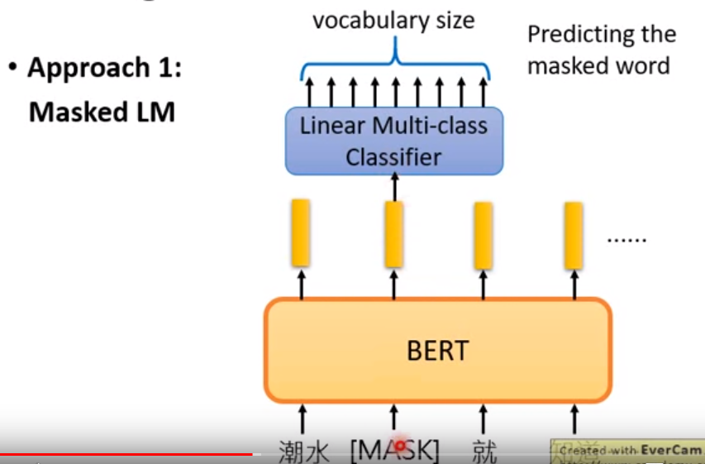
BERT(Bidirectional Encoder Representations from
Transformers)(1/6)
BERT: Pre-training of Deep Bidirectional Transformers for
Language Understanding

Slide 13
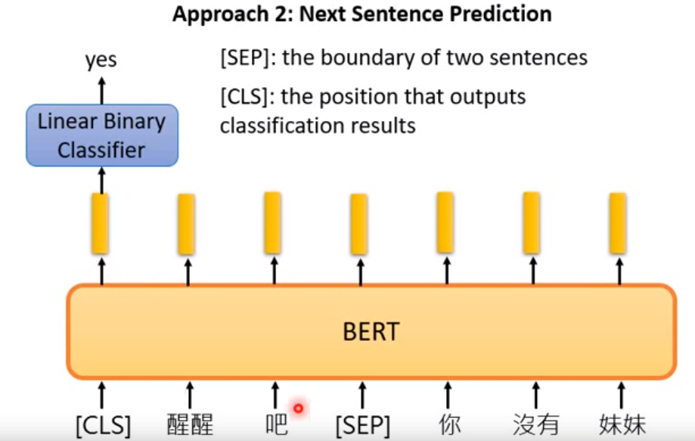
BERT(2/6)
BERT: Pre-training of Deep Bidirectional Transformers for
Language Understanding

Slide 14
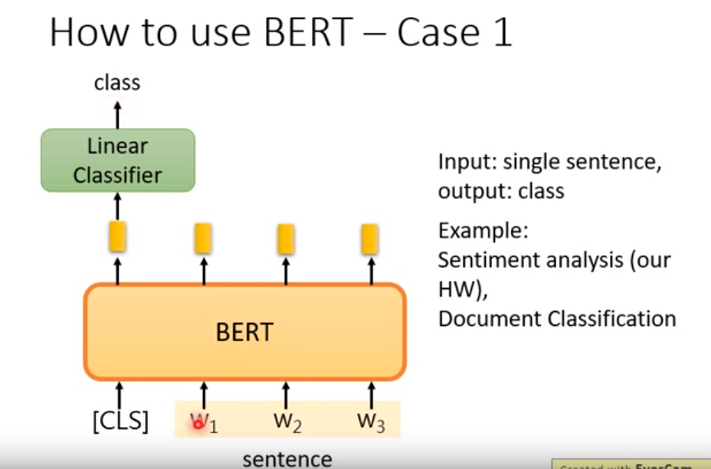
BERT(3/6)
BERT: Pre-training of Deep Bidirectional Transformers for
Language Understanding

Slide 15
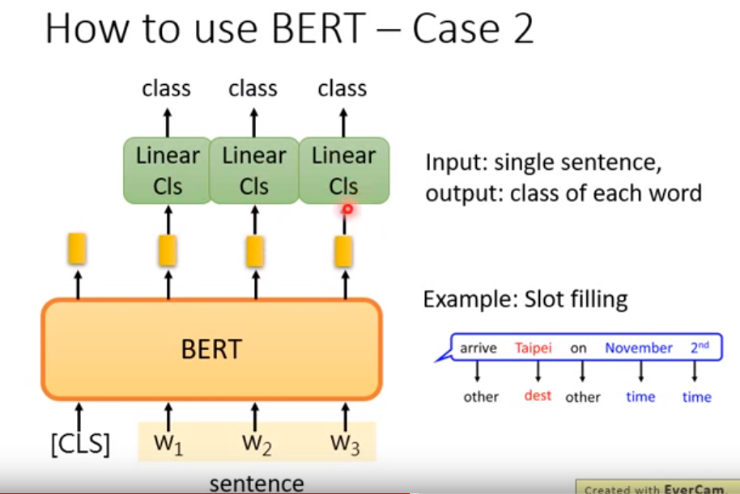
BERT(4/6)
BERT: Pre-training of Deep Bidirectional Transformers for
Language Understanding

Slide 16
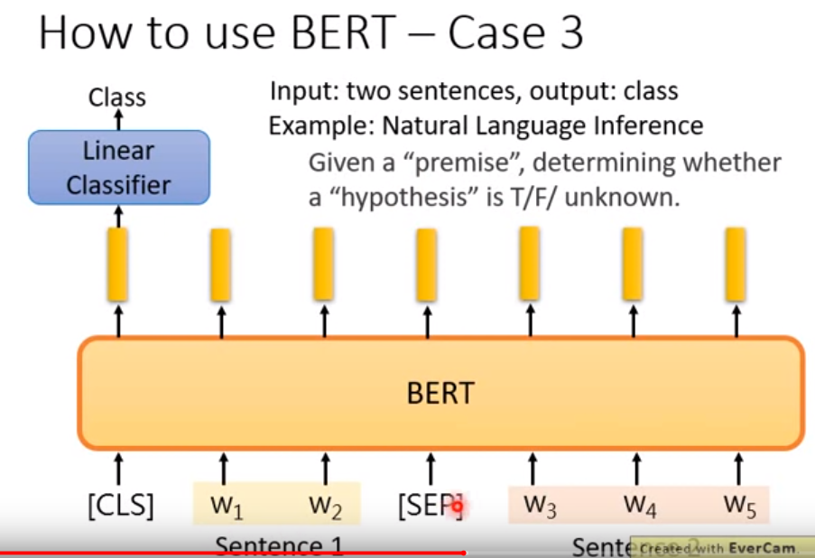
BERT(5/6)
BERT: Pre-training of Deep Bidirectional Transformers for
Language Understanding

Slide 17
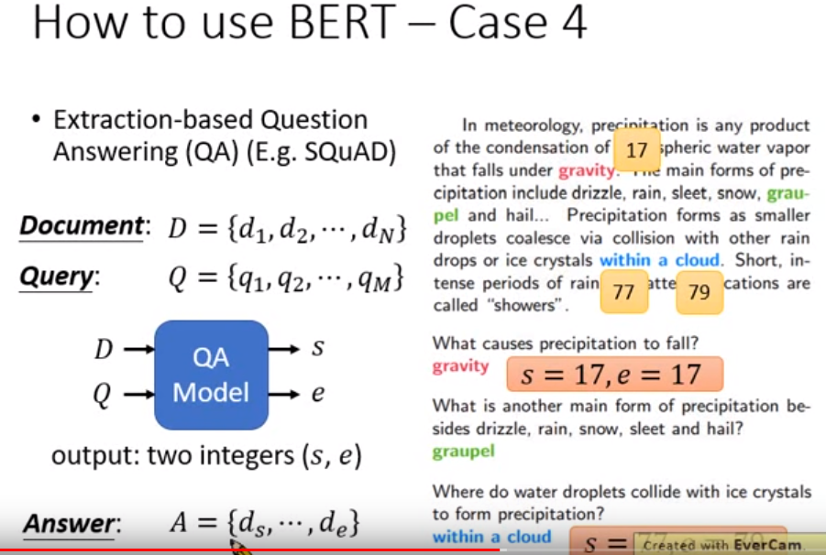
BERT(6/6)
BERT: Pre-training of Deep Bidirectional Transformers for
Language Understanding

Slide 18
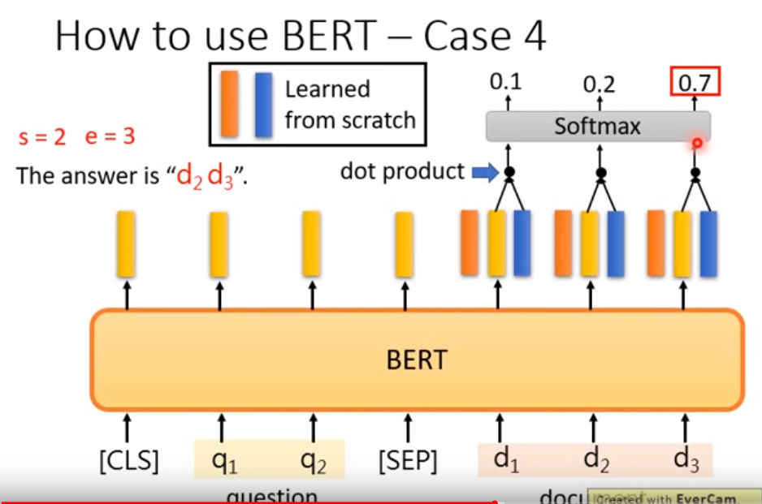
BERT(6/6)
BERT: Pre-training of Deep Bidirectional Transformers for
Language Understanding

Slide 19
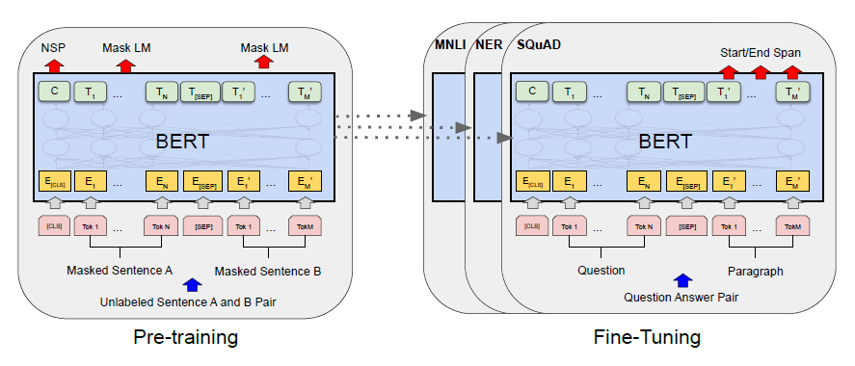
BERT(1/2)
BERT: Pre-training of Deep Bidirectional Transformers for
Language Understanding

Slide 20
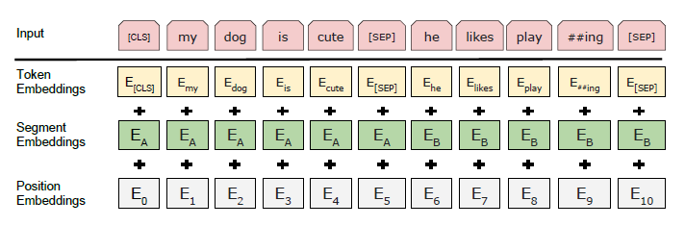
BERT(2/2)
BERT: Pre-training of Deep Bidirectional Transformers for
Language Understanding

Slide 21
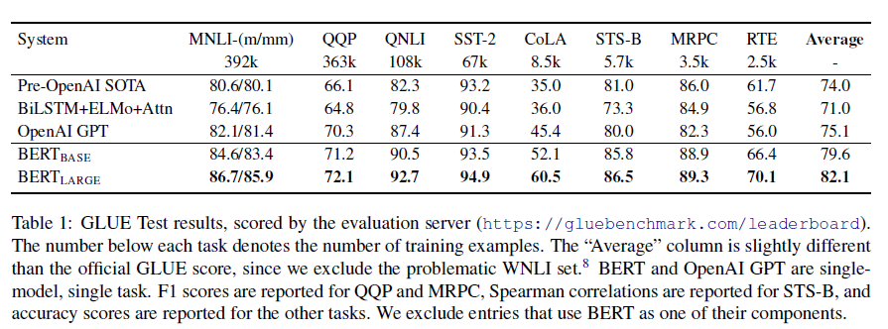
Experimental Results(1/3)
BERT: Pre-training of Deep Bidirectional Transformers for
Language Understanding

Slide 22
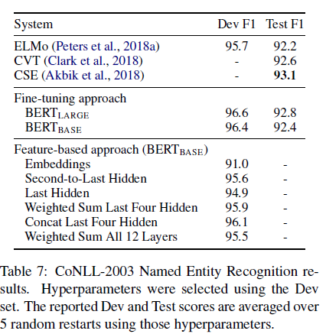
Experimental Results(2/3)
BERT: Pre-training of Deep Bidirectional Transformers for
Language Understanding

Slide 23
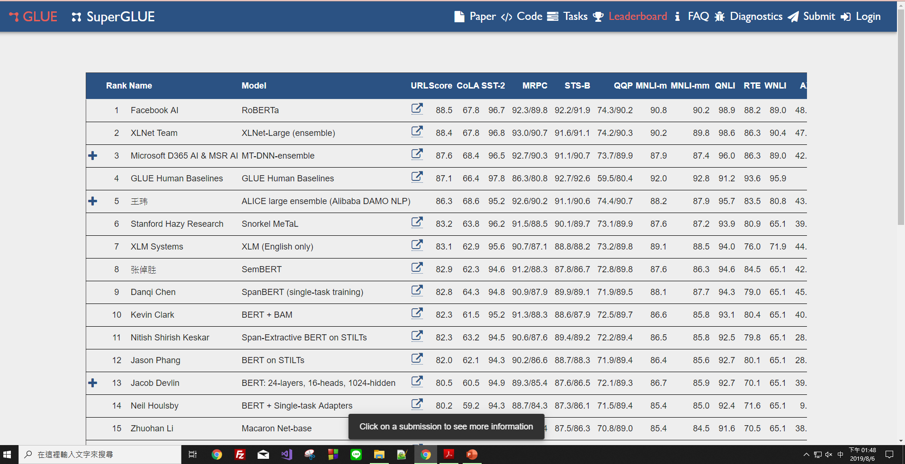
Experimental Results(3/3)
BERT: Pre-training of Deep Bidirectional Transformers for
Language Understanding

Slide 24
Thank you!

