Slide 1
Induction of Decision Trees
John Ross Quinlan
Machine Learning 1: 81-106, 1986
Presenter : Chia-Lin Chen
Sep. 18, 2019
Notes:
此篇被引用了20895次(截至今天)
John Ross Quinlan(不確定是否澳洲人)先後提出了ID3, C4.5, C5.0三種決策樹演算法，
還有另一種常用的decision tree演算法，叫CART(Classification And Regression Tree)，被引用42052次(截至今天)，
它的作者Leo Breiman(不確定是否美國人)也是提Random forest(被引用48853次)的作者。
Machine Learning期刊是月刊、Springer出版、在Guide2Search網站期刊排Top600的第298名。
期刊前五名都來自IEEE的有關Survey/Evolution/Tutorial等，http://www.guide2research.com/journals/machine-learning。

Slide 2
Table of Contents
Abstract
The TDIDT family of learning systems
The Induction task
ID3
Noise
Experiment
Additional Decision Tree Algorithms
Notes:
wiki有紀錄ID3演算法決策樹做mRNA序列內的特定核苷酸對是否對應於mRNA剪接位點，已經證明該樹具有95％的正確預測率。

Slide 3
Abstract(1/2)
The technology for building knowledge-based systems by inductive inference from examples has been demonstrated successfully in several practical applications. This paper summarizes an approach to synthesizing decision trees that has been used in a variety of systems, and it describes one such system,ID3, in detail.

Slide 4
Abstract(2/2)
Results from recent studies show ways in which the methodology can be modified to deal with information that is noisy and/or incomplete. A reported shortcoming of the basic algorithm is discussed and two means of overcoming it are compared. The paper concludes with illustrations of current research directions.

Slide 5
The TDIDT family of learning systems(1/2)
Top-Down Induction of Decision Trees(TDIDT)

Slide 6
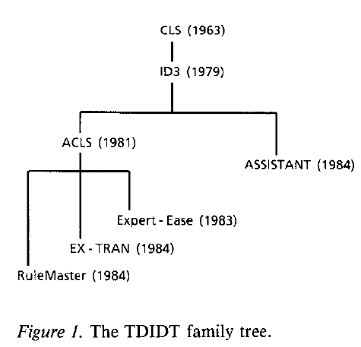
The TDIDT family of learning systems(2/2)
Image regonize
Continuous number
Medical
Notes:
CLS(沒寫全稱): 目標將分類的cost最小化=>缺點:需大量計算時間。
ID3將CLS作改良，到現在到處被人提及也被skleran官方提到。
ACLS則是不限制輸入得是數字，比如可以是圖片，因此可拿來做圖片辨識。(1983年的人發表，當時人們做圖片辨識用此技術)。
ASSISTANT是ID3的子孫，但不同的是ASSISTANT針對連續數值(ID3則是基於離散數值)。
且ASSISTANT會建立等級制度，使得最後分類有時會分類過細；常用於藥學。
最後三種樹則是有ACLS的子孫，有很多user-friendly的應用，比如:為一間西屋公司預測哪裡可能盛產石油，幫西屋公司大賺一筆。

Slide 7
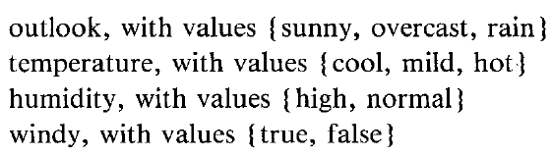
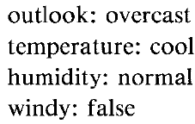
The Induction task(1/5)
Universe of inputs(attributes) must be discrete.
Attributes example(Classification is P/N):
Then, weather of a Saturday morning will be:
P/N
We call it an object

Slide 8
The Induction task(2/5)
Attributes should be sufficient to
the decision trees.

Slide 9
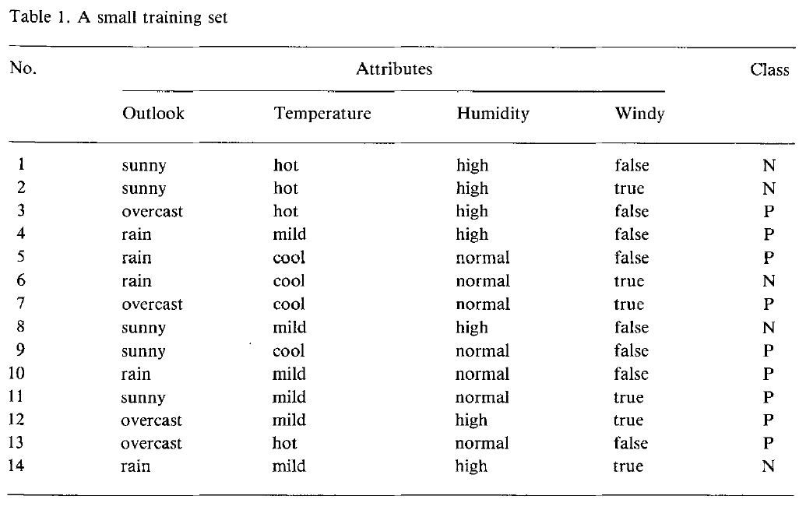
The Induction task(3/5)
Notes:
判斷是否該出門(P:是，N:否)

Slide 10
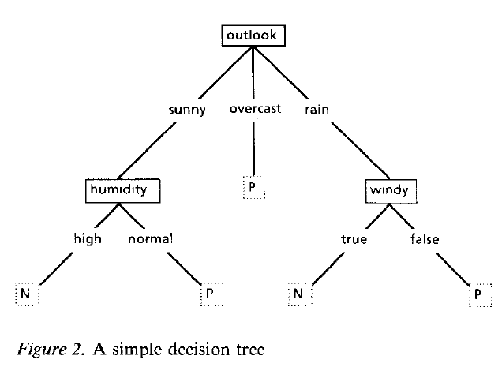
The Induction task(4/5)

Slide 11
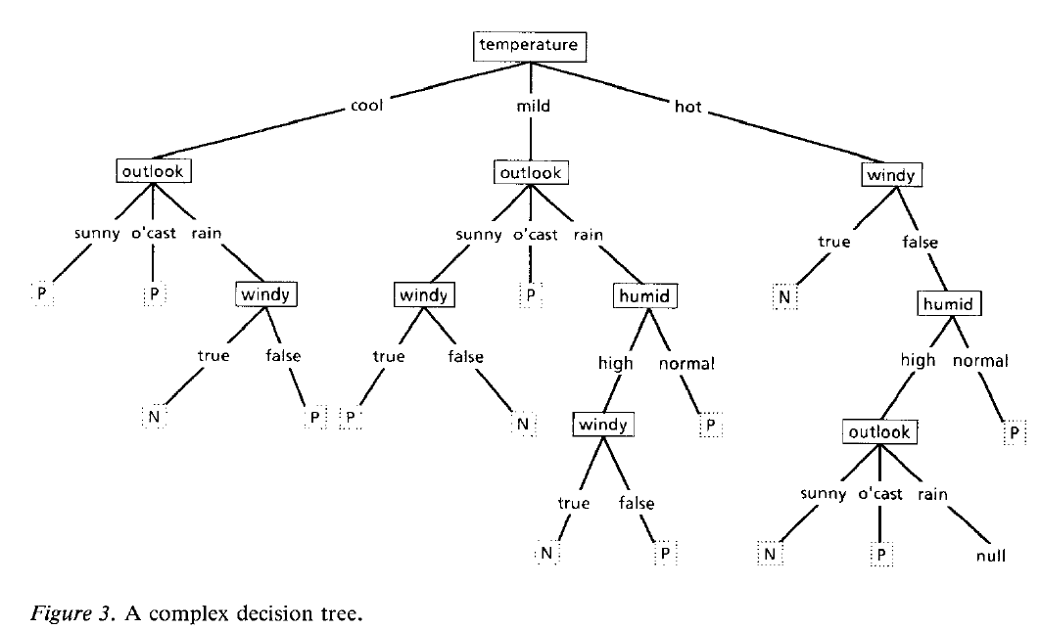
The Induction task(5/5)

Slide 12
ID3(1/7)
A simple way to choose the subset of the above induction tasks is choosing randomly.
Choosing randomly will stop while it is a “correct” decision tree.
It tasks only a few iterations for training set is above 30,000 objects and up to 50 attributes.

Slide 13

ID3(2/7)
ID3 is based on two assumptions:
p in class P, n in class N;
probability: p/(p+n), n/(p+n).
Information I(p,n):

Slide 14


ID3(3/7)
(Expected Information)
(Information gain)
Notes:
i指其中一種attribute可得class

Slide 15
ID3(4/7)

Slide 16


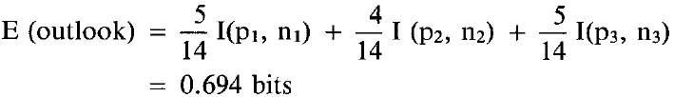
Attribute Outlook (sunny)
Attribute Outlook (rain)
Attribute Outlook (overcast)

Slide 17
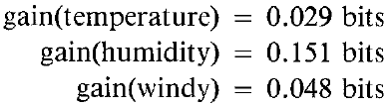
ID3(6/7)
Choose higher ones, and check if it is a “correct” decision tree.
If it is, then stop. Otherwise, continue.

Slide 18
ID3(7/7)

Slide 19

Noise

Slide 20
Experiment
Chess:
715 object (train:test=2:8), 49 binary-valued attributes➔precision94%
551 object (train:test=2:8), 49 binary-valued attributes➔precision98%
Wiki有紀錄ID3演算法決策樹做mRNA序列內的特定核苷酸對是否對應於mRNA剪接位點，已經證明該樹具有95％的正確預測率。

Slide 21
Additional Decision Tree Algorithms
John Ross Quinlan
ID3
C4.5
C5.0
Leo Breiman
CART(Classification And Regression Tree)
Notes:
目前Python的sklearn的決策樹採的是CART演算法。
Decision tree有被討論什麼時候適合用classify決策樹，什麼時候用regression決策樹。
若資料用於分類:如分是晴天/雨天/陰天=>classify
若資料用於預測實際數值:明天的溫度=>regression

Slide 22
Thank You!

