Slide 1
LGA: a method for finding 3D similarities in protein structures
Adam Zemla
Nucleic Acids Research, 2003, Vol. 31, No. 13
Presenter: EN-AN SONG
Date: September 18, 2019

Slide 2
Abstract
We present the LGA (Local-Global Alignment) method, designed to facilitate the comparison of protein structures or fragments of protein structures in sequence dependent and sequence independent modes. The LGA structure alignment program is available as an online service at http://PredictionCenter.llnl.gov/local/lga. Data generated by LGA can be successfully used in a scoring function to rank the level of similarity between two structures and to allow structure classification when many proteins are being analyzed. LGA also allows the clustering of similar fragments of protein structures.

Slide 3
Introduction
A small perturbation in just one part of the protein can create a large RMSD and it would seem that the two structures are very different overall.
We were motivated to develop a method that would take into account both local and global structure superpositions.

Slide 4
LGA
Data generated by the LCS and GDT algorithms
Results of the LCS algorithm identify local regions of similarity between proteins, while residues identified by GDT arise from anywhere in the structure
GDT (global distance test)
  The GDT algorithm is designed to complement evaluations made with LCS searching for the largest (not necessary continuous) set of ‘equivalent’ residues that deviate by no more than a specified distance cutoff.
LCS(Longest continuous segement)
  LCS procedure is able to localize and superimpose the longest segments of residues that can fit under a selected RMSD cutoff.

Slide 5
GDT(global distance test)
The list of such equivalences is iteratively extended to collect the largest set of residues that can fit under a given distance cutoff.
The goal of the iterative procedure is to exclude atoms that are more distant than a threshold .

Slide 6
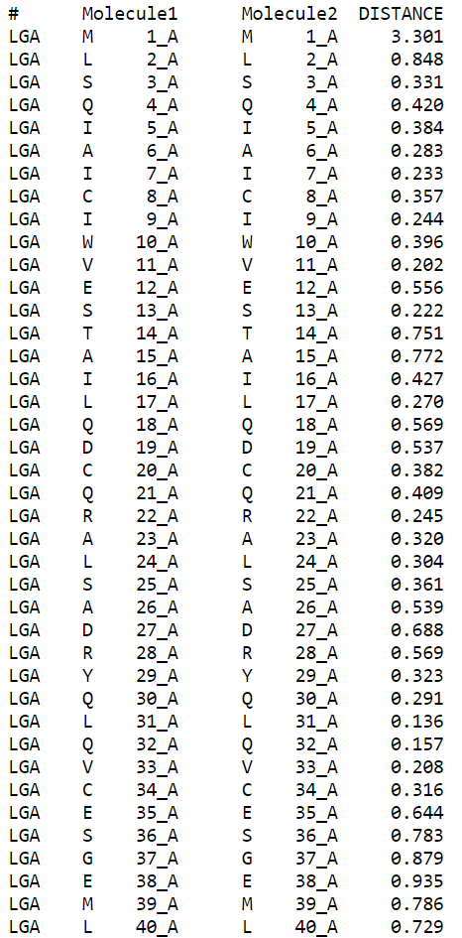
(1m2e_A 1m2f_A)
Tool :
http://proteinmodel.org/AS2TS/LGA/lga.html

Slide 7
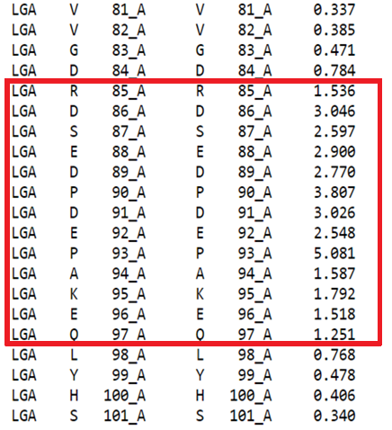

Slide 8
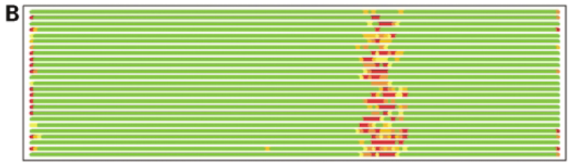
Residues superimposed below 1.0Å are in green, below 2.0Å in yellow, below 3.0Å in orange, below 4.0Å in brown and residues at or above 4.0Å in red

Slide 9
LCS (longest continuous segments)
Find the longest and continuous segment in the two Sequences, and the RMSD needs to be less than the fixed value.

Slide 10
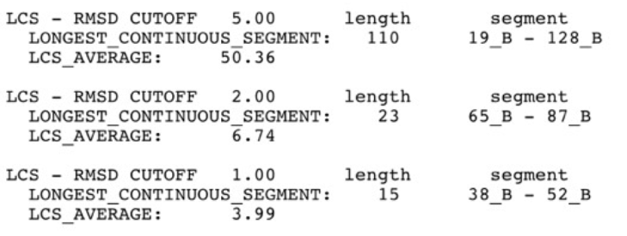
(1m2e_A 1a04_B)
Tool :
http://proteinmodel.org/AS2TS/LGA/lga.html

Slide 11
Get Full Information
If an analysis of two structures is based only on the superpositions limited to one selected RMSD or distance cutoff then it would not give full information on similarity between the two structures; some similarities would be detected, some would not.
In the GDT analysis, two structures are scanned every 0.5Å, starting from 0.5Å up to a 10.0Å distance cutoff.
LCS results are generated for a set of increasing RMSD cutoffs [1Å (Ångstrom), 2Å and 5Å]

Slide 12
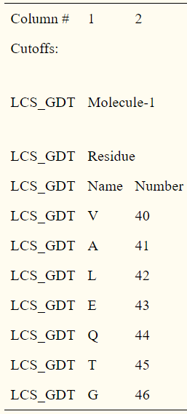
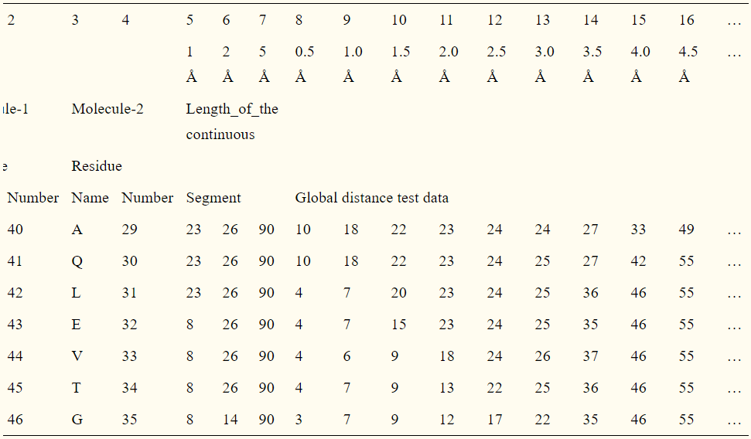

Slide 13
LGA scoring function
By combining these two techniques, LGA not only calculates a ‘best’ superposition between two proteins , but also identifies the regions of local similarity between compared structures.
LCS_vi : percent of residues (continuous set) that can fit under an RMSD cutoff of vi Å ( for vi=1.0, 2.0,… )
GDT_vi : an estimation of the percent of residues (largest set) that can fit under the distance cutoff of vi Å (for vi=0.5, 1.0,…)

Slide 14
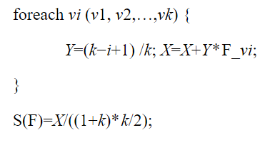
LGA scoring function
we calculate LGA_S by the formula (0.0≤w≤1.0): LGA_S=w * S(GDT)+(1−w) * S(LCS)
S(F) :

Slide 15
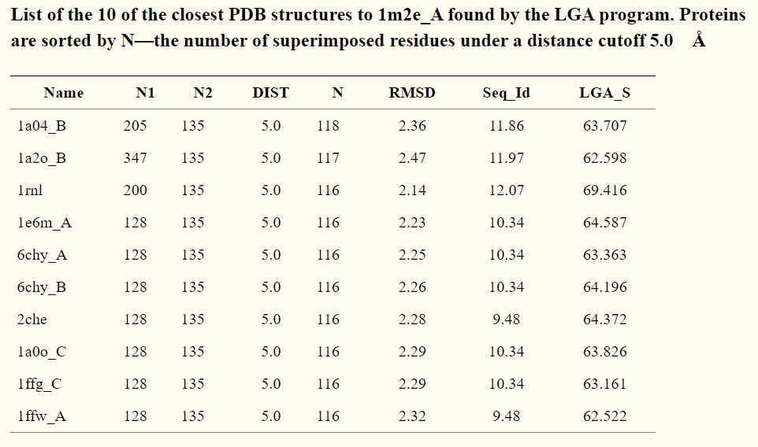

Slide 16
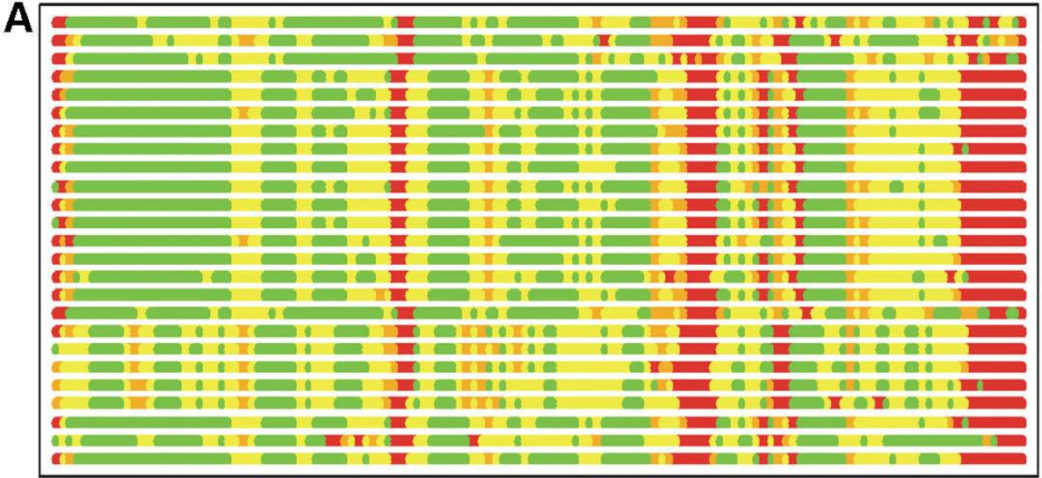
Residues superimposed below 2.0Å are in green, below 4.0Å in yellow, below 6.0Å in orange and residues at or above 6.0Å or not superimposed are in red.

Slide 17
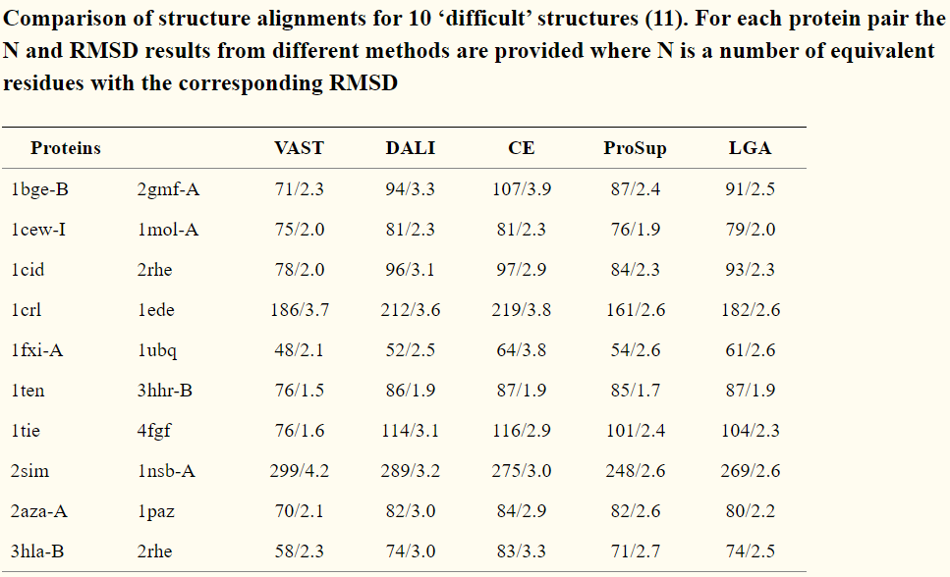
Comparison

