Slide 1
Maximal Common Subsequences and Minimal Common Supersequences
Campbell B. Frase and Robert W. Irving
Information and Computation. Volume 124, Issue 2, February 1996, Pages 145-153
Presenter: Du-Cheng Wu
Date: Sept. 18, 2019

Slide 2
Abstract(1/2)
The problems of finding a longest common subsequence and a shortest common supersequence of a set of strings are well known.
They can be solved in polynomial time for two strings (in fact the problems are dual in this case), or for any fixed number of strings, by dynamic programming.
But both problems are NP-hard in general for an arbitrary number k of strings. Here we study the related problems of finding a shortest maximal common subsequence and a longest minimal common supersequence.
We describe dynamic programming algorithms for the case of two strings (for which case the problems are no longer dual), which can be extended to any fixed number of strings.

Slide 3
Abstract(2/2)
We also show that both problems are NP-hard in general for k strings, although the latter problem, unlike shortest common supersequence, is solvable in polynomial time for strings of length 2.
Finally, we prove a strong negative approximability result for the shortest maximal common subsequence problem.

Slide 4
Longest Common Subsequence(LCS) and Shortest Common Supersequence(SCS)
X = aaecdf
Y = acdefaa
LCS = acdf
SCS = aaecdefaa

Slide 5
Shortest Maximal Common Subsequence(SMCS) and Longest Minimal Common Supersequence(LMCS)
X = aaecdf
Y = acdefaa
maximal common subsequence = aa, acdf, aef
minimal common supersequence =acdefaaecdf, aaecdefaa, aacdecdfaa

Slide 6
Shortest Maximal Common Subsequence(SMCS) and Longest Minimal Common Supersequence(LMCS)
X = aaecdf
Y = acdefaa
maximal common subsequence = aa, acdf, aef
minimal common supersequence =acdefaaecdf, aaecdefaa, aacdecdfaa

Slide 7
Shortest Maximal Common Subsequence(SMCS) and Longest Minimal Common Supersequence(LMCS)
X = aaecdf
Y = acdefaa
maximal common subsequence = aa, acdf, aef
minimal common supersequence =acdefaaecdf, aaecdefaa, aacdecdfaa

Slide 8
Shortest Maximal Common Subsequence(SMCS) and Longest Minimal Common Supersequence(LMCS)
X = aaecdf
Y = acdefaa
maximal common subsequence = aa, acdf, aef
minimal common supersequence =acdefaaecdf, aaecdefaa, aacdecdfaa
smcs = aa
lmcs = acdefaaecdf

Slide 9

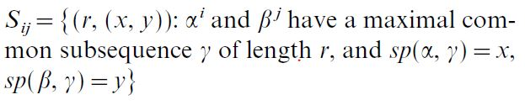
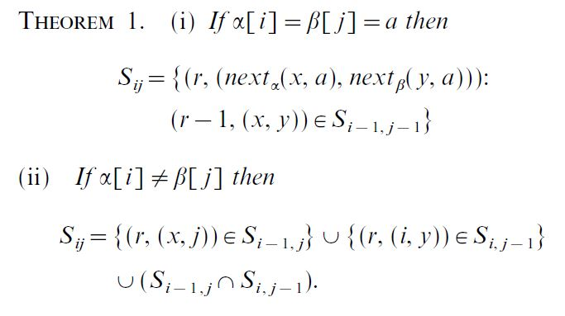
Shortest Maximal Common Subsequence(SMCS)

Slide 10
Shortest Maximal Common Subsequence(SMCS)
i j |  | a | c | d | e | f | a | a
 | (0,(0,0)) | (0,(0,0)) | (0,(0,0)) | (0,(0,0)) | (0,(0,0)) | (0,(0,0)) | (0,(0,0)) | (0,(0,0))
a | (0,(0,0)) | (1,(1,1))
a | (0,(0,0))
e | (0,(0,0))
c | (0,(0,0))
d | (0,(0,0))
f | (0,(0,0))

Slide 11
Shortest Maximal Common Subsequence(SMCS)
i j |  | a | c | d | e | f | a | a
 | (0,(0,0)) | (0,(0,0)) | (0,(0,0)) | (0,(0,0)) | (0,(0,0)) | (0,(0,0)) | (0,(0,0)) | (0,(0,0))
a | (0,(0,0)) | (1,(1,1)) | (1,(1,1)) | (1,(1,1)) | (1,(1,1)) | (1,(1,1)) | (1,(1,1)) | (1,(1,1))
a | (0,(0,0)) | (1,(1,1)) | (1,(1,1)) | (1,(1,1)) | (1,(1,1)) | (1,(1,1)) | (2,(2,6)) | (2,(2,6))
e | (0,(0,0))
c | (0,(0,0))
d | (0,(0,0))
f | (0,(0,0))

Slide 12
Shortest Maximal Common Subsequence(SMCS)
i j |  | a | c | d | e | f | a | a
 | (0,(0,0)) | (0,(0,0)) | (0,(0,0)) | (0,(0,0)) | (0,(0,0)) | (0,(0,0)) | (0,(0,0)) | (0,(0,0))
a | (0,(0,0)) | (1,(1,1)) | (1,(1,1)) | (1,(1,1)) | (1,(1,1)) | (1,(1,1)) | (1,(1,1)) | (1,(1,1))
a | (0,(0,0)) | (1,(1,1)) | (1,(1,1)) | (1,(1,1)) | (1,(1,1)) | (1,(1,1)) | (2,(2,6)) | (2,(2,6))
e | (0,(0,0)) | (1,(1,1)) | (1,(1,1)) | (1,(1,1)) | (2,(3,4)) | (2,(3,4)) | (2,(2,6)) (2,(3,4)) | (2,(2,6)) (2,(3,4))
c | (0,(0,0))
d | (0,(0,0))
f | (0,(0,0))

Slide 13
Shortest Maximal Common Subsequence(SMCS)
i j |  | a | c | d | e | f | a | a
 | (0,(0,0)) | (0,(0,0)) | (0,(0,0)) | (0,(0,0)) | (0,(0,0)) | (0,(0,0)) | (0,(0,0)) | (0,(0,0))
a | (0,(0,0)) | (1,(1,1)) | (1,(1,1)) | (1,(1,1)) | (1,(1,1)) | (1,(1,1)) | (1,(1,1)) | (1,(1,1))
a | (0,(0,0)) | (1,(1,1)) | (1,(1,1)) | (1,(1,1)) | (1,(1,1)) | (1,(1,1)) | (2,(2,6)) | (2,(2,6))
e | (0,(0,0)) | (1,(1,1)) | (1,(1,1)) | (1,(1,1)) | (2,(3,4)) | (2,(3,4)) | (2,(2,6)) (2,(3,4)) | (2,(2,6)) (2,(3,4))
c | (0,(0,0)) | (1,(1,1)) | (2,(4,2)) | (2,(4,2)) | (2,(3,4)) (2,(4,2)) | (2,(3,4)) (2,(4,2)) | (2,(2,6)) (2,(3,4)) (2,(4,2)) | (2,(2,6)) (2,(3,4)) (2,(4,2))
d | (0,(0,0))
f | (0,(0,0))

Slide 14
Shortest Maximal Common Subsequence(SMCS)
i j |  | a | c | d | e | f | a | a
 | (0,(0,0)) | (0,(0,0)) | (0,(0,0)) | (0,(0,0)) | (0,(0,0)) | (0,(0,0)) | (0,(0,0)) | (0,(0,0))
a | (0,(0,0)) | (1,(1,1)) | (1,(1,1)) | (1,(1,1)) | (1,(1,1)) | (1,(1,1)) | (1,(1,1)) | (1,(1,1))
a | (0,(0,0)) | (1,(1,1)) | (1,(1,1)) | (1,(1,1)) | (1,(1,1)) | (1,(1,1)) | (2,(2,6)) | (2,(2,6))
e | (0,(0,0)) | (1,(1,1)) | (1,(1,1)) | (1,(1,1)) | (2,(3,4)) | (2,(3,4)) | (2,(2,6)) (2,(3,4)) | (2,(2,6)) (2,(3,4))
c | (0,(0,0)) | (1,(1,1)) | (2,(4,2)) | (2,(4,2)) | (2,(3,4)) (2,(4,2)) | (2,(3,4)) (2,(4,2)) | (2,(2,6)) (2,(3,4)) (2,(4,2)) | (2,(2,6)) (2,(3,4)) (2,(4,2))
d | (0,(0,0)) | (1,(1,1)) | (2,(4,2)) | (3,(5,3)) | (2,(3,4)) (3,(5,3)) | (2,(3,4)) (3,(5,3)) | (2,(2,6)) (2,(3,4)) (3,(5,3)) | (2,(2,6)) (2,(3,4)) (3,(5,3))
f | (0,(0,0))

Slide 15
Shortest Maximal Common Subsequence(SMCS)
i j |  | a | c | d | e | f | a | a
 | (0,(0,0)) | (0,(0,0)) | (0,(0,0)) | (0,(0,0)) | (0,(0,0)) | (0,(0,0)) | (0,(0,0)) | (0,(0,0))
a | (0,(0,0)) | (1,(1,1)) | (1,(1,1)) | (1,(1,1)) | (1,(1,1)) | (1,(1,1)) | (1,(1,1)) | (1,(1,1))
a | (0,(0,0)) | (1,(1,1)) | (1,(1,1)) | (1,(1,1)) | (1,(1,1)) | (1,(1,1)) | (2,(2,6)) | (2,(2,6))
e | (0,(0,0)) | (1,(1,1)) | (1,(1,1)) | (1,(1,1)) | (2,(3,4)) | (2,(3,4)) | (2,(2,6)) (2,(3,4)) | (2,(2,6)) (2,(3,4))
c | (0,(0,0)) | (1,(1,1)) | (2,(4,2)) | (2,(4,2)) | (2,(3,4)) (2,(4,2)) | (2,(3,4)) (2,(4,2)) | (2,(2,6)) (2,(3,4)) (2,(4,2)) | (2,(2,6)) (2,(3,4)) (2,(4,2))
d | (0,(0,0)) | (1,(1,1)) | (2,(4,2)) | (3,(5,3)) | (2,(3,4)) (3,(5,3)) | (2,(3,4)) (3,(5,3)) | (2,(2,6)) (2,(3,4)) (3,(5,3)) | (2,(2,6)) (2,(3,4)) (3,(5,3))
f | (0,(0,0)) | (1,(1,1)) | (2,(4,2)) | (3,(5,3)) | (2,(3,4)) (3,(5,3)) | (3,(6,5)) (4,(6,5)) | (2,(2,6)) (3,(6,5)) | (2,(2,6)) (3,(6,5))

Slide 16
SMCS time complexity
Time complexity: O(m²n) time in worst case
Space complexity: O(m²n)
Find all mcs time complexity: O(m³n)

Slide 17

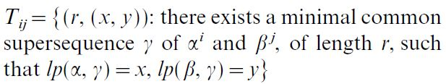
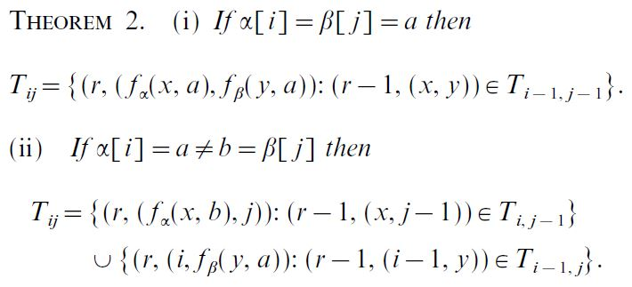
Longest Minimal Common Supersequence(LMCS)

Slide 18
LMCS time complexity
Time complexity: O(mn(m+n)) time in worst case
Find all mcs time complexity: O(mn(m+n)²)

