Slide 1
Efficient pattern matching in degenerate strings with Burrows-Wheeler transform
J.W. Daykin, R. Groult, Y. Guesnet, T. Lecroq, A. Lefebvre, M. Léonard, L. Mouchard, É. Prieur-Gaston, B. Watson Informtion Processing Letters 147(2019), pp. 82-87
Speaker: Kuan-Lin Lai
Date: Oct. 1, 2019

Slide 2
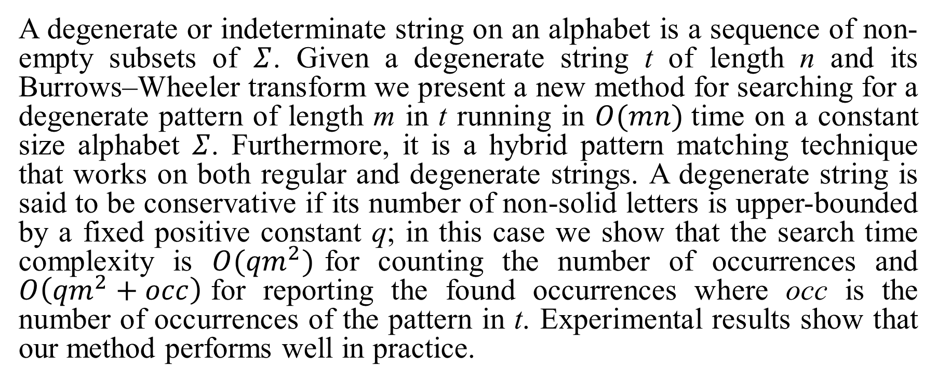
Abstract
A degenerate or indeterminate string on an alphabet is a sequence of non-empty subsets of $Σ$. Given a degenerate string t of length n and its Burrows–Wheeler transform we present a new method for searching for a degenerate pattern of length m in t running in $O(mn)$time on a constant size alphabet $Σ$. Furthermore, it is a hybrid pattern matching technique that works on both regular and degenerate strings. A degenerate string is said to be conservative if its number of non-solid letters is upper-bounded by a fixed positive constant q; in this case we show that the search time complexity is $O({qm}^{2})$for counting the number of occurrences and $O\left({qm}^{2}+occ\right)$for reporting the found occurrences where occ is the number of occurrences of the pattern in t. Experimental results show that our method performs well in practice.

Slide 3
Conservative degenerate string
Ex:
q = 1
T = {c,e}.{c,d}.{a,b,c}.{a,e}.{a,b,c}
P = c.{a,b}.a Q = c b a
Non-Conservative
Conservative degenerate string
Conservative string
Solid symbol

Slide 4

Degenerate string matching
Ex: T = {c,e}.{c,d}.{a,b,c}.{a,e}.{a,b,c}
P = c.{a,b}.a c $∩$ {c,d} $≠∅$ {a,b} $∩$ {a,b,c} $≠∅$ a $∩$ {a,e} $≠∅$
=> Matching !!

Slide 5
Burrows-Wheeler Transform
T = acaacg$
1 | a | c | a | a | c | g | $
2 | c | a | a | c | g | $ | a
3 | a | a | c | g | $ | a | c
4 | a | c | g | $ | a | c | a
5 | c | g | $ | a | c | a | a
6 | g | $ | a | c | a | a | c
7 | $ | a | c | a | a | c | g
1 | 7 | $ | a | c | a | a | c | g
2 | 3 | a | a | c | g | $ | a | c
3 | 1 | a | c | a | a | c | g | $
4 | 4 | a | c | g | $ | a | c | a
5 | 2 | c | a | a | c | g | $ | a
6 | 5 | c | g | $ | a | c | a | a
7 | 6 | g | $ | a | c | a | a | c
sorting

Slide 6
Burrows-Wheeler Transform
row | SA
1 | 7 | $ | a | c | a | a | c | g
2 | 3 | a | a | c | g | $ | a | c
3 | 1 | a | c | a | a | c | g | $
4 | 4 | a | c | g | $ | a | c | a
5 | 2 | c | a | a | c | g | $ | a
6 | 5 | c | g | $ | a | c | a | a
7 | 6 | g | $ | a | c | a | a | c
P = a
s(“a”) = 2, e(“a”) = 4.
P = ca
s(“ca”) = 5, e(“ca”) = 5.
Goal: Find s(P), e(P).

Slide 7
Burrows-Wheeler Transform
row | SA | F |  |  |  |  |  | L
1 | 7 | $ | a | c | a | a | c | g
2 | 3 | a | a | c | g | $ | a | c
3 | 1 | a | c | a | a | c | g | $
4 | 4 | a | c | g | $ | a | c | a
5 | 2 | c | a | a | c | g | $ | a
6 | 5 | c | g | $ | a | c | a | a
7 | 6 | g | $ | a | c | a | a | c
C (c)
$ | a | c | g
0 | 1 | 4 | 6
rank_{c}(L, i)
 | $ | a | c | g
1 | 0 | 0 | 0 | 1
2 | 0 | 0 | 1 | 1
3 | 1 | 0 | 1 | 1
4 | 1 | 1 | 1 | 1
5 | 1 | 2 | 1 | 1
6 | 1 | 3 | 1 | 1
7 | 1 | 3 | 2 | 1
c
i

Slide 8
Burrows-Wheeler Transform
row | SA
1 | 7 | $ | a | c | a | a | c | g
2 | 3 | a | a | c | g | $ | a | c
3 | 1 | a | c | a | a | c | g | $
4 | 4 | a | c | g | $ | a | c | a
5 | 2 | c | a | a | c | g | $ | a
6 | 5 | c | g | $ | a | c | a | a
7 | 6 | g | $ | a | c | a | a | c
T=acaacg$, P=ac
s(NULL)=1, e(NULL) = 7.
x=‘c’ and Y = NULL.
C(c)=4,
rank_{c}(BWT, s(NULL)-1) = 0,
rank_{c}(BWT, e(NULL)) = 2.
s(c)=4+0+1=5, e(c) = 4+2=6.

Slide 9
Burrows-Wheeler Transform
row | SA
1 | 7 | $ | a | c | a | a | c | g
2 | 3 | a | a | c | g | $ | a | c
3 | 1 | a | c | a | a | c | g | $
4 | 4 | a | c | g | $ | a | c | a
5 | 2 | c | a | a | c | g | $ | a
6 | 5 | c | g | $ | a | c | a | a
7 | 6 | g | $ | a | c | a | a | c
T=acaacg$, P=ac
s(c)=5, e(c) = 6.
x=‘a’ and Y = ‘ c’.
C(a)=1,
rank_{c}(BWT, s(c)-1) = 1
rank_{c}(BWT, e(c)) = 3
s(ac)=1+1+1=3, e(ac) = 1+3=4.

Slide 10
Searching degenerate pattern in a degenerate string
T = {c,e}.{c,d}.{a,b,c}.{a,e}.{a,b,c} = DCABA P = {c}.{a,b}.{a}
row | SA | F |  |  |  | L
1 | 7 | A | B | A | D | C
2 | 3 | A | D | C | A | B
3 | 1 | B | A | D | C | A
4 | 4 | C | A | B | A | D
5 | 2 | D | C | A | B | A
row | SA | F |  |  |  | L
1 | 3 | A | B | A | D | C
2 | 5 | A | D | C | A | B
3 | 4 | B | A | D | C | A
4 | 2 | C | A | B | A | D
5 | 1 | D | C | A | B | A
sorting

Slide 11
Searching degenerate pattern in a degenerate string
row | SA | F |  |  |  | L
1 | 3 | A | B | A | D | C
2 | 5 | A | D | C | A | B
3 | 4 | B | A | D | C | A
4 | 2 | C | A | B | A | D
5 | 1 | D | C | A | B | A
C (c)
A | B | C | D
0 | 2 | 3 | 4
rank_{c}(L, i)
 | A | B | C | D
1 | 0 | 0 | 1 | 0
2 | 0 | 1 | 1 | 0
3 | 1 | 1 | 1 | 0
4 | 1 | 1 | 1 | 1
5 | 2 | 1 | 1 | 1
c
i

Slide 12
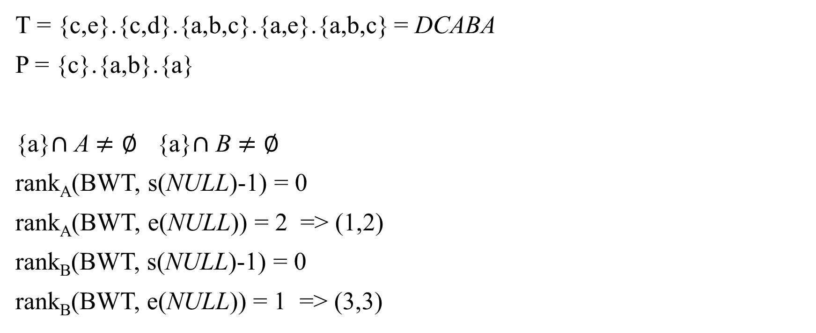
Searching degenerate pattern in a degenerate string
T = {c,e}.{c,d}.{a,b,c}.{a,e}.{a,b,c} = DCABA P = {c}.{a,b}.{a} {a}$∩$ A $≠∅$ {a}$∩$ B $≠∅$ rank_{A}(BWT, s(NULL)-1) = 0
rank_{A}(BWT, e(NULL)) = 2 => (1,2)
rank_{B}(BWT, s(NULL)-1) = 0
rank_{B}(BWT, e(NULL)) = 1 => (3,3)
row | SA | F |  |  |  | L
1 | 3 | A | B | A | D | C
2 | 5 | A | D | C | A | B
3 | 4 | B | A | D | C | A
4 | 2 | C | A | B | A | D
5 | 1 | D | C | A | B | A

Slide 13
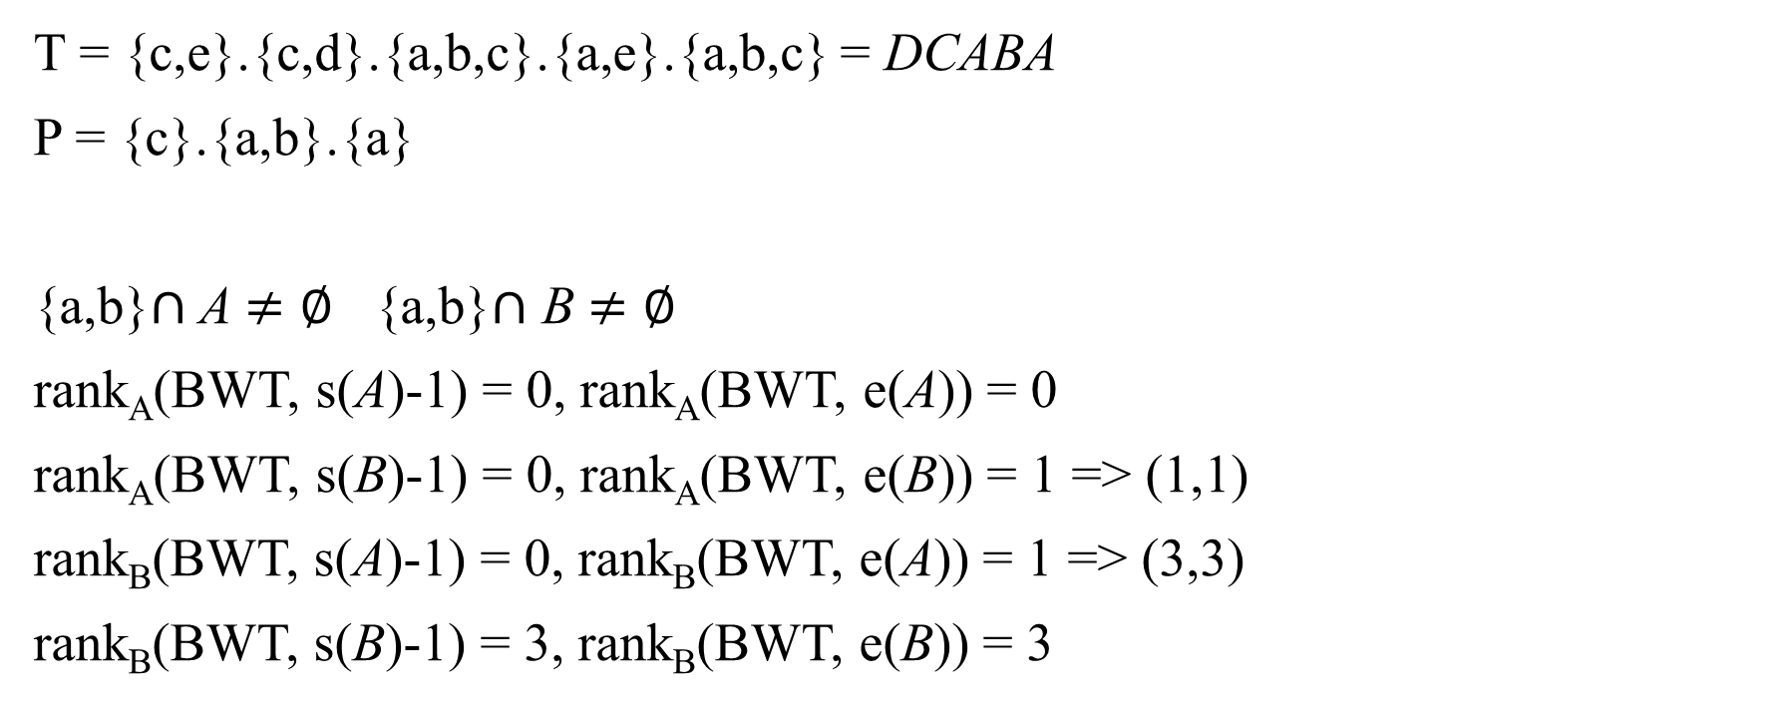
Searching degenerate pattern in a degenerate string
T = {c,e}.{c,d}.{a,b,c}.{a,e}.{a,b,c} = DCABA P = {c}.{a,b}.{a} {a,b}$∩$ A $≠∅$ {a,b}$∩$ B $≠∅$ rank_{A}(BWT, s(A)-1) = 0, rank_{A}(BWT, e(A)) = 0
rank_{A}(BWT, s(B)-1) = 0, rank_{A}(BWT, e(B)) = 1 => (1,1)
rank_{B}(BWT, s(A)-1) = 0, rank_{B}(BWT, e(A)) = 1 => (3,3)
rank_{B}(BWT, s(B)-1) = 3, rank_{B}(BWT, e(B)) = 3
row | SA | F |  |  |  | L
1 | 3 | A | B | A | D | C
2 | 5 | A | D | C | A | B
3 | 4 | B | A | D | C | A
4 | 2 | C | A | B | A | D
5 | 1 | D | C | A | B | A

Slide 14
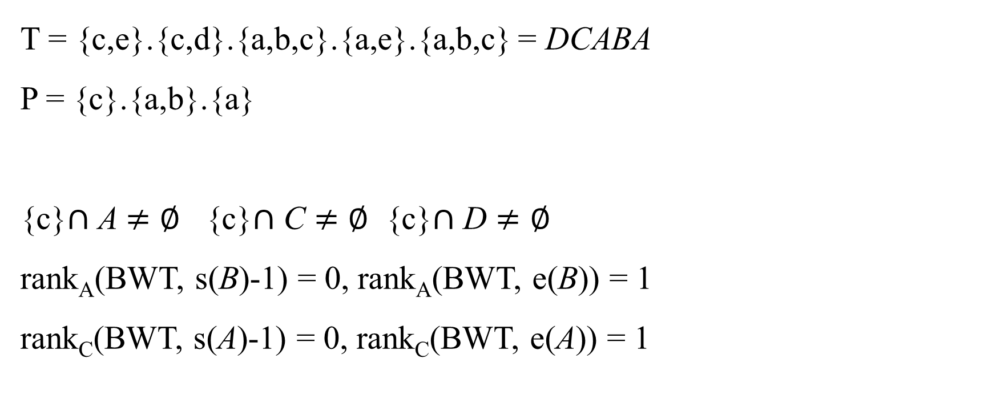
Searching degenerate pattern in a degenerate string
T = {c,e}.{c,d}.{a,b,c}.{a,e}.{a,b,c} = DCABA P = {c}.{a,b}.{a} {c}$∩$ A $≠∅$ {c}$∩$ C $≠∅$ {c}$∩$ D $≠∅$ rank_{A}(BWT, s(B)-1) = 0, rank_{A}(BWT, e(B)) = 1
rank_{C}(BWT, s(A)-1) = 0, rank_{C}(BWT, e(A)) = 1
row | SA | F |  |  |  | L
1 | 3 | A | B | A | D | C
2 | 5 | A | D | C | A | B
3 | 4 | B | A | D | C | A
4 | 2 | C | A | B | A | D
5 | 1 | D | C | A | B | A

Slide 15
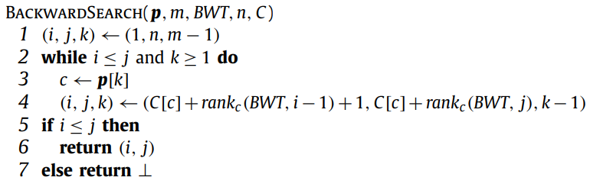
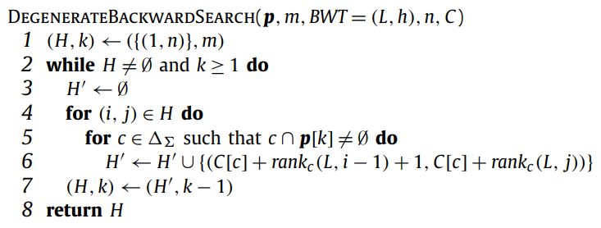
Pseudocode

Slide 16
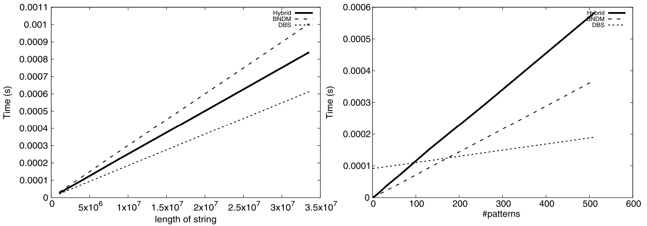
Experiment

Slide 17
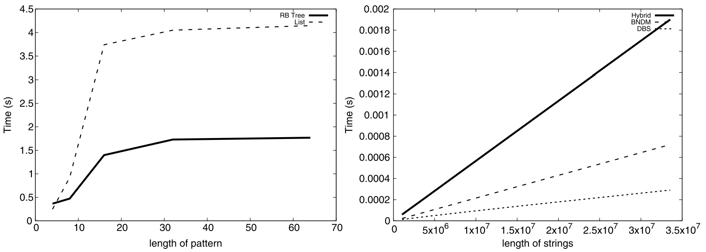
Experiment

