Slide 1
Gene Classification Using Codon Usage and Support Vector Machines
Jianmin Ma, Minh N. Nguyen, and Jagath C. Rajapakse
IEEE/ACM Transaction on Computational Biology and Bioinformatics, vol. 6, no. 1, January-March 2009
Presenter : Tz-Hsu Lee
Date : Oct. 1, 2019.

Slide 2
Abstract(1/2)
A novel approach for gene classification, adopting codon usage bias as feature inputs to support vector machines (SVMs) is proposed. The DNA sequence is first converted to a 59-dimensional feature vector, where each element corresponds to the relative synonymous usage (RSCU) frequency of a codon. Since the input to the classifier is independent of sequence length, the approach is especially useful when sequences to be classified are of differing lengths and homology-based methods tend to fail. The method is demonstrated with 1,841 Human Leukocyte Antigen (HLA) sequences, which are classified into two major classes,
HLA-I and HLA-II. Each major class is further classified into subgroups.

Slide 3
Abstract(2/2)
Using codon usage frequencies, binary SVM achieved an accuracy rate of 99.3 percent for HLA major class classification and multiclass SVM achieved accuracy rates of 99.73 percent and 98.38 percent for the subclass classification of HLA-I and HLA-II molecules, respectively. Comparisons with K-Means clustering and other classifiers and homology-based features are given. Results indicate that the classification based on codon usage bias is consistent with biological functions of HLA molecules.

Slide 4
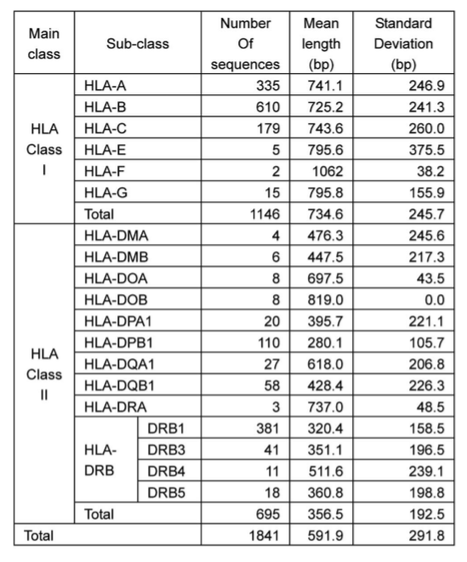

HLA (Human Leukocyte Antigen)
Notes:
Aligning distance matrices for structural alignment

Slide 5
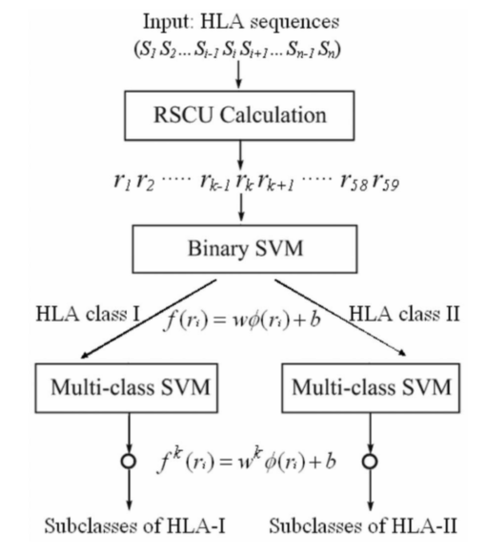
Methods of Gene Classification

Slide 6
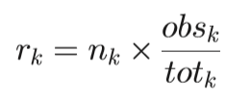
RSCU (Computation of Relative Synonymous Codon Usage Frequency)
obsk : observed number of codon k
totk : total observed number of codons coding for the amino acid coded by codon k
nk : the number of synonymous codons of codon k

Slide 7
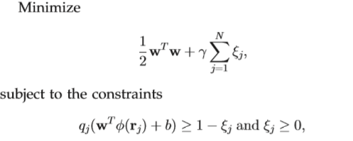
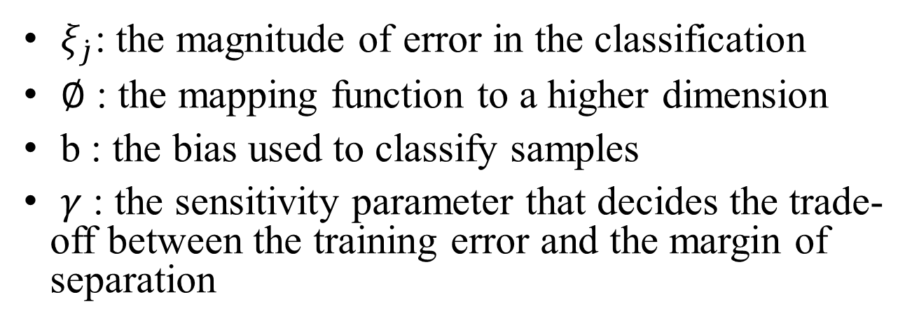
Binary SVM
$ξ_{\dot{j}}$: the magnitude of error in the classification
$∅$ : the mapping function to a higher dimension
b : the bias used to classify samples
$γ$ : the sensitivity parameter that decides the trade-off between the training error and the margin of separation

Slide 8
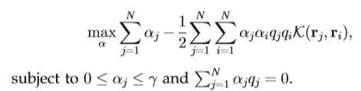

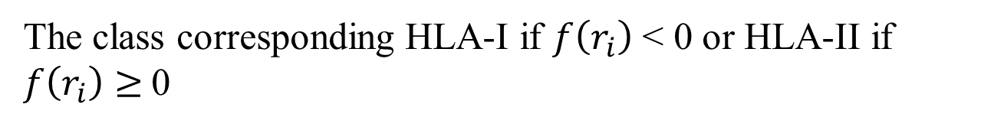
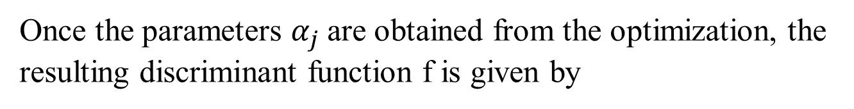
Binary SVM
Once the parameters $α_{j}$are obtained from the optimization, the resulting discriminant function f is given by
The class corresponding HLA-I if $f\left(r_{i}\right)$ < 0 or HLA-II if $f\left(r_{i}\right)≥$0

Slide 9
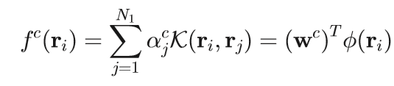
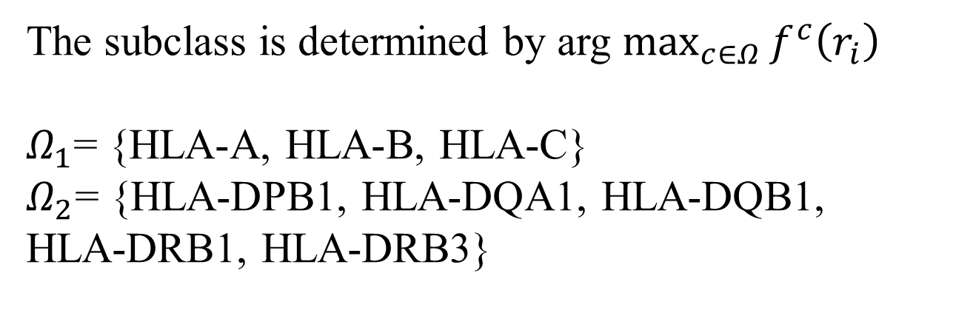
Multiclass SVM
The subclass is determined by arg $\max_{c∈Ω}{f^{c}\left(r_{i}\right)}$
$Ω_{1}$= {HLA-A, HLA-B, HLA-C}
$Ω_{2}$= {HLA-DPB1, HLA-DQA1, HLA-DQB1,
HLA-DRB1, HLA-DRB3}

Slide 10
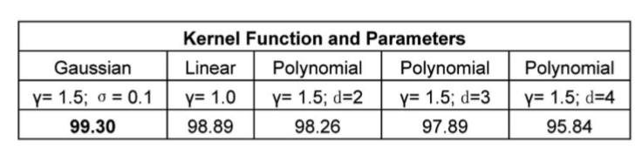
Classification of HLA Molecules Using SVM and Codon Bias
HLA major class classification
Ten-fold cross validation
Different kernel function and parameters

Slide 11
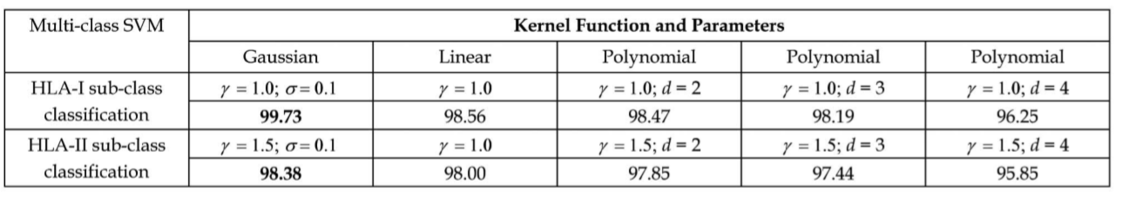
Classification of HLA Molecules Using SVM and Codon Bias
HLA-I and HLA-Ⅱ subclass classification
For HLA-I subclass classification, we first considered the subclasses of HLA-A, HLA-B, and HLA-C, as the numbers of sequences in other subclasses such as HLA-E, HLA-F, and HLA-G are less than 25, to be included in the analysis. For similar reason, we only consider the subclasses of HLADPB1, HLA-DQA1, HLA-DQB1, HLA-DRB1, and HLADRB3 for HLA-II subclass classification.

Slide 12
Classification of HLA Molecules Using SVM and Codon Bias
HLA-I and HLA-Ⅱ subclass classification
They also performed multiclass SVM on the original data set for the subclass classification of HLA-I and HLA-II molecules without excluding subclasses having less than 25 samples. Two-fold cross validation was adopted as the numbers of sequences in the subclasses of HLA-E, HLA-F, HLA-DMA, HLA-DMB, HLA-DOA, HLA-DOB, or HLADRA were small. The multiclass SVM achieved the accuracies of 99.39 percent for the classification of six subclasses of HLA-I and 98.71 percent for 13 subclasses of HLA-II.

Slide 13
Classification of HLA Molecules Using SVM and Codon Bias
Significance analysis of codon usage
T-test
Bonferroni correction

Slide 14
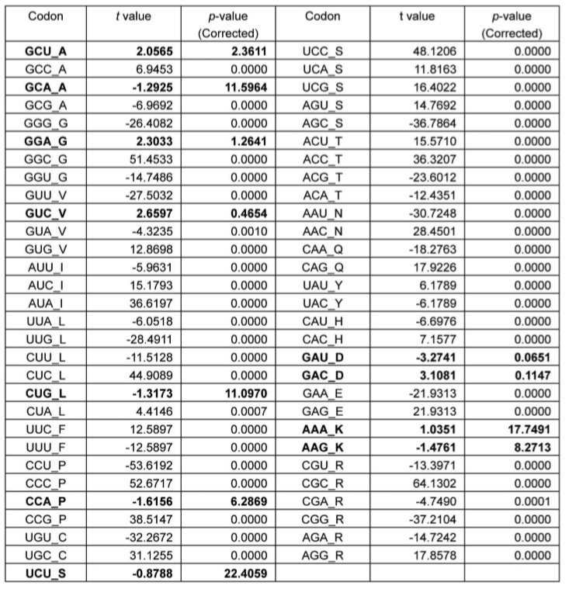

Slide 15
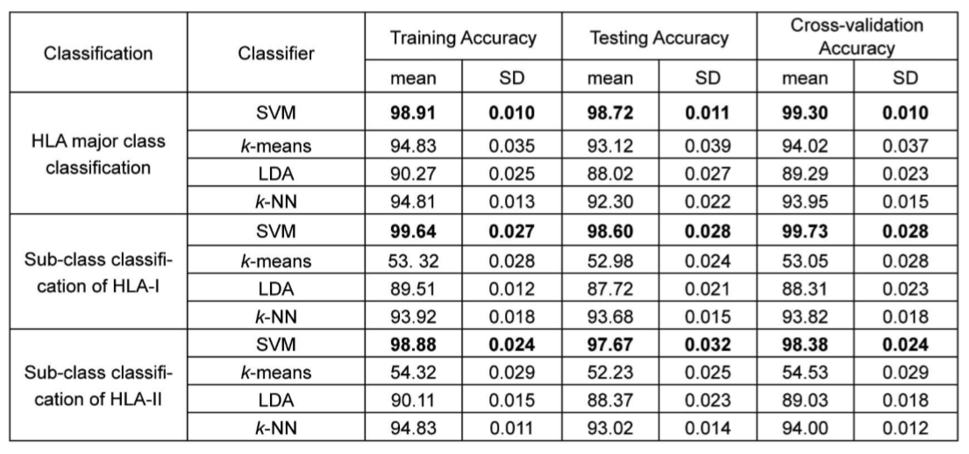
Results and Conclusion
SVM outperformed all other methods in major class and subclass classifications of HLA molecules.

Slide 16
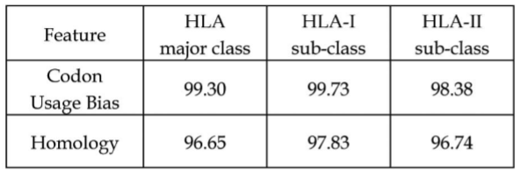
Results and Conclusion
codon usage bias is an effective feature for gene classification better than homology-based method

