Slide 1
Dynamic String Alignment
Tomasz Kociumaka, Shay Mozes
31st Annual Symposium on Combinatorial Pattern Matching (CPM 2020), Copenhagen
Presenter : Yu-Ju, Liao
Date : Aug. 10, 2021

Slide 2
Abstract
We consider the problem of dynamically maintaining an optimal alignment of two strings, each of length at most n, as they undergo insertions, deletions, and substitutions of letters. The string alignment problem generalizes the longest common subsequence (LCS) problem and the edit distance problem (also with non-unit costs, as long as insertions and deletions cost the same). The conditional lower bound of Backurs and Indyk [J. Comput. 2018] for computing the LCS in the static case implies that strongly sublinear update time for the dynamic string alignment problem would refute the Strong Exponential Time Hypothesis. We essentially match this lower bound when the alignment weights are constants, by showing how to process each update in O˜(n) time. When the weights are integers bounded in absolute value by some w = n ^{O(1)}, we can maintain the alignment in O˜(n · min{ √ n, w}) time per update. For the O˜(nw)-time algorithm, we heavily rely on Tiskin’s work on semi-local LCS, and in particular, in an implicit way, on his algorithm for computing the (min, +)-product of two simple unit-Monge matrices [Algorithmica 2015]. As for the O˜(n √ n)-time algorithm, we employ efficient data structures for computing distances in planar graphs.

Slide 3
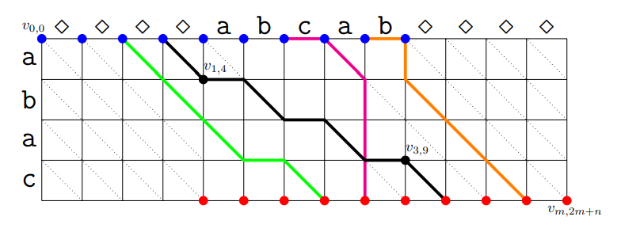
LCS
S = abac
T = abcab
G

Slide 4
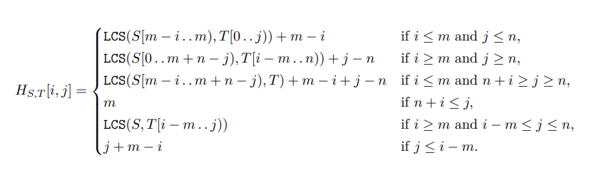
LCS
T
(0,3)
G_{S,T}
S
(4,10)
H_{S,T} [i, j] => v_{0,i} to v_{m,m+j}
H_{S,T} [3,6] = 4
=LCS(S[1, 3), T) + 4 − 3 + 6 − 5
Notes:
=>v_{0,3} to v_{4,9}

Slide 5
LCS
P_{S,T} [3, 6] = H_{S,T} [3,6] + H_{S,T} [4,7] – H_{S,T} [4,6] – H_{S,T} [3,7] = 0
0
1
2
3
4
5
6
7
8
0
4 | 4 | 4 | 4 | 4 | 4 | 4 | 4 | 4
3 | 3 | 3 | 4 | 4 | 4 | 4 | 4 | 4
2 | 3 | 3 | 4 | 4 | 4 | 4 | 4 | 4
1 | 2 | 2 | 3 | 3 | 3 | 4 | 4 | 4
0 | 1 | 2 | 3 | 3 | 3 | 4 | 4 | 4
-1 | 0 | 1 | 2 | 2 | 2 | 3 | 4 | 4
-2 | -1 | 0 | 1 | 1 | 1 | 2 | 3 | 4
-3 | -2 | -1 | 0 | 0 | 1 | 1 | 2 | 3
-4 | -3 | -2 | -1 | 0 | 0 | 1 | 2 | 3
1
2
3
4
5
6
7
8
Notes:
=>v_{0,3} to v_{4,9}

Slide 6
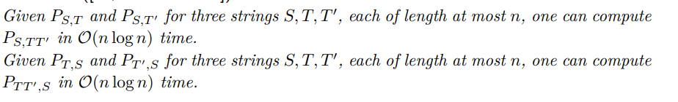
LCS
Notes:
=>v_{0,3} to v_{4,9}

Slide 7


Supporting Only Substitutions
S=1
S = abac
T = abbc
S=2
ab
ac
ab
bc
a
a
a
S=0
b
c
b
b
c
(n/$2^{s})2$

Slide 8

Supporting Only Substitutions
S=1
S = abbc
T = abbc
S=2
ab
bc
ab
bc
a
b
a
S=0
b
c
b
b
c
(n/$2^{s})2$

Slide 9
Supporting Insertions
|U_{s}| = 1 /4 * 2 ^{s} ~ 2 * 2 ^{s}
S=1
S = ababc
T = abbc
S=2
ab
abc
ab
bc
S=0
a
b
ab
c
a
b
b
c

Slide 10
Supporting Deletions
|U_{s}| = 1 /4 * 2 ^{s} ~ 2 * 2 ^{s}
S=1
S = ab c
T = abbc
S=2
ab
c
ab
bc
S=0
a
b
a
c
a
b
b
c

Slide 11
Supporting Insertions and Deletions
|U_{s}| = 1 /4 * 2 ^{s} ~ 2 * 2 ^{s}
|V | < 7/ 4 · 2 ^{s} , VU=R_{s}
|V | > 7/ 4 · 2 ^{s} ,

Slide 12
Obtaining the longest common subsequence

Slide 13

String Alignment Under Integer Weights
S
w_{match}
w_{gap}
T
w_{mis}
Notes:
=>v_{0,3} to v_{4,} w_{mis9}

Slide 14
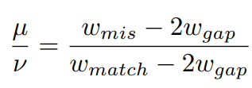

String Alignment Under Integer Weights
,
W_{match} = 4
W_{gap} = 3
W_{mis} = 1
S = ac
T = bc
S’ = $a$c
T’ = $b$c

Slide 15
String Alignment Under Integer Weights
G_{S,T}
c
(0,2)
$
b
$
$
S’ = $a$c
T’ = $b$c
a
$
c
(4,6)
(0,1)
b
c
S = ac
T = bc
a
c
(2,3)
(1,1) = ½*H_{S’,T’} (2,2) = 1

