Slide 1
Sorting by Prefix Reversals and Prefix Transpositions
Zanoni Dias, Ulisses Dias
Discrete Applied Mathematics, 2015
Volume 181, pp. 78-89
Presenter: Tsung-Lin Lu
Date: Aug. 10, 2021

Slide 2
Abstract
In this paper, we present a new algorithm for the Sorting by Prefix Reversals and Prefix Transpositions Problem. The previous approximation algorithm was bounded by factor 3, and here we present an asymptotic 2-approximation algorithm. We consider theoretical and practical aspects in our analysis, and we show that our method is better than other approaches in both cases.

Slide 3
Outline
Breakpoints
Prefix reversals and prefix transpositions
Previous algorithms
Lemma 1. ~ 7.
Z. Dias, U. Dias : Asymptotic 2-approximation (2-app) algorithm
Removing prefix reversal breakpoints
Dealing with π₁ = 1
Lemma 11. ~ 13.
Proof and time complexity of 2-app

Slide 4
Breakpoints
A permutation 𝛑, n = 11
(π₀ , π₁ ) is not a breakpoint
breakpopint
𝛑₀ | 𝛑₁ | 𝛑₂ | 𝛑₃ | 𝛑₄ | 𝛑₅ | 𝛑₆ | 𝛑₇ | 𝛑₈ | 𝛑₉ | 𝛑₁₀ | 𝛑₁₁ | 𝛑₁₂
0 | 3 | 1 | 2 | 4 | 5 | 6 | 7 | 9 | 10 | 11 | 8 | 12
pr breakpopint
pt breakpopint
strips
pt breakpopint
1 ≤ i ≤ n
(π_{i}, π_{i+1}) is a prefix reversal (pr) breakpoint if |π_{i+1} − π_{i}| ≠ 1
(π_{i}, π_{i+1}) is a prefix transposition (pt) breakpoint if π_{i+1} − π_{i} ≠ 1
Strips are maximal intervals with no prefix reversal breakpoints

Slide 5
Prefix reversals and prefix transpositions
A prefix reversal ρ_{pr}(k) = ρ_{r}(1, j)
A prefix transposition ρ_{pt}(j, k) = ρ_{t}(1, j, k)
A reversal ρ_{r}(i, j)
A transposition ρ_{t}(i, j, k)
Genome Rearrangement
Operations
Reversal | Signed
Transposition | Prefix
Translocation | Weighted
Fusion
Fission
1 | … | i-1 | i | i+1 | … | j-1 | j | j+1 | … | n
𝛑
1 | … | i-1 | j | j-1 | … | i+1 | i | j+1 | … | n
𝛑 × ρr(i, j)
1 | … | i-1 | i | i+1 | … | j-1 | j | j+1 | … | k-1 | k | … | n
𝛑
1 | … | i-1 | j | j+1 | … | k-1 | i | i+1 | … | j-1 | k | … | n
𝛑 × ρ_{t}(i, j, k)

Slide 6
Previous algorithms
0 | j | j-1 | … | 2 | 1 | j+1 | … | n+1
𝛑 × ρ_{pr}(k)
0 | j | j+1 | … | k-1 | 1 | 2 | … | j-1 | k | … | n+1
𝛑 × ρ_{pt}(j, k)
Lemma 1. ∆b_{pr}(π, ρ_{pr} ) ∈ {−1, 0, 1}
Lemma 2. b_{pr}(π) ≤ d_{pr} (π) ≤ 2b_{pr}(π)
Lemma 3. ∆b_{pt}(π, ρ_{pt}), ∆b_{pr}(π, ρ_{pt}) ∈ {−2, −1, 0, 1, 2}
Lemma 4. b_{pt}(π) / 2 ≤ d_{pt}(π) ≤ b_{pt}(π)−1
Lemma 5. d_{prpt}(π) ≥ b_{pr}(π) / 2
Lemma 6. ∆b_{pt}(π, ρ_{pr}) ∈ {−n, −(n−1) ,... ,−1 ,0 ,1 ,... ,n−1 ,n}
Lemma 7. d_{prpt} (π) ≥ b_{pt} (π) / n

Slide 7
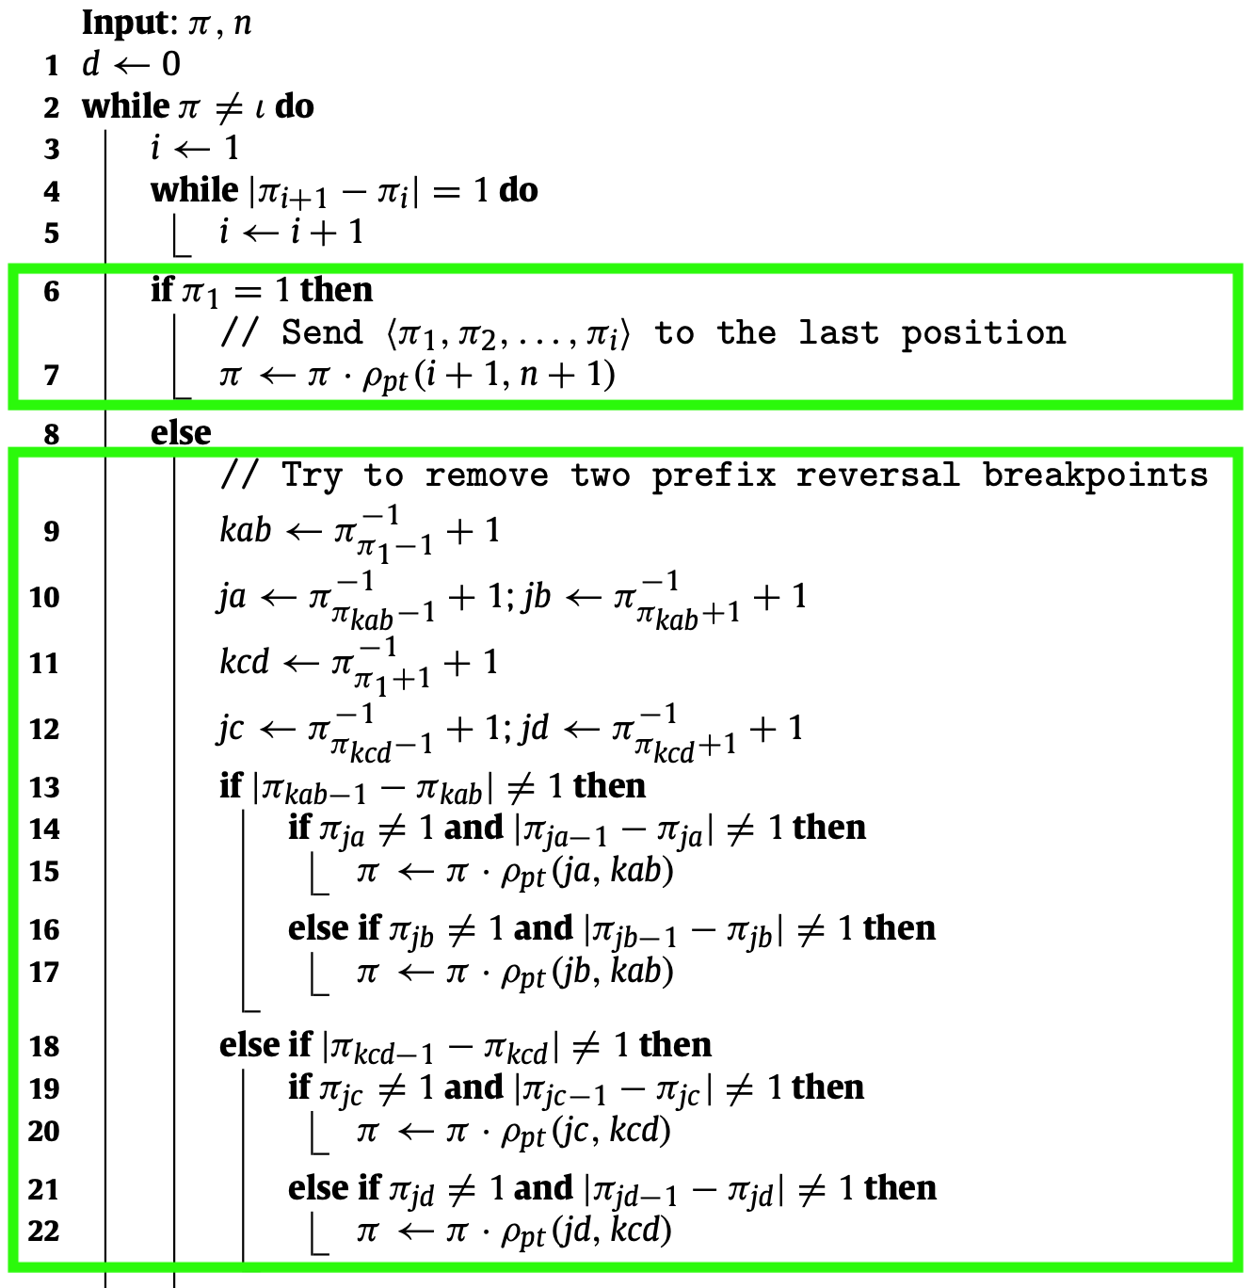
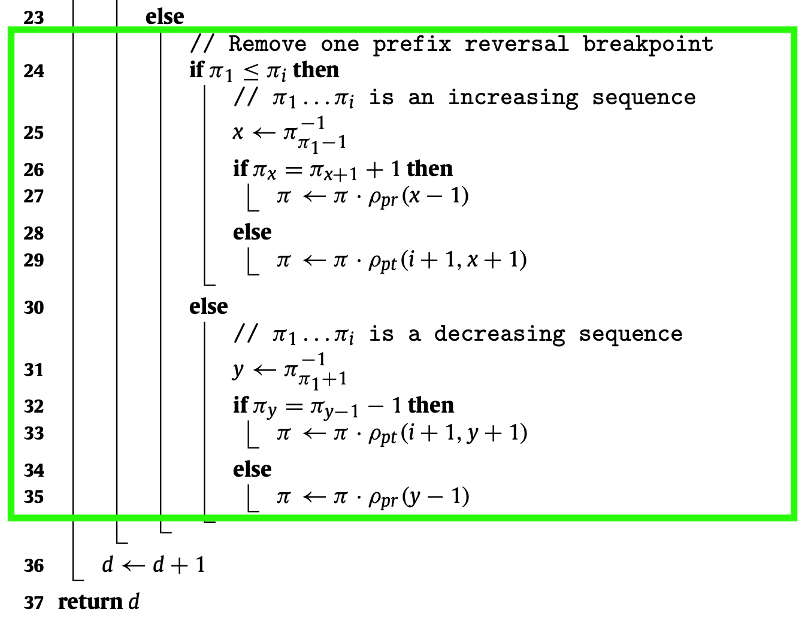
2-app pseudocode

Slide 8
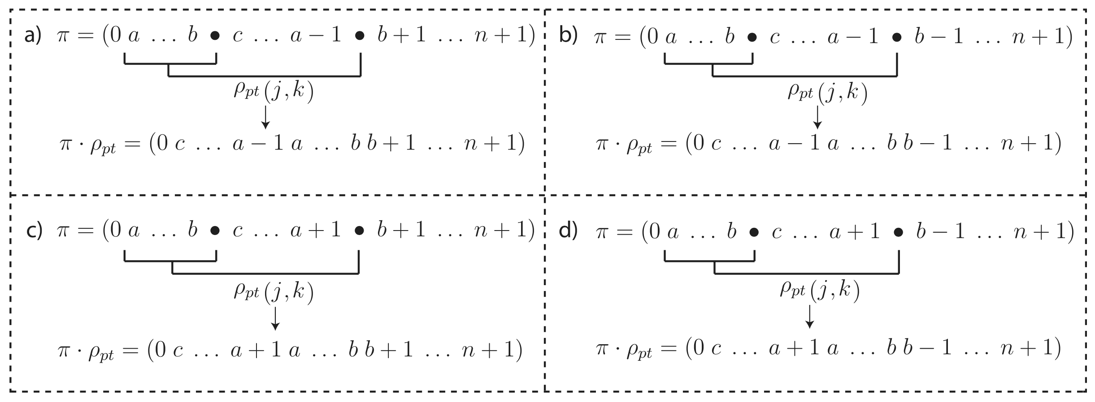
Removing prefix reversal breakpoints (1/2)
Ⓐ Ⓓ
Ⓐ Ⓒ
Ⓑ Ⓓ
Ⓑ Ⓒ
Fig. 1. Scenarios where we can remove two prefix reversal breakpoints. In addition, Algorithm forces c ≠ 1.
Ⓐ | Ⓑ | Ⓒ | Ⓓ
a-1 | a+1 | b-1 | b+1

Slide 9
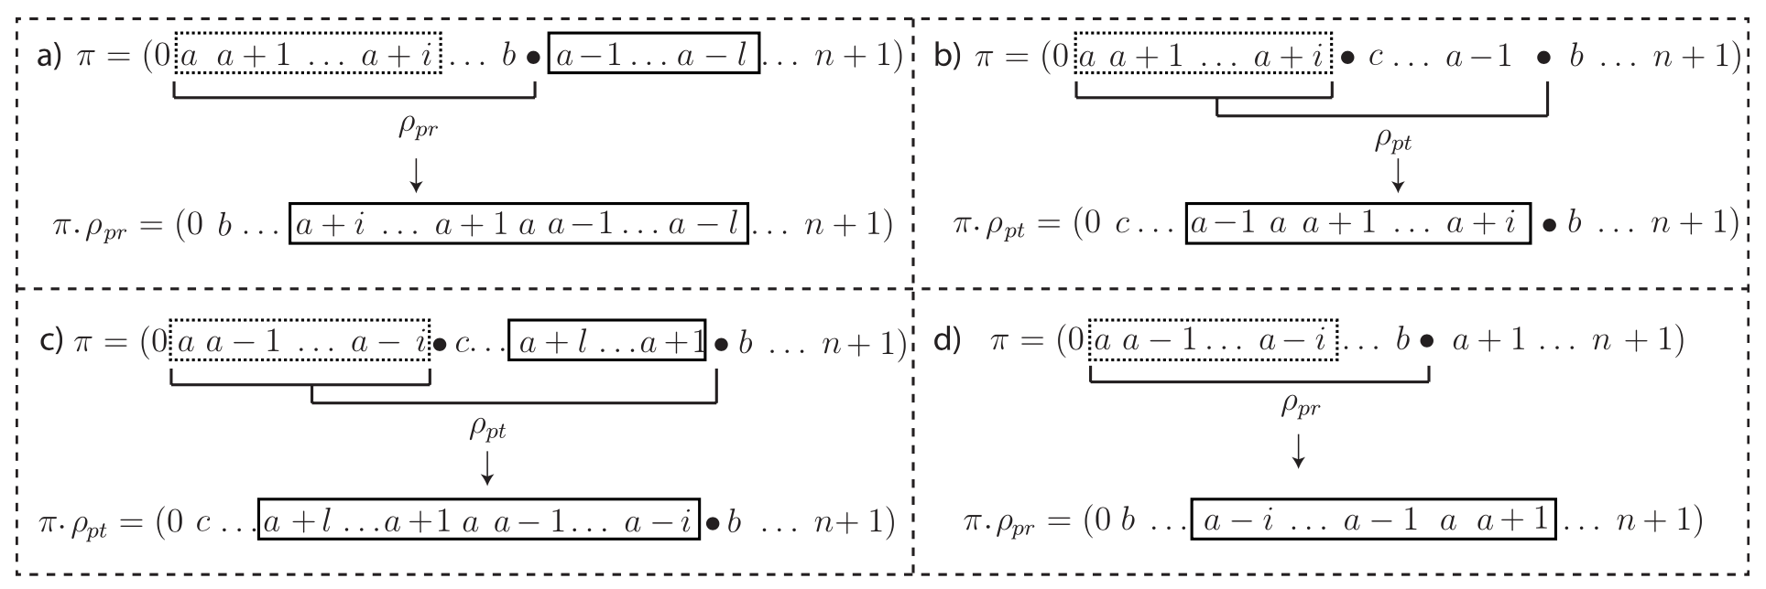
Removing prefix reversal breakpoints (2/2)
Fig. 2. Remove one prefix reversal breakpoint. Dotted boxes represent strips that have one or more elements. Solid boxes represent strips that have at least two elements.

Slide 10
Dealing with π₁ = 1
𝝓(π) is the strip that contains the element 1 in π
Lemma11. When 𝝓(π) is in ascending order at the end of the permutation π, the prefix operation performed by 2-app that moves it away from there forces the element n to be moved to the end of the permutation.
Lemma 12. Let π be a permutation of the form π = (... n 𝝓(π) n + 1), 𝝓(π) in ascending order, 2-app will not split the pair [n, 1] unless we can find a prefix transposition ρpt such that π · ρ_{pt} = ι.
Lemma 13. The prefix transposition that moves π1 = 1 to the end of the permutation occurs at most twice during the execution of 2-app.

Slide 11
2-app algorithm
0 | 𝝓(π) | … | … | … | … | … | … | … | n+1
1st π1 = 1
Lemma 11.
2st π1 = 1
Lemma 12.
3st π1 = 1
0 | … | … | … | … | … | … | … | 𝝓(π) | n+1
0 | … | … | … | … | … | … | … | n | n+1
0 | 𝝓(π) | … | … | … | … | … | … | n | n+1
0 | … | … | … | … | … | … | n | 𝝓(π) | n+1
0 | n-6 | n-5 | n-4 | n-3 | n-2 | n-1 | n | 𝝓(π) | n+1
0 | 1 | 2 | 3 | 4 | … | … | … | n | n+1

Slide 12
Lemma11.
0 | … | … | … | … | … | … | … | 𝝓(π) | n+1
𝝓(π)
It is comprised solely of n + 1

Slide 13
Lemma11.
0 | … | … | … | … | … | … | … | 𝝓(π) | n+1
𝝓(π)
It is comprised solely of n + 1

Slide 14
Lemma12.
0 | … | … | … | … | … | … | n | 𝝓(π) | n+1
π_{j} = c = 1, we explicitly deny.

Slide 15
Lemma12.
0 | … | … | … | … | … | … | n | 𝝓(π) | n+1
𝝓(π)
It is comprised solely of n + 1

Slide 16
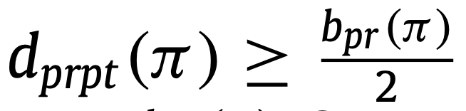
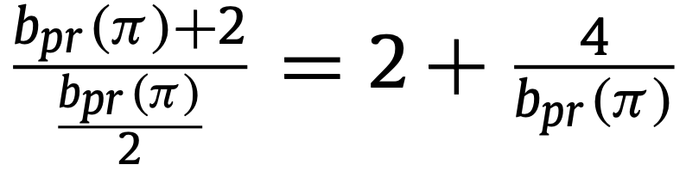
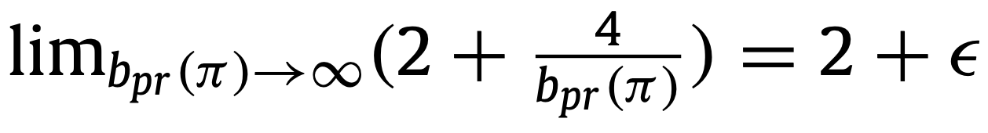
Proof and time complexity of 2-app
Theorem 1. 2-app is an asymptotic 2-approximation algorithm to the Sorting by Prefix Reversals and Prefix Transpositions Problem
Theorem 2. 2-app runs in O(n²)

Slide 17
Results (1/6)
Year | Abbreviation | Topic | Author
2002 | ptSort | Sorting by Prefix Transpositions | Dias & Meidanis
2005 | prSort | Sorting by Prefix Reversals | Fischer & Ginzinger
2010 | 3-app | Sorting by Prefix Reversals and Prefix Transpositions | Sharmin et al.
2015 | 2-app | Sorting by Prefix Reversals and Prefix Transpositions | Dias & Dias
Data set 1 : All permutation of n = 2 ~ 12
Data set 2 : Random permutation of n = 2 ~ 500

Slide 18
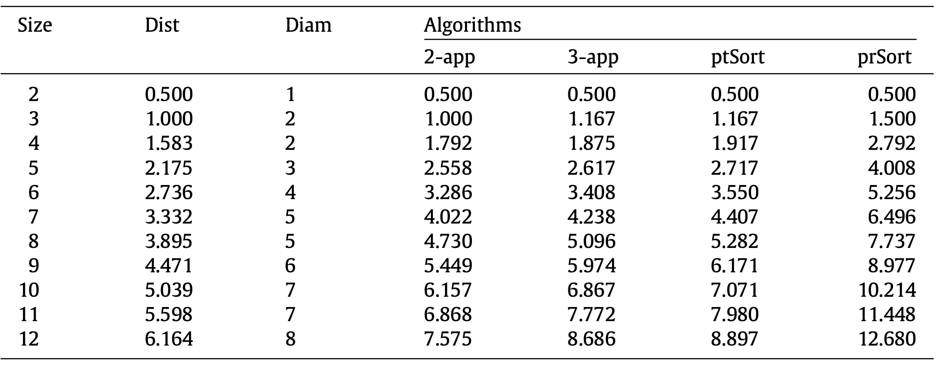
Results (2/6)

Slide 19
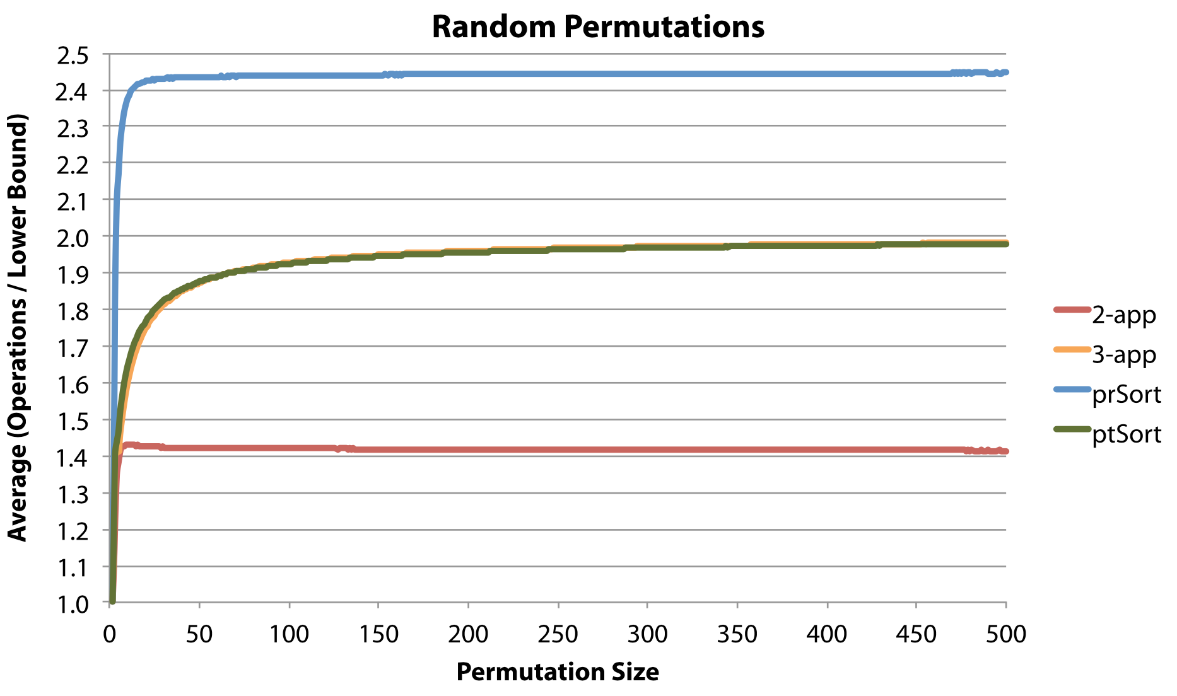
Results (3/6)

Slide 20
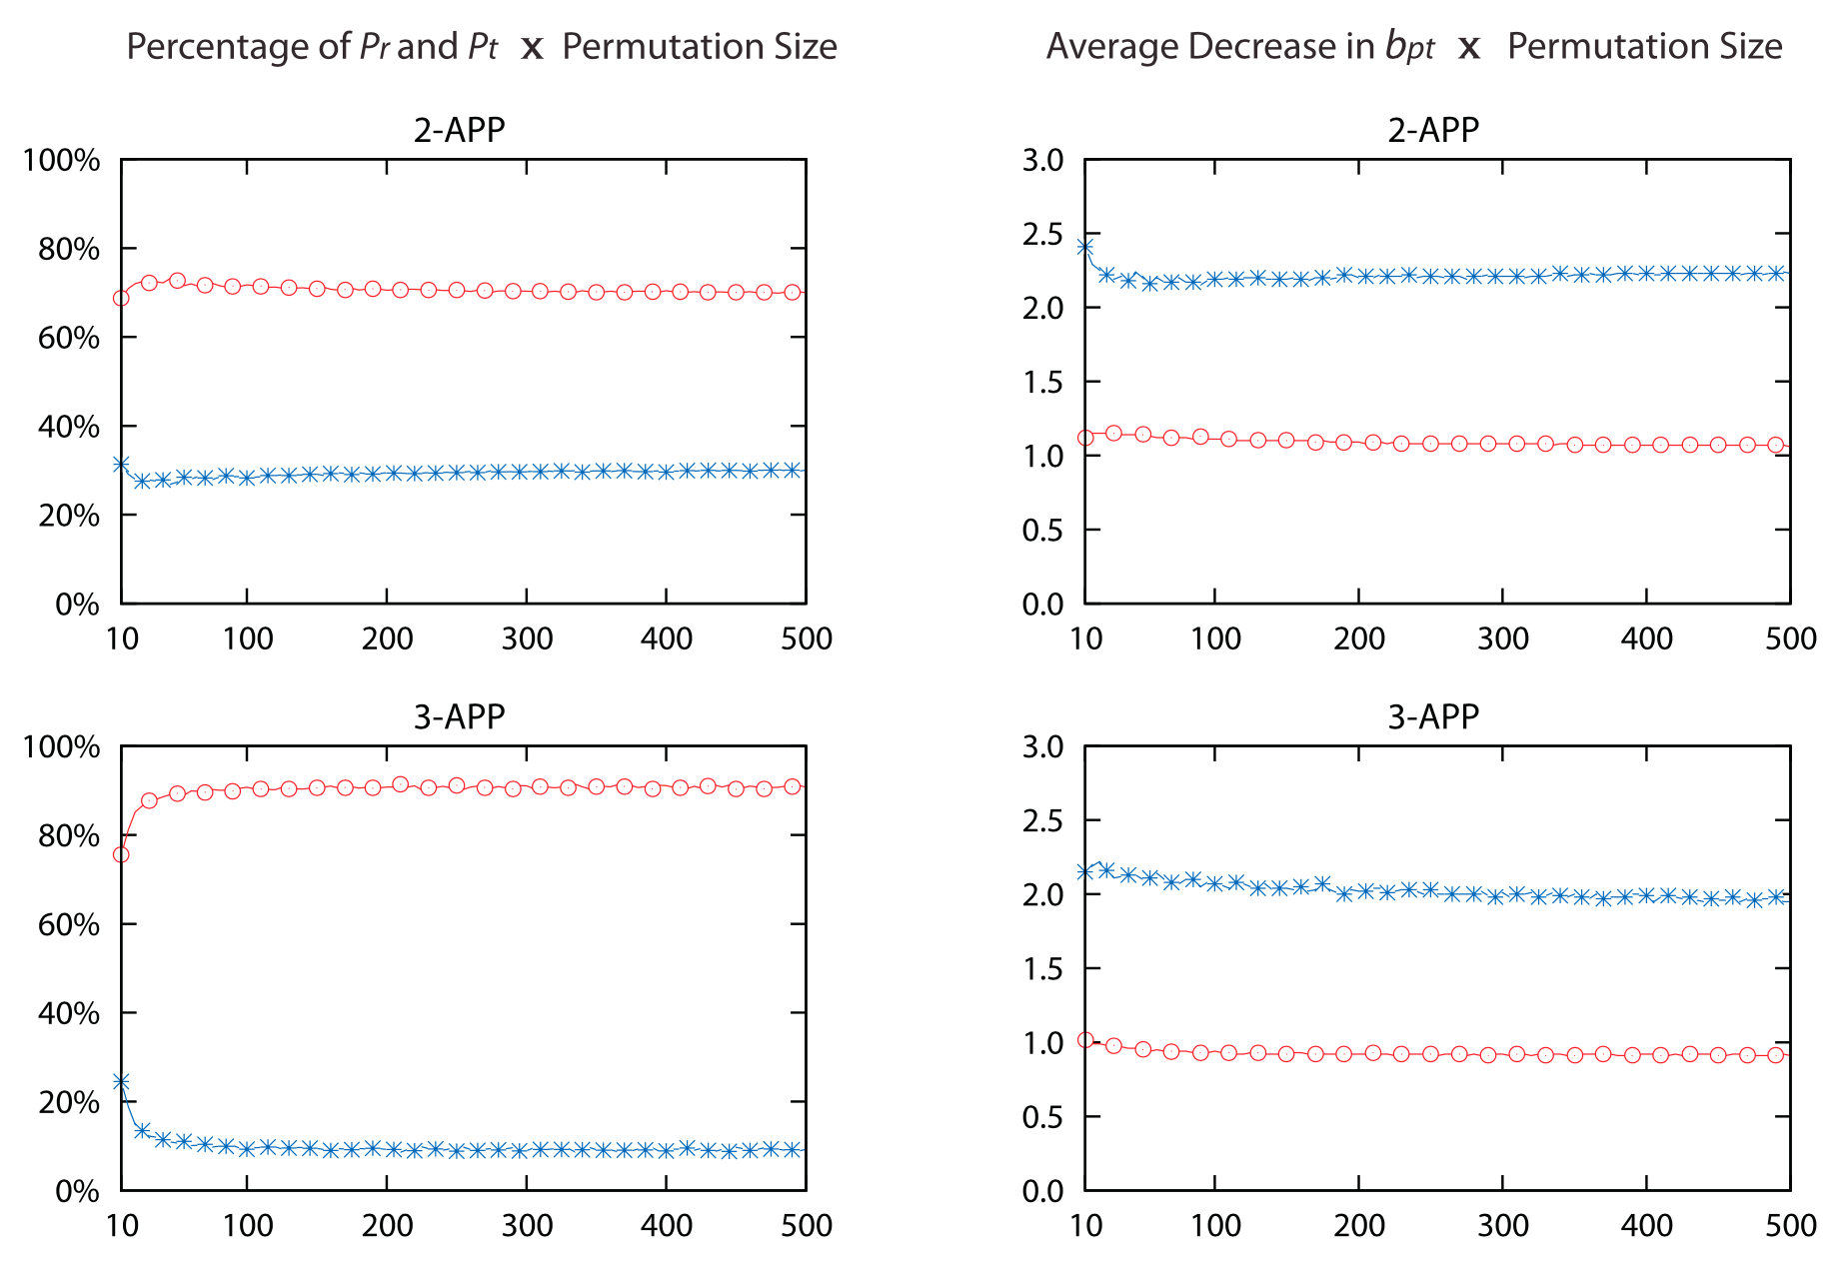
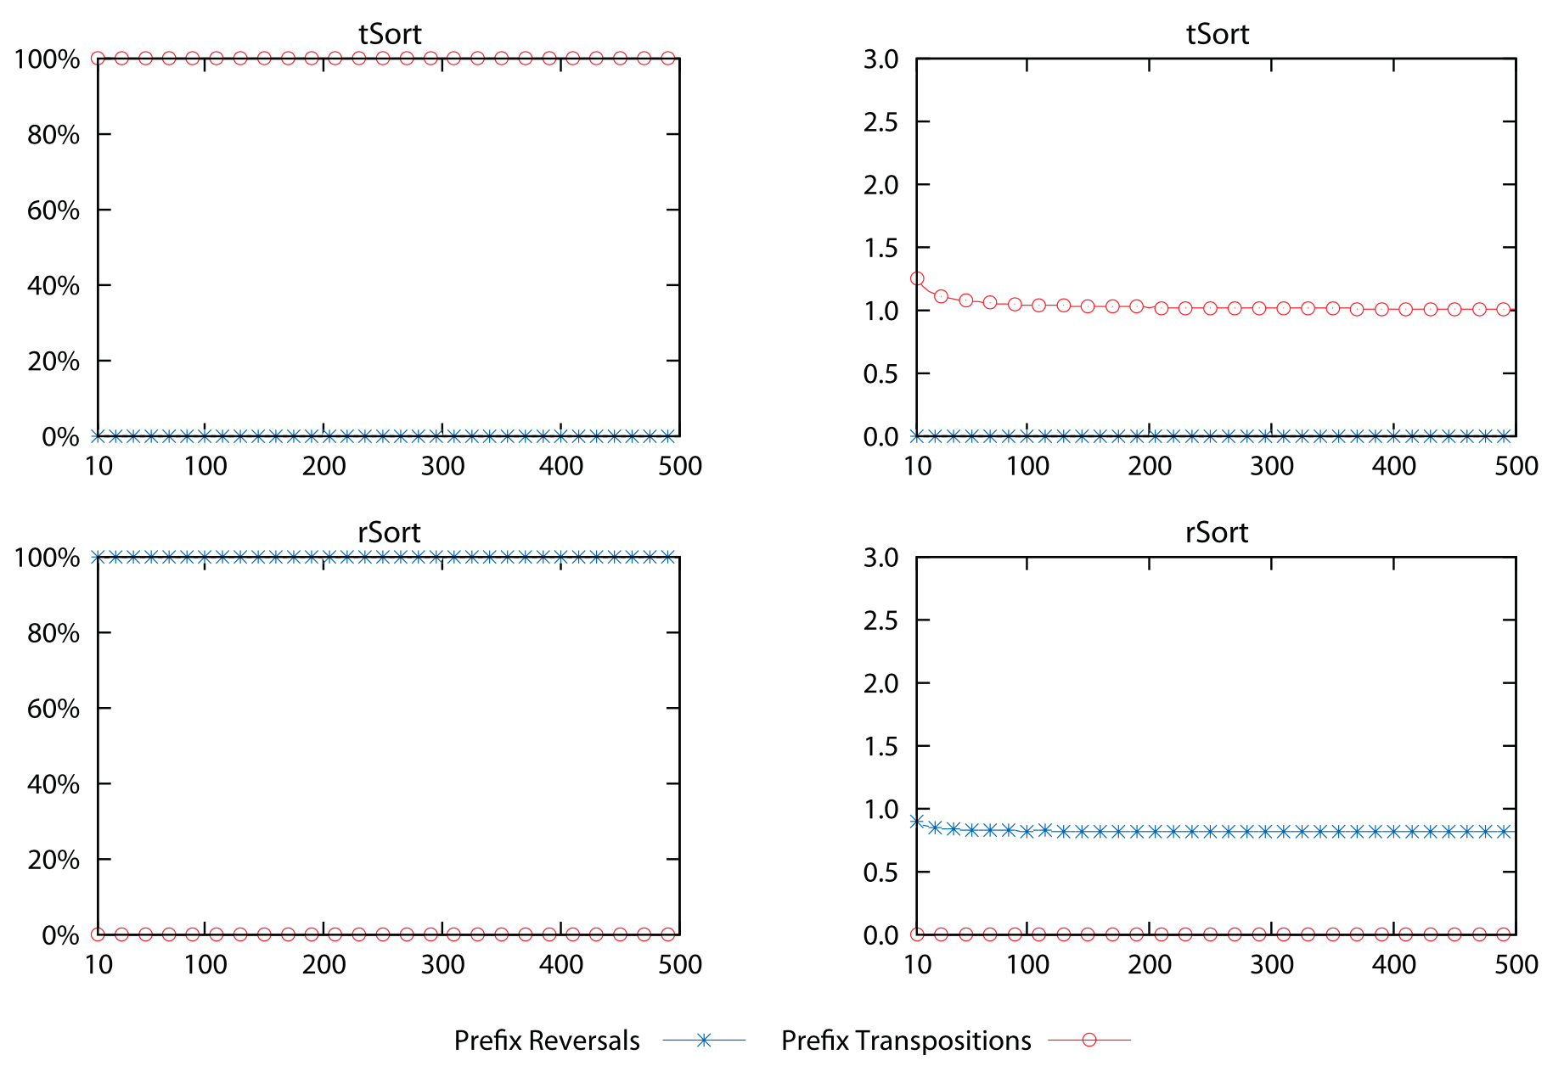
Results

Slide 21
Results

Slide 22
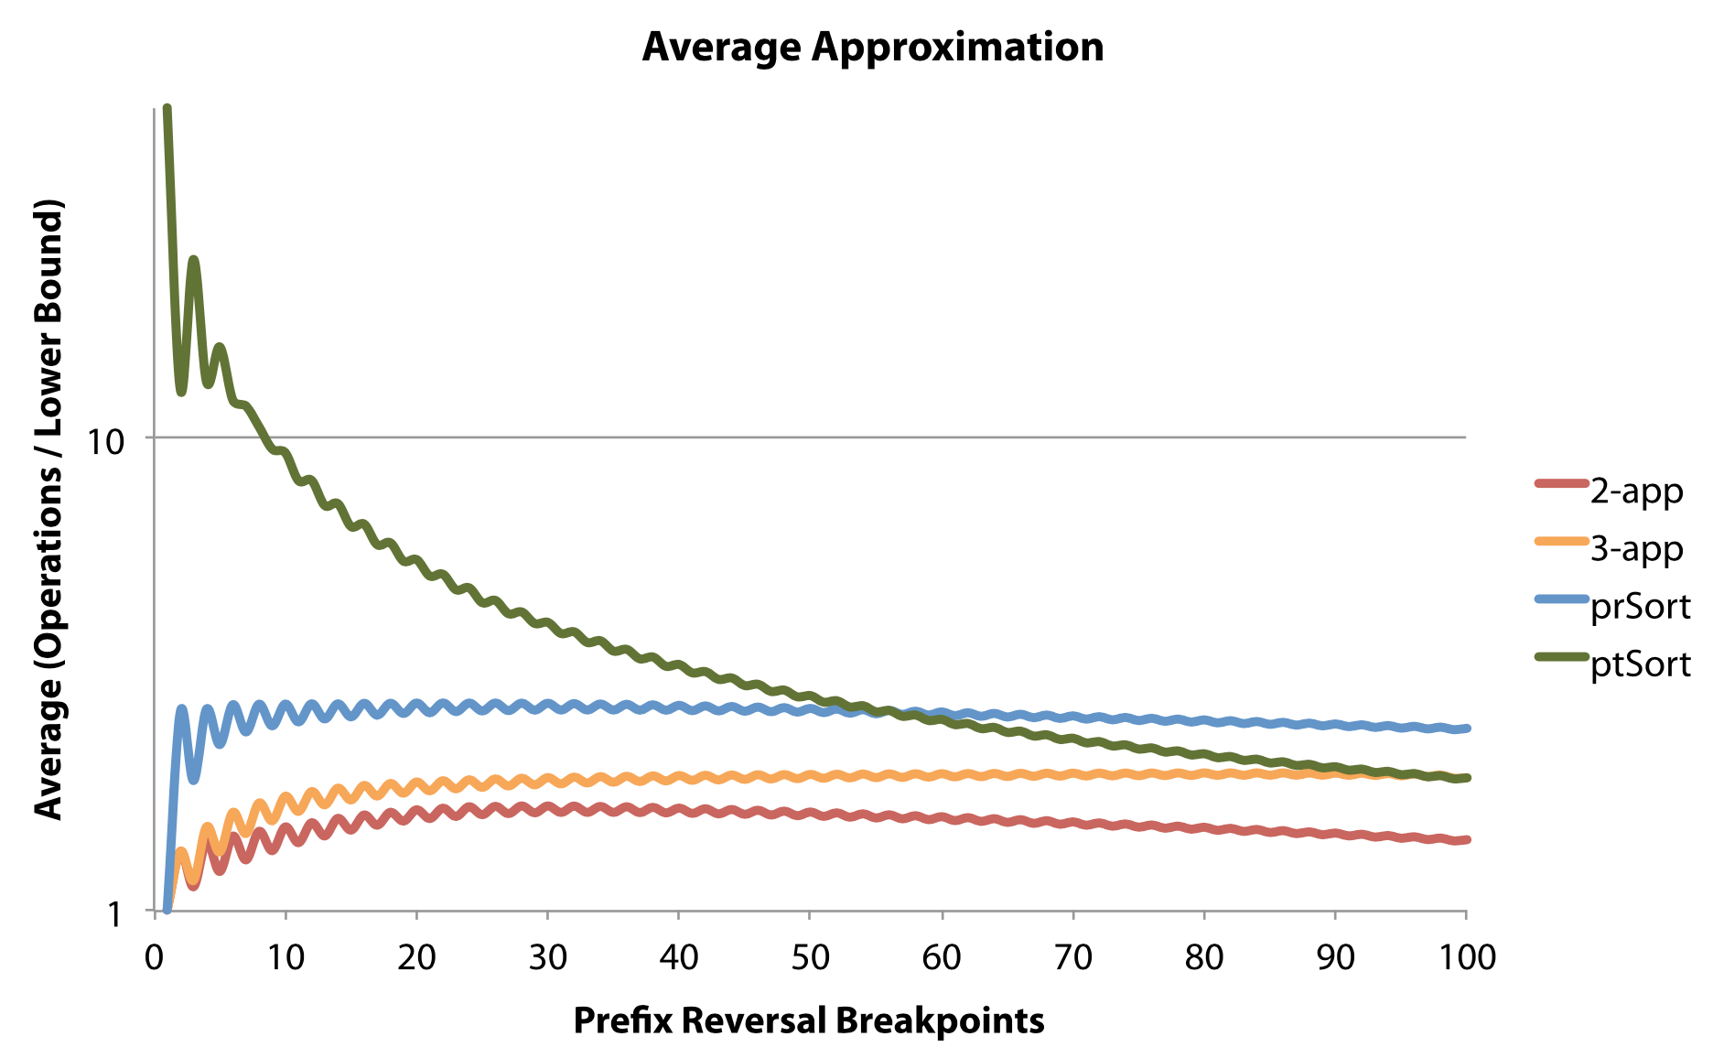
Results (6/6)

Slide 23
Thank you for listening

Slide 24
Abstract
s

