Slide 1
Vehicle routing problem with cross docking: A simulated annealing approach
Şule BİRİM
12th International Strategic Management Conference, ISMC 2016, 28-30 October 2016, Antalya, Turkey
Procedia - Social and Behavioral Sciences 235 ( 2016 ) 149 –158
Date: Aug. 10 , 2021
Presenter: Jue-Jun Wu

Slide 2
Abstract
Cross docking is a valuable logistics strategy given that it provides less inventory holding costs, less transportation costs and fast customer deliveries. Cross docking should also be considered in strategic planning since it provides competitive advantage by reducing firm costs. An efficient vehicle routing may even increase the benefits of the cross docking. This study presents a vehicle routing problem in a cross docking setting with heterogeneous vehicles having different capacities. All the routes begin and end at the cross dock and all the pickup and delivery sites are visited by only one vehicle. The aim of this study is to find the routes that minimize total transportation costs and the fixed costs of the vehicles. A simulated annealing algorithm is proposed to solve the problem. The proposed simulated annealing heuristic presents reasonable solutions in terms of computational time, best cost values and the convergence pattern on the best cost.

Slide 3
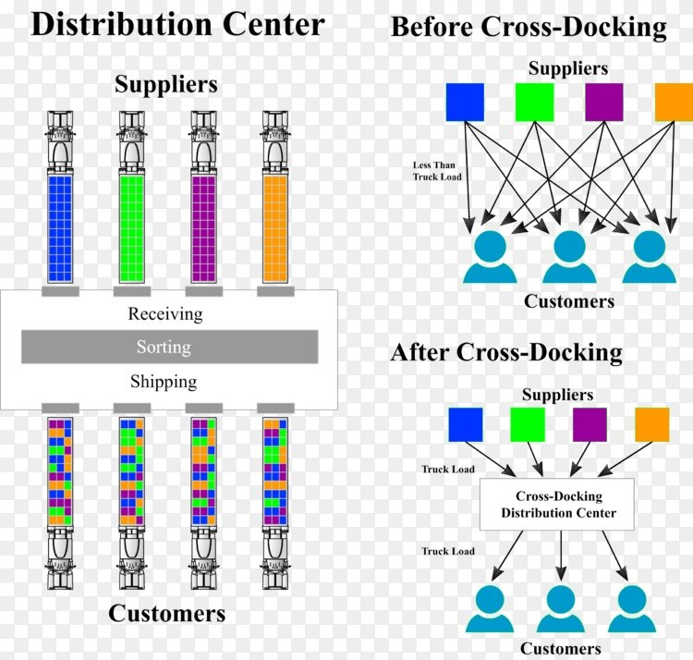

Slide 4
The aim of VRP(vehicle routing problem ) is to determine a set of vehicle routes that brings minimum total cost in a single period given that
each route starts and ends at a depot;
each customer is served by only one vehicle;
the total demand on each route does not exceed the vehicle capacity.
In this aspect VRP with cross docking (VRPCD) can be considered as a vital logistics strategy during strategic planning of the organization and should take more attention from the strategic management point of view.
Notes:
貨物從多個供應商處取出並合併到一個交叉對接中。在根據客戶事先已知的需求將合併貨物分配給客戶之後。與其他研究不同，在提議的環境中運行的車輛是異質的(不同的容量)。分別取貨和送貨的最佳路線。建議設置的目的是最大限度地減少系統中的總配送成本，

Slide 5
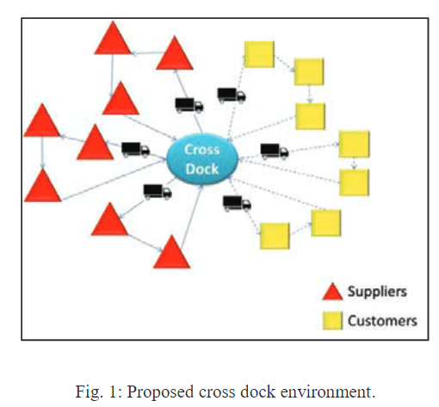
Heterogeneous vehicles.
All routes start and end at the crossing terminal, and split delivery is not allowed.
For pickup and delivery, all nodes are accessed by only one vehicle.
Delivery starts immediately after completing all pickup routes.
Notes:
異構車輛，並且為了計算的簡單性而不使用時間範圍。所有路線都在交叉碼頭開始和結束，不允許拆分交付。對於取貨和送貨，所有節點僅由一輛車訪問。完成所有取件路線後立即開始交付。

Slide 6
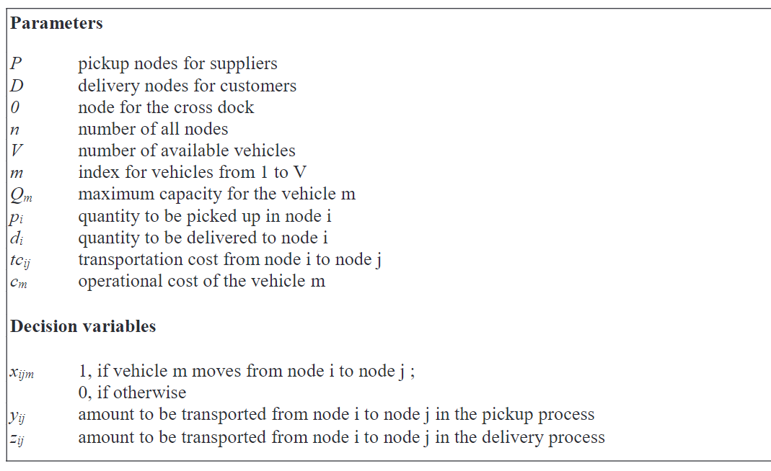

Slide 7
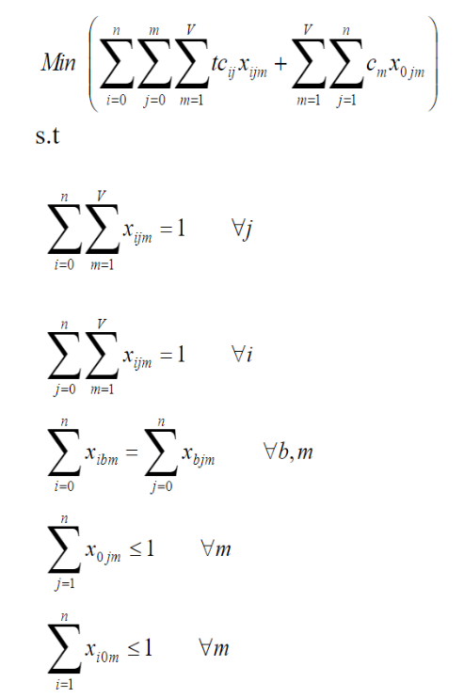
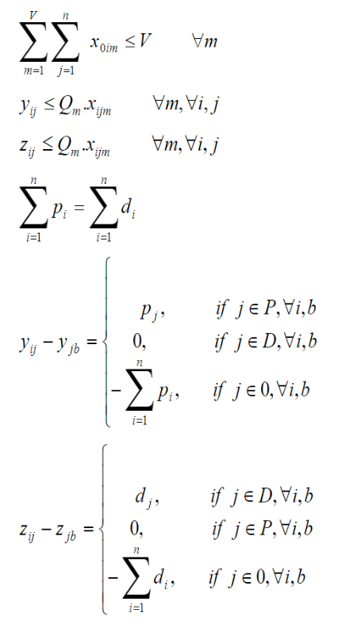
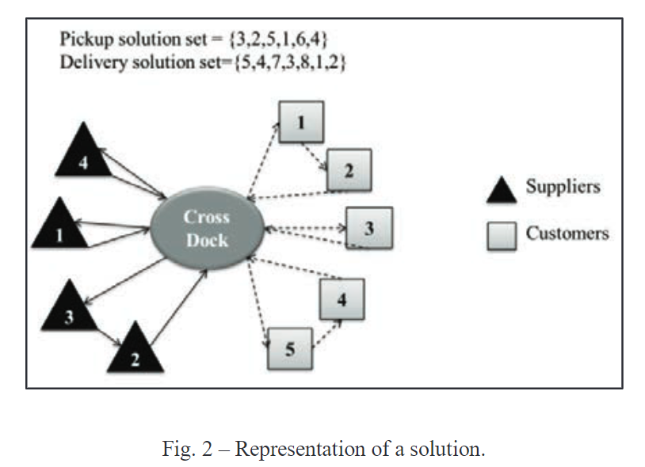

Slide 8
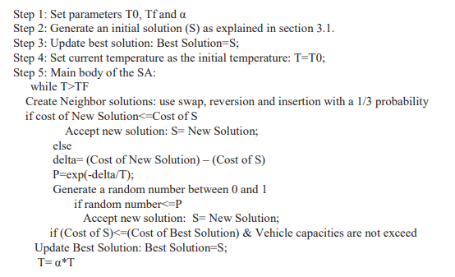
Simulated Annealing Algorithm

Slide 9
Three different neighborhood search mechanisms
Swap: In this technique two nodes in a solution are randomly selected and their positions are exchanged in the new solution.
Reversion: In this technique two nodes in a solution are randomly selected and the nodes between the selected nodes are reversely sorted in the new solution.
Insertion: In this technique two nodes in a solution are randomly selected and the node which has the smallest position is inserted into the position just before the other node.

Slide 10
Simulated Annealing Algorithm
Step 1: Select a vehicle to route.
Step 3: Add cross dock as the starting point of the route.
Step 4: Determine a random combination of the cities.
Step 5: Add the first city in the random combination to the route.
Step 6: Add demand of the selected city to the vehicle’s capacity.
Step 7: Check if the vehicle’s capacity is full. If it is not full, increment the city number and repeat steps 5 and 6. If the vehicle is full send vehicle back to the cross dock.
Step 8: Repeat steps1 to 8 until all cities has been visited.
Notes:
忽略了 Şirin (2010) 中使用的公差值，解決組合優化的元啟發式算法，它通過進行小的局部更改來反復改進初始解，SA 使用多個參數，包括初始溫度、每個溫度下允許的迭代次數、冷卻速率和最終溫度，這意味著搜索的結束條件.

Slide 11
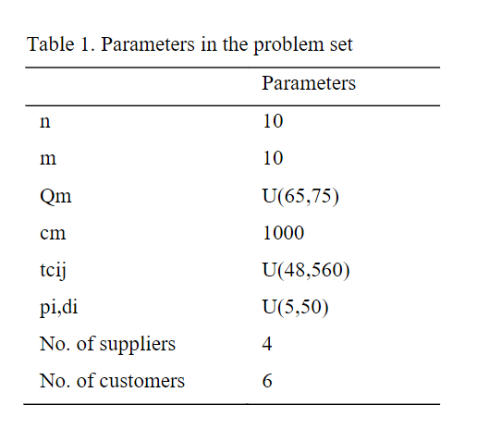
The SA procedure was run for 30 instances for each data set.
Every run is performed on a Mac with a 2.6 Ghz Intel Core i5 Processor and 8 GB of RAM under the OS X El Capitan operating system.
Among SA parameters T0, Tf, and alpha were set to 100, 0.01 and 0.99 respectively

Slide 12
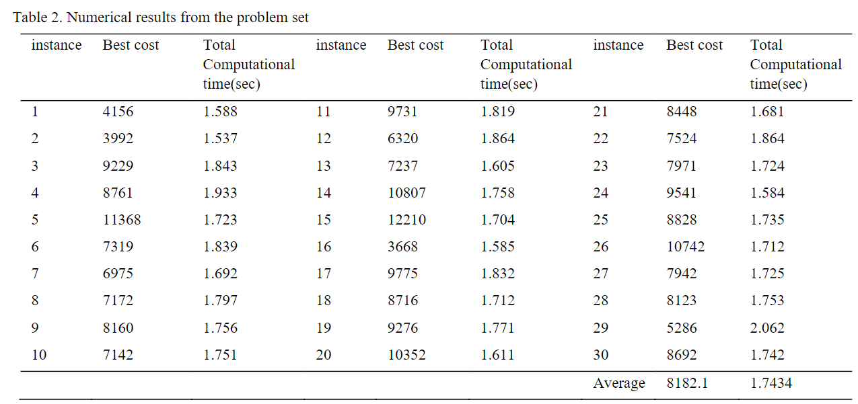
Notes:
結果表明，每個測試實例都在合理的時間內完成。除一個實例外，每個測試實例均在 2 秒前完成。對於 30 個實例，平均計算時間記錄為 1.7434 秒

Slide 13
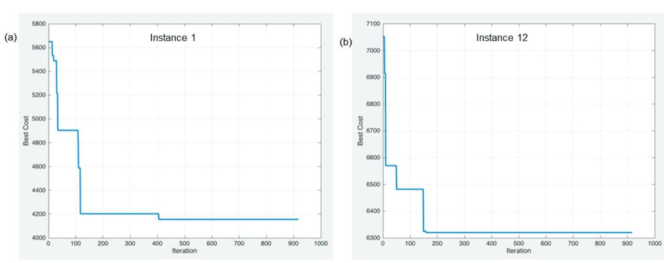

Slide 14
Conclution
In cross docking there is a transfer center which is called the cross dock that consolidates the products picked up from a supplier.
The cross dock is not an actual warehouse, firms in the integration bear less inventory costs.
In the proposed setting the goods picked up from the suppliers. The same amounts of goods that are picked up are delivered to the customers. During the pickup and delivery processes heterogeneous vehicles that have different capacities are used.

Slide 15
Thanks for listening.

Slide 16
老師的提問?
1.缺點:他的LP公式可能跟退火無關。雖然退火演算法有三個鄰居的搜尋方法，但那是退火演算法的突變。但他的LP公式沒有提出這個問題。(LP定義要再精細一點會更好)
2. 每條路線若反著走0->1->2->0，0->2->1->0 會有不同結果嗎?
Ans:反這走應該是沒有問題的，這篇論文定義的是先確認好每個節點要搬運的貨物量和要走哪條路線。若是路線有新增別的節點，那才會更改結果。
3. 從節點a取貨(洗衣機->20公斤)時，經過cross dock ，再被運送到節點b時，他會不會被拆開成10公斤+10公斤來運送?(當送到b點時，車輛z最多載20公斤，目前已經分裝10公斤了，為了滿足此送貨車，所以拆成兩個10公斤)
Ans:答案是不會的，這邊用cross dock所以她的每個商品都有一個條碼用來掃描其重量和分給哪個顧客。當這台車滿了或無法載送這個貨物的時候，他不會載這個貨物也不會拆解掉這個貨物，頂多下一梯次運送(可能是明天所以收穫日期其實不會差太多)。(舉例:目前超商取貨的包裹有限制包裹大小和公斤數)(另一種像是大型家電和直播的海鮮平台，多半不走超商取貨，因為有商品需要冷藏和過重的問題，多半會用新竹貨運直接運送到某某人家裡。)

