Slide 1
Periodicity in rectangular arrays
uilhem Gamard, Gwenaël Richomme, Jeffrey Shallit, Taylor J. Smith
Information Processing Letters Volume 118, February 2017, Pages 58-63
Presenter : Yu-Ju Liao
Date : Sep. 14, 2021

Slide 2
Abstract
We discuss several two-dimensional generalizations of the familiar Lyndon–Schützenberger periodicity theorem for words. We consider the notion of primitive array (as one that cannot be expressed as the repetition of smaller arrays). We count the number of m × n arrays that are primitive. Finally, we show that one can test primitivity and compute the primitive root of an array in linear time.

Slide 3
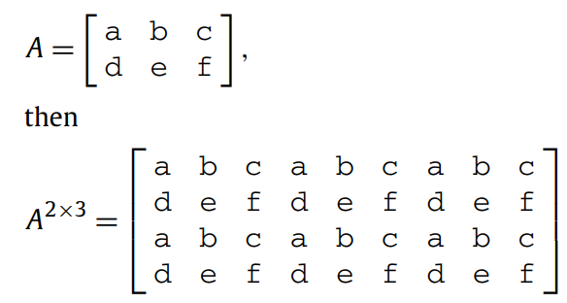
Rectangular arrays
G
G

Slide 4
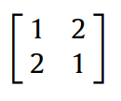
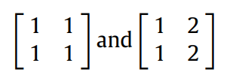


Primitive arrays
G
G
=
=

Slide 5
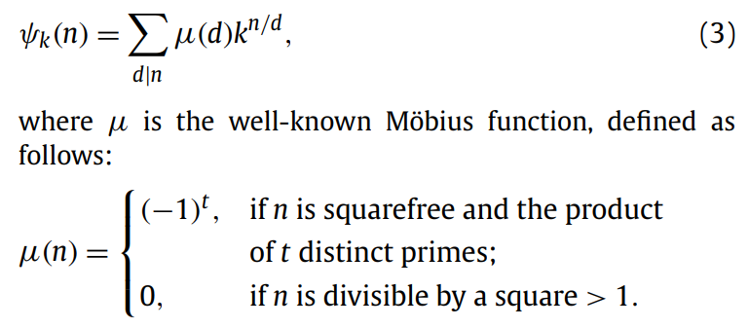
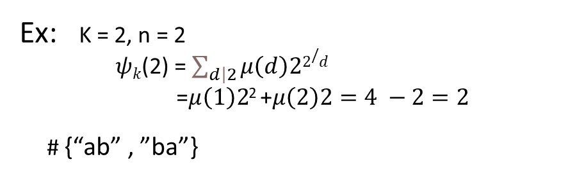
Counting the number of primitive roots
Ex: K = 2, n = 2
$ψk$(2) = $\sum_{\left.d\right|2}{μ\left(d\right)22/d}$
=$μ\left(1\right)2$² +$μ\left(2\right)2=4 −2=2$
# {“ab” , ”ba”}

Slide 6
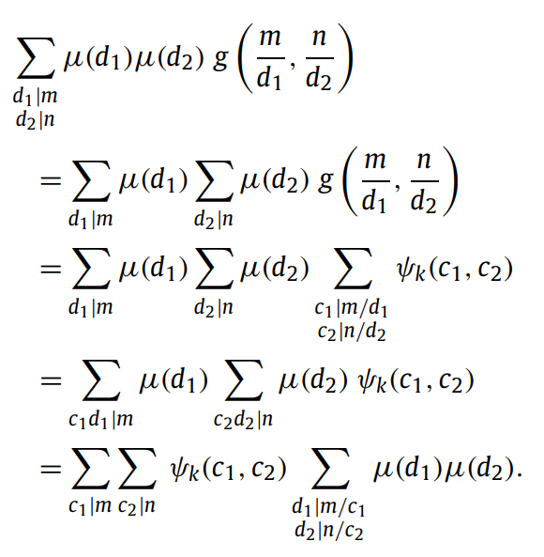


Counting the number of primitive arrays

Slide 7
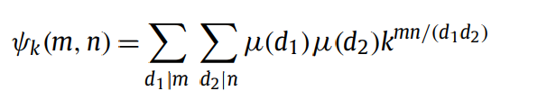


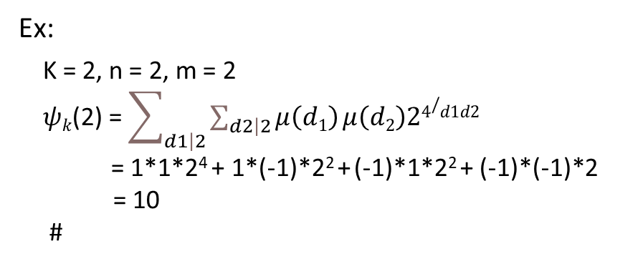








Counting the number of primitive arrays
Ex:
K = 2, n = 2, m = 2
$ψk$(2) = $\sum_{\left.d1\right|2}{\sum_{\left.d2\right|2}{μ\left(d1\right)}μ\left(d2\right)24/d1d2}$
= 1*1*2⁴ + 1*(-1)*2² + (-1)*1*2² + (-1)*(-1)*2
= 10
#
$$\left[\begin{matrix}a & b \\ b & a\end{matrix}\right]$$
$$\left[\begin{matrix}a & b \\ b & b\end{matrix}\right]$$
$$\left[\begin{matrix}b & a \\ b & b\end{matrix}\right]$$
$$\left[\begin{matrix}b & b \\ a & b\end{matrix}\right]$$
$$\left[\begin{matrix}b & b \\ b & a\end{matrix}\right]$$
$$\left[\begin{matrix}b & a \\ a & b\end{matrix}\right]$$
$$\left[\begin{matrix}b & a \\ a & a\end{matrix}\right]$$
$$\left[\begin{matrix}a & b \\ a & a\end{matrix}\right]$$
$$\left[\begin{matrix}a & a \\ b & a\end{matrix}\right]$$
$$\left[\begin{matrix}a & a \\ a & b\end{matrix}\right]$$

Slide 8
Checking primitivity
the primitive root of A has dimension p × q,
where q = lcm(|r0|,|r1|,...,|rm−1|) and p = lcm(|c0|,|c1|,...,|cn−1|)
Ex:
A B A B A B A B
A B C D A B C D
A B A B A B A B
A B C D A B C D
➔
q = (2,4,2,4) = 4
p = (1,1,2,2,1,1,2,2) = 2

Slide 9
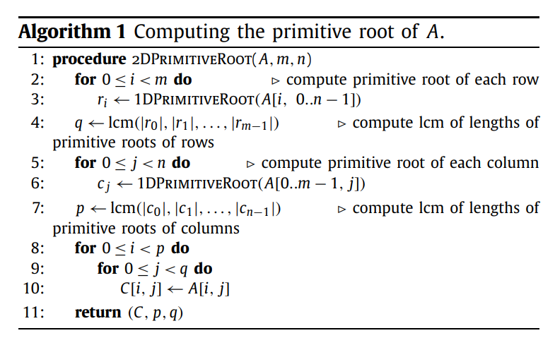
Checking primitivity

