Slide 1
Longest Square Subsequence Problem Revisited
Takafumi Inoue, Shunsuke Inenaga, Hideo Bannai
27th International Symposium, Orlando, FL, USA, 2020
String Processing and Information Retrieval
Volume 12303, pp. 147-154
Presenter: Tsung-Lin Lu
Date: Sept. 14, 2021

Slide 2
Abstract
The longest square subsequence (LSS) problem consists of computing a longest subsequence of a given string S that is a square, i.e., a longest subsequence of form XX appearing in S. It is known that an LSS of a string S of length n can be computed using O(n²) time [Kosowski 2004], or with (model-dependent) polylogarithmic speed-ups using O(n²(log log n)²/ log² n) time [Tiskin 2013]. We present the first algorithm for LSS whose running time depends on other parameters, i.e., we show that an LSS of S can be computed in O(r min{n, M} log n/r + n + M log n) time with O(M) space, where r is the length of an LSS of S and M is the number of matching points on S.

Slide 3
Small Longest Tandem Scattered Subsequences
Luís M. S. Russo, Alexandre P. Francisco
Scientific Annals of Computer Science
Volume 31 (1), pp. 79-110, 2021
Presenter: Tsung-Lin Lu
Date: Sept. 14, 2021

Slide 4
Abstract
We consider the problem of identifying tandem scattered subsequences (TSS) within a string. Our algorithm identifies a longest subsequence which occurs twice without overlap in a string. This algorithm is based on the Hunt-Szymanski algorithm, therefore its performance improves if the string is not self similar. This occurs naturally on strings over large alphabets. Our algorithm relies on new results for data structures that support dynamic longest increasing sub-sequences. In the process we also obtain improved algorithms for the decremental string comparison problem.

Slide 5
Outline
Longest square subsequence (LSS)
Longest increasing subsequence (LIS)
LSS → LIS
Analysis

Slide 6
Longest square subsequence (LSS)
A non-empty string Y of form XX is called a square.
1-LSS
1-LIS (longest increasing subsequence)
A | B | D | D | C | A | B | D | D | C
B | A | B | C | A | B | D | B | A | C | A
B | A | C | B | A | C
8 | 3 | 7 | 1 | 4 | 7 | 8 | 10 | 8 | 11 | 6
3 | 4 | 7 | 8 | 10 | 11

Slide 7
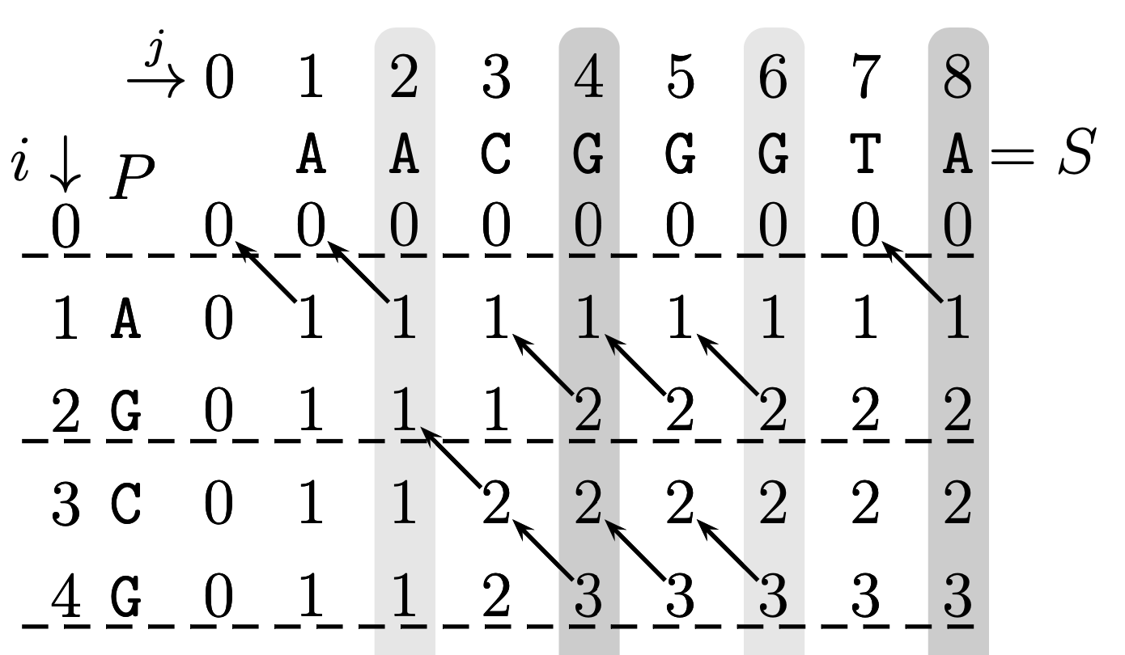
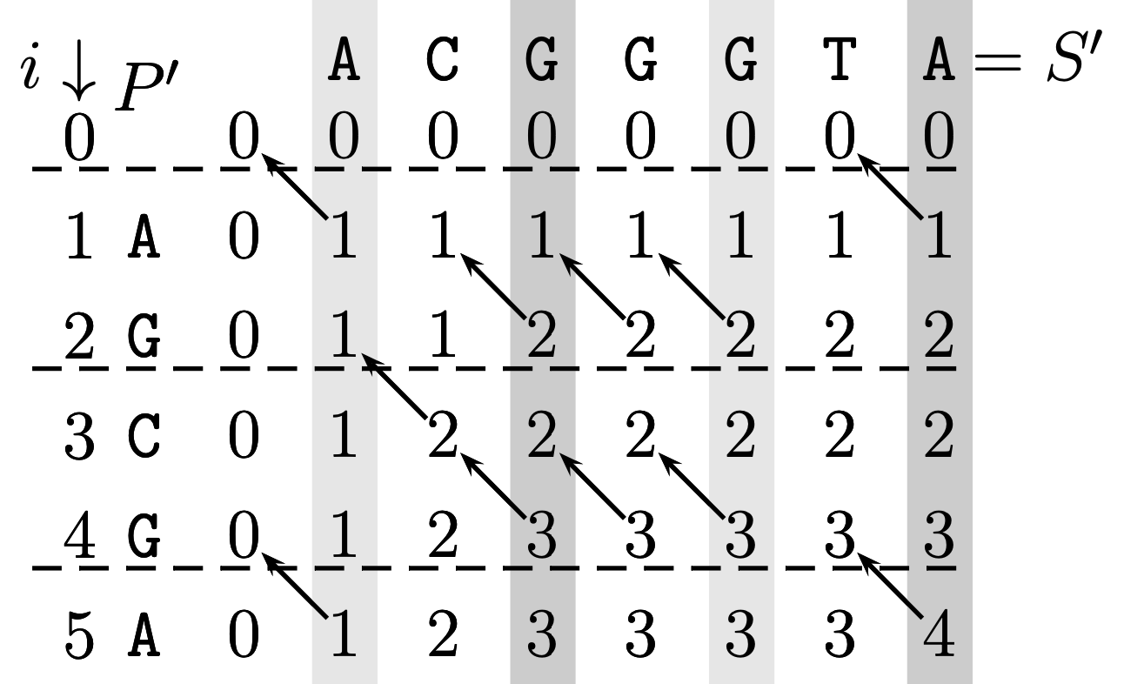
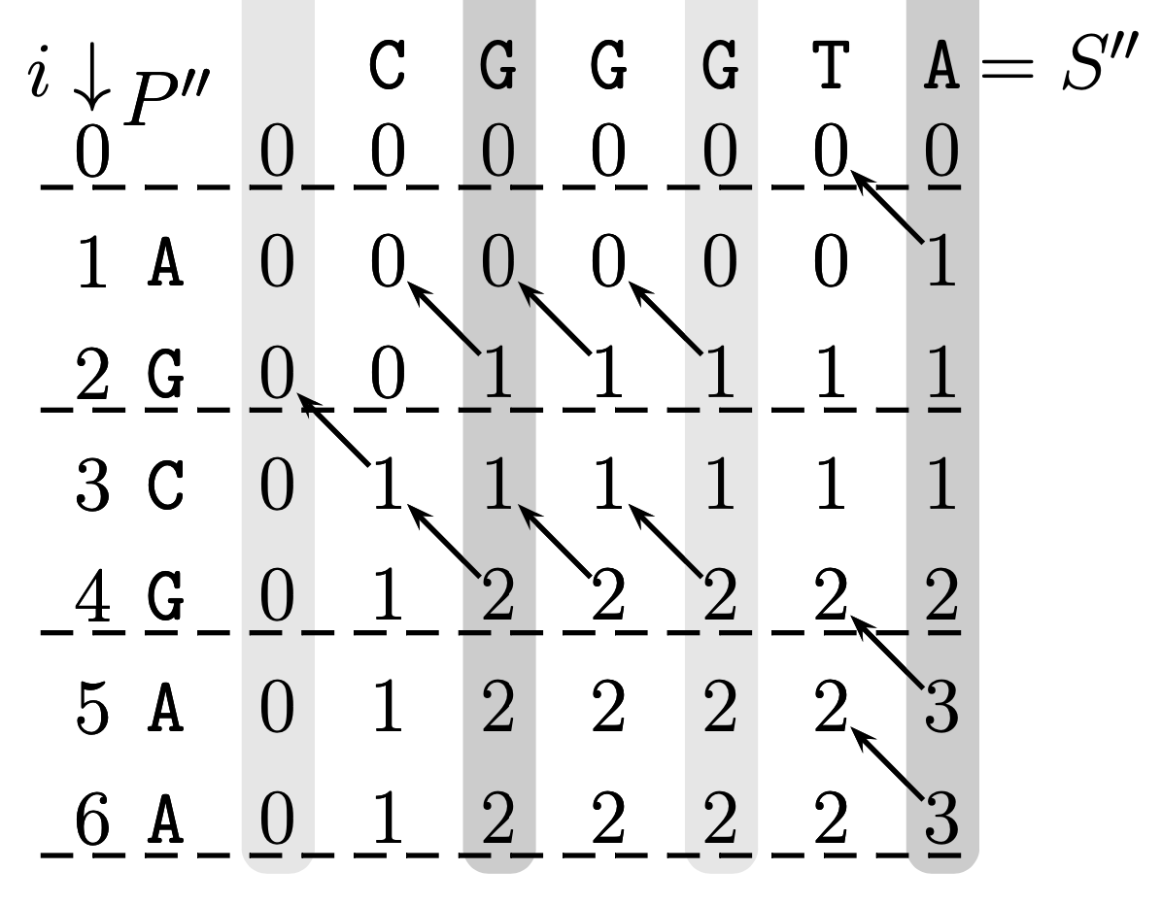
Dynamic programing
Dynamic programing
Time : O(n³)

Slide 8
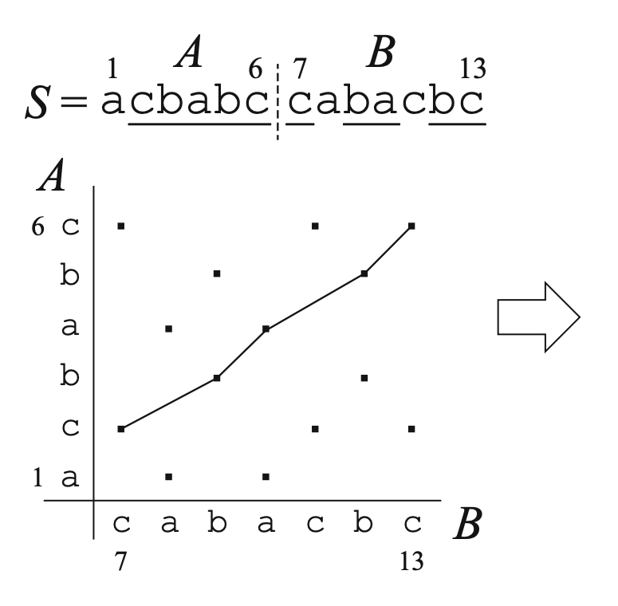
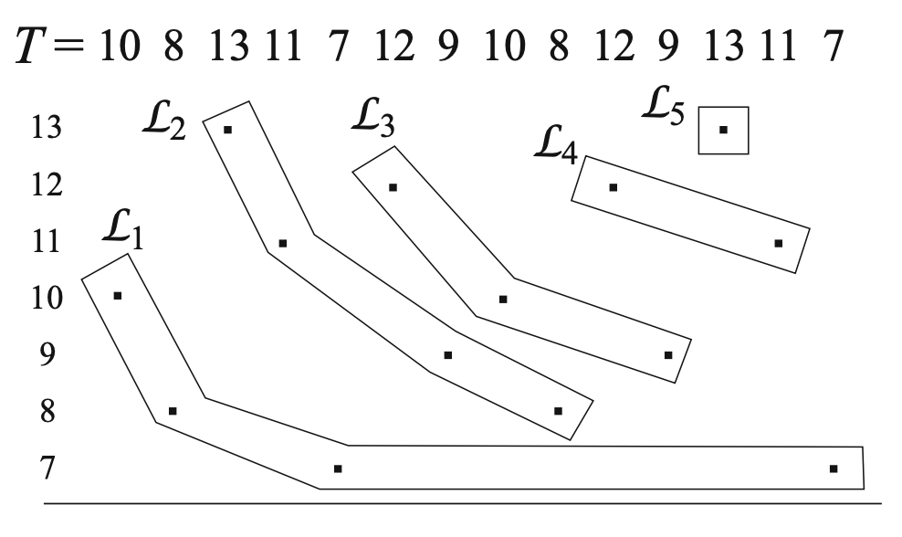
LSS → LIS (1/5)
Figure 1. Correspondence between an LCS of A = acbabc, B = cabacbc and an LIS of T .

Slide 9
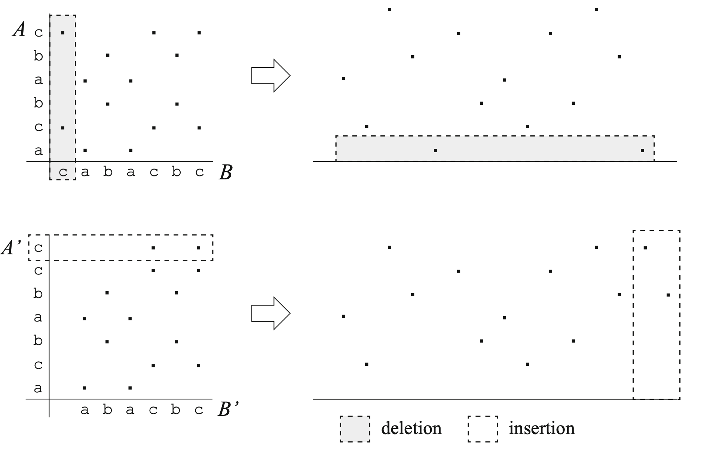
LSS → LIS (2/5)
Figure 2. Illustration on how points in the 2D plane (and elements in T ) are to be deleted or inserted when A and B are updated to A′ and B′, respectively.

Slide 10
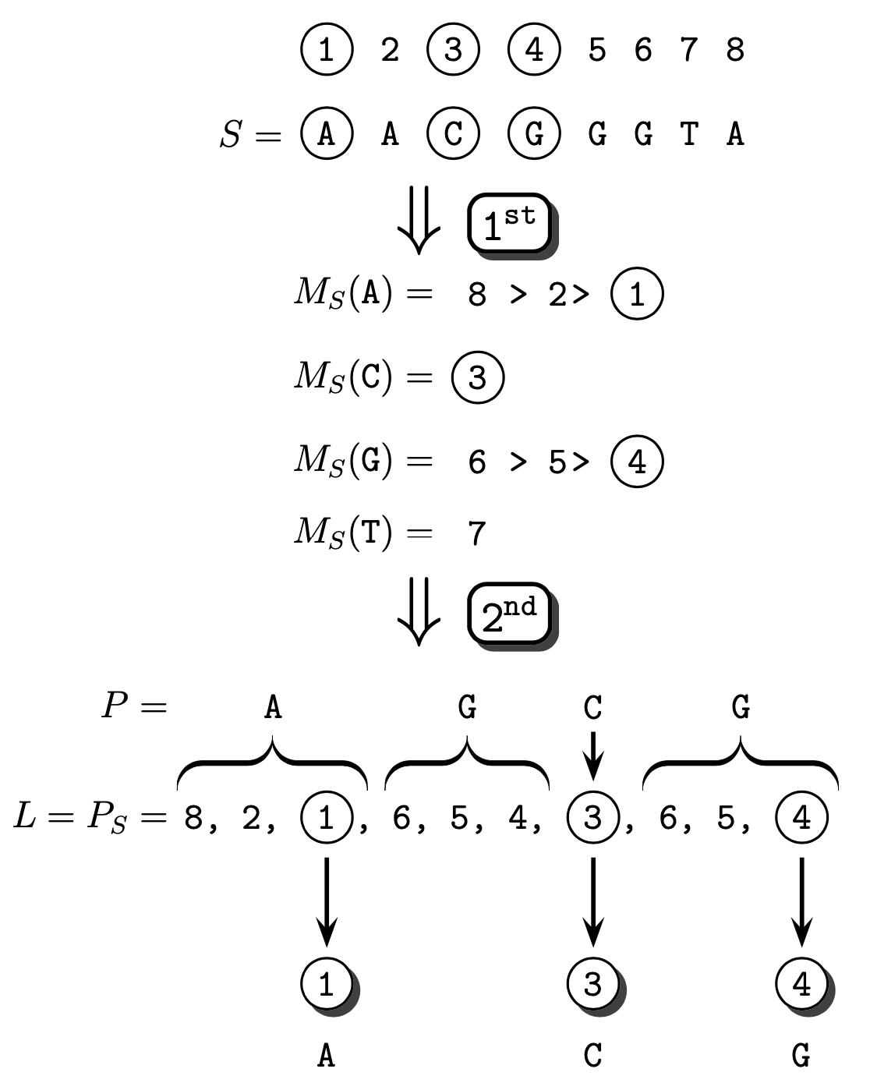
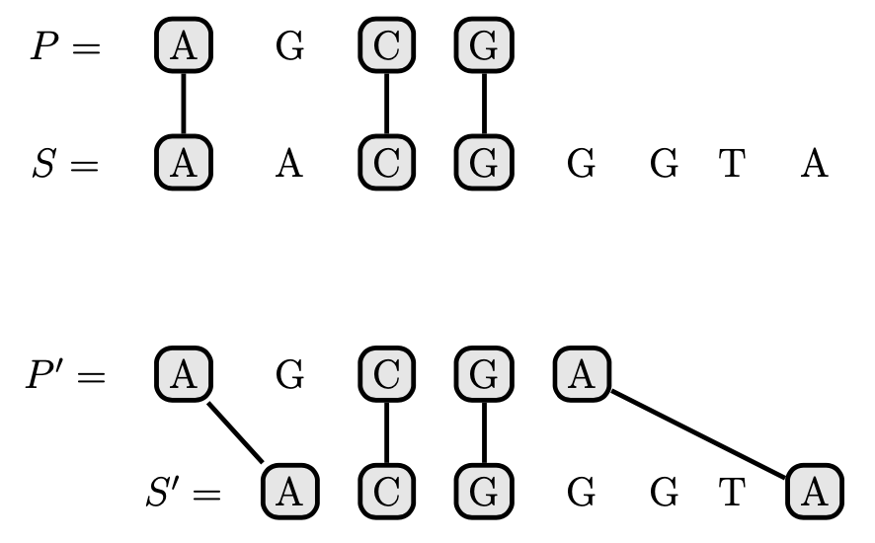
LSS → LIS (3/5)
Figure 3. Reduction from LCSS to LIS.

Slide 11
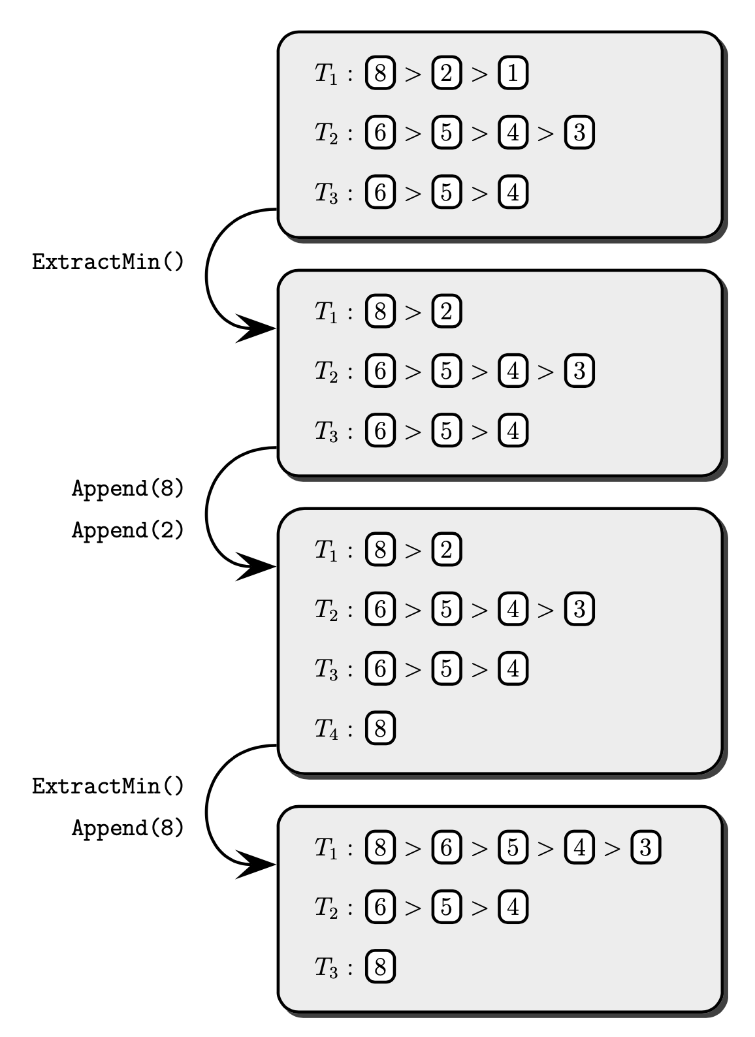
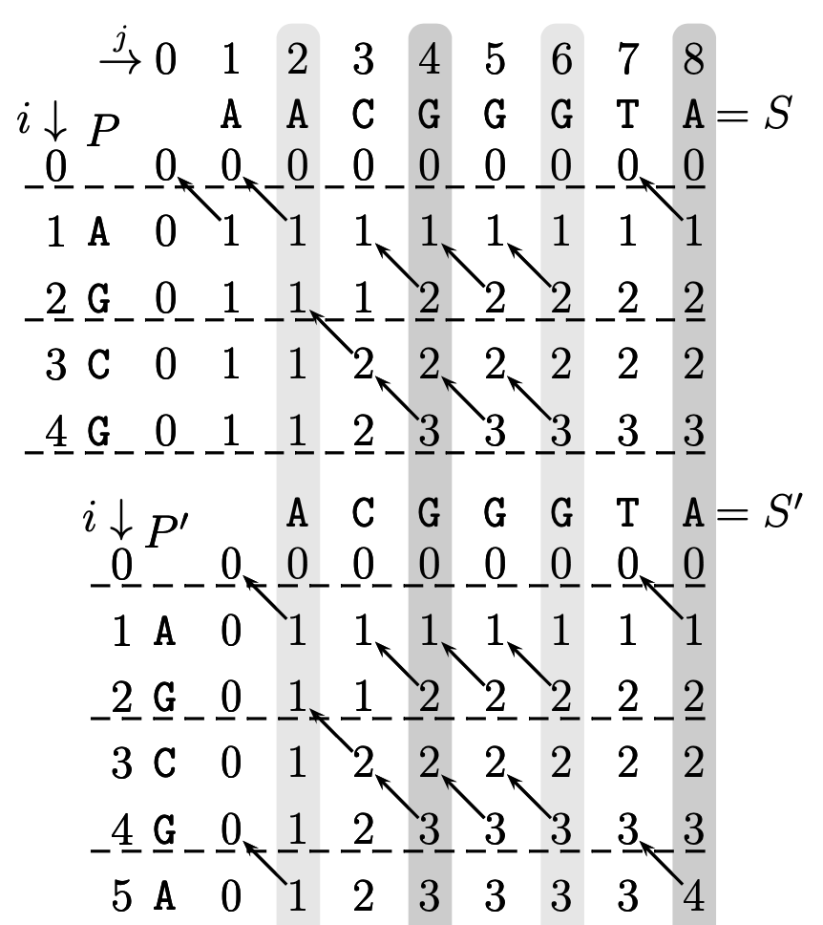
LSS → LIS (4/5)
PS
P'S'
P''S''
Figure 4. Dynamic LIS computation. The top box shows the T_{k} lists for P and S.

Slide 12
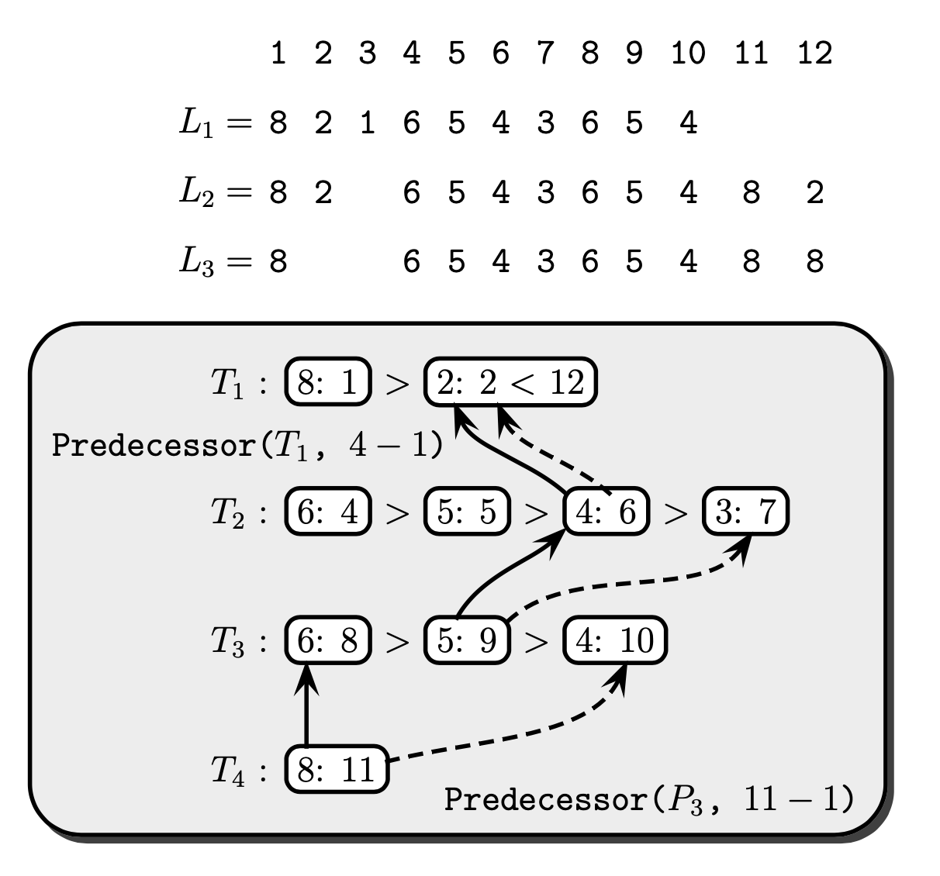
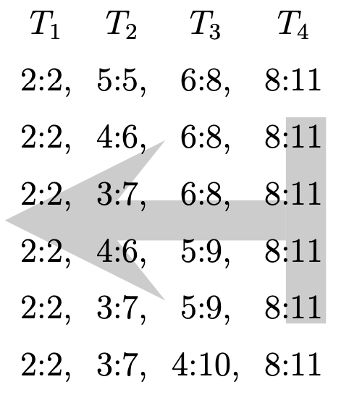
LSS → LIS (5/5)
(b)
PS
(a)
P'S'
P''S''
(c)
Figure 5.
LIS for L₂
Example dynamic list L
Augmented threshold data structure for L₂

Slide 13
Analysis
Time : O(min{n, M} r log n/r + n + M log n)
Space : O(M)
n = |S|, r = LSS(S), M = |𝞛(S)|
Batched Deletion
Test
Insertion
O(min{n, M} r log n/r + n + M log n)

Slide 14
Thank you for listening

Slide 15
Abstract
s

