Slide 1
Industrial scheduling solution based on flexible heuristics Iiro Harjunkoski, Reinhard Bauer
Computers & Chemical Engineering
Volume 106, 2 November 2017, Pages 883-891
Date: Sept. 14, 2021
Presenter: Jue-Jun Wu

Slide 2
Abstract
This paper presents a generic heuristic-based scheduling solution. It highlights the flexibility that a simple heuristic method can offer and shows that using the ISA-95 standard it is possible to express the most relevant problem requirements. In order to illustrate the possible benefits, the paper also compares the solution quality of a smaller scale example scheduling problem to a rigorous mixed-integer linear programming (MILP) approach and shows how a heuristic approach scales towards large-size industrial problems. The paper concludes with a discussion of the advantages and disadvantages of both approaches, showing that for certain types of problems, the heuristic approach is fully sufficient, even if it cannot be expected to result in optimal solutions.

Slide 3
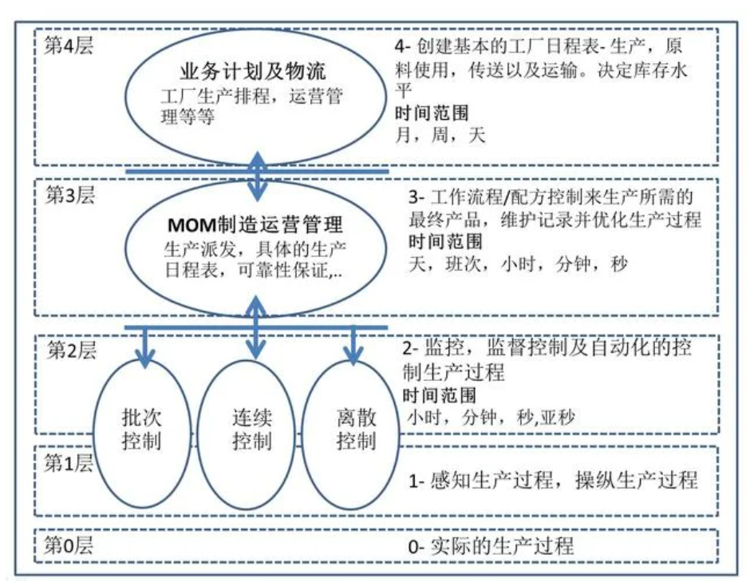
Notes:
ISA-95系統架構模型，MOM或MES在第三層，ERP以及其他企業系統在第四層

Slide 4
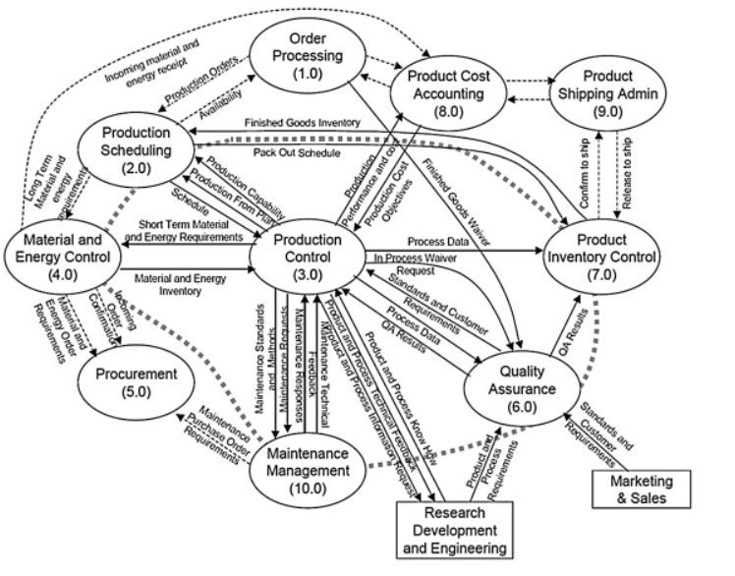
Notes:
糾正計劃成為主要工作，使所有優化目標成為次要目標。因此，獲得支持工具以確保對變化做出正確、敏捷和更有效的反應並在復雜且頻繁變化的環境中開啟優化的可能性是很有價值的。

Slide 5
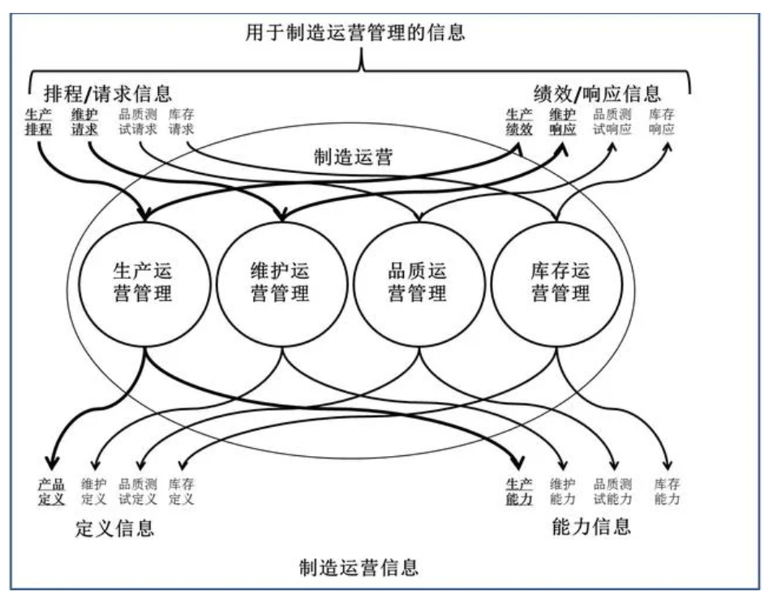
Notes:
整合對他們企業全局、供應鏈、客戶基礎和產品生命周期更完整的資訊。

Slide 6
Objective

Slide 7

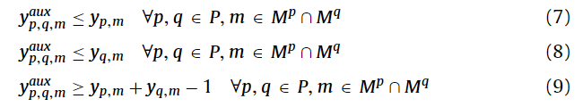

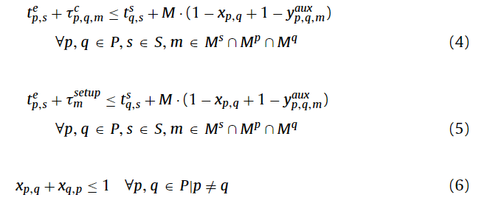
Constraints

Slide 8
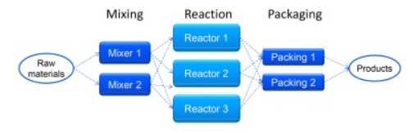
Experiments
All computations were done on a Laptop computer with an Intel I5 processor and 16GB of memory.
The MILP problems were solved on GAMS 24.5.3. using CPLEX 12.6.2.0 with standard settings.

Slide 9
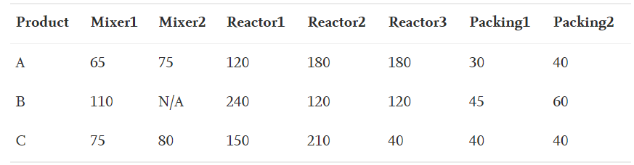
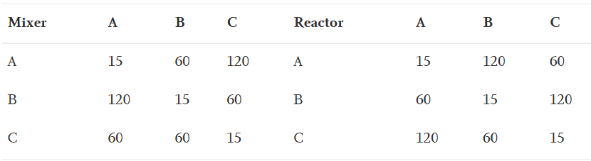
Processing times (min) of each product at each equipment.
Sequence-dependent changeover times (min) of each product at each equipment.

Slide 10
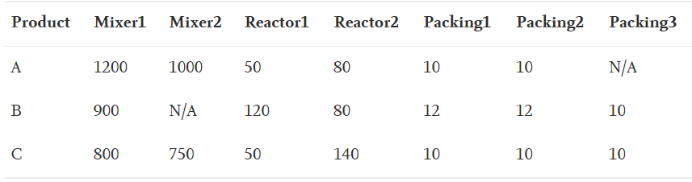
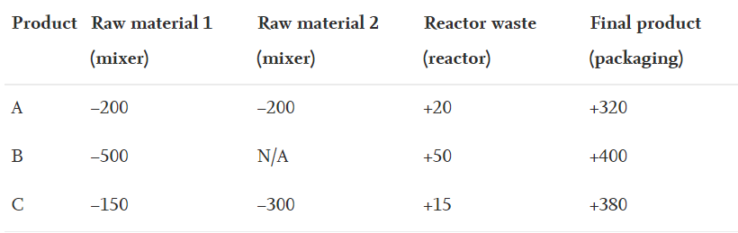
Electricity consumption (kW) of each product at each equipment.
Material consumption (−) and production (+) amounts (kg) per stage

Slide 11
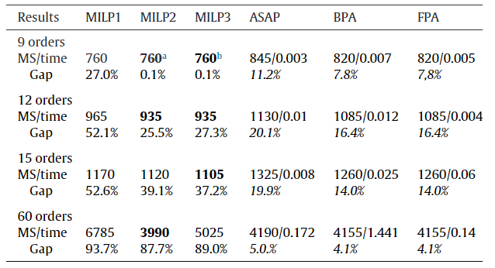
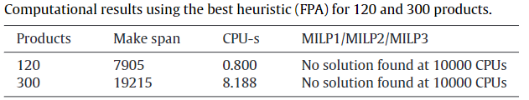
Notes:
由於尚未找到解決方案或下限與最優性相差太遠，這毫無意義。
更好的結果僅來自更成功的樹搜索。由於我們無法測量啟發式的完整性差距，因此差距僅顯示解決方案與確定的最佳 MILP 解決方案之間的距離。

Slide 12
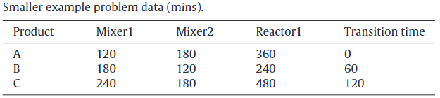
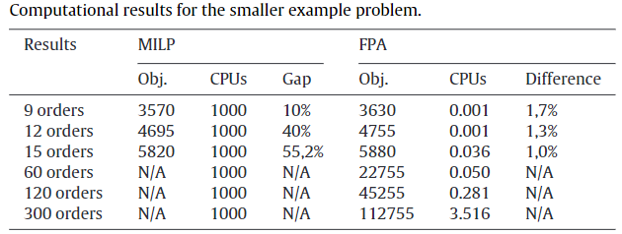
Notes:
結構不同問題的結果表明，構造啟發式算法在序列密集型問題中的性能要好得多，，啟發式解決方案在找到的最佳 MILP 解決方案的 1-2% 以內。

Slide 13
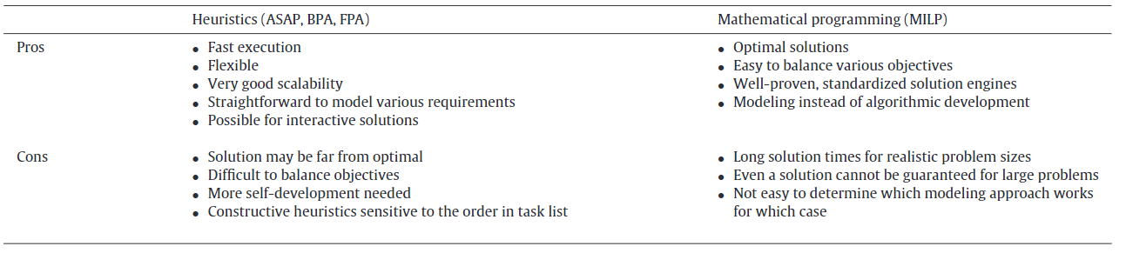
Comparison
Notes:
啟發式方法通常需要編程，而最重要的工作是在 MILP 方法的建模中完成
可擴展性問題

Slide 14
Conclusion
A generic heuristic approach can be efficiently used to solve many complex and large-size industrial scheduling problems.
Consider possibilities to combine the strengths of both approaches:
Using MILP to improve the quality of the solution supported by heuristics to boost up the performance.
MILP successfully implemented various heuristics both in the presolvers as well as within the branching schemes.
Larger problems are still not solvable to optimality and here various collaborative schemes could make a clear change.
Notes:
已知的啟發式解決方案(大多數情況下至少 80% 是最佳的)（部分 MILP 求解器已經應用根節點啟發式和模型縮減）或解決一個可行的子問題或其中的一組。
然而，由於該問題是 NP-hard 問題，因此在計算上這些任務可能與找到最佳解決方案一樣困難。因此，嚴格的數學方法和啟發式方法的結合無疑是一個有趣且具有挑戰性的研究領域。
雖然這兩種方法遵循完全不同的範式，但它們各自存在，能夠滿足不同應用程序的要求。數學啟發式介於兩種方法之間，是某些需要在算法運行時間和解決方案質量之間取得平衡的應用程序的最佳選擇。

Slide 15
Thanks for listening.

