Slide 1
Simulation-based Optimization on Quay Crane Scheduling of Container Terminals ​ Li Haoyuan, Sun Qi
29th Chinese Control And Decision Conference , Chongqing, China, 2017
Presenter:Chih-Hsuan Chien
Date:Sept. 28, 2021

Slide 2
Abstract
By applying the object-oriented simulation modeling method of discrete event system, this paper establishes an simulating model of container terminal operating system, including vessels, anchorages, berths, gantry cranes, internal and external container trucks and gate system. In order to solve the quay crane scheduling problem of container terminal, a lot of stochastic factors in the problem are taken into account. Simulation-based optimization (SBO) method is proposed to solve the problem. Genetic algorithm, particle swarm algorithm and simulated annealing algorithm are used respectively as the superior optimizer, and their application performance is compared and analyzed.

Slide 3
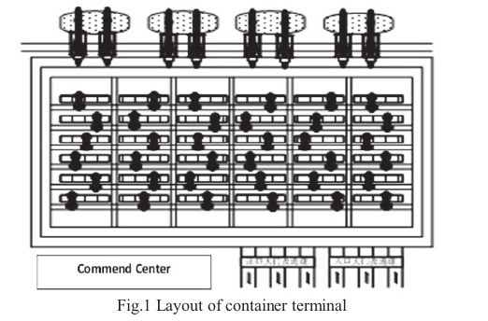
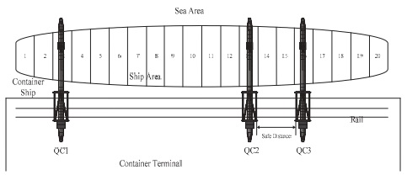
Distribution
berths​
quay cranes​
operating areas​
internal and external container truck​

Slide 4
Constraints
at any time during the operation, one ship area can be assigned to only one quay crane until it completes all operations in the area.​
quay cranes run on the same rail, so the quay cranes can not cross each other.​
for safety reasons, any two quay cranes must maintain a certain distance to ensure the safety of the operation.

Slide 5
Optimization Algorithm
Genetic Algorithm​
Particle Swarm Algorithm​
Simulated Annealing Algorithm

Slide 6

Coding scheme
The sequence of ship areas operation is used as the coding method. The gene in the chromosome represents the ship area number.

Slide 7
The objective function​
Select the container ship loading and unloading time span as the objective function value.

Slide 8
Gene Algorithm
The use of traditional single point cross or Double-cut point cross method will produce legal codes, the sequential crossover method is chosen as the crossover operator.
Two genes in chromosome were randomly selected according to the probability, and the ship area number of the two genes were exchanged.

Slide 9
Sequential crossover
Step 1: - Start from node 1.
Step 2: - Sequentially search both of the parent chromosomes and consider the first legitimate node appeared after node p in each parent. If no ‘legitimate node’ after ‘node p’ is present in any of the parent, search sequentially the nodes and consider the first ‘legitimate’ node, and go to Step 3.
Step 3: If cpα < cpβ , then select 'node α', otherwise, 'node β' as the next node and add it to the partially constructed offspring chromosome. If the offspring is a complete chromosome, then stop, otherwise, rename the present node as 'node p' and go to Step 2.

Slide 10
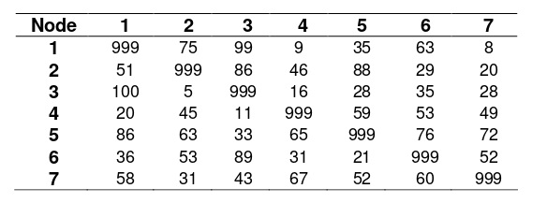
Example
P1: (1, 5, 7, 3, 6, 4, 2)
P2: (1, 6, 2, 4, 3, 5, 7)
Ans:(1, 5, 7, 2, 4, 3, 6)

Slide 11
Simulated Anealing Algorithm​
the neighborhood is defined as the set of the pairwise change of the operation sequence in the ship area. For example: from a current state [1, 2, 3, 4, ...], exchanging the operation sequence of two ship areas, then get a new state [4, 2, 3, 1, ...].

Slide 12
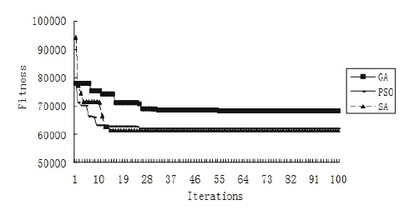
Experiment1
GA: population size is 10, and the maximum iteration is 100. ​
PSO: particle population size is 10, and the iteration is 100. ​
SA: initial temperature is 10000, terminating temperature is 0, annealing process T =T -100 , and the inner-loop time is 10.
k+1
k

Slide 13
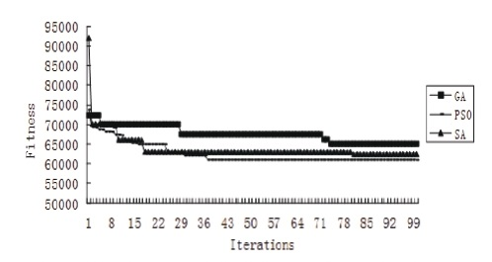
Experiment2
GA: population size is 30, and the maximum iteration is 100. ​
PSO: particle population size is 30, and the iteration is 100. ​
SA: initial temperature is 10000, terminating temperature is 0, annealing process T =T -100 , and the inner-loop time is 30.
k+1
k

Slide 14
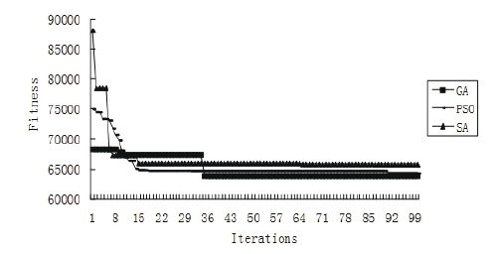
Experiment3
GA: population size is 50, and the maximum iteration is 100. ​
PSO: particle population size is 50, and the iteration is 100. ​
SA: initial temperature is 10000, terminating temperature is 0, annealing process T =T -100 , and the inner-loop time is 50.
k+1
k

Slide 15
Summary
The method, fully considering the interference of random factors, applies GA algorithm, PSO algorithm and SA algorithm respectively as its superior optimizer. GA algorithm can reach a better solution in the case of the larger population, but at the expense of long computation time. SA algorithm and PSO algorithm is more suitable for smaller population groups.

