Slide 1
Competitive Bridge Bidding with Deep Neural Networks
Jiang Rong, Tao Qin, Bo An
18th International Conference on Autonomous Agents and Multiagent Systems, AAMAS '19, Montreal, QC, Canada, May 13-17, 2019
Presenter: Jing-Ping Jan
Date: Sep. 28, 2021

Slide 2
Abstract
The game of bridge consists of two stages: bidding and playing. While playing is proved to be relatively easy for computer programs, bidding is very challenging. During the bidding stage, each player knowing only his/her own cards needs to exchange information with his/her partner and interfere with opponents at the same time. Existing methods for solving perfect-information games cannot be directly applied to bidding. Most bridge programs are based on human-designed rules, which, however, cannot cover all situations and are usually ambiguous and even conflicting with each other. In this paper, we, for the first time, propose a competitive bidding system based on deep learning techniques, which exhibits two novelties.

Slide 3
Abstract
First, we design a compact representation to encode the private and public information available to a player for bidding. Second, based on the analysis of the impact of other players’ unknown cards on one’s final rewards, we design two neural networks to deal with imperfect information, the first one inferring the cards of the partner and the second one taking the outputs of the first one as part of its input to select a bid. Experimental results show that our bidding system outperforms the top rule-based program.

Slide 4
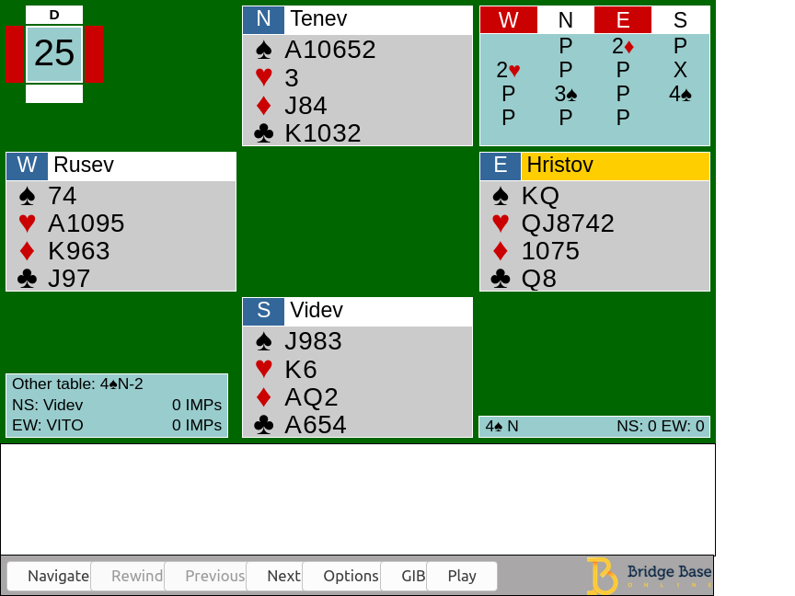
Introduction
Bidding stage Find the most profitable contract for the playing stage
Playing stage 13 rounds of a card-strength competition

Slide 5
Bidding stage
Asserting By making this bid, I assert that my hand has these properties
Denying By making this bid, I deny that my hand has these properties
Asking and Answering Questions If your hand is of type 1, make bid 1; if it is of type 2, make bid 2, etc.
Interrupting The primary purpose of this bid is to stop the opponents communicating

Slide 6
Bidding stage
{1♣,1♦,1♥,1♠,1NT, 2♣,2♦,…,7NT}
Pass
Double
Redouble

Slide 7
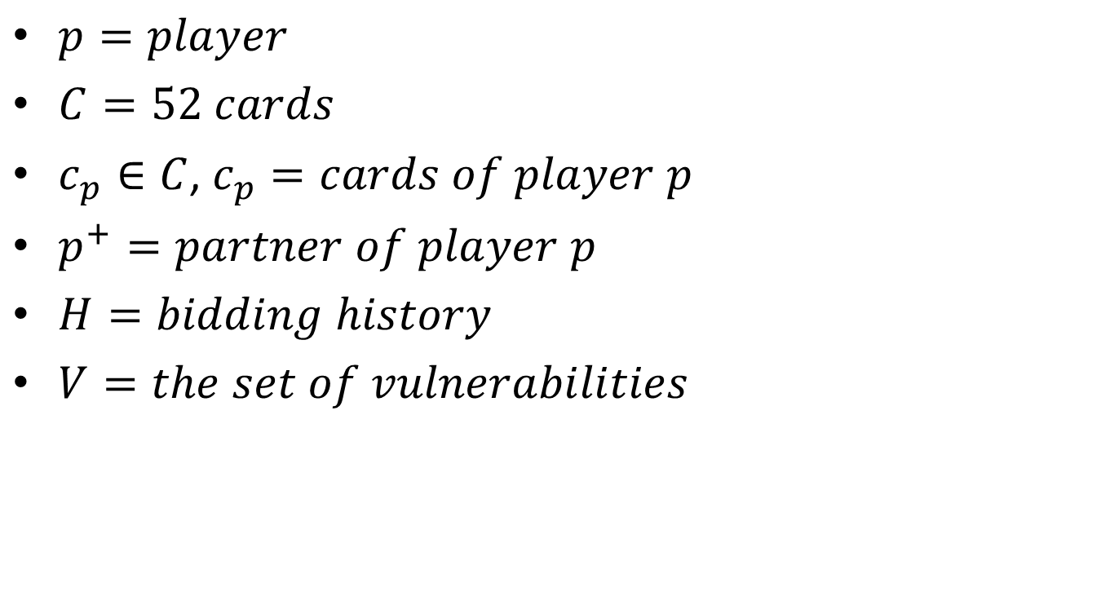
Definition
$p=player$
$C=52 cards$
$c_{p}∈C$, $c_{p}=cards of player p$
$p^{+}=partner of player p$
$H=bidding history$
$V=the set of vulnerabilities$

Slide 8

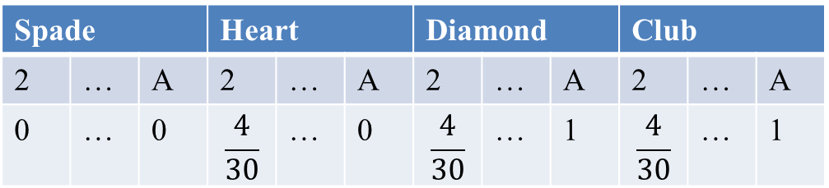

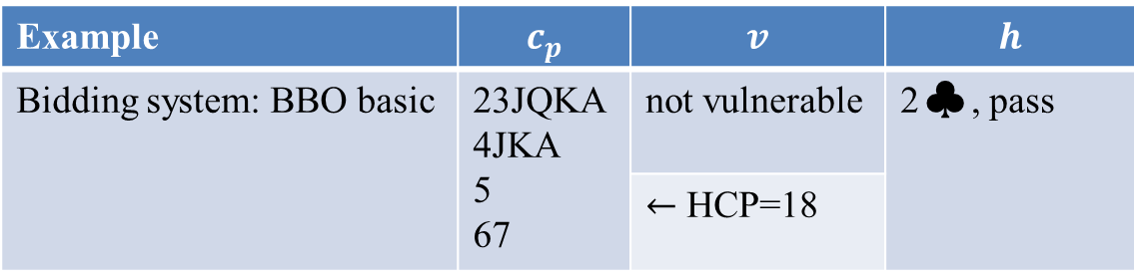
Estimation neural network (ENN)
$D:C×V×H→{\left[0, 1\right]}^{52}$
$D\left(c_{p},v,h\right)=\sum_{c_{p}^{+}∈C_{−c_{p}}}{π\left(c_{p}^{+} | v, B\left(p^{+},h\right)\right)∙ c_{p}^{+}}$
Example | $$c_{p}$$ | $$v$$ | $$h$$
Bidding system: BBO basic | 23JQKA 4JKA 5 67 | not vulnerable | 2♣, pass
 |  | $←$ HCP=18
$$D(c_{p},v,h)$$
Spade | 3 |  | Heart |  |  | Diamond |  |  | Club
2 | … | A | 2 | … | A | 2 | … | A | 2 | … | A
0 | … | 0 | $$\frac{4}{30}$$ | … | 0 | $$\frac{4}{30}$$ | … | 1 | $$\frac{4}{30}$$ | … | 1
Notes:
2 club 開叫代表手上有至少22點

Slide 9

Estimation neural network (ENN)
Time complexity of $D(c_{p},v,h)$ is O(${\left({39 \atop 13}\right)}^{\frac{n}{2}}$) $≅$ O($8^{0.5n}{10}^{4.5n}$)
n: the length of h
$φ_{ω}:C×V×H→{\left[0,1\right]}^{52}$
$ω$: the parameters to be learned
52 bits | 2 bits | 318 bits
13cards | Vulnerability | Bidding sequence
e.g. pass-pass-1♣-double-redouble-pass-1 ♥-pass-pass-double
Opening pass | 9 bits for 1 club | 9 bits for 1 diamond | 9 bits for heart | 9 x 32 bits
110 | 1 00 1 00 1 10 | 0 00 0 00 0 00 | 1 11 1 00 0 00 | 0…0

Slide 10
Estimation neural network (ENN)
1500
372
52
6

Slide 11

Policy neural network (PNN)
$σ_{θ}:C×V×H×{\left[0, 1\right]}^{52}→{\left[0,1\right]}^{38}$
$θ:$ the parameters to be learned
Fully connected with skip connection
52 bits | 52 bits | 2 bits | 318 bits
13cards | 13cards | Vulnerability | Bidding sequence
1200
424
38
8

Slide 12

Policy neural network (PNN)
$θ←θ+αr\frac{1}{M}\sum_{i=1}^{M}{∇_{θ}log(σ_{θ}(b_{i}|s_{i}))}$
$M:$ number of bids called by the target PNN
$b_{i} and s_{i}:$ i-th sampled bid and feature vector of $σ_{θ}$
$σ_{θ}\left(b_{i} | s_{i}\right):$ probability of calling $b_{i}$ given the input $s_{i}$
1200
424
38
8

Slide 13
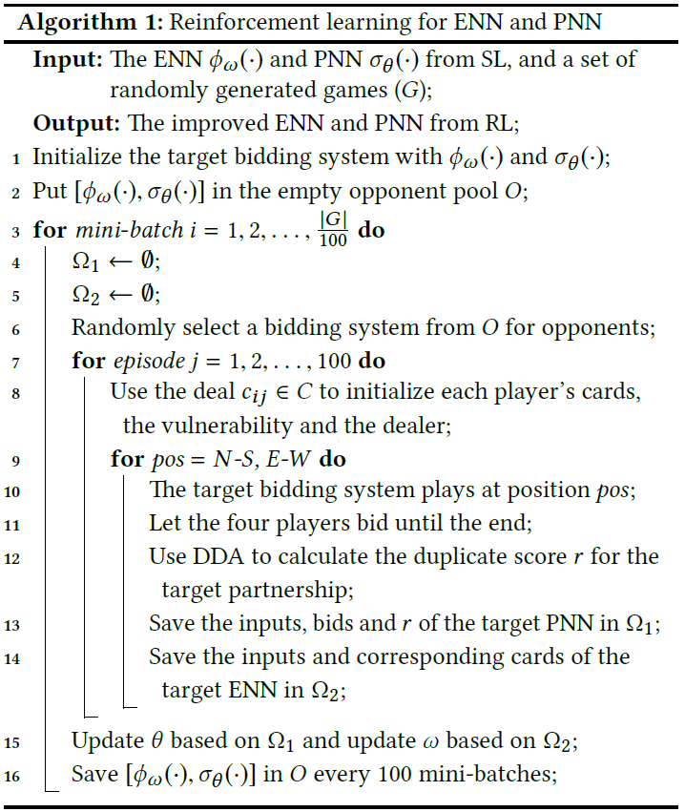
Learning algorithm

Slide 14
Experiment
Data set: more than 12 million training instances from the 1 million games. 70% of which are used for training. 10% for validation and 20% for test.

Slide 15
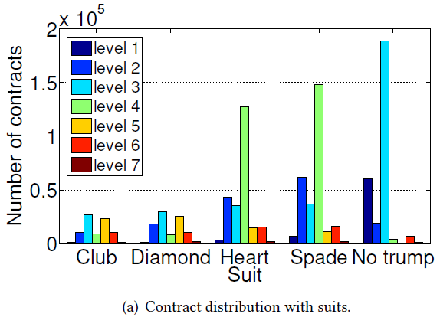
Experiment – Expert behaviors

Slide 16
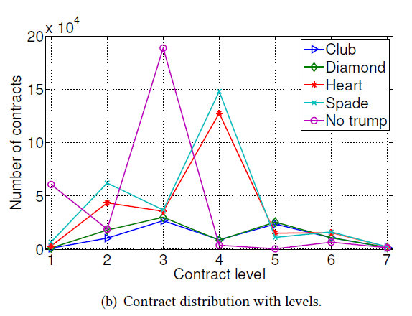
Experiment – Expert behaviors

Slide 17
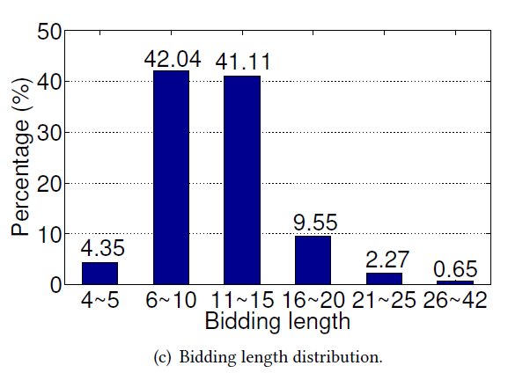
Experiment – Expert behaviors

Slide 18
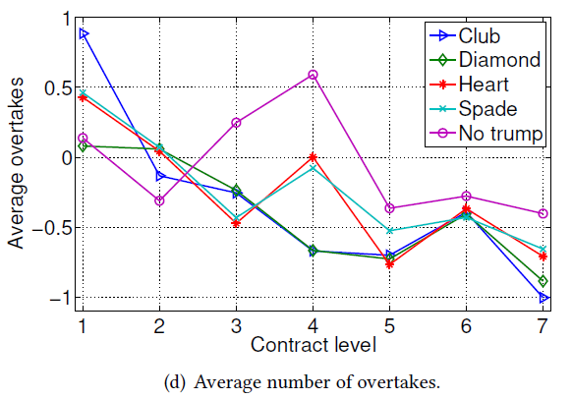
Experiment – Expert behaviors

Slide 19
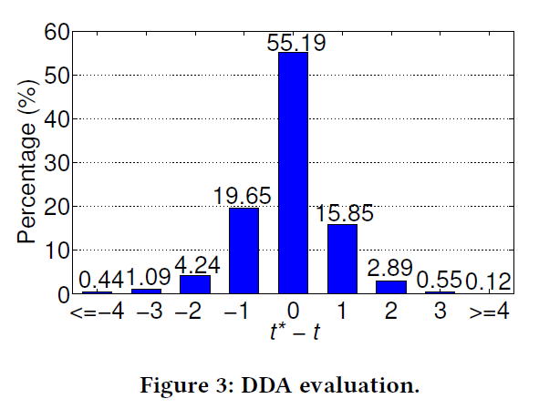
Experiment – Double Dummy analysis

Slide 20
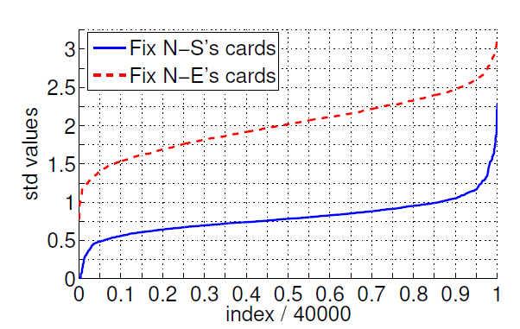
Experiment – Estimating opponents’ card?
Data set: 2000 decks
Method: randomly generate 1000 different initial card of player S(E) and then calculate the standard deviation of each declarer-suit pair over the 1000 DDA results for each decks

Slide 21
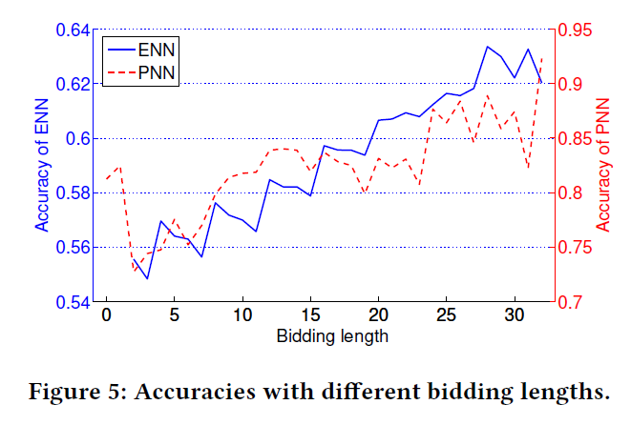
Experiment – ENN and PNN

Slide 22
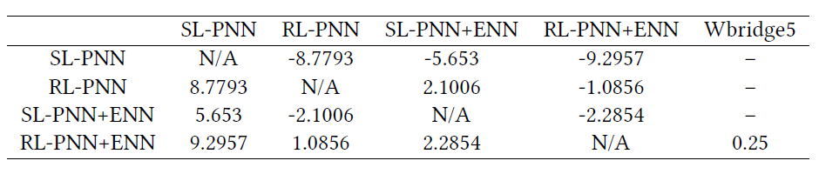
Experiment – ENN and PNN
Data set:
10000 random deals for NN
64 random deals for Wbridge5 (neither code or command line interface)

Slide 23
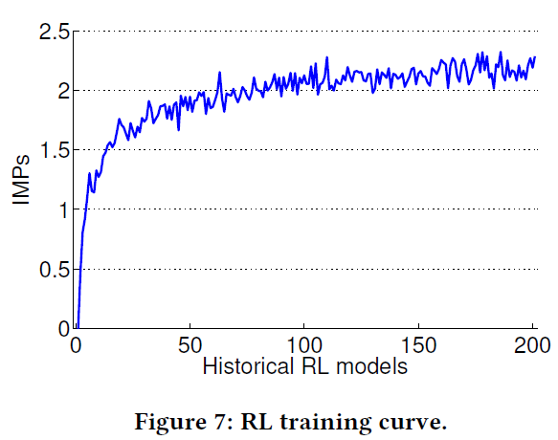
Experiment – ENN and PNN
Data set:
2 million deals to train ENN and PNN
10000 random deals to compare SL network

