Slide 1
A Reduction of the Dynamic Time Warping Distance to the Longest Increasing Subsequence Length
Yoshifumi Sakai and Shunsuke Inenaga
31st International Symposium on Algorithms and Computation (ISAAC 2020), Online
Presenter: Shin-Cheng Lin
Date: Sept. 28, 2021

Slide 2
Abstract(1/3)
The similarity between a pair of time series, i.e., sequences of indexed values in time order, is often estimated by the dynamic time warping (DTW) distance, instead of any in the well-studied family of measures including the longest common subsequence (LCS) length and the edit distance. Although it may seem as if the DTW and the LCS(-like) measures are essentially different, we reveal that the DTW distance can be represented by the longest increasing subsequence (LIS) length of a sequence of integers, which is the LCS length between the integer sequence and itself sorted.

Slide 3
Abstract(2/3)
For a given pair of time series of n integers between zero and c, we propose an integer sequence that represents any substring-substring DTW distance as its band-substring LIS length. The length of the produced integer sequence is O(c⁴n²) or O(c²n²) depending on the variant of the DTW distance used, both of which can be translated to O(n²) for constant cost functions.

Slide 4
Abstract(3/3)
To demonstrate that techniques developed under the LCS(-like) measures are directly applicable to analysis of time series via our reduction of DTW to LIS, we present time-efficient algorithms for DTW-related problems utilizing the semi-local sequence comparison technique developed for LCS-related problems.

Slide 5
intermediate grid graphs
Obtained from the DTW distance graph by transforming into a binary DTW distance graph(vhd-path grid graph).
Obtained from the binary DTW distance graph by transforming into a binary vh-path DTW distance graph.
The DTW distance sequence is obtained from this second intermediate graph.

Slide 6
Let A and B be arbitrary two time series both over a fixed integer interval {0, 1, . . . , c}
O(|A||B|)

Slide 7
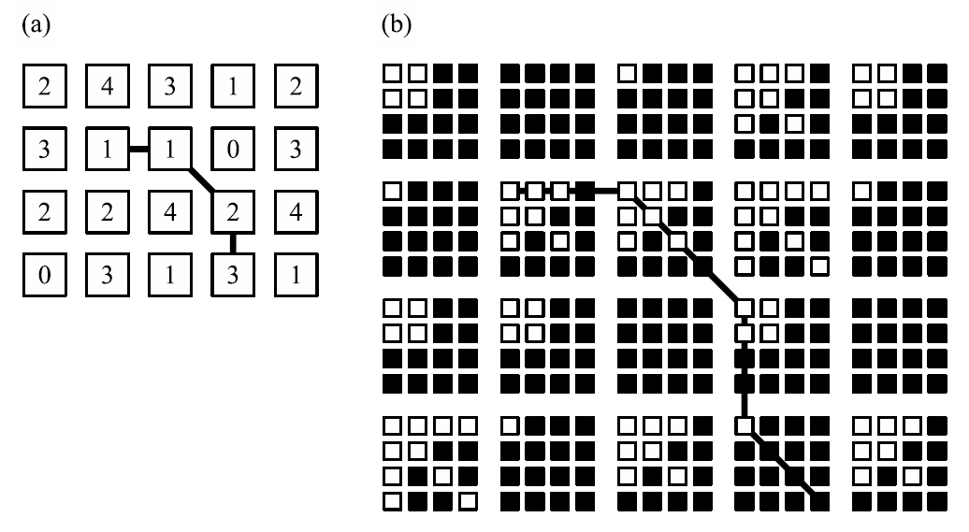
vhd-path grid graph

Slide 8
vhd-path grid graph
m × n (d + 1)-valued vhd-path grid graph → dm × dn binary vhd-path grid graph
O(c²|A||B|)

Slide 9
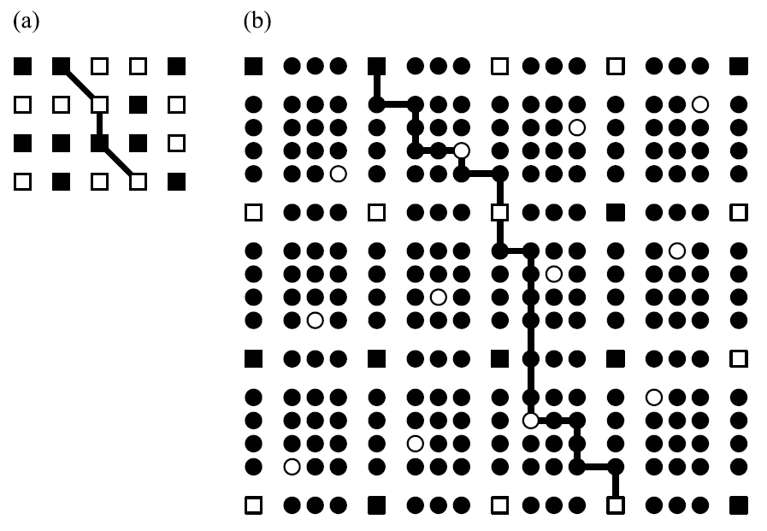
vh-path grid graph

Slide 10
vh-path grid graph
dm × dn binary vhd-path grid graph →
(m + (m − 1)(n − 1)) × (n + (m − 1)(n − 1)) binary vh-path grid graph,
(c²|A| + (c²|A| − 1)(c2|B| − 1)) ×
(c²|B| + (c²|A| − 1)(c2|B| − 1))
= O(c⁴|A||B|)

Slide 11
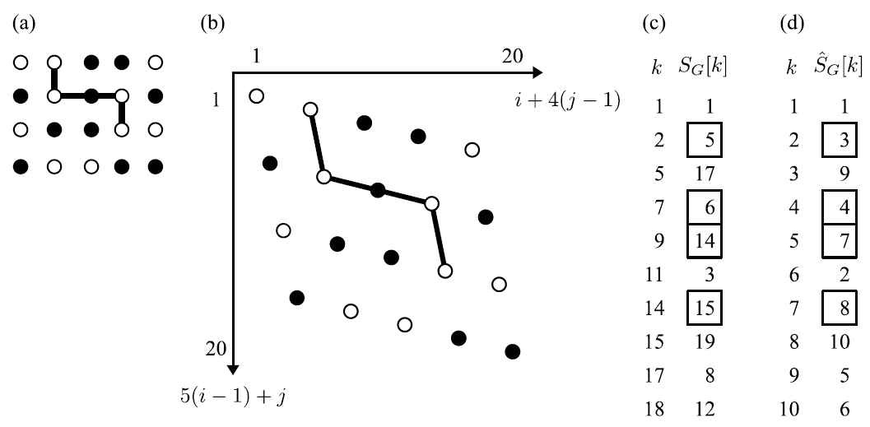
an integer sequence
S_{G}[(i − 1)n + j] = i + (j − 1)m, if vertex (i, j) is zero-weighted

Slide 12
an integer sequence
Let G be an arbitrary m×n binary vh-path grid graph.
The minimum path weight on G is hence calculated by subtracting the banded LIS length of a contiguous subsequence of S_{G} from the path length.

Slide 13
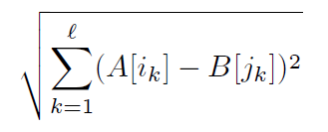
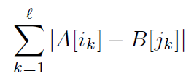
O(c⁸|A||B|)
O(c⁴|A||B|)

